Slide 1



Slide 2
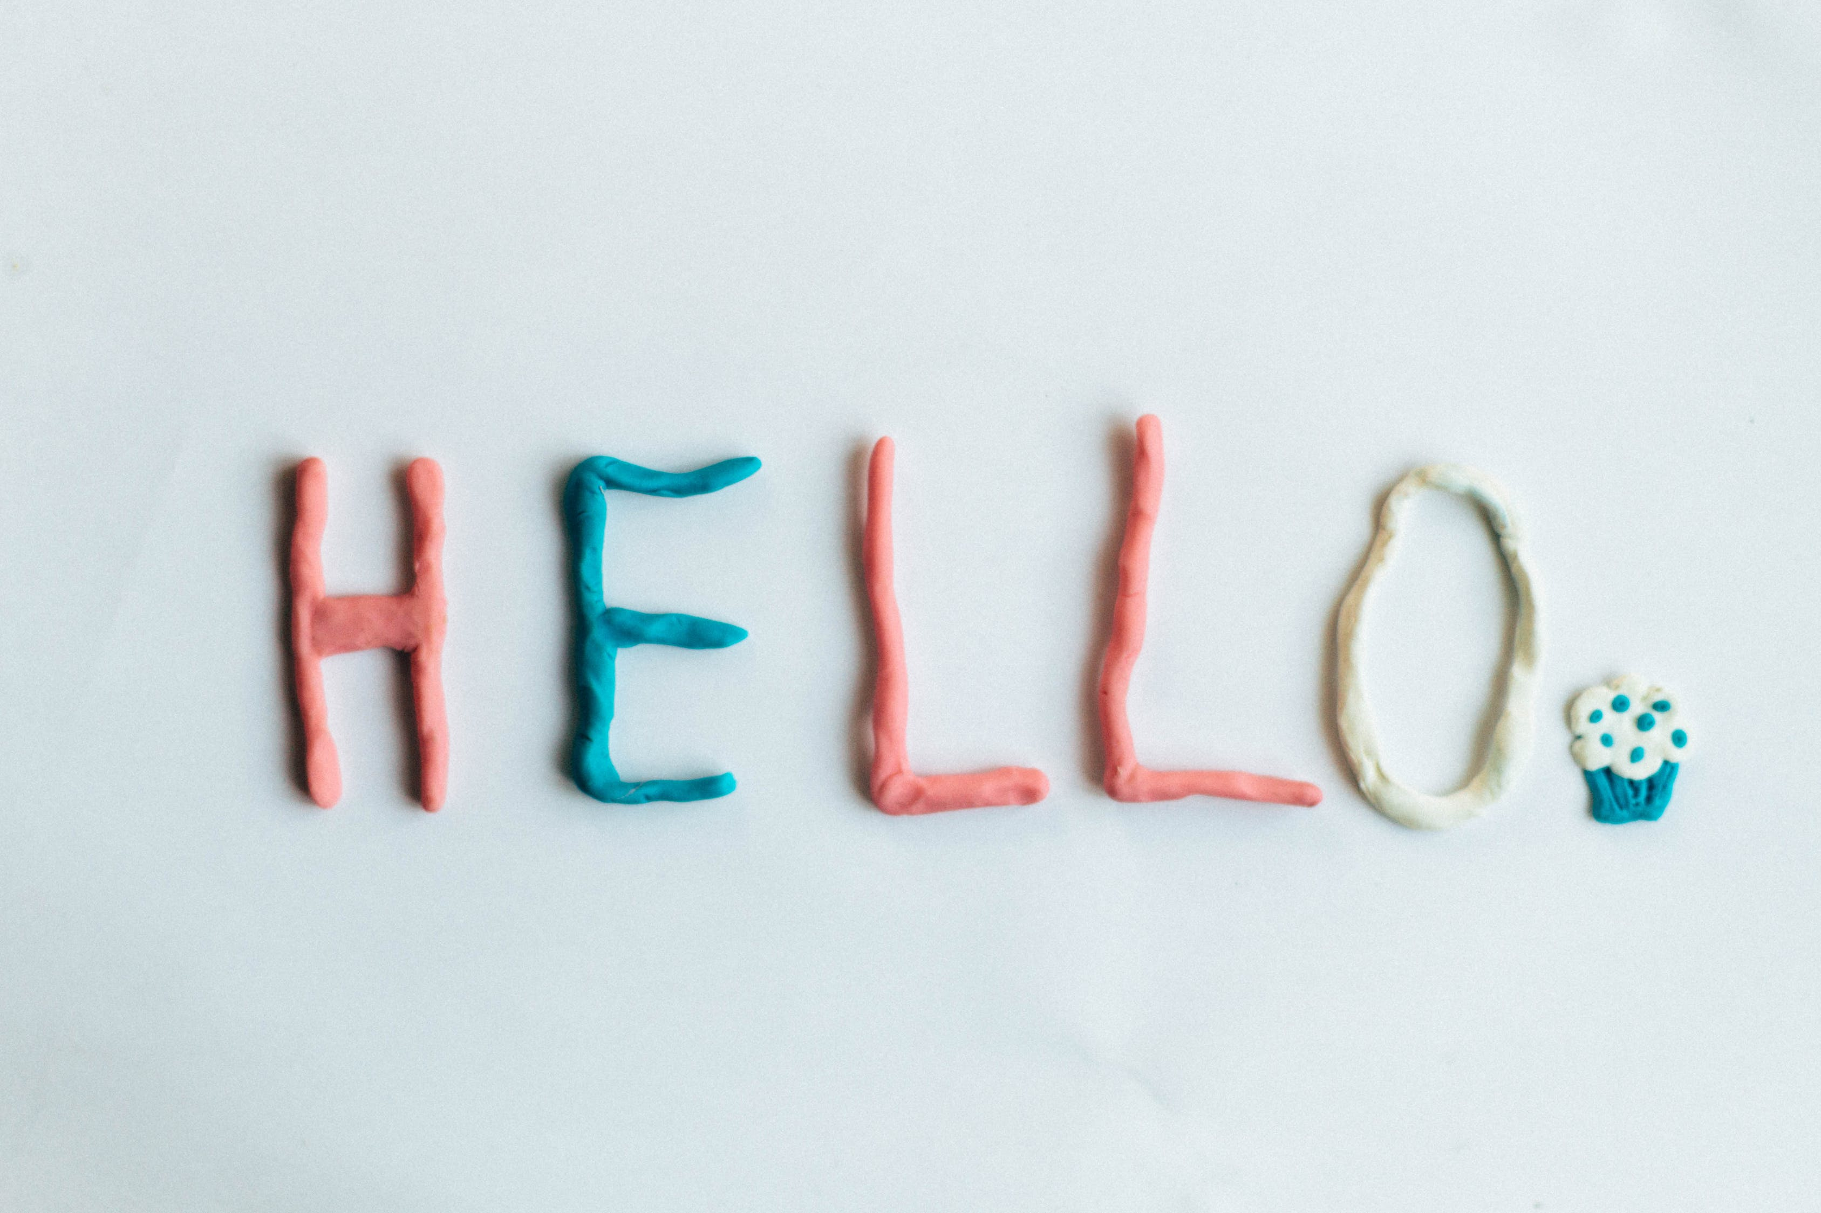
Welcome Unit

Slide 3


Slide 4



To consolidate and practise adjectives and describing feelings.
To practise collocations using words and phrases in this unit.
To learn to express your feelings about a person with the expressions you’ve learnt in this unit.

Slide 5

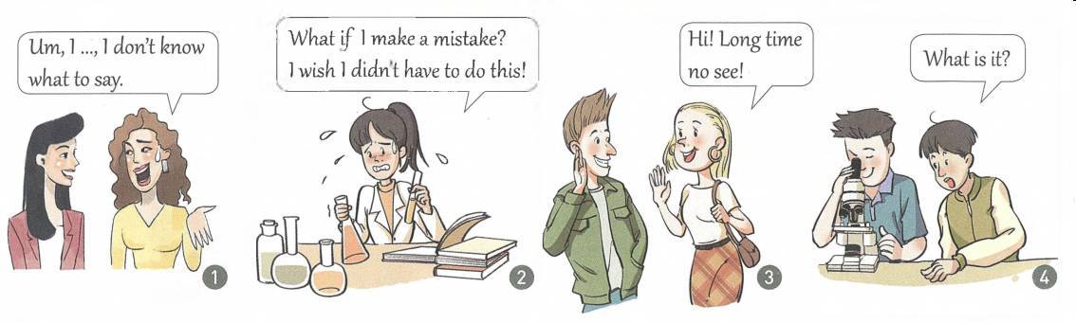
Match the pictures with the best adjectives.
anxious, awkward, annoyed, frightened, confident, curious, excited
awkward
anxious
excited
curious

Slide 6
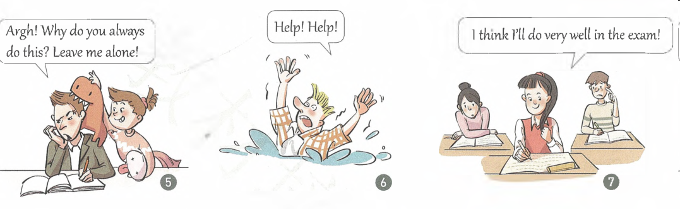
anxious, awkward, annoyed, frightened, confident, curious, excited
annoyed
frightened
confident

Slide 7

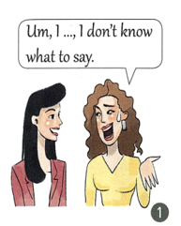
Describe each picture in two or three sentences.
awkward
Two women are talking. One woman asks a question, while the other looks awkward and doesn’t know how to answer the question, maybe because of a cultural gap between them.

Slide 8
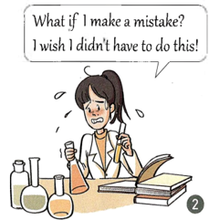
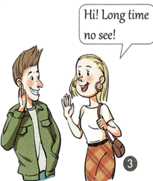
anxious
A girl is doing a chemistry experiment by following directions in a book. She is holding a beaker and a test tube full of liquid. She looks very nervous.
excited
A young woman is greeting a young man. She seems very happy to see him. He also looks happy.

Slide 9
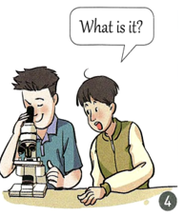
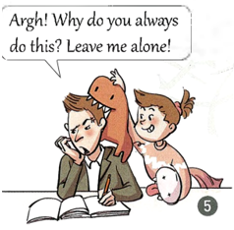
curious
A boy is looking at something through a microscope and smiling. His friend is leaning over and wants to know what he sees.
annoyed
A young man is trying hard to study, but his little sister is playfully (调皮地) disturbing him with her toys.

Slide 10
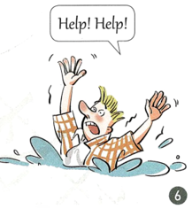
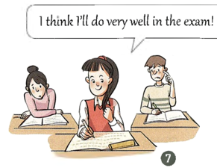
frightened
A man is in water waving his hands in the air and yelling in panic. He looks like he might be drowning.
confident
A girl is getting ready to take an examination. She looks well prepared. The two people behind her look very anxious.

Slide 11

Fill in the blanks with the adjectives.
annoyed, frightened, confident, curious, awkward
Children are always ________ about a new thing. They want to know the secret behind it.
He made the same mistake again. He was so ________ that he left without a word. But I believe that with more practice, he will be more ________.
curious
annoyed
confident

Slide 12
annoyed, frightened, confident, curious, awkward
3. It was an old dark house. I opened the door slowly. I was ___________ but I had to entered it because it was ___________ to go out without seeing anything.
frightened
awkward

Slide 13
Fill in words in the proper situation.
exchange, impress, explore, organize, improve, design, revise
1. If you __________ an activity, you make sure the necessary things are prepared.
2. If you ________ something, you plan it and make a drawing of it.
3. If two or more people _________ things, they give them to each other at the same time.
organize
design
exchange

Slide 14
exchange, impress, explore, organize, improve, design, revise
4. If you ________ something, you change it because of new information or ideas.
5. If something _________ you, you feel great respect for it.
revise
impress

Slide 15

Match the verbs on the left with the nouns on the right. Then make sentences with your new phrases.
exchange register (for)
design explore
give take
a class a dress
a lecture ideas
the world notes
Good morning. I’d like to register for a class. I’m interested in any classes on music!

Slide 16
exchange design explore give take
a dress a lecture ideas the world notes
We meet every Tuesday and exchange ideas about how to run our school clubs better.
Sally was asked to design a dress for her sister’s birthday party.
My dream is to travel a lot and explore the world.
Our head teacher went to Wuhan to give a lecture on school management last April.
Please take notes while you listen to the lecture.

Slide 17
Read the learning tips. Rewrite the underlined parts with the new words from this unit that have the similar meaning.
Know yourself.
How you like to learn depends on what kind of person you are. If you like to talk, then it may be best to study in groups. If you are quiet, you may concentrate best on you own.
Your learning style
your
personality

Slide 18
Decide on what you want to learn.
Do you want to learn spelling rules? Do you want to learn how to take notes during a talk by a teacher? No matter what you want to learn, it is important to decide on your goal before you make a plan.
your learning goals
lecture

Slide 19
Use the right strategy.
If you are learning new words, it is wise to use small cards with the words written on them. If you are organizing your thoughts or notes, try a mind map.
flash cards

Slide 20


Now, you have known the members in your group. Think carefully about who impresses you most and why he/ she makes an impression on you.

Slide 21
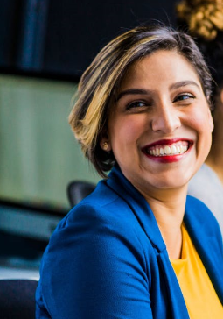
Write down the student’s personality and the reasons why he/she impresses you (examples).
personality
reasons
kind
example 1
outgoing
example 2
friendly
…
confident
helpful

Slide 22
Organize your sentences into a passage.
I’ve come into a new class in a new school. At first, I felt …. But now I am …. Of all the members in my group, … leaves me a deep impression.
He/ She is …. … (example)
I am so lucky to meet him/her when I first come into the class. I believe we can be good friends in the 3 years at senior high school.

Slide 23


I. Fill in words in the proper situation.
register, annoy, flash, concentrate, improve, take notes, revise
take notes
1. I usually listen to the teacher and __________ of the key points.
2. He ______________ on reading the book. He can’t hear the noise.
3. My English was so poor that I must think of a way to __________ it.
is concentrating
improve

Slide 24
register, annoy, flash, concentrate, improve, take notes, revise
4. When you come to the school, you should _________ your name first.
5. Lightening ________ among the distant dark clouds.
6. His words _________ me. I left his office at once.
register
flashed
annoyed

Slide 25
II. Fill in words in the proper situation.
strategy, flash, goal, confidence, experiment, look forward to, style
1. Even in the same country, people have different living _________. They live in different ways.
2. Don’t be afraid. You need ___________ when you face difficulties.
3. When you are learning English, you need a efficient (有效的) ___________.
styles
confidence
strategy

Slide 26
strategy, flash, goal, confidence, experiment, look forward to, style
4. I _______________ your coming. I have prepared everything for you.
5. Once we have a __________, we will try our best to get it.
look forward to
goal

Slide 27
III. Write down the sentence structures.
1. Amy is getting her student ID card.
2. Max meets Amy in the dining hall.
3. I am an exchange student.
4. The teacher helps Amy to fill in the registration chart.
5. Max introduced himself to the class.
6. Max showed Amy his ID card.
7. Max looks different in all the students.
8. The headmaster is standing on the stage.
SVO
SVOA
SP
SVOC
SV DO IO
SV IO DO
SPA
SVA

Slide 28
IV. Complete sentences with the help of
the sentence structure.
1. 他觉得英语有趣。
He found ____________________. (SVOC)
2. 在黑暗的地方他感到害怕。
He felt _______________________. (SPA)
3. 他给我们买了我们最喜欢的礼物。
He bought ____________________. (SV IO DO)
English interesting
frightened in dark places
us our favorite gifts

Slide 29
4. 他们将探索未来。
They will __________________. (SVO)
5. 我期望明年再见到你们。
I _________________________________. (SVOA)
explore the future
look forward to meeting you next year
6. 如果我们交换想法，我们就得到了两个想法。
If we __________________, we can have two ideas. (SVO)
exchange our ideas

Slide 30
7. 他正在思考。别打扰他。
He ____________. Leave him alone. (SV)
8. 他的英语最终提高了。
His English ___________________. (SVOA)
9. 他对公司的风格很好奇。
He is _______________________________.
(SPA)
10. 周五将有一个关于英语学习的演讲。
___________________________________
on Friday. (There be)
is thinking
has improved at last
curious about the company’s style
There will be a lecture on English study

Slide 31


Write a paragraph about your study and life in the new semester, using as many collocations as possible of this unit.

Slide 32


