Slide 1

Unit 3

Slide 2

Unit 3 Sports and Fitness

Slide 3


Slide 4


To hear and talk about sports events and sportsmanship.
To learn to use expressions of agreement and disagreement appropriately.

Slide 5


What is good sportsmanship? Can you give an example of sportsmanship?
belief
teamwork
sportsmanship
devotion
value

Slide 6
Good sportsmanship is that sports should be enjoyed for their own sake, and that athletes should show respect for their fellow athlete, treating them in the same way they would want to be treated themselves. This can be seen when athletes remain friendly and shake hands after an event, despite who won or lost.

Slide 7
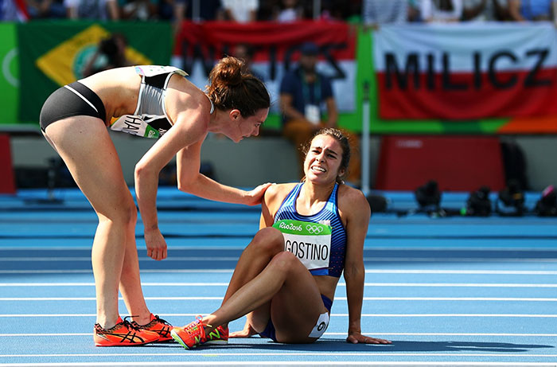
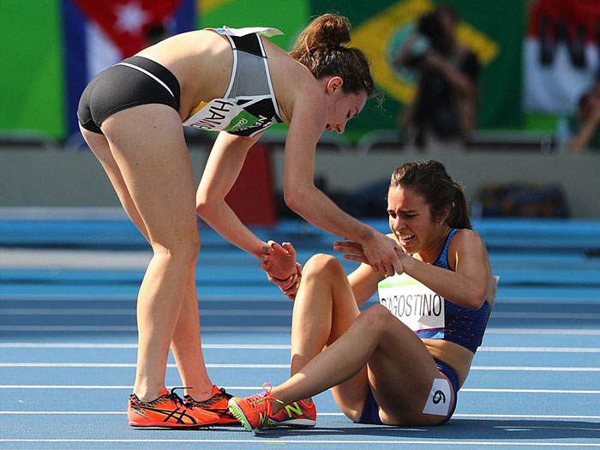
A good example occurred at the 2016 Olympic Games in Rio de Janeiro, Brazil. Athletes Nikki Hamblin and Abbey D’ Agostino both fell while running a 5,000-m heat. The two women were injured but helped each other finish the race and were praised around the world for their good sportsmanship.

Slide 8



Three students are talking about sportsmanship. Listen to the conversation and match each opinion with the right speakers. Who do you agree with? Why?
Cao Jing Lily Max

Slide 9
A. An athlete should do his/ her best to win.
B. The girl should stop and help the other girl. Good sportsmanship is more important than winning!
C. An athlete should think about honour and his/ her fans if he/she is competing for his/ her country.
Max
Cao Jing
Lily

Slide 10
Listen again and circle the expressions that you hear in the conversation.
Agreeing
I agree. So do I. Exactly! All right. Good idea. | Yes, I think so. Me too. Sure./ Certainly/ Of course. You’re right / correct. I guess so.

Slide 11
Disagreeing
I’m sorry, but I disagree/ don’t agree. I don’t think so. That’s not right. That doesn’t make any sense! That’s not how I see it. I see what you mean, but…

Slide 12

Who do you agree with? Why?

Slide 13

proposition | Reason for agreement | Reason for disagreement
A soccer player should not pretend to fall down even if it helps his/ her team. | honesty is more important people care about fair play … | winning is more important good for the team …
In school teams, everyone should get a chance to play, not only the best players. | equal chance is important spread the spirit of sports … | important thing is to win best player can help win …

Slide 14
proposition | Reason for agreement | Reason for disagreement
It is wrong to pay people millions of yuan to play sports. | spoil spirit of sports might cheat to win … | motivate athletes attract talented people …
Athletes should play only for their own country. | set an example of loving one’s own country get more support … | not beneficial for personal growth not good for competition …

Slide 15


Choose one of the situations below and make a conversation.
1 | A soccer player should not pretend to fall down even if it helps his/ her team.
2 | In school teams, everyone should get a chance to play, not only the best players.

Slide 16
3 | It is wrong to pay people millions of yuan to play sports.
4 | Athletes should play only for their own country

Slide 17

A: I agree with the idea that a soccer player should never pretend to fall down even if it helps his or her team. You should never cheat.
B: Exactly! It’s important to do the right thing.
C: Well, I don’t think so. Many players do it, and they think it helps their team to win.
A: That doesn’t make any sense!
B: I see what you mean, but the audience wants fair play.
C:…

Slide 18

A: It is wrong to pay people millions of yuan for playing sports.
B: I agree. They are only sports. Doctors and teachers should get more money, because their jobs are more important.
C: That’s not how I see it. Sports stars get paid a lot because they also help sell things…

Slide 19


1. An athlete should think about honour and his/ her fans if he/ she is competing for his/ her country.
compete vi. to try to be more successful than someone or something else 竞争
strive to gain or win something by defeating or establishing superiority over others who are trying to do the same 比赛

Slide 20
【归纳】
compete in 参加……比赛
compete against/with sb. (for sth.) (为某事物)与某人竞争 compete for 为争取/得到......而比赛/竞争
compete in 参加……比赛
compete to do sth.竞争做某事
【拓展】
competition n. 比赛，竞争
competitive adj. 有竞争力的，努力竞争的
competitor n 竞争者; 对手

Slide 21
【语境应用】翻译句子。
1) 在圣诞节期间，商店必须为了争夺顾客而竞争。
2) Tom明天将参加百米赛跑。
The stores have to compete for customers in the Christmas season.
Tom will / is going to compete in the 100 meters tomorrow.

Slide 22
3) Jim是个非常争强好胜的人，他不想被打败。
4) 电脑公司之间有很多竞争。
Jim is a very competitive person and he doesn’t want to be beaten.
There’s a lot of competition between computer companies.

Slide 23
2. A soccer player should not pretend to fall down even if it helps his/ her team.
pretend vt.& vi. speak and act so as to make it appear that something is the case when in fact it is not 假装
To feign an action or a character, as in play. 扮演

Slide 24
【归纳】
pretend that… 假装
pretend sth. 伪称某事; 假装
pretend to be＋n./adj. 假装是
pretend to do sth. 假装做
pretend to be doing sth. 假装在做
pretend to have done sth. 假装做过

Slide 25
eg Were you just pretending to be interested?
I don’t want to pretend to be an expert on the subject.
When I came in, he pretended to be reading.
Jim pretended to have solved the difficult problem.
He pretended that nothing had happened.

Slide 26
【语境应用】根据汉语提示完成下列句子。
1) The man _____________ (假装是) a doctor.
2) Peter _________________ (假装没看见) me when I passed the coffee shop.
3) The workers ____________________ (假装正在工作) hard at their machines when the boss came in.
4) So I carried around a book, and each night, just to be like her, I would __________ (假装) to be reading. (2019 天津)
pretends to be
pretended not to see
pretended to be working
pretend

Slide 27
even if引导让步状语从句，相当于even though“即使，尽管”。主句如果用一般将来时，从句常用一般现在时表将来。
【拓展】
as if/ as though 引导方式状语从句或表语从句，“就像；似乎；仿佛”。

Slide 28
【语境应用】翻译句子。
1) 我们决定明天去参观博物馆，即使下雨。
2) 我感觉即使我们输掉比赛也是胜利。
3) Ben不停地看表，好像在等什么人。
We have decided to visit the museum even if/though it rains tomorrow.
I felt that it would be a victory for us even if we lost the game.
Ben watched his watch again and again as if waiting for someone.

Slide 29
3. That doesn’t make any sense!
make sense to have a clear meaning 有道理
seem right; sound reasonable or practical
合乎情理
to be easy to understand or explain表述清楚

Slide 30

make sense of 理解; 明白
make no sense 没道理; 没意义
in no sense 决不(位于句首时句子用部分倒装)
in a sense 在某种意义上
there is no sense in doing sth. 做某事没道理/ 没意义
common sense 常识
a sense of humor 幽默感

Slide 31
eg Can you make sense of what I say?
However, this isn’t true since some phrases, if translated literally, would make no sense.
In no sense can the problem be said to be solved.
There’s no sense in criticizing him any more.

Slide 32
【语境应用】完成句子。
1) Planning so far ahead _________________ (无意义) ‒ so many things will have changed by next year.
2) I am sure David will be able to find the library ‒ he has ____________________ (很好的方向感).
3) See, your computer has broken down again! It _______________________________ (没有意义) to buy the cheapest brand of computer just to save a few dollars.
makes no sense
a good sense of direction
doesn’t make sense/ makes no sense

Slide 33


Write an article about your understanding of sportsmanship.

Slide 34


