Slide 1

Unit 1
Review

Slide 2
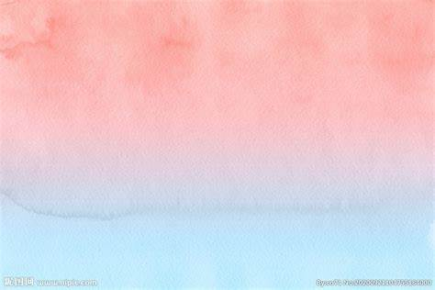
Useful Expressions
1. prefer doing to doing
prefer to do rather than do
be suitable for
be confused about
confuse A with B
4. sign up for
5. quit doing
6. be responsible for
7. attract one’s attention
be attracted to/ by
8. be addicted to doing
v.ing 做主语
2. so that引导目的状语从句
3. It is adj. (for sb.) to do
4. make it adj. for sb. to do

Slide 3

【语境应用】完成句子。
孩子们宁可骑自行车到乡下去，也不愿整天待在家里。
1) The children preferred _______ to the countryside to _______ indoors all day.
2) The children preferred ________ to the countryside rather than ______ indoors all day.
3) Lucy ________ sweets as her snacks while Lily has a _________ for nuts. (prefer)
cycling
staying
to cycle
stay
prefers
preference

Slide 4
【语境应用】翻译句子。
1) 吉尔(Jill)的新发型不很适合她。
2) 她穿着一套深蓝色的衣服。
3) 这部电影适宜儿童观看。
Jill’s new hairstyle doesn’t really suit her.
She wore a dark blue suit.
The film is suitable for children.

Slide 5
sign up (for sth.) to add your name to a list for something because you want to take part in it 报名（参加课程）
e.g. I have decided to ____________ evening classes this term.
我决定这学期报名上夜校。
My sister is thinking of ________________ a yoga club.
我姐姐正考虑报名加入瑜伽俱乐部。
sign up for
signing up for
【拓展】
sign up to do sth. 报名做某事
e.g. I’ve signed up to make tea for the party.

Slide 6
attract完成句子。
1) The story ___________________________ from the media.
这则报道引起了媒体的广泛关注。
2) Babies _______________ bright colours.
婴儿喜欢鲜艳的颜色。
has attracted a lot of attention
are attracted to

Slide 7
addict【语境应用】根据提示补全句子
1) John is only 9 years old but already a heavy computer game ______ (addict).
2) Barbara _______ ________ _______ (addict) TV soap operas and never wanted to work.
3) Morris addicted himself _______ rock music.
4) Cigarettes are highly ________ (addict).
5) Many adults are addicted to ________ (view) short videos on their cell phones.
addict
became addicted to
to
addictive
viewing

Slide 8
1.句型： v.ing 做主语
2.句型：so that引导目的状语从句
3. It is adj. (for sb.) to do
Going
_____________ (go) from junior high school to senior high school is really a big challenge.
that
I’ll find a way to improve on my own so _________ I can make the team next year.
I am a bit worried about keeping up with the other students in my advanced course, and it will be quite difficult __________(get）used to all the homework.
to get
4. make it adj. for sb. to do
it
But spending too much time online is unhealthy and makes _____ a very difficult _____________(focus) on other things in life.
to focus

Slide 9

Make a short story with the above!
1. prefer doing to doing
prefer to do rather than do
be suitable for
be confused about
confuse A with B
4. sign up for
5. quit doing
6. be responsible for
7. attract one’s attention
be attracted to/ by
8. be addicted to doing
These days I am confused about how to study English well. I try to follow the teachers, but it is almost impossible for me to review and preview as scheduled. You know, I am neither addicted to any computer games nor attracted to any super stars, but I just prefer to deal with maths problems rather than remember the terrible vocabulary. I know quitting is a shame, but how can I make it easier to face the vocabulary?
v.ing 做主语
2. so that引导目的状语从句
3. It is adj. (for sb.) to do
4. make it adj. for sb. to do

Slide 10
Work in groups
to make your own story
with at least 5 ones!
You have to ask yourselves:
1. Is the story meaningful?
2. Are the useful expressions included in it?
3. Are the sentence structures correct?
4. Are there any spelling mistakes?
5. Is the handwriting clear enough?
10
scores

