Slide 1

Unit 2
Review

Slide 2

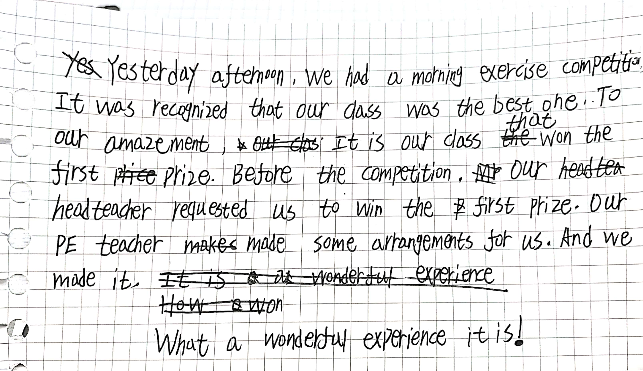
From Class Two

Slide 3

Useful Expressions
1. apply to sb. for sth.
apply oneself to doing
2. be amazed at
to one’s amazement
3. make some arrangements for
4. recognize ... as / to be
It is recognized that…
5. other than
6. make(lose) contact with…
keep in contact with ...
7. make up for
be made up of
8. request sb. to do sth.
9. comment on/about sth. / sb.
make comments on sth./sb.
request that sb.(should) do
2. It is/was …that
3. It is adj. that 从句

Slide 4


1. apply for ... 申请……
apply to ... for ... 向……申请……
eg He applied for a job in the company.
You have to apply to the U.S. embassy (大使馆) for a visa.

Slide 5
apply vt. 应用
apply ... to ... 把……应用于……
eg He is eager to apply the technology to practical business problems.
apply v. 贴，涂，敷
apply ... to ... 把……贴/涂/敷到……
eg Please apply the glue to both surfaces.

Slide 6
apply vt. 适用
apply to... 适用于……
eg What I have said applies only to some of you.
【拓展】
apply oneself to ... / apply one’s minds to ...致力于……，专心于……
application n. 应用
applicant n. 申请人（尤指求职、进高等学校等）

Slide 7
eg Frank has applied himself to this task with considerable energy.
We applied our minds to finding a solution to our problem.
The university welcomes applications from overseas students.
How many applicants did you have for the job?

Slide 8
【语境应用】用所给词的正确形式填空。
1) His ____________ (apply) for membership of the organization was rejected.
2) Please clean the wound with a clean cloth and then apply the medicine ______ it.
3) Later I decided to apply my previous experience to __________ (learn) how to read and write.
application
to
learning

Slide 9
1. be amazed at 对感到……惊讶
v.-ing用作形容词，表示“feature”
v.-ed用作形容词，表示“feeling”

Slide 10
【拓展】
amaze vt. 使吃惊；惊讶
amazement n. 惊奇；惊喜
to one’s amazement 令人惊讶的是…
eg She was _________ at how calm she felt after the accident.
Mary told me an __________ story.
To my ___________, he ate the whole lot.
amazed
amazing
amazement

Slide 11
make arrangements for 为……做好安排
eg Don’t worry. I’ll make arrangements for you to be picked up at the airport.
arrange to do sth. 安排做……
arrange for 为……做准备(安排)
arrange for sb./sth. to do... 安排某人/某物做某事

Slide 12
【归纳】
recognise ... as / to be ... 认为……是……
recognise sb. by sth. 从/根据某物认出某人
It is recognised that… 人们公认……
【拓展】
recognition n. 识别；承认；赞誉

Slide 13
【语境应用】根据提示完成句子。
1) I ______________________________ (从她的红色头发认出了她).
2) ______________________________ (它没有被看成) a problem then.
recognised her by her red hair
It was not recognised as/to be
翻译句子。
我现在认出你了，你是Tom的哥哥。
John被公认为是全校最好的足球运动员。
这个演员不久就得到了观众的承认。
I recognise you now; you are Tom’s brother.
John is recognised as the best footballer in the school.
The actor soon won recognition from the public.

Slide 14
other than: except 除……之外
【拓展】
except, but, apart from 除……以外
besides 除……以外还有……
eg English is now spoken in many countries other than England.
In my village, nobody can speak English other than I.
I like reading novels other than the textbooks.

Slide 15
【拓展】
be in/out of contact with ... 与……有/失去联系
keep in contact with ... 与……保持联系
lose contact with ... 和……失去联系，离开
make contact with 与……取得联系
eg I had been in contact with her.
We lost contact with the Wangs when they moved away.
I finally made contact with her in Paris.

Slide 16
【语境应用】单句语法填空。
1) I have tried hard ________ (contact) my old monitor many times but in vain. He seemed to have disappeared.
2) Tom told me that I could keep ________ contact with him through WeChat.
3) Do write to me as often as you can. I don’t want to lose _________ with you.
to contact
in
contact

Slide 17
eg North Africans make up the largest and poorest immigrant group in the country.
I think it’s very unkind of you to make up stories about him.
Can I leave early this afternoon and make up the time tomorrow?
She spent too much time making herself up.
组成
编造
补足；弥补
化妆

Slide 18
【归纳】
make up for 弥补；补偿
be made up of 由……构成
make up an excuse 编造一个理由
make up with sb. 与某人和解
【语境应用】翻译句子。
我们编了一个故事。这个故事由三个部分组成。其中之一是关于一个人如何弥补他的过失的。
We make up a story. The story is made up of three parts, one of which is about how a man makes up his mistakes.

Slide 19
【归纳】
request sb. to do sth. 请求某人干某事
request that-clause 请求……(从句谓语动词用should＋动词原形，should可以省略)
句型转换
They requested us not to smoke in the office.
→They requested that we_______________________ in the office.
→It was requested that we _______________________ in the office.
(should) not smoke
(should) not smoke

Slide 20
【归纳】
comment on/about sth. / sb. 对某事/某人进行评论
make comments on sth./sb. 对某事/某人进行评论
no comment 无可奉告
【语境应用】完成句子
1) She _______________________ my work.
她对我的工作提出了有益的评论。
2) I don’t feel ____________________________.
我觉得我无法对他们的决定作出评论。
made helpful comments on
I can comment on their decision

Slide 21

It is for this reason that Spanish in the main official language of Peru.
【翻译】也正是因为这段历史，西班牙语成了秘鲁的主要官方语言。
【分析】本句为强调句，“for this reason”为被强调部分。
1) 强调状语时，只能用that而不能用where/ when/ why等；强调人时，可以用that/ who/ whom。
2) 原句的时态是一般过去时、过去进行时、过去完成时时，用“It was …”；其他时态用“It is…”。
3) 强调句型的判断：去掉It is / was 与 that/ who 后，剩余部分若结构完整、句意明确，则为强调句，否则不是。

Slide 22
【语境应用】句型改写
I met Li Hua at the hospital yesterday.
强调主语:
强调宾语:
强调地点状语:
强调时间状语:
It was I that/ who met Li Hua at the hospital yesterday.
It was Li Hua that/ whom I met at the hospital yesterday.
It was at the hospital that I met Li Hua yesterday.
It was yesterday that I met Li Hua at the hospital.

Slide 23

Make a short story with the above!
1. apply to sb. for sth.
apply oneself to doing
2. be amazed at
to one’s amazement
3. make some arrangements for
4. recognize ... as / to be
It is recognized that…
5. other than
6. make(lose) contact with…
keep in contact with ...
7. make up for
be made up of
8. request sb. to do sth.
9. comment on/about sth. / sb.
make comments on sth./sb.
Two weeks ago, after the headteachers had made some arrangements, we went to the Military Training Base. It is recognized that the training is the most tiring and boring stuff in the senior high school, but much to our amazement, we found a lot of unexpected fun in it. Other than plenty of food and comfortable accommodation, it was actually cool that we found ourselves stronger and tougher though we were requested to stand still for a long time in the hot sun. Maybe it was the bitter training that could add some interest to our life.
1. request that sb.(should) do
2. It is/was …that
3. It is adj. that 从句

Slide 24
Work in groups
to make your own story
with at least 5 ones!
You have to ask yourselves:
1. Is the story meaningful?
2. Are the useful expressions included in it?
3. Are the sentence structures correct?
4. Are there any spelling mistakes?
5. Is the handwriting clear enough?
10
scores

Slide 25
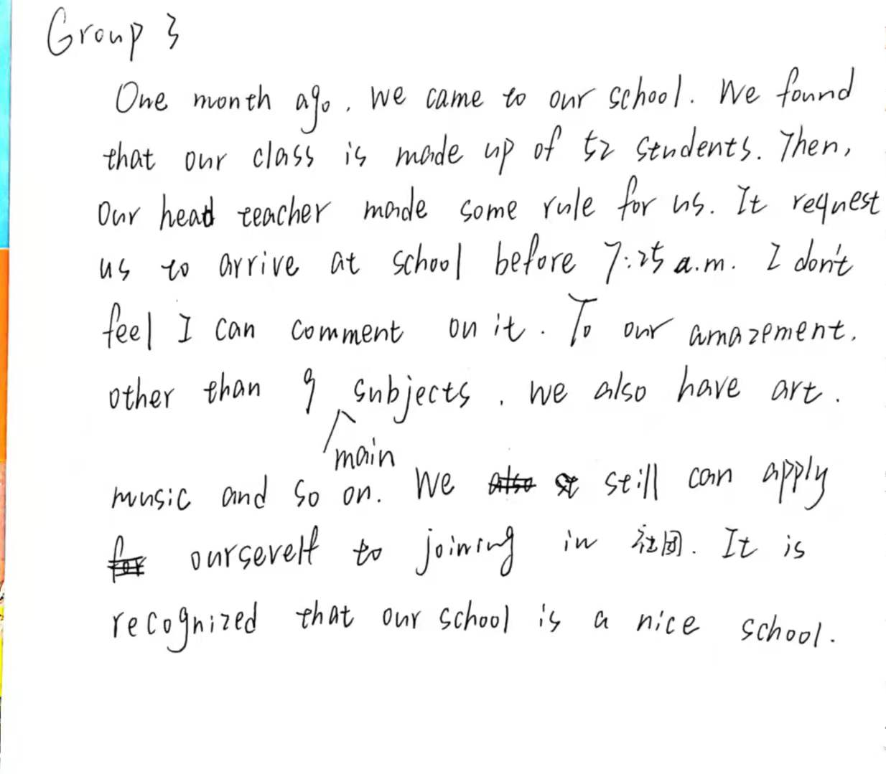
From Class Two

Slide 26
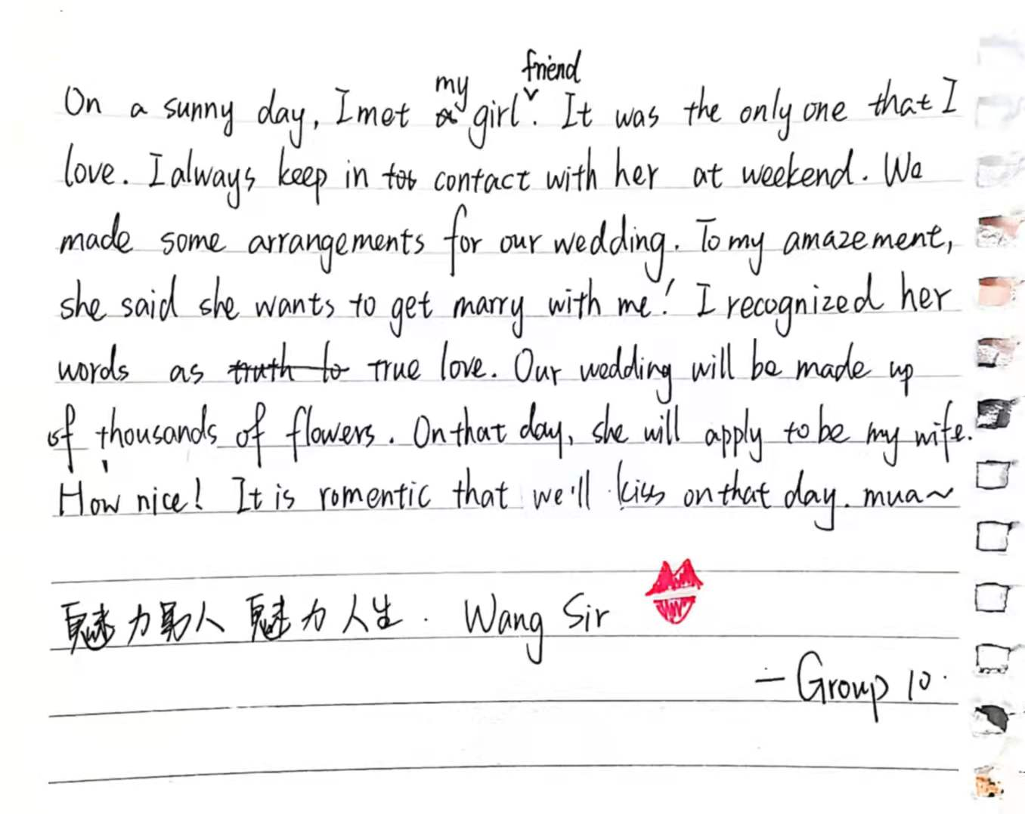
From Class Two

