Slide 1

Unit 1 Wise men in history
英语教学课件系列
---九年级上册
More practice ＆ Study skills
教学内容：P13, P14
Notes:
T明确本课时教学内容。

Slide 2

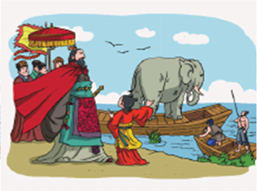
Pre-reading
Questions:
Who was in the story?
What did Cao Cao want to know about the elephant?
How did Cao Chong weigh the elephant?
What do you think of Cao Chong?
Notes:
学生结合自己已有的《曹冲称象》的背景知识讨论以上四个问题。

Slide 3
While-reading
Read and order the sentences below.
( ) Soldiers filled the boat with rocks.
( ) The boat went down again and water reached
the line on the boat.
( ) The boat went lower into the water.
( ) Cao Chong weighed all the rocks.
( ) The elephant walked onto a boat.
( ) That was the weight of the elephant.
( ) Cao Chong drew a line on the boat.
4
5
2
6
1
7
3

Slide 4
Read and complete the passage with proper
words.
How did Cao Chong weigh the elephant?
As soon as the elephant ____________ a boat, the boat _____________the water. So Cao Chong ___________ on the side of the boat to _______ how low it went. After that, some soldiers ______
the elephant ______ the boat and _____the boat ____________until it went down again and water __________ the line on the boat. Finally, Cao Chong _________ all the _________. That was the _________ of
the elephant.
walked onto
went lower into
drew a line
mark
took
off
filled
with rocks
reached
weighed
rocks
weight

Slide 5
Post-reading
Retell the story with the words or phrases below.
rock
Cao Chong asked some soldiers to lead the elephant onto a boat. The boat went lower into the water when the elephant walked onto it. He drew a line on the side of the boat to mark how low it went. Then Cao Chong asked the soldiers to take the elephant off the boat and fill the boat with rocks until it went down again and water reached the line on the boat. Then Cao Chong weighed the rocks one by one and added up the weight of all the rocks. That was the weight of the elephant.
lead … onto
mark
weigh
go lower
take ... Off
go down
add up
draw a line
reach
fill ... With

Slide 6

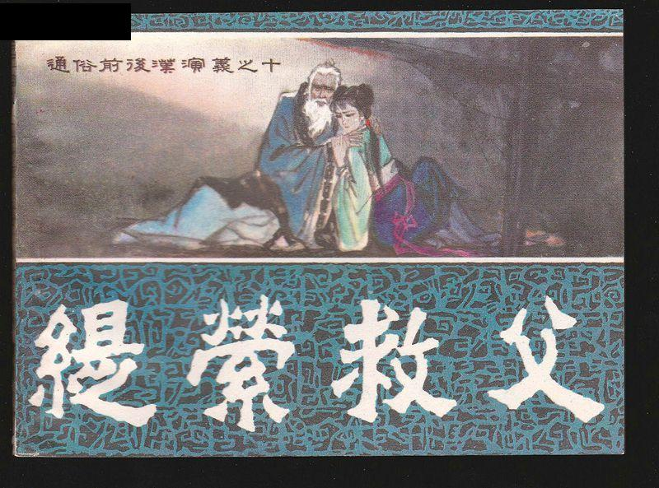
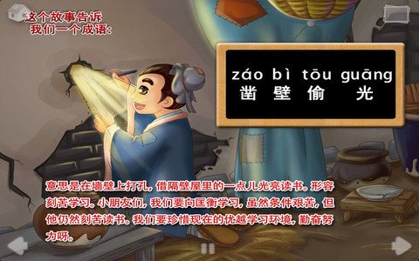
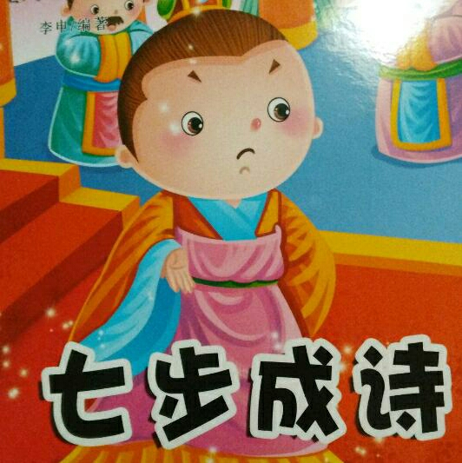
Story time
Notes:
《司马光砸缸》——Sima Guang breaks the rain barrel
《凿壁偷光》——Kuang Heng bores a hole in the wall for light
《七步成诗》——Cao Zhi composes a poem within seven paces
《缇萦救父》——Ti Ying saves her father

Slide 7
Practice makes perfect.
熟能生巧。

Slide 8
Intensive exercise
一、根据英语释义写出单词。
1. w______ how heavy somebody/something is
2. r______ to arrive at a particular point after a period of time
3. b______ to feel certain that something is true
4. h______ extremely large in size
5. l_______ to go in front of an animal to make it go in the right direction
eight
each
elieve
uge
ead

Slide 9
二、根据中文提示完成句子。
1.我的儿子很聪明，不是吗？
My son is very _____ ,_____ _____?
2.这头大象可真大啊！
—— —— elephant it is!(第一种用法）
—— —— the elephant.（第二种用法）
3.当时没有人知道称出大象的重量。
No one ____ _____ ____ ____ an elephant at that time.
clever
isn't
he
What
huge
How
huge
knew
how
to
weigh

Slide 10
英语中标点符号的用法
句号(Full stop)
用于陈述句后
eg: Hockey is a popular sport in Canada.
用于一些缩写语中
eg: B.C. is the province located on the West Coast.
问号(Question mark)
用于疑问句后
eg: How many provinces are there in Canada?
Notes:
What is a directory? (It is a book with information about a certain city or area. )
What does a directory usually have? (It usually has different categories.)
How is a directory arranged? (It is arranged in alphabetical order. )
What is the most common type of directory? (A list of phone numbers.)

Slide 11
感叹号(Exclamation Mark )
用于带有强烈情感的语句后或感叹句后
eg: We won the Stanley Cup!
What a nice trip!
逗号 (Comma)
  用于分隔句子成分
  eg: Therefore, we should write a letter to the prime minister.
  用于反意疑问句的疑问部分前
  eg: You like reading, don’t you?
  罗列三个或以上的单词或短语
  eg: Ontario, Quebec, and B.C. are the three biggest provinces.
  引出从句
  eg: Emily Carr, who was born in 1871, was a great painter.

Slide 12
引号（Quotation Marks）
①用于直接引语中
eg: The prime minister said, “We will win the election.”
②表示特定称谓
eg: Mark Twain is often called the “father of American literature”.
撇号 (Apostrophe)
①表示所有格
eg: This is David's computer.
②用于缩略词中
eg: I don't know how to fix it.

Slide 13
连字符（Hyphens）
将两个或两个以上的单词连接成一个词
eg: sweet-smelling
anti-Canadian
one-quarter
冒号 (Colons)
①介绍一组内容或要点
eg: There are three positions in hockey: goalie, defence, an
forward.
②引出一个较长的引语
eg: The prime minister said: "We will fight. We will not give up.
We will win the next election.“

Slide 14
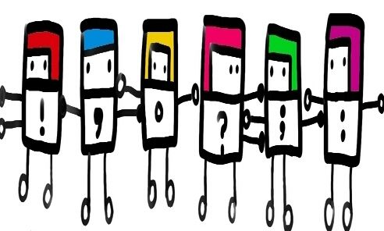
Add punctuation marks to the following sentences.
1. “You like Chinese food, don’ t you?” asked Mary.
2. Since she’s your little sister, please take care
of her.
I’ve passed these subjects: Chinese, Maths,
English, History and Music.
4. This is a well-run hotel.
You like Chinese food don t you asked Mary
Since she s your little sister please take care
of her
I ve passed these subjects Chinese Maths English History and Music
4. This is a well run hotel

Slide 15
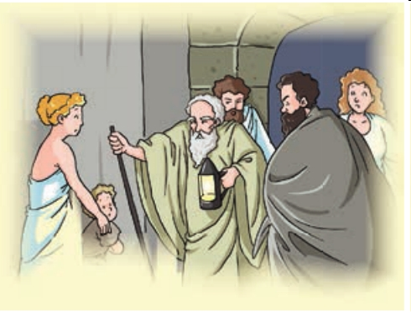
Underline the mistakes and write the correct
punctuation marks above them.
One of the most famous wise
men in ancient Greece was
Diogenes, Diogenes lived a
simple life? He only owned
three things-the clothes he
wrote, a lantern and a bowl to
eat with.
Diogenes used to walk through the city with his lantern during the day. When people asked him why he was carrying the lantern, he would hold it up to their face, look at them, and say. “I,m looking for an honest man.’
.
.
:
,
”
I’m

Slide 16

Homework
完成练习册剩余练习。
复习本单元。
完成Unit1 单元测试题。
Notes:
点击”单元测试题”,即可打开《单元测试题》的Word文档链接。

Slide 17



