Slide 1

Unit 2 Great minds
英语教学课件系列
---九年级上册
Grammar
教学内容：P 23-25
Notes:
T明确本课时教学内容。

Slide 2

Grammar
Infinitives after nouns
Infinitives as subjects
Infinitives after the verb to be

Slide 3

Presentation/Practice
Infinitives
（动词不定式）
含义：表示目的或是未来要发生的动作。
基本结构：“to+动词原形”(to有时可以省略)。
功能：在句中除不能充当谓语外，其他成分
都可充当。如：主语、表语、宾语、
状语、宾语补足语、定语等。

Slide 4

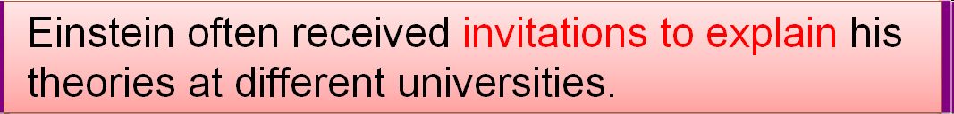
A. Infinitives after nouns
动词不定式一般都是作后置定语，修饰前面的的名词或代词，用来解释某一事物的功能或用途。

Slide 5

Extension
如果名词或代词是动词不定式的宾语，动词不定式
后不加宾格代词。
eg: I give a newspaper to read. √
I give a newspaper to read it. ×
在动词不定式与其所修饰的词构成逻辑上的动宾关
系时，若该动词为不及物动词，其后应加上相应的
介词。
eg: I am looking for a room to live in.
I need a piece of paper to write on.
There’s nothing to worry about.
动词不定式作定语且所修饰的名词是time，place或
way时，其后的介词通常省略。
eg：He had no money and no place to live.
动词不定式作定语应注意：

Slide 6

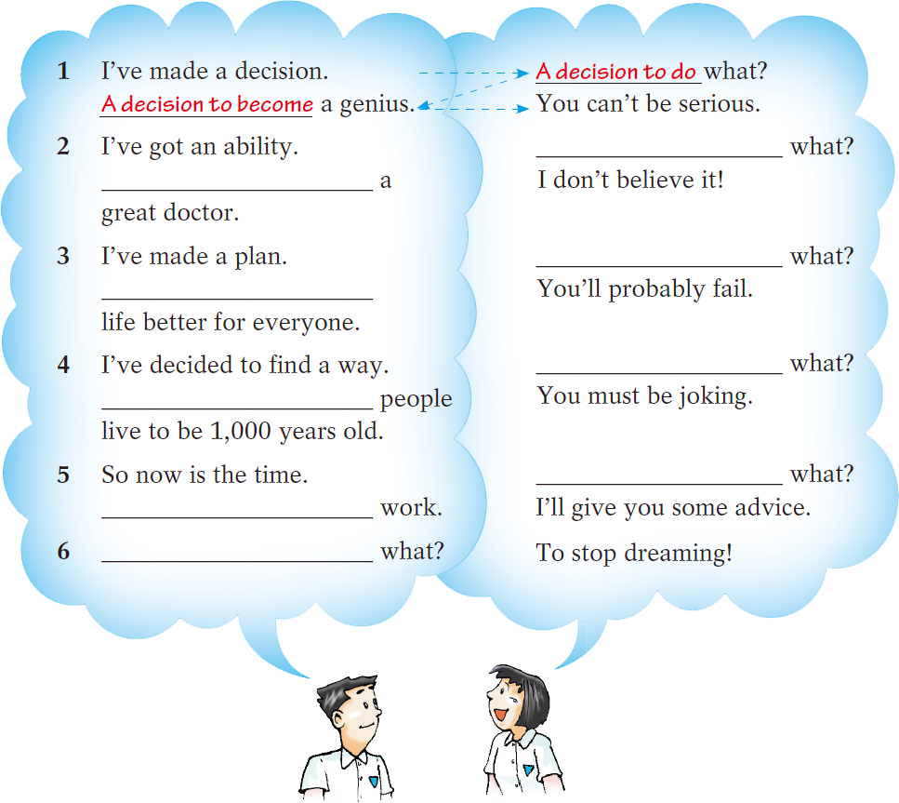
Complete their conversation with the words
from the box.
Production
An ability to do
An ability to be
A plan to do
A plan to make
A way to do
A way to help
The time to do
The time to start
Advice to do
be become help make start

Slide 7
Complete the paragraph below with the
words from the box.
become a scientist go to university
do Maths try again
to do Maths
At school, Einstein’s ability (1)____________ surprised his teachers, but he was bored with other subjects. At the age of 15, he was given the chance (2)________ _________, but he did not do well enough in the exam. He did not lose heart, however, and he had a wish (3)____________ the next year. This time, he succeeded. He kept trying, so he achieved his dream (4)___________________.
to go to
university
to try again
to become a scientist

Slide 8
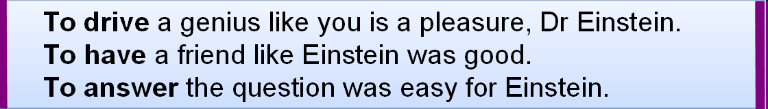
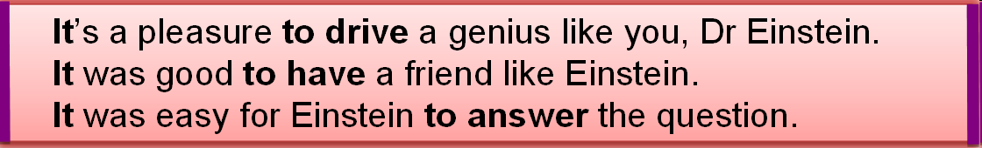
Presentation/Practice
B. Infinitives as subjects
动词不定式短语作主语时，一般不放在句首，通常以it作形式主语，将动词不定式后置。

Slide 9
Extension
It作形式主语时，主要有三种情况：
常用形容词作它的表语：
It’s + adj.（描述事物特征）+ for sb. to do sth..
It’s + adj.（描述人性格、品质）+ of sb. to do sth..
有时也接名词作表语。
eg: It must be great fun to fly to the moon in a spaceship.
it作形式主语还用于“It takes/took/will take sb. some
time to do sth.”的句型中。
eg: It took me more than an hour to do my homework yesterday
evening.
It will take us a long time to walk there.

Slide 10
Production
Complete their conversation with infinitives and
words in brackets.
Dr Green: Hello, Hans.
Hans: Hello, Dr Green. How long did it take you to get here
by plane?
Dr Green: (1)_______________________________________.
(take/two hours) How long will it take to get to the
university?
Hans: (2)_________________________________________.
(take/20 minutes)
It took me two hours to get here by plane
It’ll take 20 minutes to get there/get to the university

Slide 11
Dr Green: Well, that’s not very long. Hans, you’re a very good
driver. Is it difficult to drive a car?
Hans: No. (3)____________________________.(easy/drive)
Dr Green: Maybe I’ll learn to drive some day, but
(4)________________________________________
(difficult/for me/learn) right now. I’m too busy. Do you
like your job, Hans?
Hans: Yes, I like it a lot. I meet many great people because
I’m a driver. (5)______________________________.
(lucky/for me/have/job)
It’s easy to drive a car
it’s difficult for me to learn to drive
It’s lucky for me to have this job

Slide 12
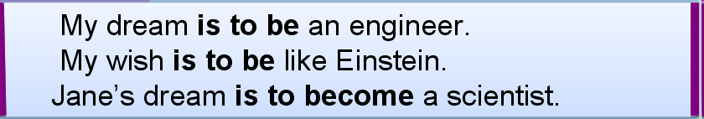
Presentation/Practice
c. Infinitives after the verb to be
动词不定式作表语常常用于补充说明主语的具体内容或表示目的、计划或打算等。

Slide 13
Extension
动词不定式作表语其主要用法有：
主语为aim, dream, hope, idea, plan, purpose,
suggestion, wish等表示目的、计划或打算的
词。
eg: His wish is to become an astronaut.
当句子的主语为work， job或function时，
往往也使用这一结构。
eg: The man’s job was to give advice to the king.

Slide 14
Production
Put the words in the correct order to make
sentences.
1 do the work/the most important thing/well
________________________________________
2 in a year/Mr White’s plan/have a small shop ________________________________________
3 attract the students/my idea/aby making a poster ________________________________________
4 children/her job/take care of ________________________________________
The most important thing is to do the work well.
Mr White’s plan is to have a small shop in a year.
My idea is to attract the students by making a poster.
Her job is to take care of children.

Slide 15


Slide 16
选择填空。
The bus was so crowded that I couldn’t find a
chair ____.
A. to sit on B. to sit
C. sitting D. to sitting
2. Don’t bother me. I have many letters _____.
A. write B. to writing
C. to write D. writes
3. Is _ __ possible to fly to the moon in a spaceship?
A. now B. man
C. that D. it

Slide 17
4. All I want is ____ treated as a child by the
teachers and parents.
A. not be B. being
C. not to be D. to be not
5. To answer correctly is more important than ________.
A. a quick finish B. to finish quickly
C. finishing quickly D. you finish quickly
6. Her wish is ___ an engineer.
A. becoming B. become
C. to become D. being come

Slide 18
中考真题实战篇
It's easy if you try.

Slide 19
一、选择题
1.Miss Chen, my dear English teacher,often encourages me _______the challenges in my study. (2019重庆中考B卷）
A.face B.faces C.facing D.to face
2.---Would you like_____a film with us tonight？ (2019黑龙江）
---Sorry, I have to help my mother do housework.
A.see B.to see C. seeing D.to seeing
3.Young people are encouraged to work hard ________their own dreams. (2019广东中考）
A.achieve B.achieves C.to achieves D.achieved
4 . A friend in need is a friend indeed.All of us need a friend _________. (2019黑龙江）
A.to talk with B .talking C. to talk

Slide 20
5.Michel visits many websites ______about Chinese culture. (2019吉林中考）
A.learn B.learned C.to learn
6._____noise pollution,and we can live in a quiet environment. (2019四川眉山）
A.Present B.Preventing C.Prevented D.To prevent
7.He ran as fast as he could_______the bus but he failed. (2019广西柳州）
A.catch B.to catch C.caught
8._____ me an email before you come to Hohhot,and I'll meet you at the train station. (2019内蒙古呼和浩特中考）
A.Send B.Sending C.To send D.Sent

Slide 21
9.---In my opinion,animals shouldn't be kept for fun. (2020湖北中考）
---I think so.Forests are the best places for animals______.
A.live B.living C.to living D.to live in
10.---Have you ever heard that China is building a nationwide 5G network? (2019湖北中考）
---Right.5G will allow us _____English movies faster than ever.
A.download B.downloads C.to download D.downloading

Slide 22

Homework
1. 复习并熟记该部分语法点。
2. 完成本部分《同步练习题》。
Notes:
《同步练习题》见超链接Word文档。

Slide 23



