Slide 1
Unit 1 Wise men in history
Grammar
教学内容：P 7-9
Notes:
T明确本课时教学内容。

Slide 2

Grammar
Question tags
Sentence types
Notes:
此处三个知识点分别有超链接，超链接内容为：该知识点的呈现与练习、产出等 。注重讲练结合。

Slide 3

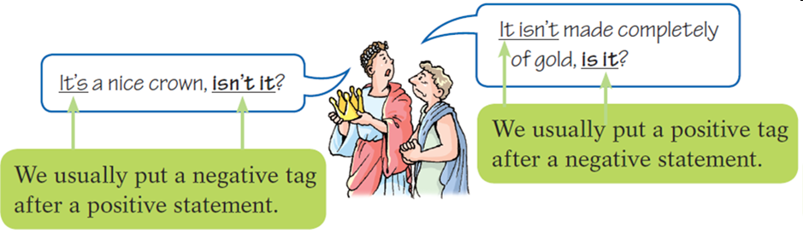
Presentation/Practice
A. Question tags
反义疑问句是由陈述句和附在其后的附加疑问句组成。其中附加疑问句是对陈述句所说的事实或观点提出疑问，起证实作用，一般用于证实说话者所说的事实或观点。

Slide 4

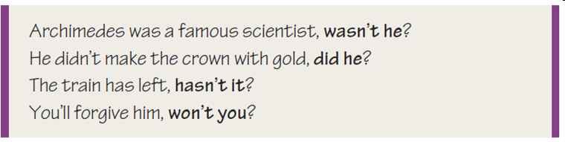
反意疑问句遵循“（人称、时态和数的）
一致性；前肯后否；前否后肯”的原则。
反意疑问句的回答：根据事实来回答。与事实
相符，用yes；与事实不符用no。
eg: ---The runner didn’t win the race, did he?/
The runner won the race, didn’t he?
---Yes, he did. (He won the race.)
---No, he didn’t. (He did not win the race.)

Slide 5

Extension
如果陈述句中有助动词（be, have, do及情态动词），
则在附加问句中重复该助动词。
eg: You can’t be serious, can you?
附加问句用人称代词主格，不能用名词。
eg: The bag is yours, isn’t it? √
The bag is yours, isn’t the bag? ×
简略问句如果是否定式：not应与be，do，will等系动
词、助动词、情态动词缩写。
Take out your books, will you?
使用反意疑问句时应注意：

Slide 6
陈述句中含有little, few, never, no, nobody, hardly, seldom
等否定词或too…to时，附加问句用肯定式。
eg：She never lies, does she?
祈使句后用will you?或shall we?
eg: Let’s get out of here, shall we?
陈述部分I am时，疑问部分要用 aren't I?
eg: I'm as tall as your sister，aren't I?
陈述部分有情态动词：
have to +v. 时，疑问部分常用don’t +主语 。
eg: We have to get there at eight tomorrow, don't we?
used to +v. 时，疑问部分用didn't +主语或 usedn’t +主语。
eg: He used to take pictures there, didn't he? / usedn't he?

Slide 7
陈述部分主语是指示代词或不定代词everything, that,
nothing, this, 疑问部分主语用it。
eg: Everything is ready, isn't it?
陈述部分主语是不定代词everybody, anyone, somebody,
nobody, no one等，疑问部分常用复数they，有时也用单
数he.
eg: Everyone knows the answer, don't they? (doesn’t he?)
think引导的宾语从句：
A.主语是第一人称
eg: I don't think he is bright, is he?
eg: We believe she can do it better, can't she?
B. 如果主语不是第一人称则疑问部分与主句相对应构
成反意疑问句。
eg: He thought they were wrong, didn't he?
（而不能说weren't they?）

Slide 8
Production
Complete their conversation with question tags.
are you
Queen: You aren’t happy, _________? What happened?
King: It’s my new crown. Take a look at it, _________?
Queen: It looks beautiful, _________? What’s wrong with it?
King: It isn’t made completely of gold. That’s why I’m angry.
Queen: The crown maker tricked you, __________? How did
you find out?
King: Archimedes told me. Let’s have dinner with him
tonight, __________?
Queen: OK.
will you
doesn’t it
didn’t he
shall we

Slide 9
Presentation/Practice
B. Sentence types
Statements | Positive statement | One day in ancient Greece, King Hiero asked a crown maker to make him a golden crown.
 | Negative statement | It was not a real golden crown.
Questions | Yes/No question | Is it made completely of gold?
 | Wh-question | What should I do?
 | Alternative question | What is the crown made of, gold or something else?
 | Tag question | It’s a nice crown, isn’t it?
Imperatives |  | Look at this!
 |  | Let me help you.
Exclamations |  | How excited Archimedes was! What a bad man the crown maker is!
Do 型
Let 型
How引导的
What引导的

Slide 10
Production
Add a full stop (.), a question mark (?) or an exclamation mark (!) to the end of the following sentences.
How can I find out___
The crown is nice___
How wonderful___
The king was not happy___
Please close the window___
What a nice crown___
This is difficult, isn’t it___
Leave me alone ___
?
.
!
.
.
!
?
!

Slide 11
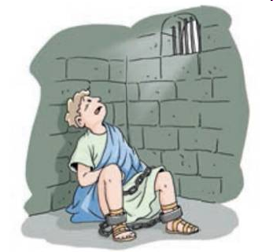
Look at the sentences below and label the
sentence types.
(1) How did Archimedes discover the truth? (2) He’s so clever, isn’t he? (3) King Hiero sent me to prison. (4) What a lonely place this is! (5) Will he let me out soon? (6) I don’t want to stay here any longer. (7) Please let me out!
1. ___________
2. ___________
3. _______________
4. ___________
5. ______________
6. _______________
7. ___________
Wh-question
Tag question
Positive statement
Exclamation
Yes/No question
Negative statement
Imperatives

Slide 12
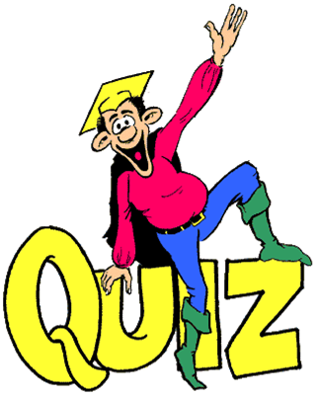

Slide 13
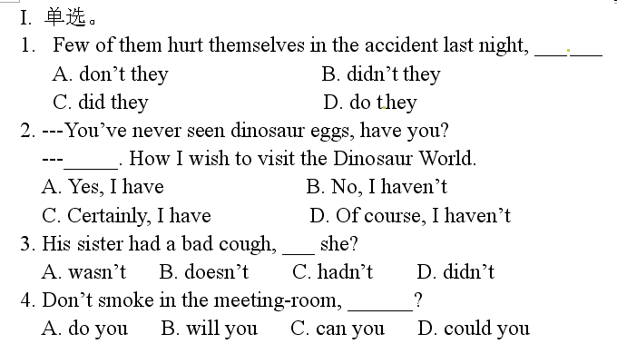

Slide 14
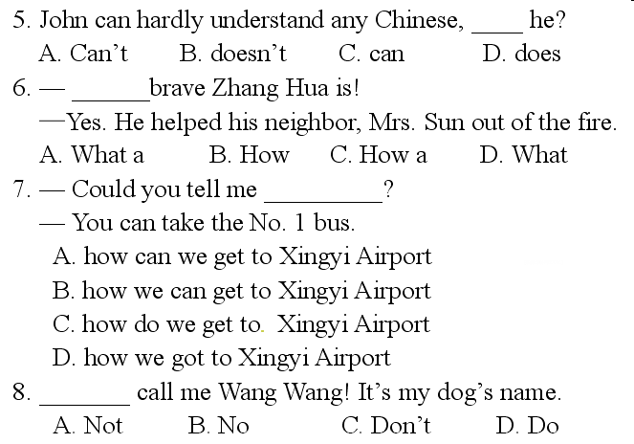

Slide 15
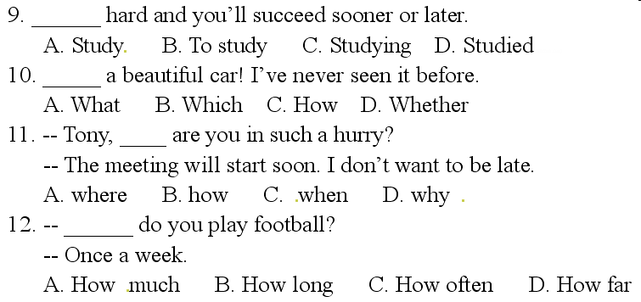

Slide 16
中考真题实战篇
It's easy if you try.

Slide 17
一、选择题
1._______special classes we had! We have learned a lot about paper cutting.(2019.青岛市）
A.What B.What a C.How a D.How
2.______smart the driverless car is! I really want to have one.(2019.广东省）
A.What B.What a C. What an D.How
3.-----It is said that 5G is coming. It will improve our life greatly.
------ _____ amazing it is!(2019.淮安市）
A.What an B.How a C.What D.How
4.The self-driving plane proves to be useful in many ways.______ smart invention it is!（2018.上海市）
A. What B.What a C.What an D. How

Slide 18
5.-----All of my classmates have passed the PE test.
-----______exciting the news is！（2018.白银市）
A.How B.What C.What an D.How an
6.People in the past could hardly eat fish vegetables in winter,_________? (2018.黑龙江省）
A.could they B.couldn’t they C. could people
7.Professor Tu Youyou never stops doing research on Chinese medicine,______? (2017.上海市）
A.is she B.does she C.isn’t she D.doesn’t she
8.I hear the tall girl wearing glasses is your new classmate.She’s from America,______? （2011.广州市）
A.has she B.isn't she C. hasn't she D. does she
9.____me a chance and I'll bring you a surprise.（2018.重庆市）
A.Give B.Giving C.Gives D.To give

Slide 19
10.Tom,_________the umbrella with you .Look at the clouds,it's going to rain! (2018.黑龙江省）
A.taking B.takes C.take
11.----Sorry I'm late.
----______tell me the bus broke down again! (2014.广州市）
A.Never to B.Not C.Don’t D.No
12.----He doesn't speak English or Japanese ,_________? (2020广东深圳市)
----________.He speaks Chinese.
A.does, he ; Yes,he does.
B.doesn't he; No, he does.
C.does he;No, he doesn't.

Slide 20
13.---There is nothing left in the fridge,_____?(2019.甘肃）
---________.Let's go to the supermarket to buy some.
A.is there;Yes B.isn't there;Yes
C.is there;No D.isn't there;No
14._____ on the grass.It's a rule of the park.(2019青海中考）
A.Step B.Don’t step C.To step
15.----All of my classmates have passed the English test.(2019新疆中考）
----_____ exciting the new is!
A.How B.What C.What an D.How an

Slide 21

Homework
1. 复习并熟记该部分语法点。
2. 完成本部分《同步练习题》。
Notes:
《同步练习题》见超链接Word文档。

Slide 22



