Slide 1

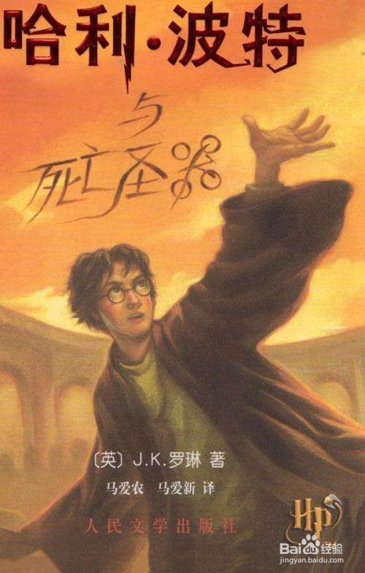
A timeless franchise
nniversary
This year marks the 20th a____________ of the first Harry Potter film. To celebrate it, a special show: Return to Hogwarts, will come out on Jan 1, 2022. The trio of Daniel Radcliffe, Rupert Grint and Emma Watson, who p________ Harry Potter, Ron Weasley and Hermione Granger, respectively will come together and talk about making the films.
layed

Slide 2
A_________ 20 years have passed, it’s like Potter-mania has never ended. “Mania” is the only word for it. Harry Potter has changed children’s literature the way that Star Wars has changed movies. Before Harry Potter, nobody l______ up at midnight to buy books. Then, in 2001, a character from literature was more b___________ than Super Mario.
Harry Potter has not only made children’s literature important, but also made it more extensive. Just like Star Wars, the story is c_________, Good vs Evil. J.K. Rowling writes characters we can easily e___________ with. From the first scene, we know Harry is good. He has no parents and he lives in a c_________. We feel bad for him.
lthough
ined
eloved
lassic
mpathize
loset

Slide 3
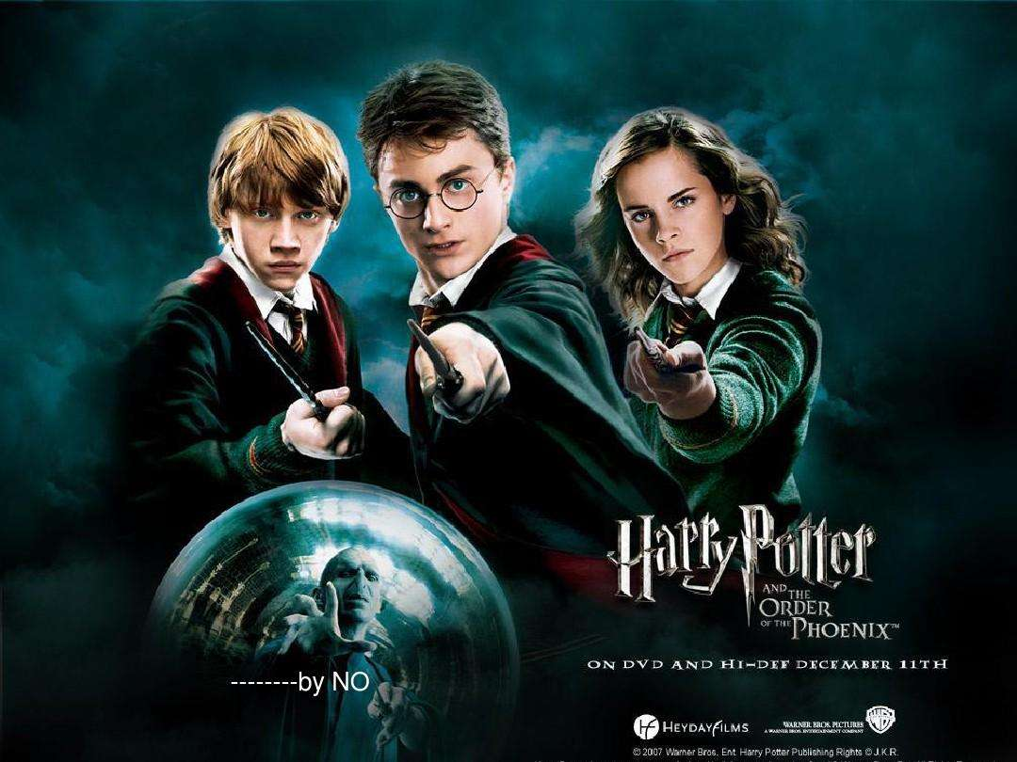
My favorite part is Rowling’s knack for names. Rowling is a
m_________ of nonsense words with fun words. Rowling knew
exactly what kids think is funny.
Now, the kids who watched the movie 20 years ago can sit down with their own kids and e______ books and movies together.
aster
njoy

