Slide 1

维克多英语
新方略基础课件
Unit 5
生活起居

Slide 2
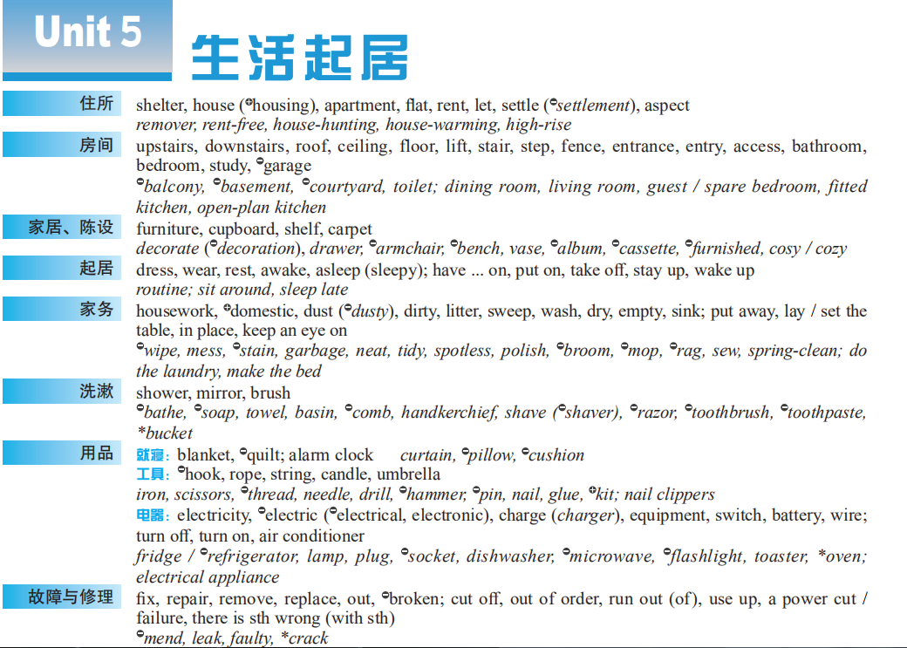
Notes:
2

Slide 3
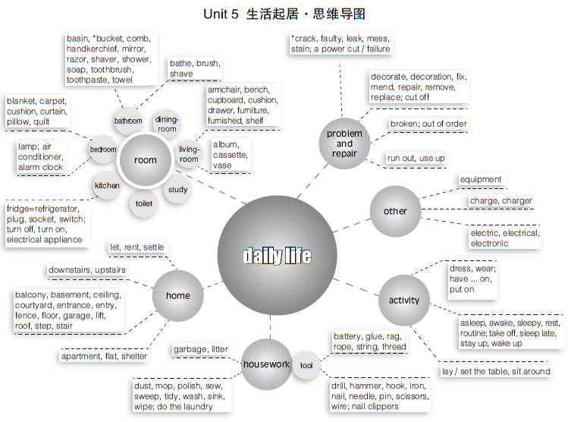


Slide 4
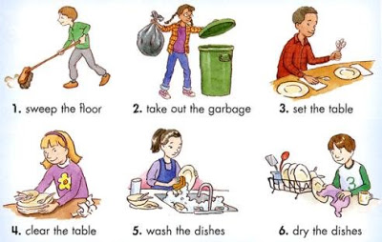
Warm up: Household duties
As the saying goes, “Many hands make light work.” Family members should share the housework. For example, the children should keep their own rooms tidy, _____________ (铺床), ____________ (摆放餐具) for meals, ____________________ (收拾餐具) and _________ (清洗餐具).
make the bed
lay the table
clear away the dishes
wash up

Slide 5
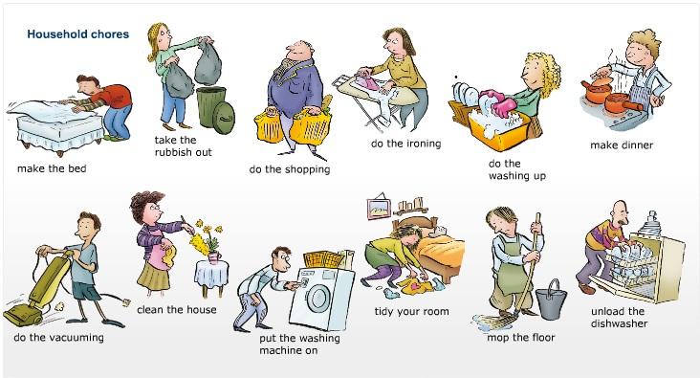
They can also wipe the dust of the furniture and take out the garbage. The mother could then concentrate on the more specialized jobs of cooking, ironing (释义_______) and mending (释义_______). Shopping at the supermarket could be a kind of family outing. The father should do more difficult physical work.
熨烫
缝补

Slide 6

Part I
基础训练

Slide 7
Teaching Guide
教学重难点 | 概念意识
charge, settle | 词源义 / 基本义
switch | 英语释义 / 精准的汉语释义
dress | 输出表达；辨析义
tape, mirror, house, shower, dirty, empty | 熟词生义：名词 / 形容词动化
cast a wet blanket, wear and tear, mend fences (with sb), sink or swim, be far removed from | 熟词生义：习语
charge, rest, ceiling, switch off, put on | 熟词生义：词源义 / 基本义
put on, run out of, cut off, stay up, keep an eye on | 词块
out of order, power failure, out, use up, run out of, turn off , switch off , be in charge of, take charge of | 同义异构

Slide 8
charge

Slide 9
charge
责任的“负荷”
主管；负责
数字的“形状”
n 负荷
load
（词源义）
金钱的“负荷”
费用；价钱
罪名的“负荷”
指控；罪名
电荷的“负荷”
电荷；电量

Slide 10
charge
■ n
A few years ago Tom _______________________________ the
company. 几年前汤姆掌管这家公司。
Your order will be sent ______________________.
您订的货物将免费送达。
Guided tours are provided ____________________.
免费提供有导游带队的观光游览。
took charge of/was in charge of
free of charge
at no charge

Slide 11


■ v
❶ (向…) 收费；开价
① charge (sb / sth) for sth:
We _______________________________.
我们免费为您送货。
② charge sb sth (for sth):
The restaurant only ___________________.
餐馆仅收了我40美元。
won’t charge you for delivery
charged me $40

Slide 12

❷指控；控告
charge sb with (doing) sth:
She ____________________________ her husband.
她被指控谋杀了她的丈夫。
is charged with murdering

Slide 13
【备考指导】
➔ charge的名词释义①②及动词释义①②考频较高；
➔ charge主要在高考听力、阅读和完形中出现，为完形词汇；
➔ take charge of, free of charge, charge (...) for ... 主要在高考听力、阅读和写作中出现。

Slide 14
settle

Slide 15
settle
人 停止移动
坐下；(使) 处于舒适的位置
人 停止奔波
（移民、殖民）定居（于）
停止移动、定下来
come to rest
（基本义）
停止/结束争论、争端、分歧、纠纷等
对某事达成一致意见；解决
计划、行程、安排等定下来
明确；确定
情绪、状态等定下来
(使) 平静；(使) 安定
物 停止移动
降落；停留
出版；刊登；发表
感觉、情绪等在某人身上/某地停止移动
围绕；充满；强烈影响着

Slide 16
settle
■ v
With so much noise outside, I couldn’t _________________my work.
外面那么吵，我无法专心工作。
She didn’t start the lesson until the pupils ______________________.
等学生们安静下来后，她才开始上课。
Most of the problems ____________________ satisfactorily.
大多数问题已得到满意的解决。
settle down to
settled down
have been settled

Slide 17
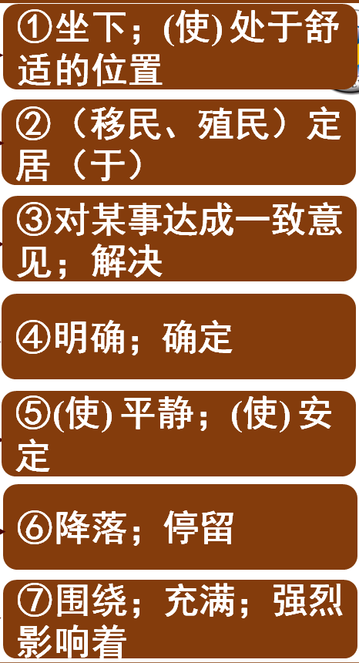
【备考指导】
➔ settle的释义❶❷❸考频较高；
settle在高考阅读和完形中经常出现，为
完形词汇；
短语动词settle down考频较高，主要出现
在高考阅读中。

Slide 18
switch

Slide 19
switch
■ v
❶ 改变；转变 to change or be changed from one thing to another
He _____________________________from one subject to another.
他转变了话题。
❷ 交换；调换 to exchange one thing for another
You drive first and then we’ll ________________.
你先开车，过一会儿咱们再换着开。
■ n 开关；电闸
________________the light switch 打开 / 关掉灯的开关
switched the conversation
switch round
turn on / off

Slide 20
【备考指导】
switch
n [C] ❶ 开关；电闸 ❷ 骤变；突变
vt & vi ❶ 开 / 关（电器等设备） ❷ 改变；转变 ❸ 交换；调换
switch off ❶ 关上（电灯、电视等） ❷［非正式用语］不听；不理睬
switch on 打开（电灯、电视等）
switch over 改变；转换
➔ switch的动词释义❷❸考频较高；
➔ switch主要在高考听力、阅读和写作中出现；
➔ 短语动词switch off释义❶在写作中出现，释义❷在阅读中出现。

Slide 21
dress

Slide 22
dress
■ v
She ___________________ a two-piece suit.
她穿着一身两件套的套装。
The students often _______________________school uniform.
学生们经常穿校服。
They __________________and try to frighten people.
他们乔装打扮试图去吓唬别人。 人教③ – 1
is / was dressed in
dress themselves in
dress up

Slide 23
辨 dress, wear, have on, put on
四者均可作“穿”解，但意义、用法不同。
dress 常含注意选择服饰，为某一正式场合而穿着得体的服装等义，既可表示穿衣动作，又可表示穿衣状态；作及物动词时，宾语为人。
• Don’t come in! I’m dressing. 别进来！我在穿衣服。
• Wait! I’m just dressing the baby. 等等！我在给孩子穿衣服。
• He got dressed in his Sunday clothes. 他穿上了自己最好的衣服。

Slide 24


wear 强调穿衣的状态，即衣服已穿在身上。
• The girl is wearing a new coat.
那个女孩穿着一件新外套。
have on 指“穿”后的状态，不用于进行时。
• She had a red jacket on.
她穿着一件红夹克。
put on 侧重穿衣的动作、过程。
• He put his coat on and hurried out.
他穿上外套，急匆匆地出去了。

Slide 25
【备考指导】
dress
vi & vt（给……）穿衣服；穿……的衣服
dress up（给……）穿上盛装；（给……）乔装打扮
n ❶ [U] 衣服 ❷ [C] 连衣裙
dressed adj［不用于名词前］穿着衣服的
➔ 短语动词dress up和(be) dressed in及派生词dressed考频较高；
➔ dress在高考听力、阅读和完形中经常出现，为完形词汇。

Slide 26
(重点词块)
用完；耗尽________________________
切掉；切断；使隔绝_________________________
熬夜 _________________________
穿上；上演 ____________________
照看；留意；密切注意____________________
run out (of)
cut off
stay up
put on
keep an eye on

Slide 27

Smart Home
A Smart Home is one that provides its home owners comfort, security, energy efficiency (low operating costs) and convenience at all times, ______________ whether anyone is home.
regardless of

Slide 28
“Smart Home” is the term commonly used to define a house that has appliances, lighting, heating, ____________________
(空气调节系统), TVs, computers, entertainment audio & video systems, security, and camera system that are capable of communicating with one another and can be controlled remotely by a time schedule, from any room in the home, as well as remotely from any location in the world by phone or internet.
air conditioning

