Slide 1

维克多英语
新方略基础课件
Unit 9
学校生活（二）

Slide 2
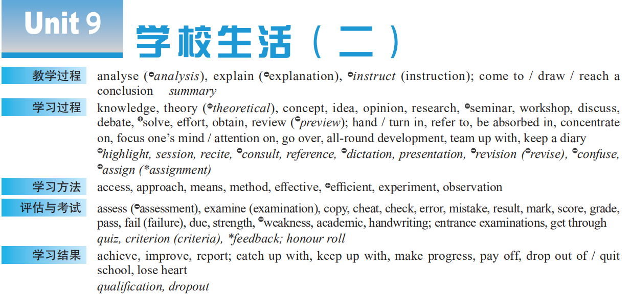
Notes:
2

Slide 3
learning processes
teaching processes
school life
learning approaches
achievements
assessment/exams

Slide 4

Warm up:
Top 3 Anime Characters with a High IQ
Able to find others’ __________ (弱点；缺点), Yagami Light (夜神月) has an ______ (使用 / 接近…的权利或机会) to Death Note, which gives him the power to judge humanity and _______ (获得) fairness.
w
eaknesses
access
a
chieve

Slide 5
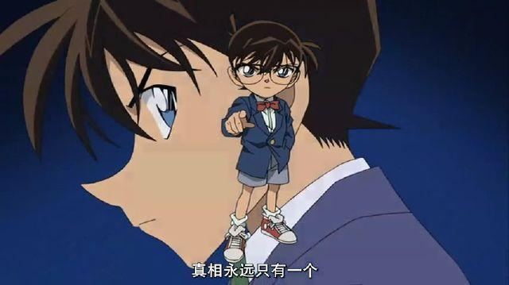
Warm up:
Top 3 Anime Characters with a High IQ
Conan, a talent in detective work, is well known for his analysis ability of ____________ (challenge) cases. Teaming up with his crew, Conan starts _______ (解决) a major case in a body of a 7-year- old.
challenging
solving

Slide 6
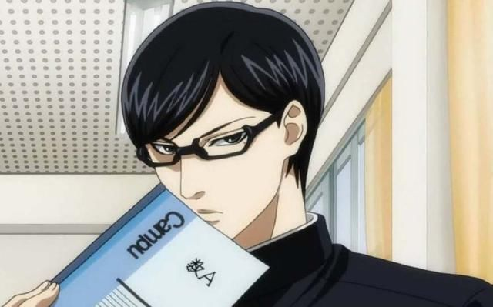
Warm up:
Top 3 Anime Characters with a High IQ
Sakamoto (坂本), a student with all-round development, is too good to be true. ____________ (专注于) his own world though, Sakamoto makes a perfect man, who has a range of “secret ________ (方法；办法)” to _____ (解决) any problem.
Absorbed in
m
ethods
solve

Slide 7


Part I
基础训练

Slide 8
Teaching Guide
教学重难点 | 概念意识
access | 释义；搭配义
strength | 词源义 / 基本义
energy, power, strength, force | 辨析义
due | 英语释义
effort, make progress, pay off , (be) absorbed in, catch up with, refer to, get through | 词块
turn / hand in, pass, get through, quit, drop out of, concentrate on, focus on, team up with, review, go over, consult, refer to, obtain, achieve | 同义异构

Slide 9
access, accessible

Slide 10
access
■ n
❶ 通道；入口
Fallen rocks cut off ___________________ the village.
坠石挡住了通往村子的唯一道路。
❷ 进入 / 到达…的方法或途径
The police _______________ through a broken window.
警察从一扇破窗钻了进去。
❸ 使用 / 接近…的权利或机会
Across the world, 1.1 billion people _______________________clean drinking water.
全世界有11亿人喝不到干净的饮用水。
the only access to
gained access
have no access to

Slide 11
■ v
❶ [正式用语] 到达；进入；使用
The road is closed but ___________________ by emergency vehicles.
这条路封了，但是应急车辆可以通过。
❷ 访问；获取 (计算机数据)
Computer users can _____________________because of the World Wide Web.
因为有万维网，计算机用户可以获取信息。外研① – 6
can be accessed
access information

Slide 12
【备考指导】
access
n [U] ❶ 通道；入口 ❷ 进入 / 到达……的方法或途径 ❸ 使用 / 接近……的权利或机会
vt ❶［正式用语］到达；进入；使用 ❷ 访问；获取（计算机数据）
accessible adj ❶ 易进入的；易得到的；可使用的 ❷ 易懂的
access:
➔ access的名词释义及其与介词to的搭配考频较高；
➔ access在高考听力、阅读、完形和写作中经常出现。
accessible:
accessible的释义❶“易进入的，易得到的，可使用的”考频较高，主要在高考阅读中出现。

Slide 13
strength

Slide 14
strength
人外在的“力”
体力；力气
形状或尺寸“合适”
人内在的“力”
意志力；勇气
力
（基本义）
由表及里
言论或情感的“力”
强烈程度；深度
由具象到抽象
安装
国家等集体的“力”
实力
符合；使……一致
由个体到群体
人或事物的优秀特质所显示的“力”
优点；长处
由具象到抽象
……
……
由人到物

Slide 15
strength
■ n
The limited edition watch is worth about 5,000 dollars.
He had a ________________ that matched his outward appearance.
他的体力与外形相称。
We need someone who _________________________ take on a difficult job.
我们需要一个有勇气承担这项艰巨任务的人。
Be aware of your own________________________________.
要清楚你自己的长处和短处。
physical strength
has the strength to
strengths and weaknesses

Slide 16
【备考指导】
strength n ❶ [U, 单数] 体力；力气 ❷ [U] 意志力 ❸ [U] 实力 ❹ [C] 优点；长处（反 weakness） ❺ [C] & [U] 强度；浓度
strengthen vt & vi 加强；巩固（反 weaken）
➔strength的释义❶❷❸❹考频较高；
➔strength在高考阅读、完形和写作中经常出现，为完形词汇；
➔strengthen常在高考阅读和写作中考查。

Slide 17
energy, power, strength, force

Slide 18
辨 energy, power, strength, force
三者都可用作动词，表“适合”之意。
energy 指人的精力、活力；物理学中指“能量”。
• Where does the little girl get her energy? 这小女孩哪儿来的那么多精力？
• the world’s energy resources 世界能源
power 指人的权力、势力、能力和物的“能力”。物理学中指
“动力”、“功率”。
• The party came to power at the last election.
这个政党在上次大选中当选执政。
• I had a strong belief in my power to get what I wanted.
我坚信能得到自己想要的东西。 2011 陕西
四者都有“力”、“力量”之意，但具体意思不同:

Slide 19
strength 指人体或物体内存在的力，如气力、耐力、抵抗力。
• She didn’t even have the strength to stand up.
她连站起来的力气都没有。
force 指外力、强迫力、破坏力 (包括武力)；物理学中指“力”。
• the force of the blow / explosion 打击力 / 爆炸力
• He took the money from me by force. 他抢了我的钱。

Slide 20
due

Slide 21
due
■ adj
[不用于名词前] 预定的；预期的 arranged or expected to happen or arrive at a particular time
Please make sure you return the book before _______________.
请确保在到期前还书。2012全国
❷[不用于名词前] 应得的；欠下的 owed to sb either as a debt or
because they have done sth to deserve it
Our thanks _____________________the whole team.
我们要向全队致谢。
it’s due
are due to

Slide 22
due
■ adj
❸ [不用于名词前] (钱) 到期的
The next income tax payment is due on January 31.
下一次的所得税支付期限是1月31日。
❹[正式用语] [仅用于名词前] 适当的；合适的 (formal) proper or suitable
He was charged with driving without _________ care and attention.
他被控鲁莽驾驶。
due

Slide 23
due to 由于；因为
I think I would be a good journalist _________________________ .
鉴于我的语言能力，我想我可以成为一名出色的记者。
北师大⑤ – 14
due to my language skills

Slide 24
【备考指导】
due adj ❶［不用于名词前］预定的；预期的 ❷［不用于名词前］（钱）到期的 ❸［不用于名词前］应得的；欠下的 ❹［正式用语］［仅用于名词前］适当的；合适的
due to 由于；因为
➔ due的释义❶❹和搭配due to考频较高；
➔ due在高考各题型中均有出现，为完形词汇。

Slide 25
effort

Slide 26
effort
■ n
The limited edition watch is worth about 5,000 dollars.
She ________________________________ her businesses, and into
helping others.
她把时间和精力投入到她的事业中，投入到帮助他人中。
What’s the point of helping him if he __________________________ help himself?
如果他自己不努力，那么帮他又有什么用呢？
puts her time and effort into
doesn’t make an effort to

Slide 27
Let’s start right now and __________________________ do a little bit every minute!
让我们现在开始努力，每一分钟都不遗余力地做好点滴。
Hospitals should __________________________ treat the sick.
医院应该尽一切努力为病人治病。
It __________________________ to find him.
费了很大劲才找到他。
spare no effort to
make every effort to
took a lot of effort

Slide 28
【备考指导】
effort n ❶ [U] & [C] 气力；精力 ❷ [C] 努力；尽力 ❸ [C]［常用于名词后］有组织的活动
➔effort释义❷的搭配考频较高；
➔effort多在高考阅读、完形和写作中考查，为完形词汇。

Slide 29
其他词块
取得进步 ________________________
还清（欠款等）；取得成功；遣散 ____________________
被……吸引住；专心致志_________________________
赶上；追上 ____________________
指的是；提到；查阅____________________
make progress
pay off
(be) absorbed in
catch up (with)
refer to

Slide 30


到达；完成；(使) 通过 ________________________
get through

