Slide 1
Man builds rotating house
so his wife can change the view
波黑一位72岁的老人自学成才，用电动机和旧军用运输车的轮子设计建造了一栋旋转房屋，只为让妻子欣赏到不同视角的风景。网友直呼：这是什么极致浪漫！
https://language.chinadaily.com.cn/a/202110/13/WS61662184a310cdd39bc6e824.html （视频链接）

Slide 2
Vojin Kusic built the home in Srbac, northern Bosnia and Herzegovina, ______ his wife Ljubica, who has a penchant for changing views.
“After I reached _______ advanced age and after my children took over the family business, I finally had enough time to task myself with granting my wife _______ wish,” Kusic said, according to AP.
for
an
her

Slide 3
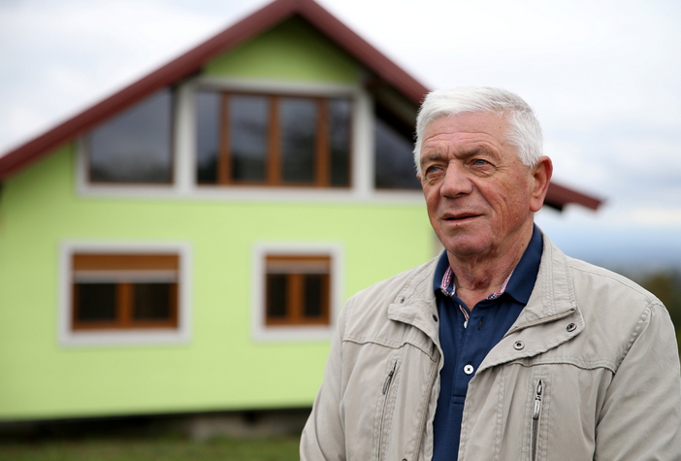
This is not the first time Kusic built a house for his family. When they first married he had built a regular, non-rotating home, _________ he and his wife raised their three children. At the time, his wife wanted their bedroom to face the sun, _____this meant their living room faced away from the road. After some time, this issue proved too much and Kusic had to get to work to switch the entire house around. “I had to tear down the wall between our two bedrooms __________(turn) them into a living room and move all (electrical) installations,” he said. "It was a very ______
(demand) task, and it took a lot from me, but I did _______ she wanted."
where
but
to turn
demanding
what

Slide 4
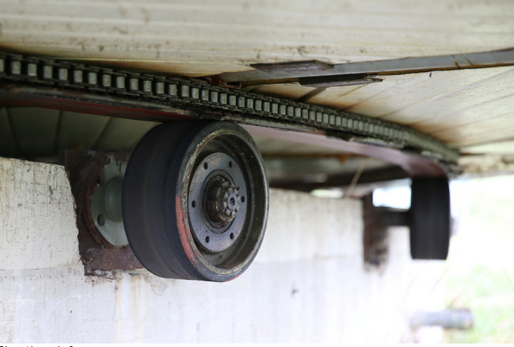
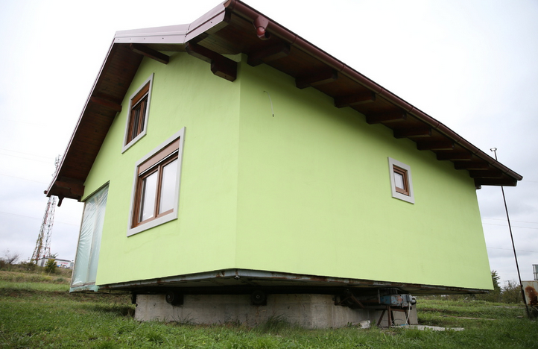
When the family moved, Kusic said he had learnt his lesson the first time around and, not ___________(want) to have to switch the home around again. He decided a rotating house would solve the problem. “Once again, this time on the ground floor, I had to start tearing down some walls, at which point, to not wait for her to change her mind again, I decided to build a new, rotating house so that she can spin it ________ she pleases,” Kusic said.
wanting
as

Slide 5
“Now, our front door also rotates, so if she spots __________(want) guests heading our way, she can spin the house and make _______turn away,” he joked.
Having never had the chance to go to university, Kusic designed and built the rotating house by himself __________ (use) electric motors and the wheels of _____ old military transport vehicle.
库西奇没有上过大学，他自己设计并用电动机和一辆旧军用运输车的轮子造出了这座旋转房屋。
unwanted
them
using
an

