Slide 1

TIME’s top artists
Time magazine just made its “100 Most I____________ People” list for 2021. The list includes politicians, CEOs, actors, artists, athletes and lawyers who have influenced the world, for better or for worse. TEENS has c__________ Bad Bunny and Kate Winslet from this year’s list. Read more about them.
nfluential
hosen

Slide 2
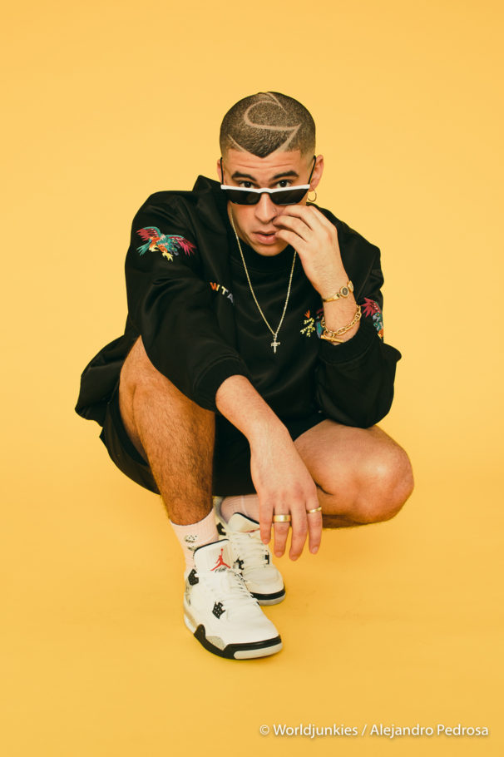
Bad Bunny, 27
It’s hard to believe that Bad Bunny is a successful US musician. When it comes to art and performance, Bad Bunny breaks the rules and does what he wants. O_________ from Puerto Rico, he sings in Spanish. Most men in Latin hip-hop try to look tough with serious names. “Bab Bunny” is a name that sounds more like a cartoon c________ than a rapper.
“I am p_______ that we are in a time where I don’t need to change anything about myself----not my m__________ style, not my language, not my culture------ It feels great to do things my way.
riginally
haracter
leased
usical

Slide 3
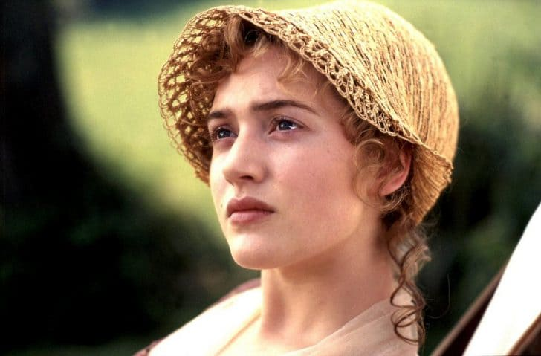
Kate Winslet, 46
You might not know her name, but you have s_________ seen one of her movies. Winslet, from England, was the star of Titanic. She comes from a family of actors. Since her first role at age 13, when she appeared in a TV cereal a_______________, she has never looked back.
Winslet refuses to just play similar roles. I________, she often appears in small, independent films. “It’s not about b__________ a film star, but trying to do good work.” Her work must be good. Last month, she won an Emmy Award for her role in the crime drama series Mare of Easttown.
urely
dvertisement
nstead
eing

