Slide 1
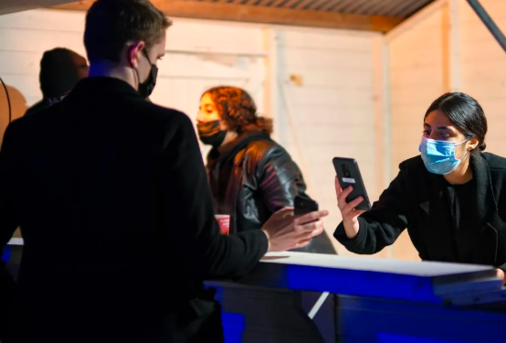

Slide 2
Britain, Germany and Italy detected cases of the new Omicron coronavirus variant on Saturday and British Prime Minister Boris Johnson announced new steps ____________ (contain) the virus, while more nations imposed restrictions ______ travel from southern Africa.
当地时间11月27日，英国、德国和意大利相继报告变异毒株相关疫情。英国首相鲍里斯·约翰逊宣布了控制疫情的新措施，更多国家对非洲南部国家施加旅行限制。
to contain
on

Slide 3
Two cases of the Omicron coronavirus variant have been detected in Britain, British Health Secretary Sajid Javid said Saturday.
He said the cases, detected in Chelmsford and in Nottingham, __________ (link) and the two individuals are now self-isolating along with their households while further tests and contact tracing take place.
are linked

Slide 4

当天，英国将26日列入红色旅行禁令名单的6个非洲国家扩展为10个：南非、纳米比亚、津巴布韦、博茨瓦纳、莱索托、斯威士兰、安哥拉、莫桑比克、马拉维和赞比亚。所有 28日凌晨4点后由这些国家入境的人都需在酒店进行10天的隔离。
Ten countries - South Africa, Namibia, Zimbabwe, Botswana, Lesotho, Eswatini, Angola, Mozambique, Malawi and Zambia - are now on the UK's travel red list, from Sunday at 04:00 GMT, all _____________(arrive) will have to quarantine in a hotel for 10 days.
arrivals

Slide 5
suspected
❶ All contacts of __________(suspect) Omicron cases will be required to self-isolate for 10 days. This is regardless of a person's vaccination status.
不论疫苗接种情况，任何变异毒株疑似病例接触者都需要进行10天自我隔离。
❷ Anyone entering the UK will require a PCR test by the end of the second day _______ their arrival and will need to self-isolate ______ they have a negative result.
所有入境英国人都应在入境第二天内进行核酸检测，得到阴性检测结果后方可结束隔离。
after
until

Slide 6
❸ Face coverings will once again be compulsory in shops and _____ public transport.
商场和公共交通上将再次强制佩戴口罩。
❹ The UK's vaccine advisory body will consider ________(give) the booster vaccine "to as wide as group as possible". It will also reduce the gap between the second dose _______ booster.
英国疫苗顾问团体将考虑“给尽可能广泛的群体”接种加强针。这也将缩短第二针和加强针之间的距离。
on
giving
and

Slide 7
A growing number of countries and regions are suspending flights ______ southern African countries due to the new variant, which has sparked serious concern _______ scientists and researchers and triggered a massive slump of stocks in Asia, Europe and the United States.
from
among

