Slide 1
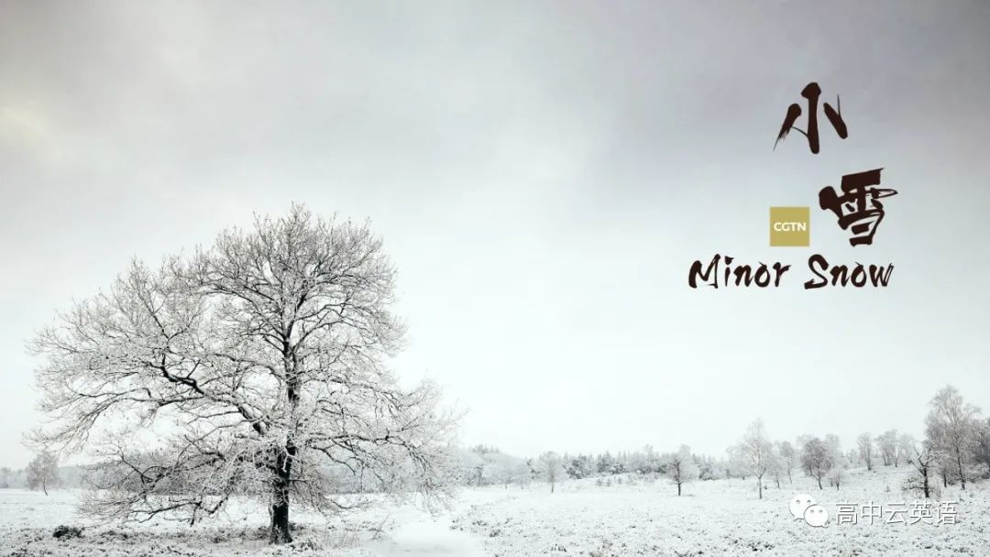

Slide 2
Minor Snow, or "Xiao Xue" in Chinese, is the 20th solar term of the Chinese lunar year, lasting from November 22 to December 6. As ___1___(indicate) by the name, the period refers to the time of year ___2___ the weather starts getting colder.
According to an old Chinese saying, "If the sky is full of snow during Minor Snow, next year ___3___(be) a harvest year." The right kind of weather during Minor Snow can benefit the ___4___(agriculture) region. Low temperatures accompanying the snow can kill some hidden pests and bacteria in the soil, which can reduce pests and diseases in the following year.
indicated
when
will be
agricultural

Slide 3
During Minor Snow, the temperature declines ___5___(sharp) and the air becomes dry. People adjust their eating ___6___(habit) to adapt to the environment. In most of north China, the temperature will drop below zero degrees. People drink more hot soups, such as radish soup, __7___(keep) them warm. Meanwhile in some areas of south China, it is customary to eat glutinous rice cakes for more energy.
sharply
habits
to keep

Slide 4
Moreover, Minor Snow is the ___8___(good) time to start making preserved foods such as preserved pork or preserved vegetables. Thanks to the cold weather, preserved food can be stored ___9___ a long time. During the Spring Festival, ___10___ couple of months later, everyone can enjoy the delicious preserved food.
best
for
a

