Slide 1
金太阳11月月考—读后续写

Slide 2
Learning aims
1. 通过快速阅读和细读，迅速抓住文本主要线索，理清故事脉络，包括故事的情节、冲突及寓意等；
2. 通过研读首句并设计问题链，预测故事发展走向，为续写打好内容基础；

Slide 3
第二节：阅读下面材料,根据其内容和所给段落开头语续写两段,使之构成一篇完整的短文。
Allan, my husband, had recently moved up the tennis league's ladder(晋级赛) and complete with someone at a similar skill level. “Do you know who your opponent is?” I asked him. My husband explained that although he knew his opponent's name. he had never met him. That's when I saw a young man-about twenty years old-at the other end of the reception area.
The young man had muscular arms and a well-built body. He was using a skip rope at quite a fast pace; I thought he might be warming up for a tennis match. I smiled at my husband and said that might be his opponent. Allan gave me a frustrated(沮丧的) look on his face, remarking it was an unusual way to prepare for a tennis match, as he continued complete his usual warm-up routine.
The league coordinator(统筹者) called out my husband's name,

Slide 4
and then she called the young man. I gave my husband a kind of smile that wives give their husband when they are encouraging them. The coordinator gave them their court number.They introduced themselves to each other, shook hands, and headed off.
The young man was dressed in the latest trendy tennis clothes and looked great. With his muscular body, he could have easily be a star athelete. Allan was at least thirty years older,much less muscular, and dressed in an ordinary tennis shirt and untrendy tennis shorts. Allan's focus had always been on good tennis shoes, socks, and , of course, the tennis racket.
When they walked onto their court, the pre-game warm-up hegan. The young man played with confidence. It was almost as if he was showing his ability. Allan Closely observed his various strokes and powerful serves, while casually returning each shot. Then began the game.
注意：1. 续写词数应为150左右；
2. 请按如下格式在答题卡的相应位置作答。

Slide 5
Para1: The young man quickly won the first round.
__________________________________________________________________________________________________________________
Para2: The young man was visibly frustrated by the end of the match.
__________________________________________________________________________________________________________________

Slide 6
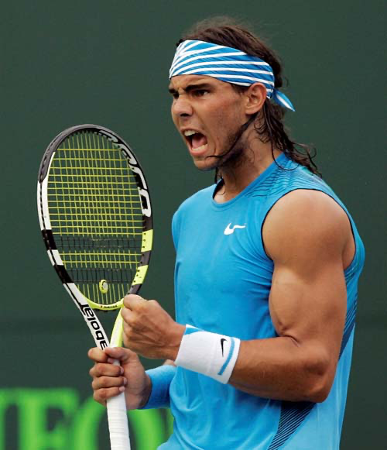
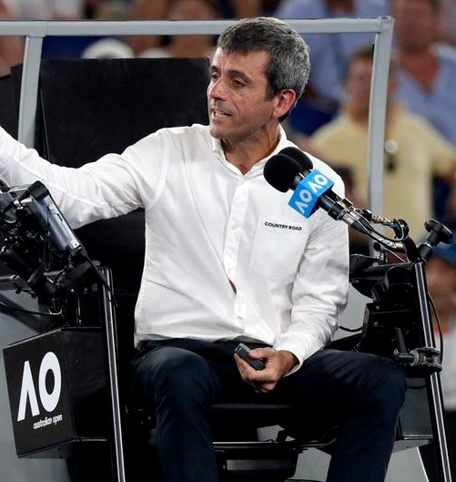
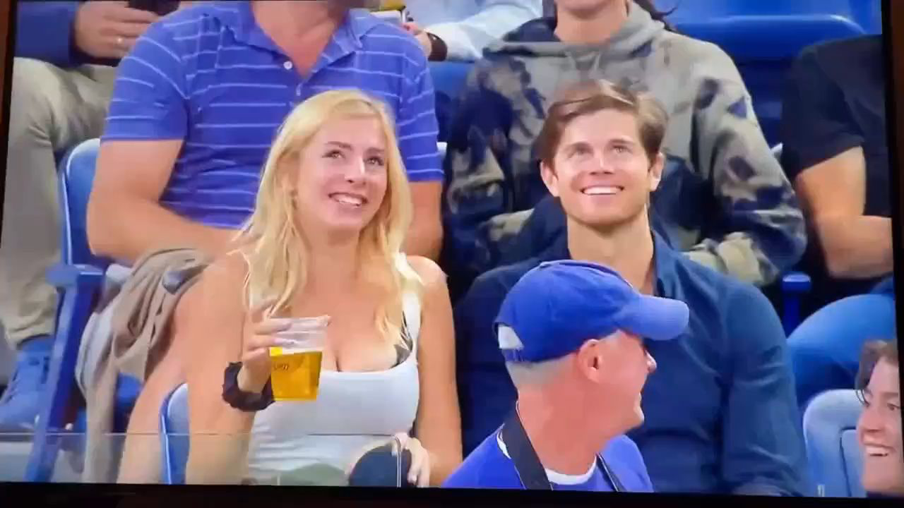
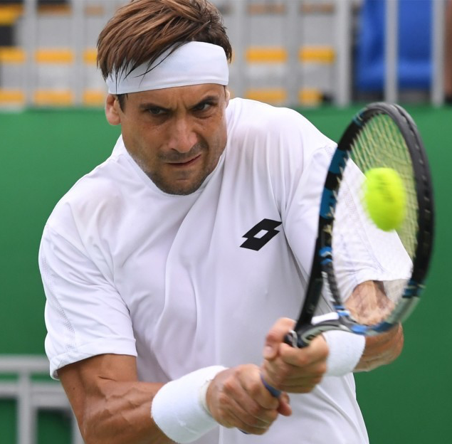
Read for characters and relationship
opponent
I
Allan
A young man
The league coodinator
统筹者

Slide 7
Find out the sentences that describe the young man's appearance.
That's when I saw a young man-about twenty years old-at the other end of the reception area. (Para1 Line4)
The young man had muscular arms and a well-built body. (Para2 Line1)
The young man was dressed in the latest trendy tennis clothes and looked great. With his muscular body, he could have easily be a star athelete. (Para4 Line1)

Slide 8
Find out the sentences that describe Allan's appearance.
Allan was at least thirty years older,much less muscular, and dressed in an ordinary tennis shirt and untrendy tennis shorts.

Slide 9
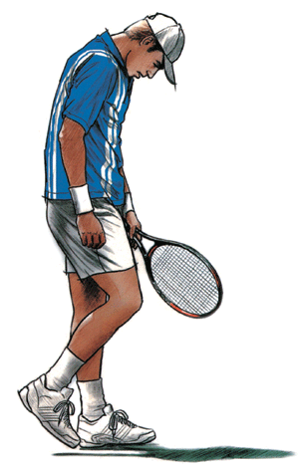
Complete the chart below to find out what Allan do and how he feel.
Recently
moved up
Allan ____________the tennis league's
ladder (晋级赛）
After seeing his opponent
Allan continued _________________.
completing his warm-up routine.
f^{rustrated}
^{unconfident}
^{casual}
After introducing themselves to each other
Allan focused on __________________
_________________________________.
his opponent's good tennis shoes, socks, and , the tennis racket.
Allan closely observed _________________________________.
During the Pre-game warm-up
his various strokes and powerful serves, while casually returning each shot.

Slide 10
What kind of person the young man is ?
The young man played with confidence. It was almost as if he was showing his ability.
confident and arrogant

Slide 11

Read for the Conflict
Allan was thirty years older,less muscular, and dressed in an ordinary tennis shirt and untrendy tennis shorts with a frustrated look and casually played the tennis.
The young man, 20 years old with muscular arms and a well-built body, dressed in the lastest clothes, showing his ability confidently.
Who will win the match in the end? and Why?

Slide 12
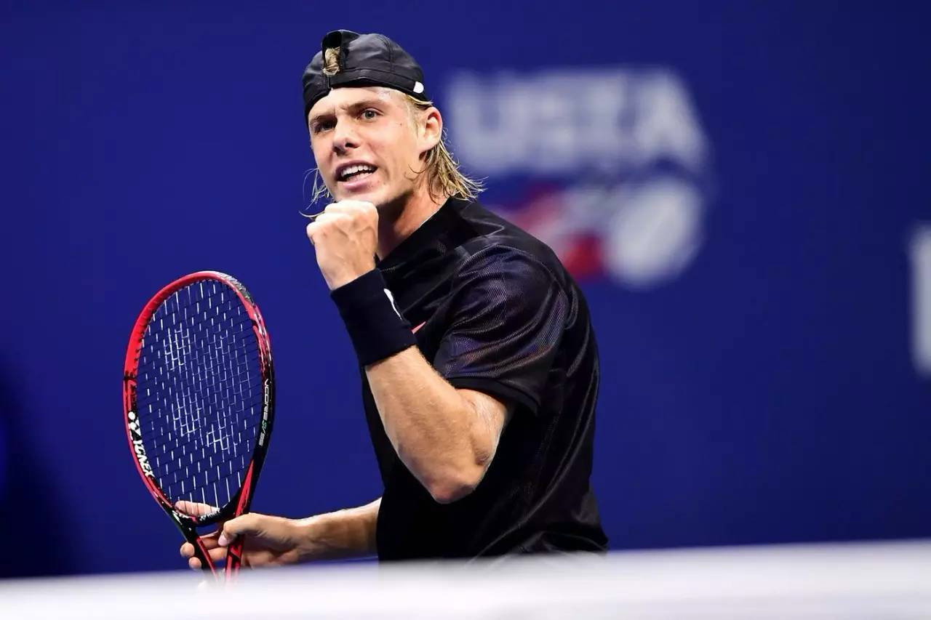
What's the theme of the story?
be confident;
believe in yourself;
don't underestimate your opponent;
experience counts in a match.

Slide 13
Tip : The development of the story can be inferred from the given information.
Para1: The young man quickly won the first round.
Para2: The young man was visibly frustrated by the end of the match.
Allan won the match.

Slide 14
Make a prediction
Work out a question chain based on the given sentences in the next two paragraphs.(问题链构思情节）+再进行细节拓展
Para1: The young man quickly won the first round.
Para2: The young man was visibly frustrated by the end of the match.
What did he do and how did he feel?
How did Allan feel and what did he do to adjust himself?
Did Allen win the second round?
Allan won the match.
What did he think?
What did Allan do?
What lesson did the story tell?

Slide 15
Appreciating a possible version
Para1: The young man quickly won the first round.
He was full of confidence at the start of the second round especially when he won the first point. I watched with amusement as they volleyed the ball back and forth, knowing well that Allan's mental toughness would win even after his slow start. Within minutes. Allan won the second round. The game continued, but the young man began to struggle and show his frustration. The final score was in Allan's favor.

Slide 16
Para2: The young man was visibly frustrated by the end of the match.
He was clearly shocked, having lost to his much older opponent. Allan shook hands with his opponent as they left the court. They were talking to each other along the way. I heard Allan say, "It's only a game- there will be others. "Knowing that Allan had been playing tennis for over forty years, the young man regretted that he shouldn't have underestimated the ability of his opponent. He thanked Allan for the lesson and left.

Slide 17
Self-assessment | Yes | No
1. 情节发展是否合理？ | .
2. 提炼的主题是否恰当？
3.上下文是否连贯？
4. 语言是否丰富？（从句，非谓语，倒装，虚拟等）
5. 语言是否和原文风格贴切？（动作，心理，神态和环境描写）
6. 语法是否正确？
7.书写是否美观（排版、字体、少涂改）？

Slide 18
Thanks!

