Slide 1
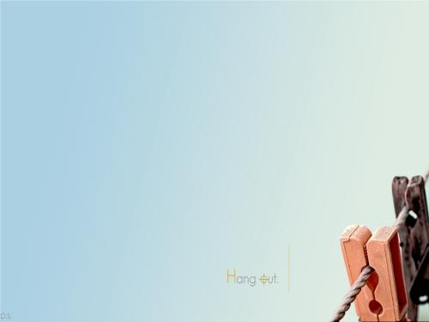
Unit 1 Making friends
----Grammar
Part A:Wh-questions
Part B:Indefinite articles: a / an

Slide 2
Part A: Wh-questions
We use Wh-questions to ask for information about someone or something.
Wh-words
(W-words&H-words)

Slide 3

Work out the rule
What is your name?
Where is she?
Who am I?
Why are you here?
Whose sister is Cici?
Where is Tony?
What do you write?
Where does she go?
Why does he always talk in class?
Whom does your mother chat with?
Whose book does Lucien read?
Where does the cat come from?
We can make Wh-questions with Wh-words and the verb
to be (e.g. am_______ and ______ ).
We use _______ or _______ to make
Wh-questions with other verbs.
is
are
do
does

Slide 4

Work out the rule
How does she do?
How often does your sister swim?
How long do you live in US?
How soon will your mother come back?
How is she?
How are you?
How is your mother?
How am I? I ask myself.
How far is it from your home to school?
How many books are there?
How much water is there?
How big is your house?
How wide is the Pearl river?
How old is your elder sister?
________
________
________
________
We can make Wh-questions with Wh-words and the verb to be (e.g. am_______ and ______ ).
We use _______ or _______ to make Wh-questions with other verbs.
is
are
do
does

Slide 5
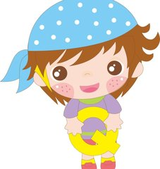
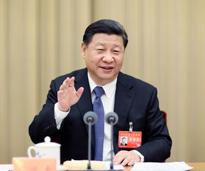
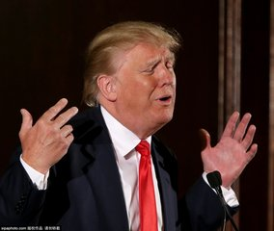
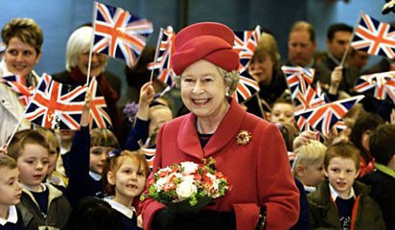
Group work in 4
Making an interview (one reporter and three leaders)
Reporter: Hi, ...
Xi Jinping:...
Trump:...
Elizabeth:...
...
Thank you!
Evaluation（评价）
content (内容） | 3’
volume(音量） | 2’
intonation（语音语调） | 3'
teamwork(团队合作） | 2’

Slide 6
More practice
1. He is my brother. ______ brother is he?
2. The bike under the tree is mine. _______car is yours?
3. The car is under the tree. ______ is your car ?
4. My father is a worker. ______ is your father ?
5. The girl is sixteen years old. _____ ______ is the girl?
6. It's twelve o'clock. ______ ______is it ?
7.It's Sunday today. ______ _____ is it today ?
8.She likes purple best. _____ _____ does she like best?
9. She goes to work by car. _____ does she go to work?
Whose
Which
Where
What
How old
What time
What day
What color
How

Slide 7
More practice
10. These pens is only 20 yuan.
_______ _______are these pens?
11.There is a computer in the room.
_______ _______ computers _______ _______ in the room?
12.I go to the library once a week.
_______ ________ do you go to the library?
13. I will be back in an hour.
_______ _______ will you be back?
14. My home is 2 miles away from my school.
_______ _______ is your home away from your school?
How much
How many
are there
How often
How soon
How far

Slide 8
Part B: (In)definite articles: a / an& the
Indefinite articles : 不定冠词 a & an
(1) a boy, a computer, a football team
a teacher, a unit, a violin
[b]
[k]
[f]
[t]
[ju:]
[v]
The rules :
(1) a + n. (beginning with consonant sounds 辅音)

Slide 9
an apple an ice cream
an egg an old book
an hour an umbrella
Summary：
(2) an + n. (beginning with vowel sounds 元音）
[ ]
[ai]
[ u]
[e]
[au]
[ ]

Slide 10
1. _____ boy 2. ______ teacher
3. _____computer 4. ______ unit
5. _____football team 6. ______ violin
7. _____apple 8. ______ ice cream
9. _____egg 10. ______ old book
11. _____hour 12. ______ umbrella
a
a
a
a
a
a
an
an
an
an
an
an

Slide 11
Discussion in pairs
What do you want to be?
I want to be a/ an doctor because the doctor can ...
I want to be a/ an...because....

Slide 12
Homework
1. Finish the exercises in Book B
2. Write down your report on three leaders.

