Slide 1

Unit 1 Making Friends
----Writing

Slide 2

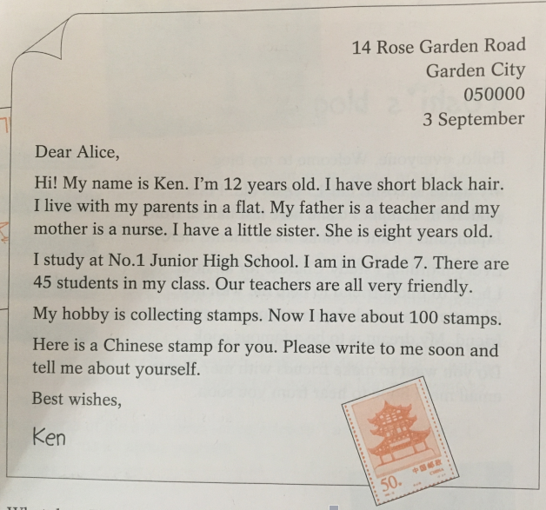

Slide 3

1. This is a letter from_____ to ______.
2. Person:
3: Tense:
4: Linking word:
5: Paragraphing:
How many paragraphs?
6: The structure :

Slide 4
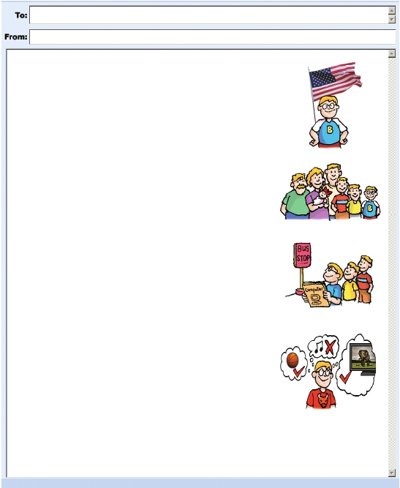
Anna
Bobby
Dear Anna,
My name is Bobby. I’d like to be your
e-friend. I’m from the US. I’m short. I have
(1)______________ hair.
I have a big family. My grandfather lives with
us. I have two (2)_____________________
and one (3)____________________. We live
in a house near New York City.
My school is very big. It’s far from our house.
I take the (4)_________________ to school every
day with my brothers. I like my school. My
(5)_________________ is to be a computer
engineer.
My favourite sport is (6)____________________.
I like swimming too. My other hobbies are
watching (7)_________________ and reading
books. I don’t like (8)__________________.
Best wishes,
Bobby
About me
yellow/ short
About my family
elder brothers
elder sister
About my school
school bus
dream
playing basketball
About my hobbies
TV
music
Discussion: find the differences between letter and Email.

Slide 5

More practice
假设你是Mike, 你愿意和Anna交朋友，请根据以下信息提示给Anna写一封完整的电子邮件介绍自己。
名字：Mike
国籍：中国
年龄：12
外貌：高个儿，黑色短发
家庭成员：爷爷奶奶，爸爸妈妈
最喜欢的科目：语文，英语，历史
爱好：游泳，阅读，放风筝
梦想：成为一名作家。

Slide 6
Show your writing and make comments
 | Classmates checking table | perfmormance
Content(内容） 4 points | He/ She can write 4 parts.
Accuracy（准确性）4 points | He/ She can use the first person. He/ She can use simple present tense. No mistakes in his/her writing.
Passage Structure（文章结构） 2 points | He/ She can use the right linking words to make the writing better.
Underline the good sentences& expressions
Total points 10 points

Slide 7
Homework
Modify your writing and then write a letter to Anna on your exercise book.
Address
Dear...
...
...
Best wishes,
Mike

