Slide 1
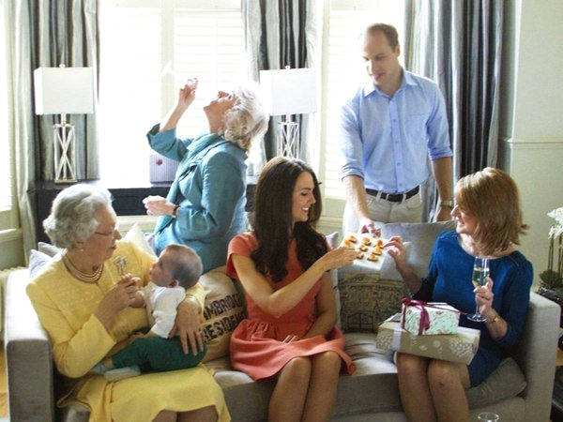
Unit2 Daily life
life at school
Notes:
When taling about daily life, which will come up to your mind first, life at school or life at home?
Today, we’re going to learn about English Ss’daily life at school.
Please watch the video and try to find out their daily activities.

Slide 2

My school day

Slide 3
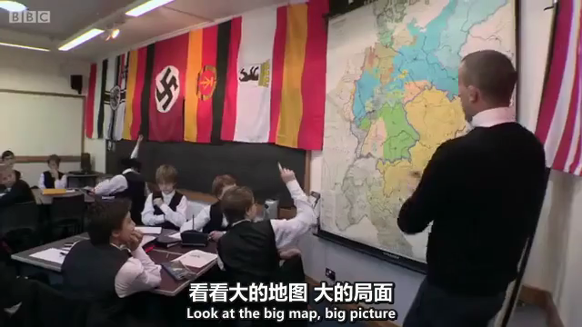
My school day
Morning activities
have __________
go to chapel
have __________
Afternoon activies
have lunch
do __________
have classes
Evening activities
do __________
_______ _______ _______ the singing competition
breakfast
homework
take part in
classes
sports
Notes:
How is this boy’s school day? busy?
Now we’re going to read about another student’s school day.

Slide 4


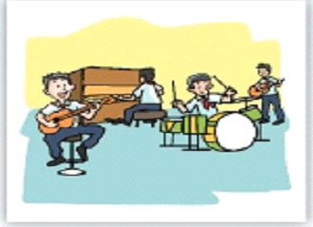
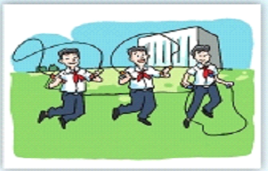
Before you read
B1 Look at the title of the article on page 17. Then circle the correct answers.
band
1 (Sam/Sam's friend) wrote this article.
2 It is about Sam's (school day/holiday).
Notes:
What can you see in each picture? Geography teacher, playing games, band

Slide 5
While reading
Read the article and match the paragraphs with the main ideas.
Paragraph 1-2
Afternoon activities
Paragraph 3
Sam is happy at school.
Paragraph 4
About Sam and his school
Paragraph 5
Morning activities

Slide 6
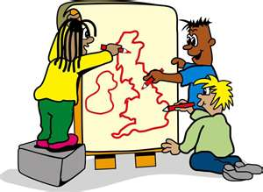
While reading
About Sam and his school
ExD1 (P19)
1 Sam is a _____ school student.
a primary b junior high c senior high
2 Sam's favourite subject is _____.
a Maths b Geography c English
Notes:
1.Junior senior
2.Geography：What can we learn from Geography classes?

Slide 7
While reading
Morning and afternoon activities
Time | Activities
_______ | Classes start
9:50 a.m.-10:10 a.m. | _______ _______
_______ | Classes
11:50 a.m.-12:30 p.m. | _______
3:30 p.m. | Classes _______
After school | _______ _______ _______
8 a.m.
a. a short time between lessons
b. a short holiday
Morning break
10:10 a.m.-11:50 a.m.
Lunchtime
end
a. stop
b. begin
School band practice
a. doing sth only once
b. doing sth again and again

Slide 8
Post reading
Fill in the timetable and compare your school day with Sam’s.
Activities | Time(Sam) | Time(Me)
Classes start | 8 a.m.
Morning break | 9:50 a.m.-10:10 a.m.
Lunchtime | 11:50 a.m.-12:30 p.m.
Classes end | 3:30 p.m.
School band practice | After school | After school
7:30 a.m.
10 minutes between two classes
12:00p.m.-12:50 p.m.
5:15 p.m.
Classes in Sam’s school start at 8 a.m., while classes in my school start at …
Notes:
I’d like you to discuss: which timetable do you think is better?

Slide 9
Which timetable do you think is better?
Why?
Post reading
We think … is better. There are two/three reasons.
On the one hand, …
On the other, …
First of all, …
Secondly, …
Finally, …
Sabc: Advisers
Sd: Note-taker
Se: Speaker

Slide 10
Homework
New words and expressions.
ExC1&C2, ExD2.

Slide 11


