Slide 1

Unit 2 Daily life
listening

Slide 2

Phrases:
after lunch
between 8 and 9 in the evening
later in the afternoon

Slide 3
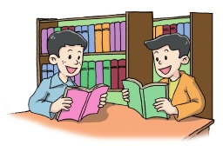
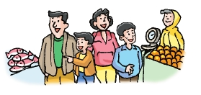
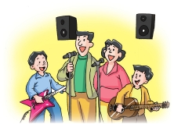

At weekends
What do these pictures show us?
Where are they?
What do they often do?
market
guitar

Slide 4

Listen and retell picture A, B, C and D.
A
B
C
D

Slide 5
Key phrases in the listening part
talk about
between A and B
later in the evening
in the library
read books
play the guitar
do one's homework

Slide 6

Lemon Tree
I'm sitting here in a boring room
it's just another rainy sunday afternoon
I'm wasting my time I got nothing to do
I'm hanging around I'm waiting for you
but nothing ever happens and I wonder
I'm driving around in my car
I'm driving too fast
I'm driving too far
I'd like to change my point of view
I feel so lonely I'm waiting for you
but nothing ever happens and I wonder
A:(I wonder how I wonder why
yesterday you told me about the blue blue sky
and all that I can see is just another lemon tree
I'm turning my head up and down
I'm turning turning turning turning turning around
and all that I can see is just another lemon tree)

Slide 7
Homework
1: Write down the retelling of listening part (Picture A, B, C and D)
2: Write a book review.

