Slide 1
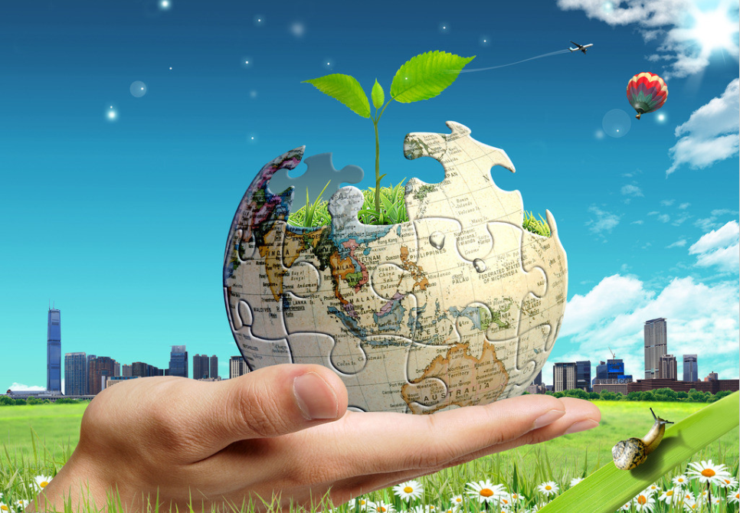
Unit 3 The Earth
Grammar

Slide 2
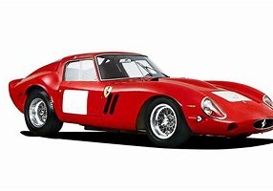
Say what you see in the picture.
a car

Slide 3
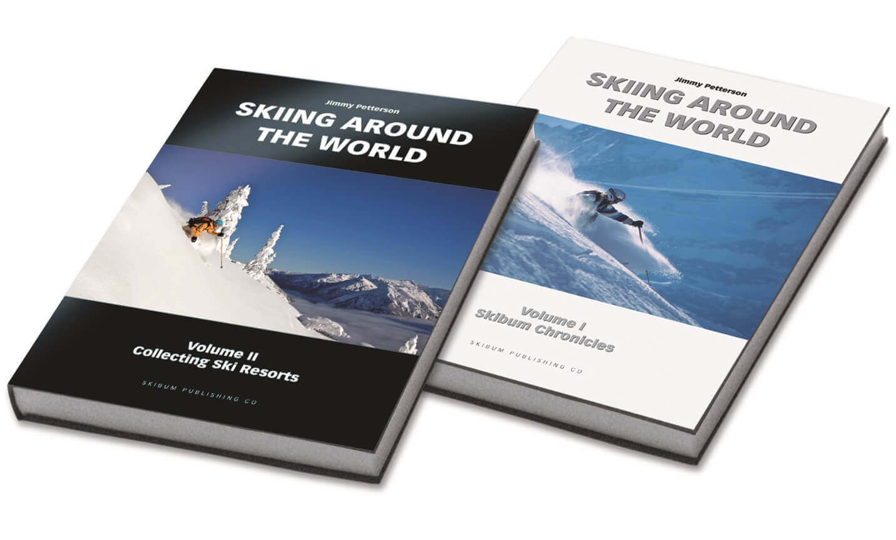
Say what you see in the picture.
two books

Slide 4
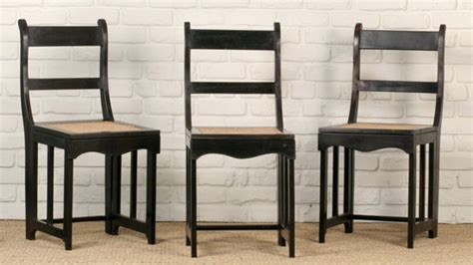
Say what you see in the picture.
three chairs

Slide 5
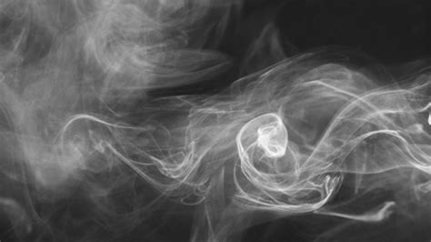
Say what you see in the picture.
smoke

Slide 6
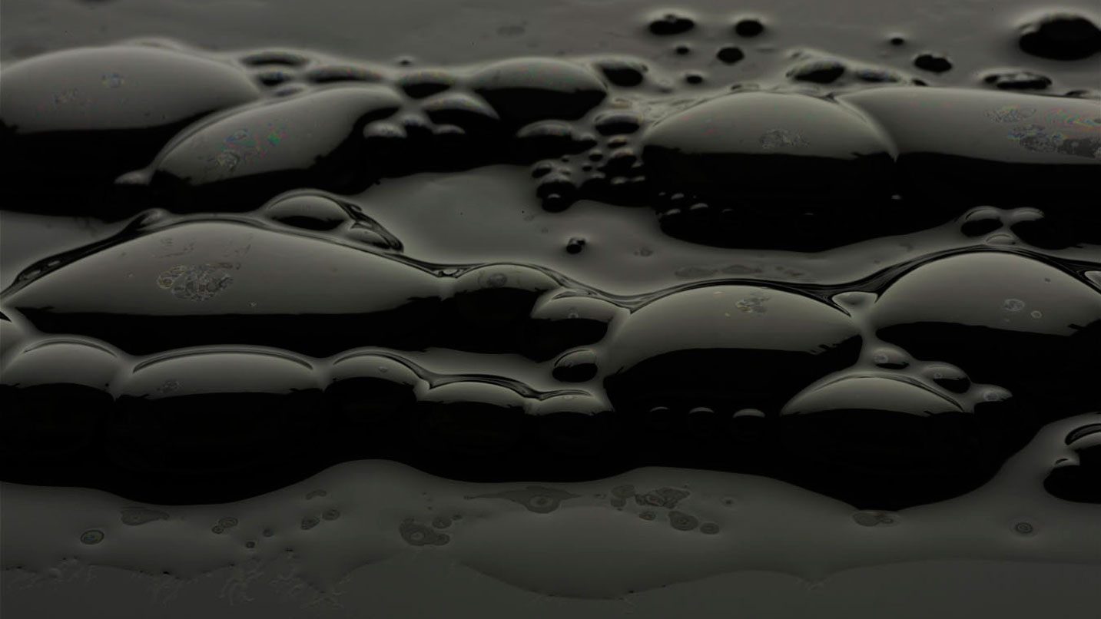
Say what you see in the picture.
petrol

Slide 7
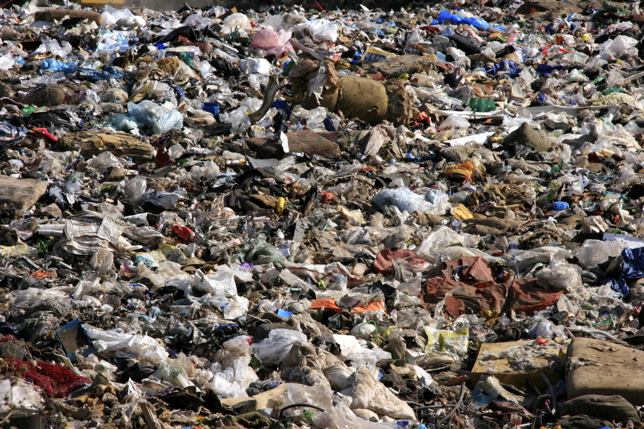
Say what you see in the picture.
rubbish

Slide 8
Grammar A
Countable nouns are words like car, book, chair. They are the names of things that you can count. You can say
“one car”, “two books” , “three chairs”
They can be singular
or plural.

Slide 9
Grammar A
Uncountable nouns are words like smoke, petrol, rubbish. These are the things that you can’t count. You can say
“smoke”, “petrol” , “rubbish”
They can only be singular.

Slide 10
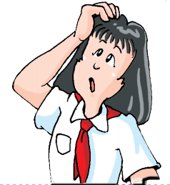
Work out the rule
• (Countable/Uncountable) nouns can have plurals.
• We can use a or an before (countable/uncountable)
nouns.
• Uncountable nouns only take (singular/plural) verbs.

Slide 11
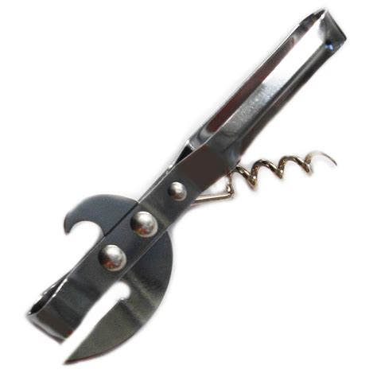
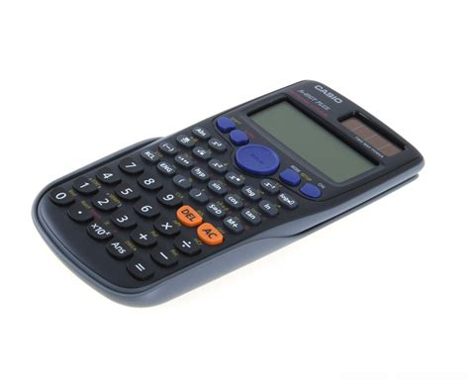
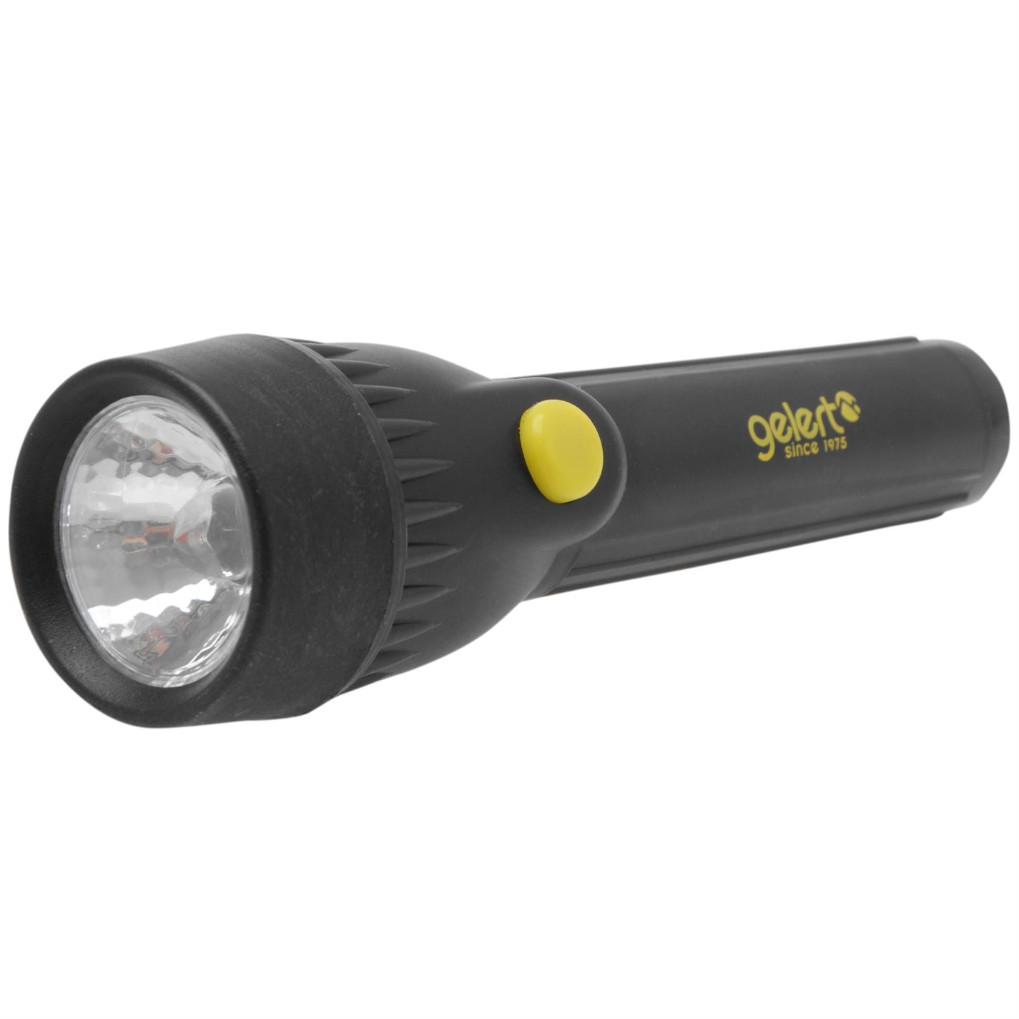
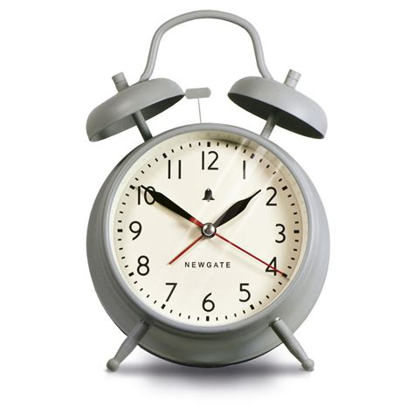
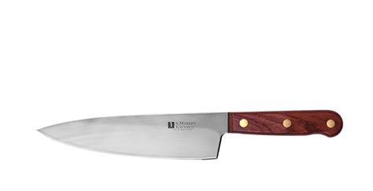
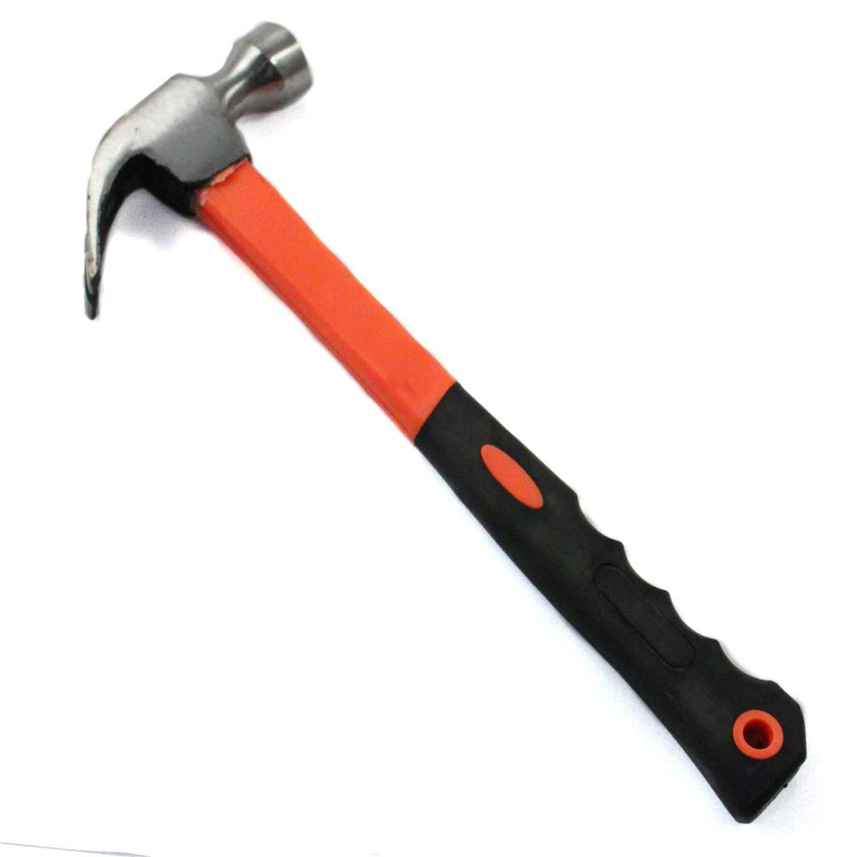
根据图片的提示，在空格处填入正确的词。
1 You use _____________ to open tins.
2 ___________ wakes you up in the morning.
3 ___________ is useful for mathematics.
4 You can see at night with _____________.
5 You can put nails into wood with _________.
6 ____________ is useful for cutting things.
a tin-opener
An alarm clock
A calculator
a torch
a hammer
A knife

Slide 12
用类指法换一种形式来表达。
1 You use _____________ to open tins.
2 ___________ wakes you up in the morning.
3 ___________ is useful for mathematics.
4 You can see at night with _____________.
5 You can put nails into wood with _________.
6 ____________ is useful for cutting things.
tin-openers
a tin-opener
Alarm clocks
wake
wakes
An alarm clock
Calculators
are
is
A calculator
torches
a torch
hammers
a hammer
Knives
are
is
A knife

Slide 13
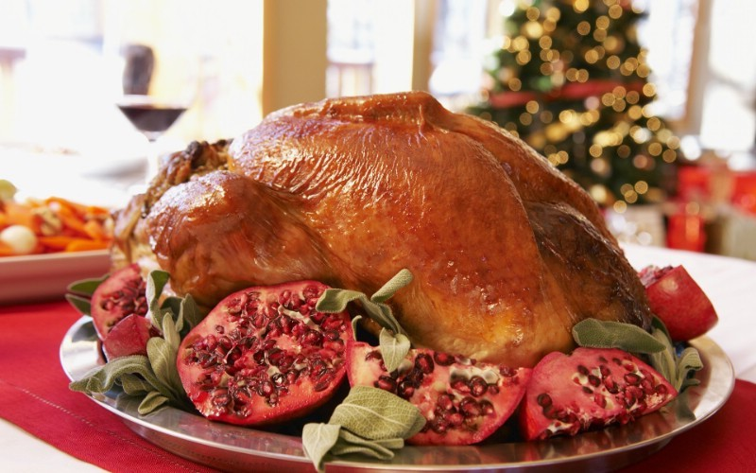
选择最佳答案填空。
( )1. --Help yourself to ______.
--Thanks. It tastes good.
A. some chickens B. a chicken
C. some chicken D. any chicken
( )2. Twelve ______ were hurt, but no ______ were
lost in that accident.
A. person, life B. people, lives
C. peoples, lives D. persons, life
C
B

Slide 14

( )3. --Thanks for giving me ______ I wanted.
--You are welcome.
A. the information B. an information
C. the informations D. a information
( )4. Could you give me ______, please?
A. two piece of paper
B. two piece of papers
C. two pieces of paper
D. two pieces of papers
A
C

Slide 15
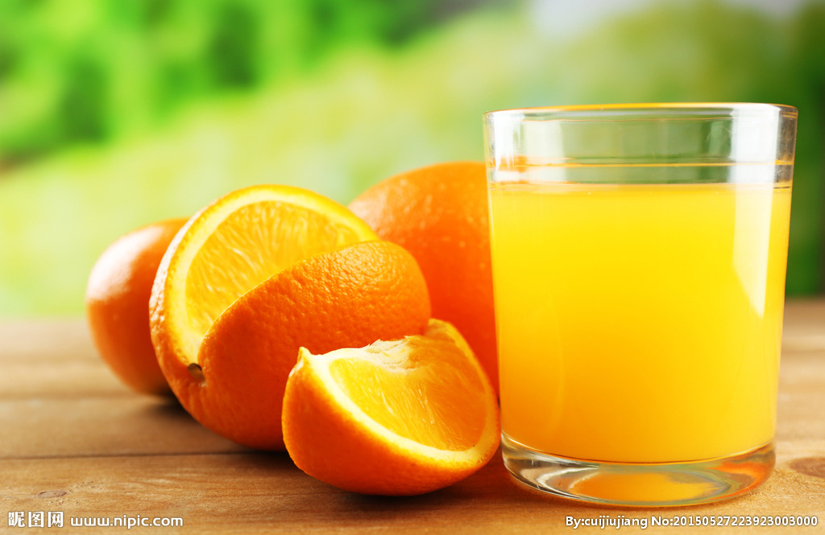
( )5. There is little ______ in the fridge. Will you
go and buy some?
A. bread B. noodle
C. dumpling D. vegetable
( )6.--Would you like some tea?
--No, thanks. I have drunk two ______.
A. bottle of orange B. bottles of oranges
C. bottles of orange D. bottle of oranges
A
C

Slide 16
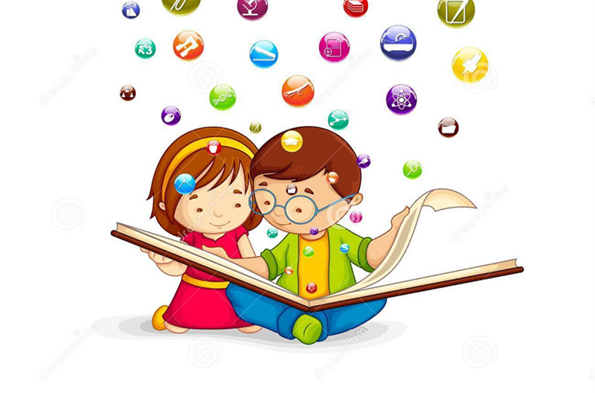
Grammar B
Using there is/are

Slide 17
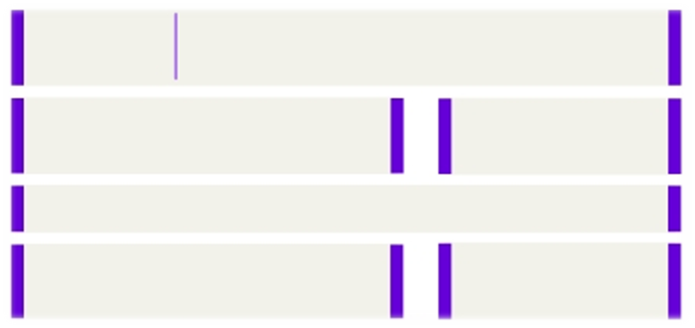

We often use there is … or there are … to say that
something exists somewhere.
a beautiful world under the water.
a lot of pollution on Earth.
There is
Is there any water in
the glass?
Yes, there is.
No, there isn't.
There are different plants and animals on Earth.
Are there five apples
in the bag?
Yes, there are.
No, there aren't.

Slide 18
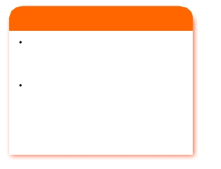
Things to remember
there is = there's
there is not = there isn't
there are not = there aren't
Note the difference below:
There is a glass of water and three apples on the table.
There are three apples and a glass
of water on the table.
•
We use ____________ with a singular noun or an uncountable noun.
We use ____________ with a plural noun.
there is
there are

Slide 19

Grammar exercise
Jane is asking Danny about what they can do to help protect the sea. Complete their conversation with there is (not), is there, there are or are there.
Jane: (1)_______ pollution in the sea. What can we do to help protect the sea?
Danny: (2)________ many things we can do. We can have a beach clean-up day. You see, (3)_________ always many bottles on the beaches. They pollute the sea.
There is
There are
There are

Slide 20
Jane: That's a good idea! What else can we do?
Danny: We can ask people not to eat shark fin soup. (4)_______ a seafood restaurant near your home?
Jane: No, (5)__________. (6)__________ any other things we can do to help?
Is there
there isn't
Are there

Slide 21
根据题目要求，完成下列句子。
1. There are some bottles of milk in the fridge.
(改为一般疑问句并作肯定和否定回答)
______ ______ ______ bottles of milk in the fridge?
Yes, ______ ______.
No, ______ ______.
2. There are ten birds flying in the air.
(就划线部分提问)
______ ______ birds ______ ______ flying in the air?
Are there any
there are
there aren't
How many are there

Slide 22

3. There is some ice on the river.(就划线部分提问)
______ ______ ice ______ ______ on the river?
4. There are some apples in the box.
(用a / an替换some改写句子)
There ______ ______ ______ in the box.
5. Is there a piece of paper on the desk?
(用three替换a 改写句子)
______ there ______ ______ of ______ on the desk?
How much is there
is an apple
Are three pieces paper

Slide 23
一. 选择最佳答案填空。
( )1. How many ______ would you like?
A. paper B. bread
C. pieces of papers D. pieces of bread
( )2. There are some ______ waiting for you outside.
A. German B. American
C. Englishman D. Japanese
( )3. Yesterday I went to the super market and bought a lot of ______.
A. tomatoes B. potatos
C. vegetable D. meats
D
D
A

Slide 24
( )4. How much are the ______?
A. bread B. meats
C. potatos D. tomatoes
( )5. There are ______ and ______ on the table.
A. two boxes cake; four bottle of oranges
B. two boxes cake; four bottle of orange
C. two boxes of cakes; four bottles of orange
D. two box of cakes; four bottles of oranges
D
C

