Slide 1
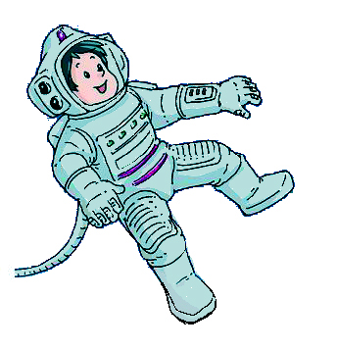

Unit 5 Visiting the Moon
Grammar

Slide 2
目录
Lead-in
1
While-Learning
2
Post-Learning
3
Review
4

Slide 3
Part I Lead-in

Slide 4
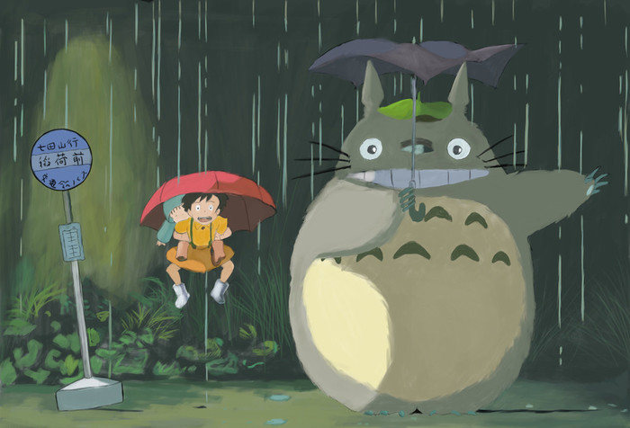
What will the weather be like tomorrow?
It will rain./ It will be rainy.

Slide 5
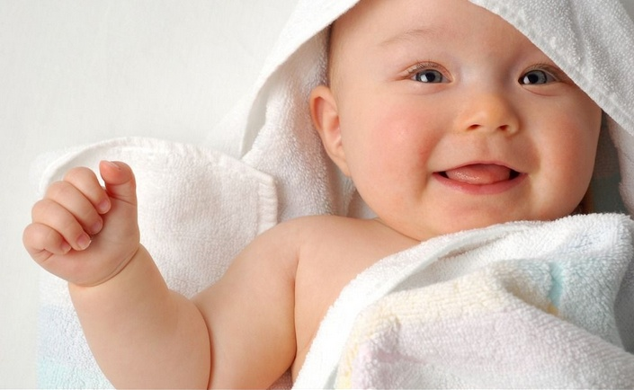
How old will the baby be next week?
She will be one year old.

Slide 6
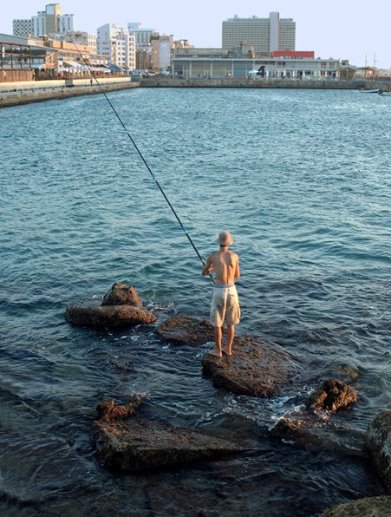
What will he do next holiday?
He will go fishing.

Slide 7
Part II While-Learning

Slide 8

Grammar A
The simple future tense (will)

Slide 10
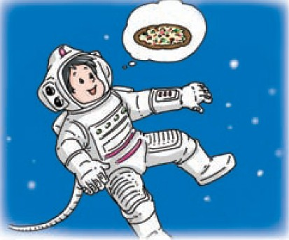
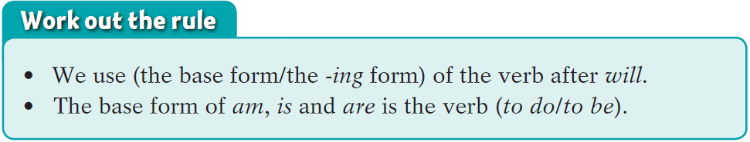
Things to remember
we'll
we will =
we will not =
we won't

Slide 11
Summary
The simple future tense (will)
一般将来时表示一个将要发生的动作或状态。常与表示将来的时间状语连用，如：
tomorrow; the day after tomorrow; next week/month/year; in three days等。
will 引导的一般将来时，基本结构：will + 动词原形

Slide 12
肯定句：
主语+ will +动词原形+（宾语）+其他
我明天要去游泳。
I will go swimming tomorrow.
否定句：
在will 的后面加not即可。will not 可缩写为 won't
我明天不会去游泳。
I won't go swimming tomorrow.

Slide 13
一般疑问句：
把will 提到句子主语之前，结尾变问号。
你明天会去游泳吗？
Will you go swimming tomorrow?
肯定回答：
Yes, 主语+will.
否定回答：
No, 主语+won't.
是的，我会去。
Yes, I will.
不，我不会去。
No, I won't.

Slide 14
Mr Green sees this advertisement. Complete his
conversation with Mrs Green using will('ll) or
will not(won't) and the words in brackets.
The Space Hotel Come and visit the Space Hotel. Wonderful views of all of the Earth and the Moon. Stay for two nights. Only ￥8,000 for a family of three! Fly from the new space centre. Call us on 677-9999 or visit our website today: www.thespacehotel.space.com

Slide 15
Mr Green: Let's visit the Space Hotel for our
next holiday!
Mrs Green: That's a good idea. What
___________(we/see) from there?
Mr Green: ______________ (We/see) all of
the Earth.
Mrs Green: __________(we/see) Mars?
Mr Green: No, ________________(we/not),
but _______________ (there/be)
wonderful views of the Moon.
will we see
We will/We'll see
Will we see
we will not/won't
there will/there'll be

Slide 16
Mrs Green: How _______________(we/get)
to the hotel?
Mr Green: _________________(We/fly) up
to the hotel in a spaceship.
Mrs Green: ______________(Tim/be) with us?
Mr Green: Oh, yes, let's take him too.
_________________(He/enjoy) it.
will we get
We will/We'll fly
Will Tim be
He will/He'll enjoy

Slide 17

Grammar B
The simple future tense(be going to)

Slide 18
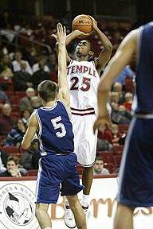
What are they going to do next Monday?
They are going to play
basketball.

Slide 19
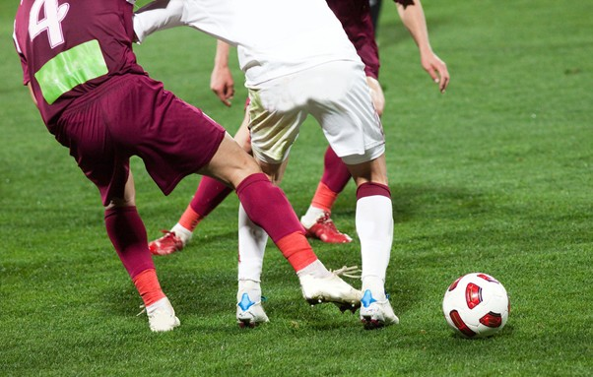
What are you going to do tomorrow?
I am going to play football.

Slide 20
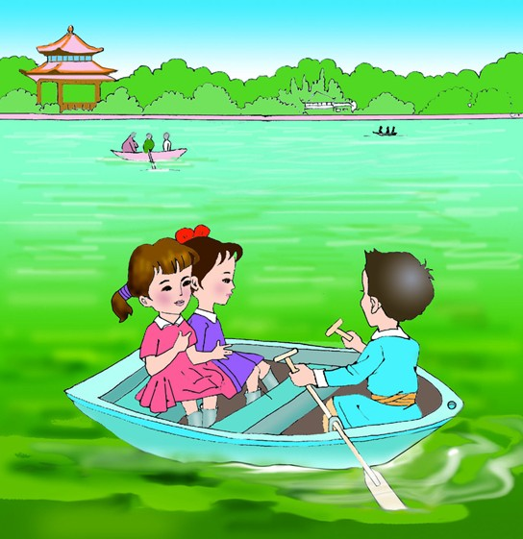
What are the children going to do next Monday?
They are going to
go boating.

Slide 21
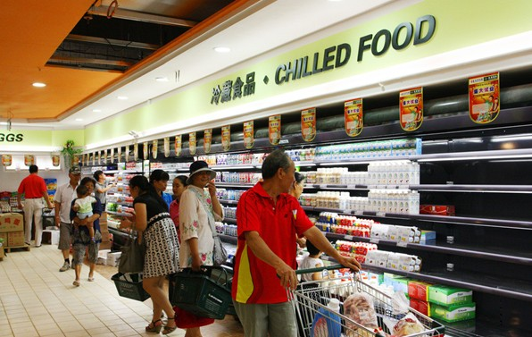
What is your grandpa going to do this Sunday?
He is going to go shopping.

Slide 22
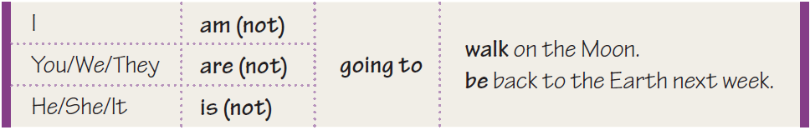
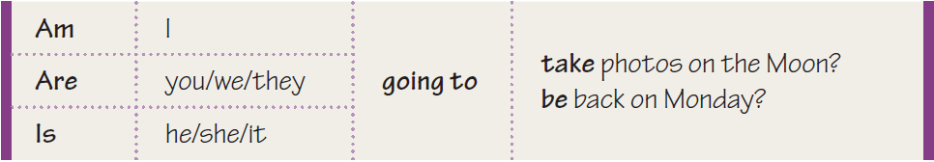
B The simple future tense(be going to)
We can use the pattern be+going to+a verb to talk
about future plans.

Slide 23
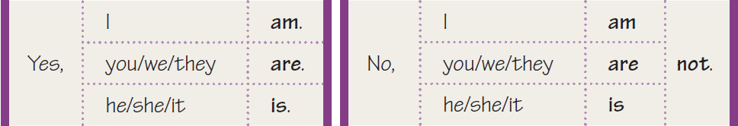
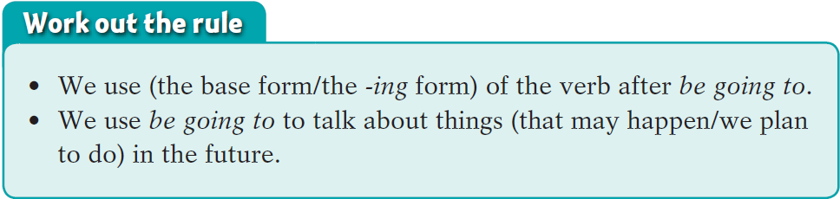

Slide 24
Summary
The simple future tense(be going to)
be going to 引导的一般将来时，表示一个事先考虑好的意图，相当于“打算、计划、准备”。基本结构：be going to + 动词原形

Slide 25
肯定句：
主语+be going to+动词原+……
我明天要去游泳。
I am going to go swimming tomorrow.
否定句：
主语+be not going to +动词原形
我明天不会去游泳。
I am not going to go swimming tomorrow.

Slide 26
一般疑问句：
be+主语+going to +动词原形…？
你明天会去游泳吗？
Are you going to go swimming tomorrow?
肯定回答：
Yes, 主语+be.
否定回答：
No, 主语+be not.
是的，我会去。
Yes, I am.
不，我不会去。
No, I am not.

Slide 27
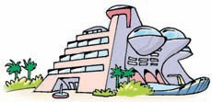
Mr Green wants to visit the Space Hotel. He is telling his son about his plan. Complete the conversation using be(not)going to and the words in brackets.
Mr Green: Come here, Tim. _______________
(I/tell) you something exciting!
_________________ (We/have) a
holiday in the Space Hotel!
Tim: Great! ___________________ (we/drive)
our car there?
I'm going to tell
We're going to have
Are we going to drive

Slide 28
Mr Green: No,______________________ (we/not
drive) our car there!
___________________ (We/travel) in a
spaceship!
Tim: Are the dogs going to come with us?
Mr Green: No. ____________________ (They/stay)
here.
Tim: _________________________(Aunt Alice /be)
here every day to feed them?
Mr Green: Yes, __________(she/be).
we're not going to drive
We're going to travel
They're going to stay
Is Aunt Alice going to be
she is

Slide 29
Part III Post-Learning

Slide 30
Disscuss
S1:What are you going to do this weekend?
S2:I'm going to visit my grandparents. What are you going to do this weekend?
S1:I'm going to do some shopping with my parents at the supermarket.
this week next week next month

Slide 31
Part IV Review

Slide 32
一. 用括号内所给单词的正确形式填空。
1. Flora _____________ (not stay) at home tomorrow.
2. — _____ she _________(be) here tonight?
— Yes, she is.
3. — How soon _____ you _________(leave)
here?
— In a week.
won't stay / isn't going to stay
Is going to be
will leave / are, going to leave

Slide 33
二. 选择最佳答案填空。
( )1. There ____ a school meeting next Friday
afternoon.
A. will be going to B. will going to be
C. is going to be D. will go to be
( )2. Mr Chan ____ us next term.
A. isn't teaching B. doesn't teach
C. isn't going to teachingD. won't teach
( )3. -- When do you have time to go travelling with me,
Mum?
-- I ____ very busy this week. I ____ free next week.
A. will be, am B. am, am
C. will be, will be D. am, will be
C
D
D

Slide 34
( )4. There ____ a tiger show in the zoo tomorrow
evening.
A. was B. is going to have
C. will have D. is going to be
( )5. I ____ you a nice present on your next birthday.
A. gave B. will give
C. gives D. give
( )6. We ____ a meeting in an hour.
A. have B. will have
C. has D. would have
D
B
B

Slide 35
三. 根据题目要求，完成下列句子。
1. I will tell you something exciting. (改为同义句)
I _____ _____ _____ _____ you something exciting.
2. Will Aunt Alice talk about her plan? (改为同义句)
_____ Aunt Alice _____ _____ _____ about her
plan?
3. Jack is going to be on a business trip in Spain.
(改为一般疑问句)
_____ _____ _____ _____ _____ on a business trip
in Spain?
4. Are they going to travel in space? (作否定回答)
_____ , _____ _____ .
am going to tell
Is going to talk
Is Jack going to be
No they aren't

Slide 36
5. They will clean the room. (改为否定句)
They _____ _____ the room.
6. Bobby is going to move to Beijing next month.
(就划线部分提问)
_____ _____ Bobby _____ _____ _____ to
Beijing?
7. The child is going to help the old men.
(就划线部分提问)
_____ _____ _____ _____ _____ the old men?
8. They will spend their holiday in London.
(就划线部分提问)
_____ _____ they _____ their holiday?
won't clean
When is going to move
Who is going to help
Where will spend

Slide 37
Thank you!

