Slide 1
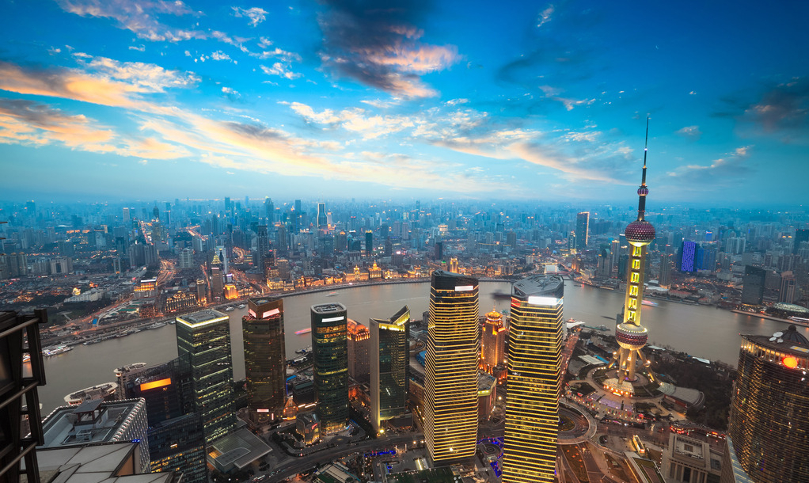
Unit 6 Travelling around Asia
Grammar

Slide 2
目录
Lead-in
1
While-Learning
2
Post-Learning
3
Review
4

Slide 3
Part I Lead-in

Slide 4
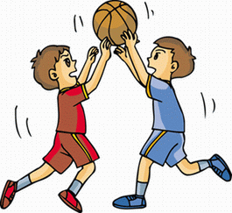
be free tomorrow, play basketball
If I am free tomorrow, I'll play basketball.
I'll play basketball if I am free tomorrow.

Slide 5
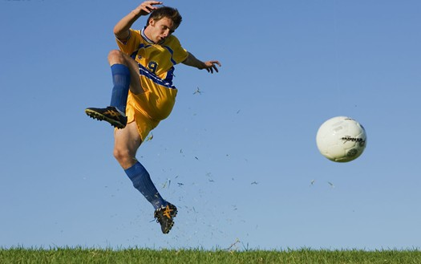
doesn't rain tomorrow, play football
If it doesn't rain tomorrow, I'll play football.
I'll play football if it doesn't rain tomorrow.

Slide 6
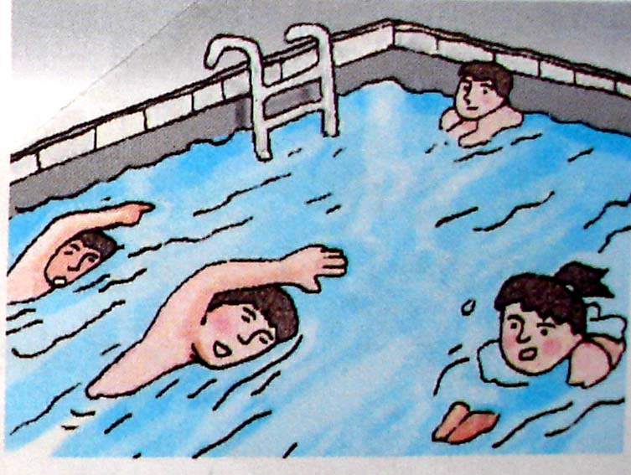
finish one's homework, go swimming
If I finish my homework, I'll go swimming.
I'll go swimming if I finish my homework.

Slide 7
if引导的条件状语从句
观察下列例句，总结if引导的条件状语从句的用法。
【例句】
1. If you stand in the rain, you get wet.
2. You get wet if you stand in the rain.
3. If it doesn't rain tomorrow, I will plant some
flowers in my garden.
4. I will plant some flowers in my garden if it
doesn't rain tomorrow.

Slide 8
Part II While-Learning

Slide 9

Grammar A
conditional sentences

Slide 10
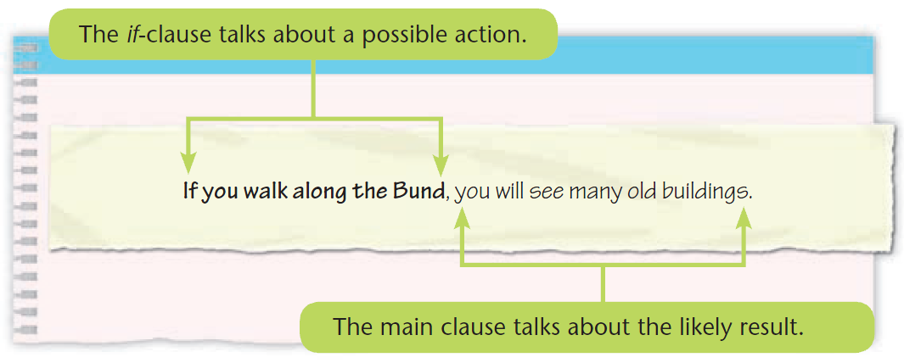
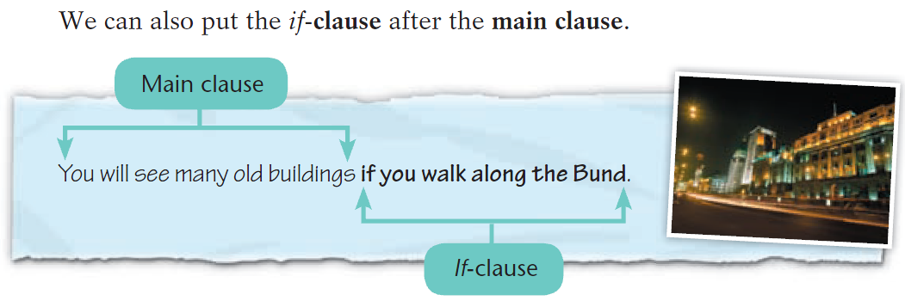
Conditional sentences (1)
We use conditional sentences to talk about possible actions and the results of these actions.

Slide 11
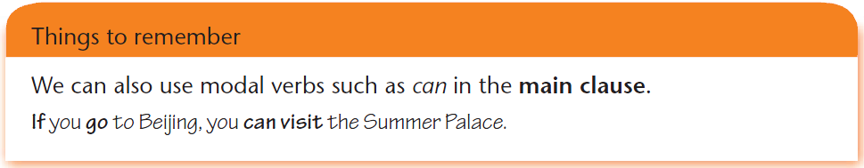
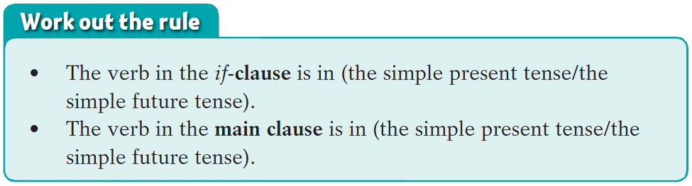

Slide 12
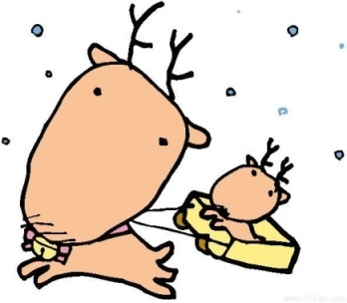
Summary
conditional sentences
1. if 意为 “____”， 引导____状语从句。当表示条件成立就必然有某种结果（常用于客观真理）时，主句和从句都用________时（例1、2）
For example:
1) If you stand in the rain, you get wet.
2) You get wet if you stand in the rain.
如果
条件
一般现在

Slide 13
当表示条件成立就可能有某种结果时，如果主
句用_________时，则从句用_________时，简称
“主将从现”（例3、4）。
For example:
3) If it doesn't rain tomorrow, I will plant some
flowers in my garden.
4) I will plant some flowers in my garden if it
doesn't rain tomorrow.
一般将来
一般现在

Slide 14
用
2. 当 if 引导的从句在主句之前时，____（用/不 用）逗号隔开两个句子（例1、3）；当主句在从句之前，则____（用/不用）加逗号（例2、4）。
【例句】
1) If you stand in the rain, you get wet.
2) You get wet if you stand in the rain.
3) If it doesn't rain tomorrow, I will plant some
flowers in my garden.
4) I will plant some flowers in my garden if it
doesn't rain tomorrow.
不用

Slide 15
条件句 | ＝ | 条件状 语从句 | ＋ | 主句
表达含义 |  | 可能 发生的 动作 |  | 可能的 结果
谓语动词 的时态 |  | 一般 现在时 |  | 一般 将来时

Slide 16
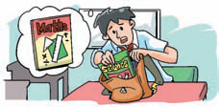
A William's mum is giving him advice about his problems. Match the half-sentences from the boxes to complete her advice for him.
William's problems
1. I sometimes bring the wrong books to school.
If you check your timetable every night，you will know which books to bring.

Slide 17
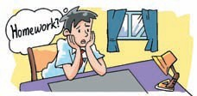
2. I was away from school today. I do not know what homework to do.
If you call your friends, they will tell you what homework to do.

Slide 18
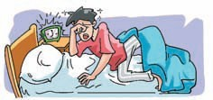
3. I hate getting up. I always feel tired in the mornings.
If you go to bed early, you will not feel tired in the mornings.

Slide 19
4. I do not know what this word means.
If you look it up in the dictionary, you will find out its meaning.

Slide 20
B Carol is giving advice to Henry. What is she saying? Use the pictures and the words in brackets to help you.
__________________ the wheels round, they_______________ easily. (make/turn)
If you make
will turn

Slide 21
2.The seeds ______________________
in the soil. (grow/plant)
will grow if you plant them

Slide 22
3. ____________ another wing, it ____________. (put on/ fly)
If you put on
will fly

Slide 23
4. ________________ your coat, you
__________ so cold. (put on/not feel)
If you put on
will not feel

Slide 24
5. The meat _______________________
in the fridge. (not go bad/put)
will not go bad if you put it

Slide 25
6. You __________________________
your classes. (see clearly/wear)
will see clearly if you wear

Slide 26
Part III Post-Learning

Slide 27

记住这个顺口溜吧！
“if条件句不一般, 几个要点记心间；
条件句，放在前, 逗号要放句中间；条件句
表可能，主句多用将来时；条件句表事
实，主句常用现在时。”

Slide 28
Part IV Review

Slide 29
一. 用括号内所给单词的正确形式填空。
1. If he ______(be) free tomorrow evening,
he will come to your birthday party.
2. I will tell her the answer if she ______(ask) me.
3. If we talk loudly in class, our teacher
______(be) unhappy with us.
is
asks
will be

Slide 30
二. 合并句子。
1. It is going to rain tomorrow.
We will not go out.
If it rains tomorrow, we will not go out.
2. She is going to post the letter now.
Her grandparents will receive it in three days.
If she posts the letter now, her grandparents will receive it in three days.

Slide 31
3. They are going to do more exercises.
They will be in better health.
If they do more exercises, they will be
in better health.
4. You are going to play with a knife.
You will hurt yourself.
If you play with a knife, you will hurt
yourself.

Slide 32
三. 选择最佳答案填空。
( )1. If it stops raining, we ____ out.
A. are go B. can go
C. goes D. to go
( )2. If you don't water the flowers, they ____.
A. died B. die
C. dying D. to die
( )3. We will go climbing ____ the weather is
fine.
A. while B. where
C. so D. if
B
B
D

Slide 33
( )4. My family and I will plant some trees in the
garden if it ____ tomorrow.
A. didn't rain B. isn't going to rain
C. won't rain D. doesn't rain
( )5. If you don't work hard, you ____ the exam.
A. can't pass B. can pass
C. will pass D. pass
( )6. If my father ____ back next Saturday, we will
go on a picnic together.
A. will come B. comes
C. is coming D. should come
D
A
B

Slide 34
Thank you!

