Slide 1
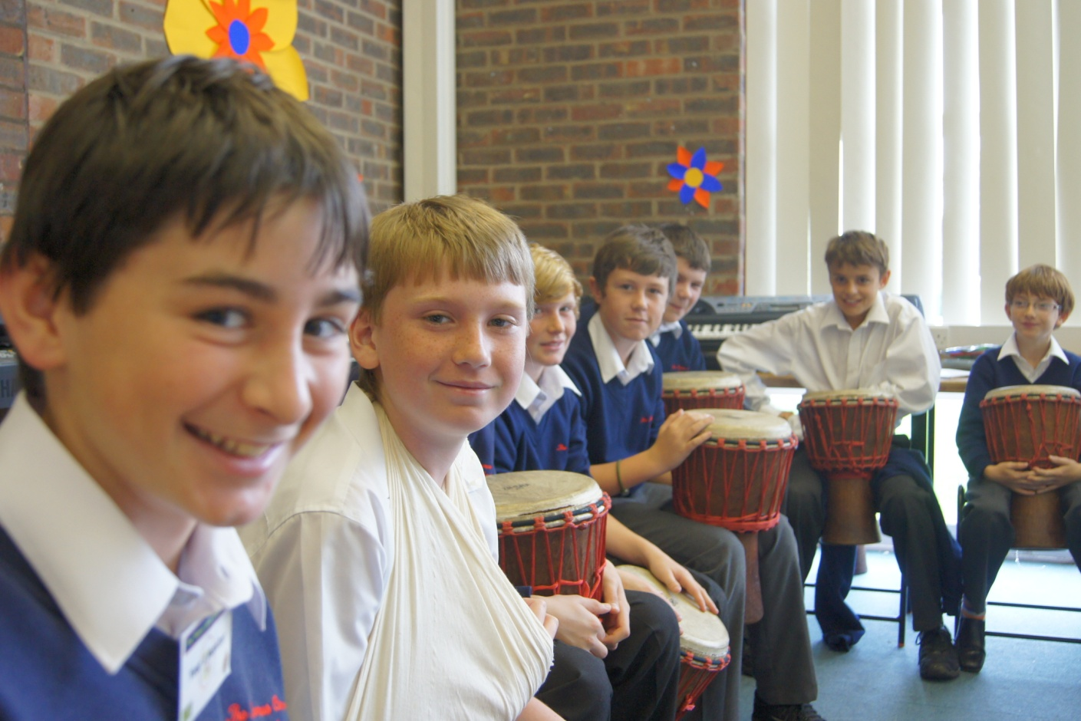
Unit 7 School clubs
Grammar

Slide 2
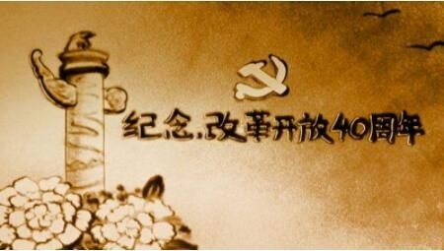
Think about what happened in 2018
关键词： The Chinese economic reform ， start,
40 years.
The Chinese economic reform started in China 40 years ago.

Slide 3
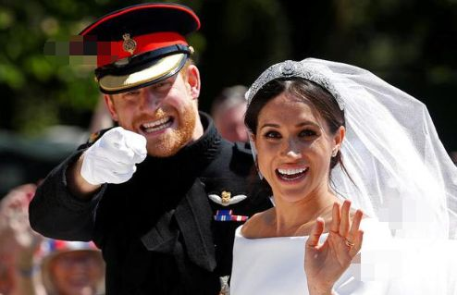
关键词： Prince Harry， marry, 2018-5-19
Prince Harry married Meghan Markle on 19 May.

Slide 4

关键词： France; win; the 2018 World Cup
France won the 2018 World Cup .

Slide 5
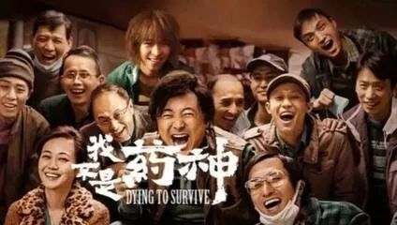
关键词： many people， Dying to Survive,
this summer holiday
Many people enjoyed the film Dying to Survive this summer holiday.

Slide 6

Grammar A
The simple past tense

Slide 7
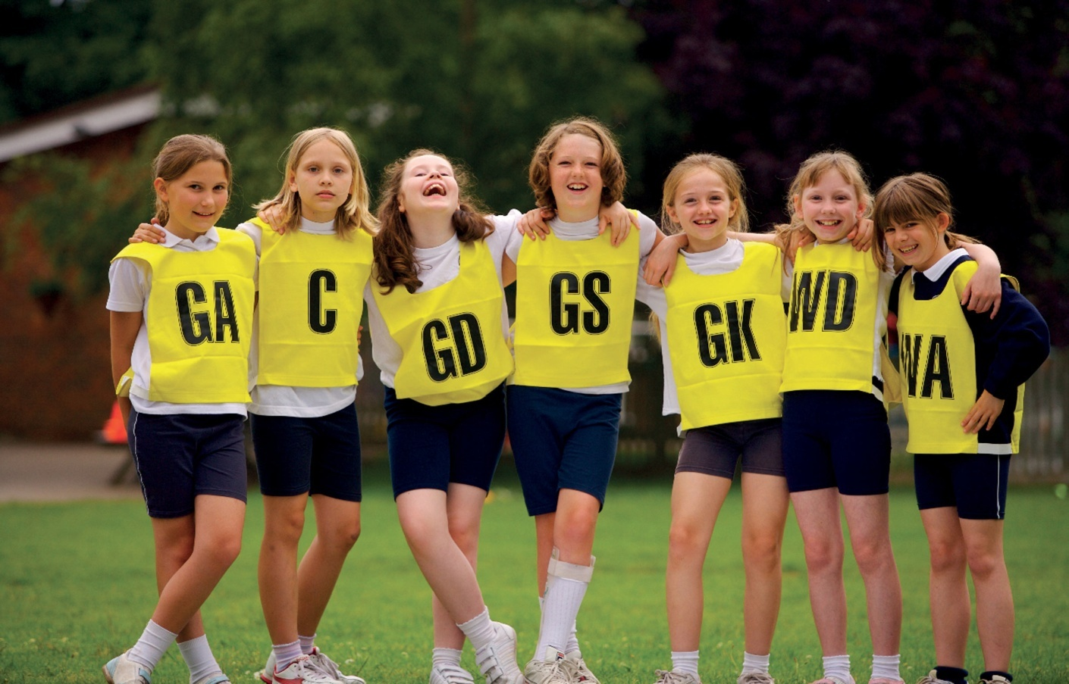
A The simple past tense
We use the simple past tense to talk about things that happened or did not happen in the past.
I attended the Clubs Fair.
You attended the Clubs Fair.
We attended the Clubs Fair.
They attended the Clubs Fair.
He attended the Clubs Fair.
She attended the Clubs Fair.
It attended the Clubs Fair.

Slide 8
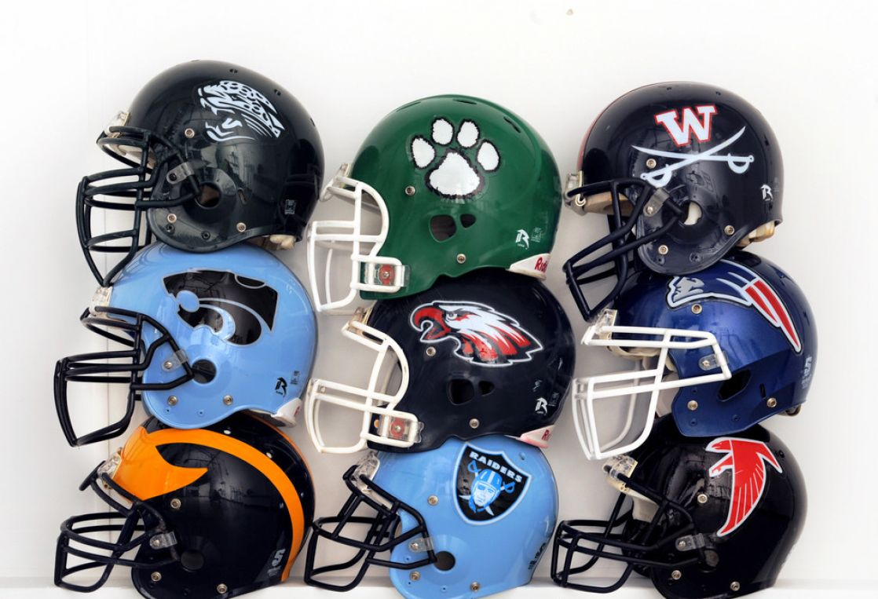
I did not attend the Clubs Fair.
You did not attend the Clubs Fair.
We did not attend the Clubs Fair.
They did not attend the Clubs Fair.
He did not attend the Clubs Fair.
She did not attend the Clubs Fair.
It did not attend the Clubs Fair.

Slide 9
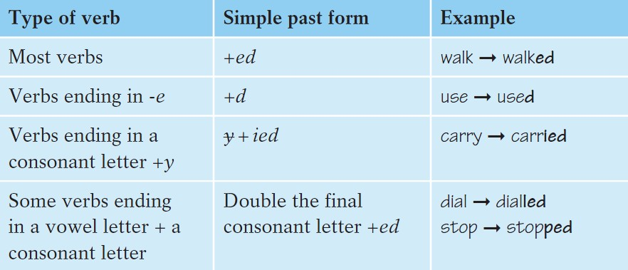
We form the simple past tense like this:

Slide 10
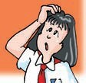
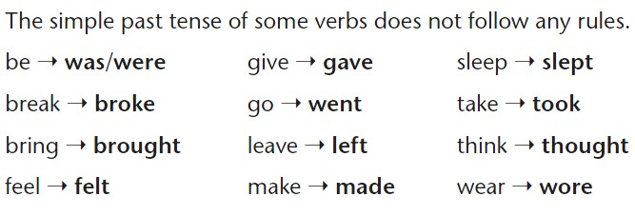
Work out the rule
For most verbs, we add to form the simple past tense.
ed
Things to remember:

Slide 11
We ask and answer Yes/No questions in the simple past tense like this:
Did | I/you/we/they/he/she/it | join | a school club?
Yes, | I/you/we/they/he/she/it | did. | *
No, | I/you/we/they/he/she/it | did not /didn't. | *
Work out the rule
We use ______, i.e. the past form of do, to ask and answer Yes/No questions in the simple past tense.
did

Slide 12
Summary
The simple past tense
1.用法：
一般过去时态表示过去发生的动作、情况或存在的状态。通常与表示过去的时间状语连用。
be动词过去式（was/were)
2.构 成：
主语+ +其它
实意动词过去式
动词如何变过去式？

Slide 13

1.一般在动词原形末尾加ed
2.结尾是 e 的动词加 d
Group One Group Two
1 play---- 1 hope----
2 look---- 2 live----
3 like---- 3 work----
4 visit---- 4 use----
5 watch---- 5 dance----
played
hoped
looked
lived
liked
worked
visited
used
watched
danced

Slide 14
3. 末尾只有一个辅音字母的重读闭音节词，双写这个辅音字母后加 ed
4. 末尾是“辅音字母+y”的动词,变“y”为“i”加 ed
Group one Group two
1 drop---- 1 try-----
2 beg---- 2 cry----
3 fit---- 3 carry----
4 prefer---- 4 worry----
5 stop---- 5 study----
dropped
tried
begged
cried
fitted
carried
preferred
worried
stopped
studied

Slide 15
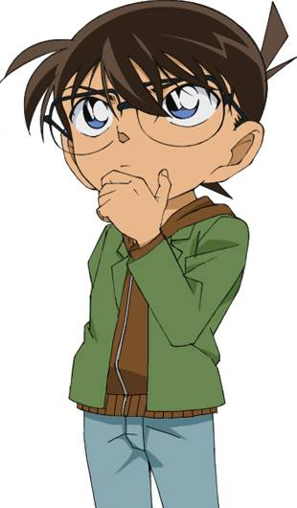
5. 不规则动词过去式需要单独记忆
Group Five Group Six
1 am/is---- 1 are----
2 have/has---- 2 do----
3 go---- 3 see----
4 take---- 4 buy----
5 bring--- 5 speak----
was
were
had
did
went
saw
took
bought
brought
spoke

Slide 16
1. be动词过去式的句式。
【否定句】
【一般疑问句】
主语+wasn't/weren't+其它
Was/Were +主语+其它
2. 实意动词过去式的句式
【否定句】
【一般疑问句】
主语+did not( didn't )+动词原形+其它
Did+主语+动词原形+其它？
肯定回答：Yes，主语+did.
否定回答：No，主语+didn't.

Slide 17
Have a try
1.I had a word with Julia this morning. (变否定句）
I didn't have a word with Julia this morning.
2.He always worked into night those days.（否定句）
He didn't always worked into night those days.
3.I was very tired last night.（一般疑问句）
Were you very tired last night?
4.German won the football game yesterday.（一般疑问句）
Did German win the football game yesterday?
5.They were absent from school two days ago.（否定句）
You weren't absent from school two days ago?

Slide 18
Last weekend, Leo went on a hiking trip. He is telling Linda about his trip. Complete their conversation with the correct forms of the verbs in brackets.
Linda: What did you do during the
weekend, Leo?
Leo: I(1)______(go) for a walk in the woods.
It(2)______(be) quite hot.
Linda: Did you (3)______(take) a cap?
Leo: Yes, I(4)_____(do). I(5)______(take)
my sunglasses too. But, I (6) _______
(drop) them onto the ground and
(7)_______(break) them!
went
was
take
did
took
dropped
broke

Slide 19
Linda: Oh, I'm sorry to hear that. What
did you do next?
Leo: I (8)______(feel) tired, so I (9)______
(sleep) under a tree.
Linda: Did you (10)______(enjoy) your
day out?
Leo: No, I(11)______(do)! I broke my
sunglasses and I
(12)______(leave) my
cap on a tree!
felt
slept
enjoy
didn't
left

Slide 20
B Time expressions with the simple past tense
We often use time expressions with the simple past
tense.
yesterday.
They went to the Clubs Fair last month.
two weeks ago.

Slide 21
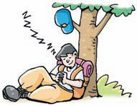
It is now 9 p.m. on 27 November. Leo is reading some sentences from his diary. What is he thinking? Complete his thought bubbles by using the correct time expressions.
1. I went to the Clubs Fair ______________.
27 September
I went to the Clubs Fair.
two months ago
27 October
I joined the Hiking Club.
2. I joined the Hiking Club__________________.
a/one month ago

Slide 22
23 November
I went to see a film.
3. I went to see a film _____________.
four days ago
26 November
I had a picnic with
my friends on
Lucky Island.
4. I had a picnic with my friends on Lucky Island _____________.
yesterday
8 p.m., 27 November
I finished all my
homework.
5. I finished all my homework ___________.
.
an/one hour ago

Slide 23
Part III Post-Learning

Slide 24
记住这个顺口溜吧！
动词一般过去时，表示过去发生事；
be用was或用were, have, has变had；
谓语动词过去式，过去时间作标志；
一般动词加-ed，若是特殊得硬记。
否定句很简单，主语之后didn't添；
疑问句也不难，did放在主语前；
如果谓语之前有did，谓语动词需还原；
动词若是was,were,否定就把not添。

Slide 25
Part IV Review

Slide 26

一. 请写出下列动词的过去式。
began
planted
said
won
spent
did
taught
stopped
1. begin _____________
2. plant _____________
3. say _____________
4. win ______________
5. spend _____________
6. do _______________
7. teach ______________
8. stop ______________

Slide 27
二. 用所给动词的正确形式填空。
1. My mother ________(wake) me up at 6 o'clock this morning.
2. Alan _________(not turn) off the light before he left the room.
3. I _________(dream) to be a star when I
_________(be) five years old.
4. Linda _________(begin) to play the guitar two years ago.
woke
didn't turn
dreamed
was
began

Slide 28
三. 选择最佳答案填空。
( )1. They ____ Taiwan last month.
A. visited B. will visit
C. visit D. are visiting
( )2. There ____ 550 students in our grade last year.
A. is B. were C. will be D. are
( )3. Mary ____ to school without breakfast this
morning.
A. will hurry B. hurries
C. hurried D. is hurrying
A
B
C

Slide 29
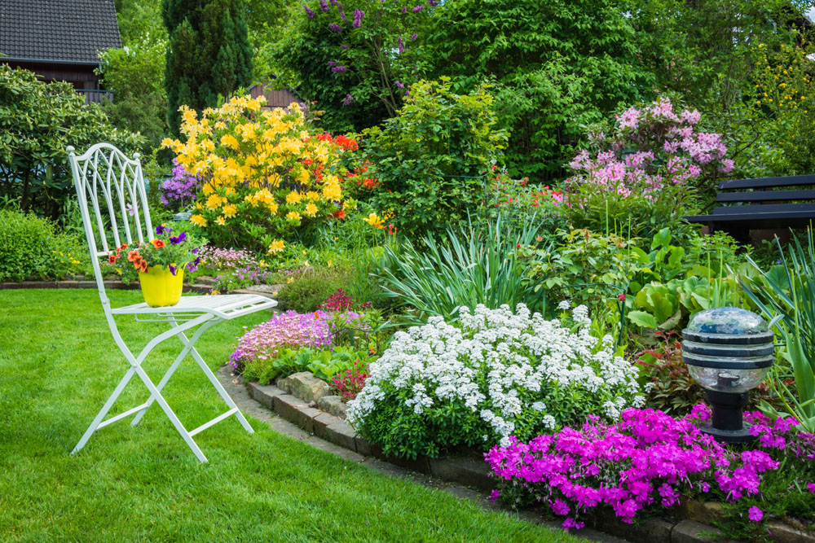
C
( )4. --Were you at home yesterday?
--No, I ____. I ____ at work.
A. wasn't, am B. am not, am
C. wasn't, was D. am not, was
( )5. -- What ____ she ____ in the garden
yesterday evening?
-- She ____ nothing.
A. was, find, found
B. was, found, found
C. did, find, finds
D. did, find, found
D

Slide 30
四. 根据题目要求，完成下列句子。
1. We built another school in this village.
(改为一般疑问句并作肯定及否定回答)
_____ _____ _____ another school in that
village?
Yes, _____ _____ .
No, _____ _____ .
2. Kate, were you happy when you met your
classmates again? (作肯定回答)
Yes, _____ _____ .
Did you build
we did
we didn't
I was

Slide 31
3. Miss Green worked as an engineer in
America. (改为否定句)
Miss Green _____ _____ as an engineer in America.
4. We spent our holiday in Australia.
(就划线部分提问)
_____ _____ you _____ your holiday?
didn't work
Where did spend

Slide 32
Thank you!

