Slide 1
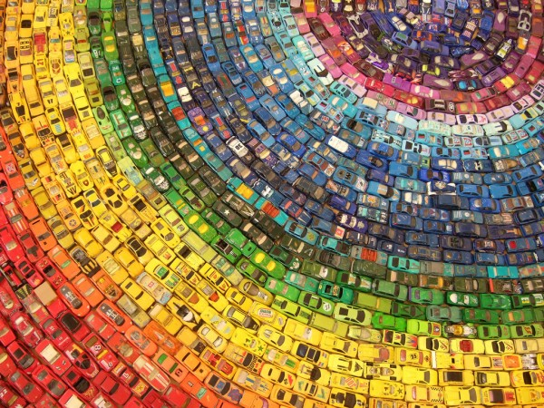
Unit 8 Collecting things
Grammar

Slide 2
Lead in--Find out the personal pronouns in the following passage.
John F. Dancer walked into the Dragon's Head Hotel with his friend Charlie. They went to the reception desk. John said, “Hi, I'm John Dancer. I booked a room last Sunday.”
The clerk said,"Yes, sir, but we don't allow pets in this hotel.”

Slide 3
We use personal pronouns to replace nouns that we have already talked about. We have subject pronouns and object pronouns.
A Personal Pronouns
 | 第一人称单数 | 第二人称 | 第三人称单数 |  |  | 第一人称复数 | 第三人称复数
Subject pronoun | I | you | he | she | it | we | they
Object pronoun | me | you | him | her | it | us | them

Slide 4
The subject is the doer of an action and is put in front of the verb.
The object is the noun upon which an action is done. It is put after the verb.

Slide 5
Sam and Helen's grandparents love collecting things. They have eight doorbells on their front door.
Helen saw a silver doorbell. She pushed it.
This silver doorbell is beautiful. What do you think of it?

Slide 6
Work out the rule
·We use pronouns in front of
verbs.
·We use pronouns after verbs
or prepositions.
subject
object

Slide 7
人称代词的用法
（1）人称代词的主格在句中做主语。例如：
I love my country.
（2）人称代词的宾格在句中作动词/介词的宾语
或作句子的表语。例如：
I don't know her.
His mother is waiting for him outside.

Slide 8
Mr Chen is speaking to his students. Complete the sentences by changing the words in brackets into pronouns.
“(1)______(Mr Chen) am happy to tell (2)______(the students) that (3)______ (everyone) will have an open day next week. Miss Smith will organize the games. (4)______ (Miss Smith) wants you to give (5)______ (Miss Smith) some ideas for games.
I
you
we
She
her

Slide 9
They
(6)______(The games) will take place in the
playground. Well, thank you for listening to
(7)______(Mr Chen). Now, Mr Wu will give you
more information. Please listen to (8)______(Mr
Wu) carefully.”
me
him

Slide 10
B Possessive adjectives and possessive pronouns
We use possessive adjectives and possessive pronouns to show that something belongs to someone or something.

Slide 11
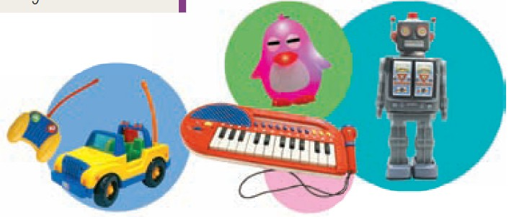
This is my phone card. It is mine.
These are our toys. They are ours.
We use a possessive adjective and a possessive pronoun like this:

Slide 12
 | Possessive adjective | Noun |  | Possessive Pronoun
This is | my | book. | This book is | mine.
 | your |  |  | yours.
 | our |  |  | ours.
 | their |  |  | theirs.
 | his/her/its |  |  | his/hers.

Slide 13
Work out the rule
Things to remember:
Its is different from it's.
It's a plant. Its leaves are green. (It's=It is)
We need to put a ______ after a possessive adjective, but we do not need to add anything after a _______________.
noun
possessive pronoun

Slide 14
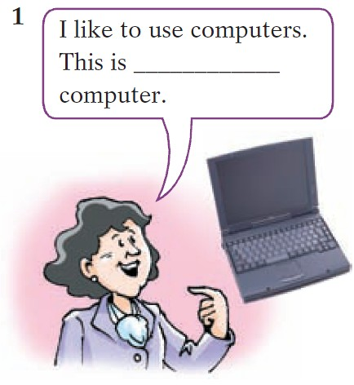
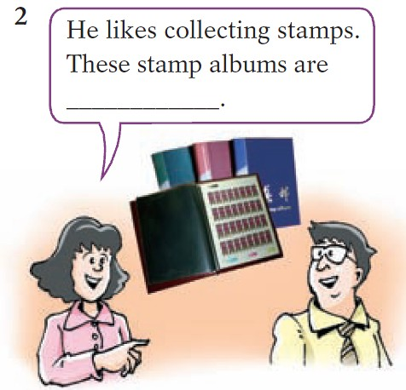
Sam's family members are talking about their hobbies. Complete their sentences with the correct possessive adjectives or possessive pronouns.
my
his

Slide 15
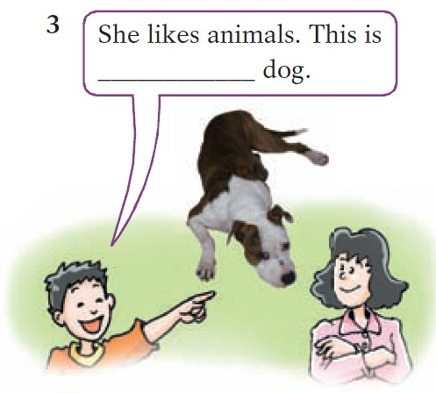
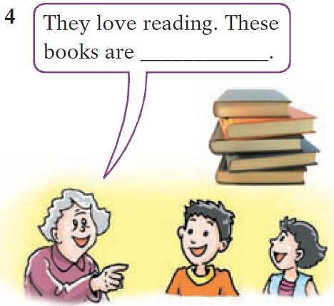
her
theirs

Slide 16
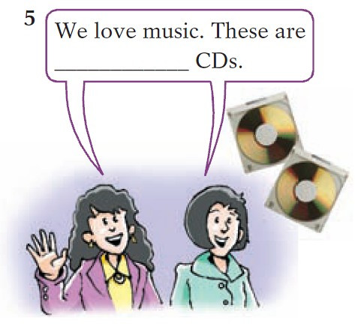
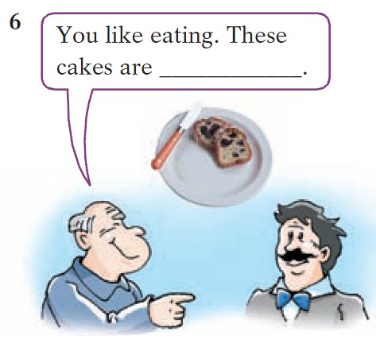
our
yours

Slide 17
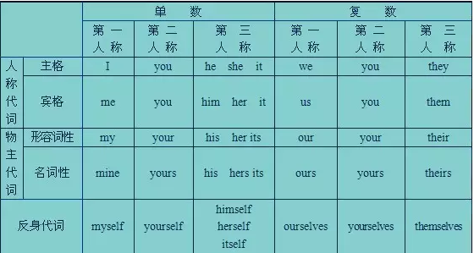
人称代词口诀
人称代词主宾格，作用不同莫用错。
主格动词前做主，动词介词后宾格。
You和it主宾同，其他主宾须分清。

Slide 18
物主代词口诀
物主代词分两种，形容词性名词性。
形容词性能力差，自己不能来当家。
句子当中作定语，身后定把名词加。
物主代词名词性，相当名词可单用。
句中充当主宾表，身后没有名词影。
两种代词形不同，添个 s 形变名。
his,its不用变，my变mine要记清。

Slide 19
一. 根据句意，用人称代词的适当形式填空。
1. Ann's new teachers are kind to ______.
2. Mr Black is my English teacher. ______ is very
kind.
3. Lily likes music. ______ listens to music
every morning.
4. John lives with his grandparents and he often
does morning exercises with ______.
5. --Mum, where is my school bag?
--______ is on the desk.
her
He
She
them
It

Slide 20
us
6. Andy is a helpful boy and he often helps ______
with our English.
7. Wake up, Tom. It's 7:30 a.m. ______ will be late
for school.
8. Mr Wang is my Chinese teacher and I like
______ very much.
9. Look at the boys and girls over there. ______
are singing and dancing.
10. My sister often teaches ______ some English
songs. I like to sing with her.
You
him
They
me

Slide 21
二. 从括号中选择适当的词填空。
1. This is ______(my / mine) English book. Where is ______(yours / your)?
2. The girl is Cindy. ______(She / Her) sister can play the piano very well.
3. These are ______(theirs / their) chairs and ______(our / ours) are in the next room.
4. Here is my dog. ______(Its / It's) name is Toby.
5. ______(He / His) bike is so old that it can hardly work.
my
yours
Her
their
ours
Its
His

Slide 22
三. 选择最佳答案填空。
( )1. He is an Australian. ____ name is David.
A. He B. Him C. Himself D. His
( )2. Could you help ____ with ____ Maths,
please?
A. I, my B. me, me
C. me, my D. my, I
( )3. ____ will go to the Canton Tower tomorrow.
And my brother will go with ____.
A. Us, we B. We, us
C. Our, us D. Ours, our
D
C
B

Slide 23
( )4. ____ dress is beautiful. But ____ is more
beautiful than ____.
A. Kates', my, her
B. Kate's, mine, hers
C. Kates', mine, her
D. Kate's, my, hers
( )5. My classmates like singing very much. Most
of ____ join the Music Club.
A. they B. their C. them D. theirs
( )6. How hard ____ works!
A. we B. her C. she D. hers
B
C
C

