Slide 1

Unit 3

Slide 2
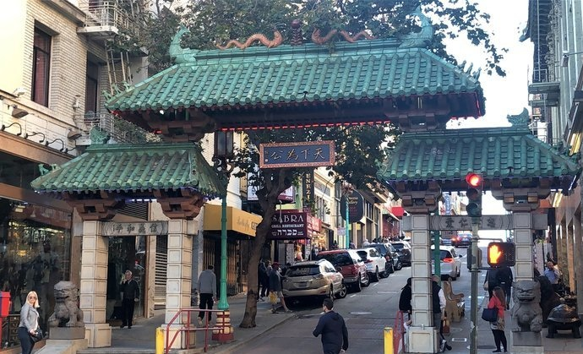
Unit 3
DIVERSE CULTURES

Slide 3


Slide 4



To consolidate and check what you have learnt in this unit when it comes to vocabulary
To consolidate and check what you have learnt in this unit when it comes to grammar

Slide 5

Complete the following sentences using the correct forms of the words in the box.
admit, claim, diverse, downtown, fold, mild,
mission, occur, select, settle, suit, super
1. The population of this district is quite ________,with immigrants from many countries ________ here.
2. When Columbus landed in the New World, he ________ the land for Spain.
diverse
settling
claimed

Slide 6
admit, claim, diverse, downtown, fold, mild,
mission, occur, select, settle, suit, super
3. The famous bar street is located in the ___________ area of the city. A large number of restaurants and cafés have opened along the street since 2000.
4. I don’t think a man’s main _______ in life is to earn as much money as possible. My dream is to live a more meaningful life.
5. It was confirmed that a ______ earthquake _________ at
6:37 p.m. on Saturday evening in Hebei Province, causing no damage.
downtown
mission
mild
occurred

Slide 7
admit, claim, diverse, downtown, fold, mild,
mission, occur, select, settle, suit, super
6. She really did a ______ job. I must ______ that she is the best designer that I have ever met.
7. We have a range of gifts to ______ all tastes, and we also have a programme that can make it quicker and easier for you to ______ from our products.
8. He arranged all the books in a neat row and then put his _______ clothes away.
super
admit
suit
select
folded
adj. 整齐的

Slide 8
Simplify the underlined sentences using ellipsis.
A: We’ve got to write a paper on music in US. Do you have ideas about what kinds of music are popular there? I only know hip-hop seems popular.
A: Can you give an example of this?
Any ideas what’s popular there?
For example? / Like what?

Slide 9
A: So, do you mean they have something like a subculture?
B: Well. Not only is country music popular in the south, but blues, rock and roll, bluegrass, and jazz are popular in the south as well.
A: Ah, of course they are popular! I forgot about New Orleans jazz!
You mean a subculture? / So, like a subculture?
Not only country music, but blues, rock and roll, bluegrass, and jazz as well.
Ah, of course!

Slide 10

Now role-play the conversation. Pay attention to how ellipsis is used.
A: We’ve got to write a paper on music in US. Any ideas what’s popular there? I only know hip-hop seems popular.
B: Yeah. Hip-hop is generally popular in the US, but different parts of the country listen to different types of music.
A: For example?
B: Well, for example, in southern US, they have their own culture.

Slide 11
A: You mean a subculture?
B: Right. The history in that region has given them a different identity.
A: Country music is popular there, right?
B: Well. Not only country music, but blues, rock and roll, bluegrass, and jazz as well.
A: Ah, of course! I forgot about New Orleans jazz!

Slide 12



What did you learn about cultural diversity in this unit?
What else would you like to know about different cultures around the world?
What was the most interesting thing that you learnt in this unit?
What problems did you have in learning this unit?
Overall, I thought this unit was
interesting useful so-so difficult

Slide 13


