Slide 1
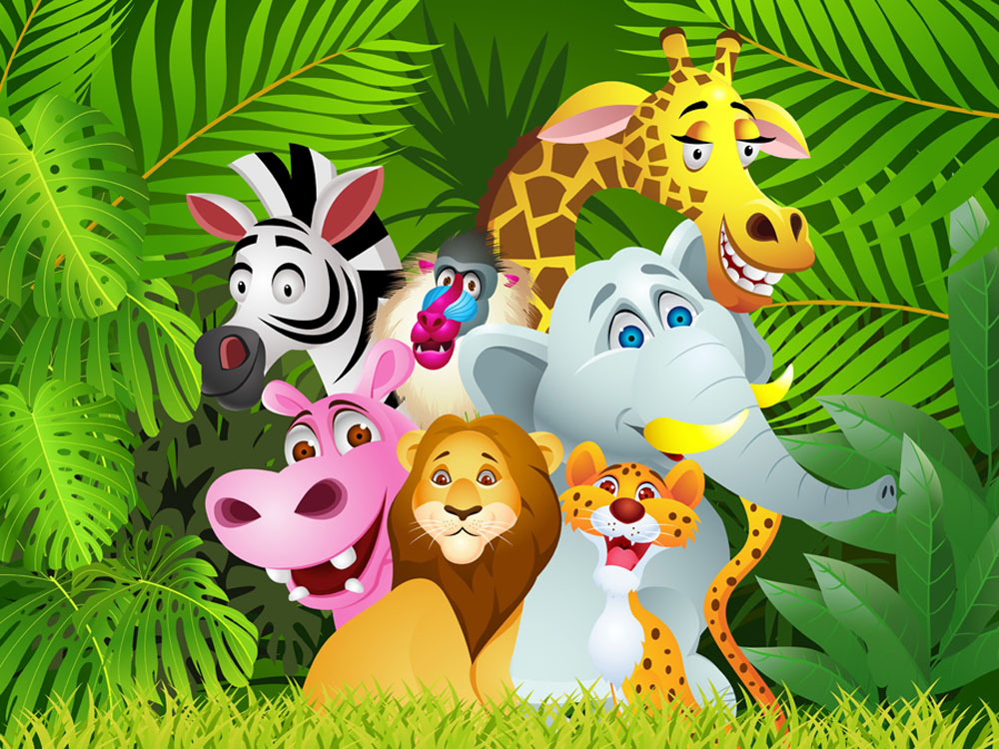
Unit 5 Save the endangered animals
Grammar

Slide 2
目录
Lead-in
1
While- Learning
2
Post- Learning
3
Review
4

Slide 3
Part I Lead-in

Slide 4
1) 对我们来说，保护熊猫是重要的。
It is important for us to protect giant pandas.
2) 对人们来说，挽救濒临灭绝的动物是有好
处的。
It is good for people to save endangered
animals.
It’s + adj + for + sb + to do sth
对某人来说，做某事是……的

Slide 5
It is important for us to protect giant pandas.
To protect giant pandas is important for us.
It is good for people to save endangered animals.
To save endangered animals is good for people.

Slide 6
Part II While- Learning

Slide 7
It is important for us to protect giant pandas.
形式主语
真正的主语
例如：
It’s impossible for us to get along with her.
=To get along with her is impossible.

Slide 8
A Using It is + adjective + for + noun/pronoun + to+ verb
It is adj. for noun/pronoun to+verb
It is | important | for | us | to protect giant pandas.
 | good |  | people | to save endangered animals.
Work out the rule
The adjective in this sentence pattern describes (the person/the action)

Slide 9

It is + adj. + for + n./pro. + to + v.
表示事物性质的形容词
difficult convenient strange
important impossible possible
necessary easy / hard useful

Slide 10
Summary
（1）在句型“It is + adj. + for + n. / pron. +
to + v.”中，it 是形式主语，不定式是真正的
主语。
（2）此句型中的形容词表示句中动作的特征，
如可能性、必要性、重要性、紧迫性、频繁
程度以及价值判断等。常用于这一句型的形
容词有：common，easy，right，good，
(un)important， (un)necessary，(im)possible，
(un)usual等。

Slide 11

Read the notes below. Then write a short notice to remind your classmates about how to protect endangered animals.
Ways to protect endangered animals
learn about endangered animals in the area ---- important
buy products made from endangered animals ---- wrong
report any hunting of endangered animals---- helpful
protect the homes of endangered animals----right

Slide 12
Protecting endangered animals:
It is important for people / us to
2. It is wrong for people/us to buy products made from endangered animals.
3. It is helpful for people/us to report any hunting of endangered animals.
4. It is right for people/us to protect the homes of endangered animals.
learn about endangered animals in the area.

Slide 13
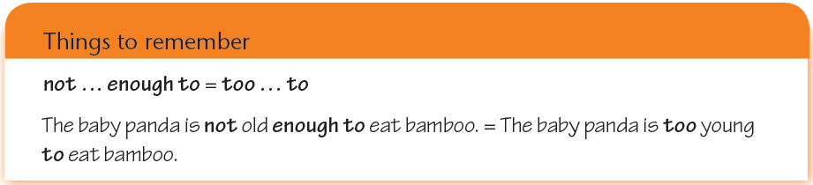
B Using adjective + enough + to + verb
They are strong enough to protect themselves.

Slide 14
Summary
（1）在“adj. + enough + to + v.”结构中enough 为副词，修饰形容词时放在其后，表示主语所指的对象有足够的能力去做某件事，该句型意为“足够……能……”。
（2）此结构的否定形式为
“not + adj. +enough + to + v.”
意为“不够……来……”
可与“too + adj. + to + v.”互换使用。例如:
他还太小了，不能上学。
He is not old enough to go to school.
=He is too young to go to school.

Slide 15

Let’s do some exercises.

Slide 16
用括号内所给的词完成下列句子。
When did you buy these cakes? Are they _________________?(fresh/ eat)
This bed is hard. It’s not _______________________.
(comfortable/ sleep on)
I’ll start the film now. Is it _________________________?
(loud/ hear)
Janet looks ill. Is she ________________________? (well/ go to school)
This box is heavy. Are you _______________________? (strong/ carry)
I want a book from the top shelf. Are you _________________? (tall/ reach)
fresh enough to eat
comfortable enough to sleep on
loud enough for everyone to hear
well enough to go to school
strong enough to carry it
tall enough to reach it

Slide 17
Simon is talking about his trip to the nature park with Emma. Complete their conversation with the adjectives and verbs in brackets.
Simon: Someone was throwing rocks at a duck in the
park, but I _________________________
(brave/tell) him to stop doing it. I feel really
sorry about it.
Emma: That’s OK, Simon. At least, you’re
____________________ (honest/say) you
were wrong. What happened to the duck then?
was not brave enough to tell
honest enough to say

Slide 18
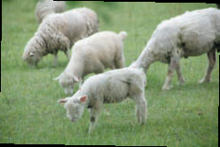
Simon: It flew away from us. I think it came close because it was hungry. Some other people in the park were
__________________ (kind/give) it some food, so it was fine.
Emma: Did you see any other animals during your trip?
Simon: Yes, I saw some birds, some horses and some sheep. I did a lot of walking. I am_____________
(tired/fall) asleep right now!
kind enough to give
tired enough to
fall

Slide 19
C Using It is + adjective + of
+ noun/pronoun + to + verb
1) 人类杀熊猫是残忍的。
2) 你真好，试着救这条狗。
It is cruel of human to kill pandas.
It is kind of you to try to save the dog.
It’s adj+of sb to do sth
“某人做了某事，他/她是……”

Slide 20

表示人的属性的形容词:
1.表示褒贬义的形容词有polite, brave, foolish, stupid, clever, careless等。
2.表示心情、心地善良或卑劣等的有：nice, kind, good, friendly, generous, thoughtful, unkind, naughty等。

Slide 21
It is + adj. + of + noun/pronoun + to + verb
It is | cruel | of | them | to kill pandas.
 | kind |  | you | to try to save the dog.
Work out the rule
The adjective in this sentence pattern describes (the person/the action)

Slide 22
What is the difference between these sentences?
It is important for us to protect giant pandas.
It is cruel of human to kill pandas.

Slide 23
It is important for us to learn English well.
“It is + adjective + for + noun/pronoun + to + verb”句型中，形容词通常是描述事物的，修饰的对象是动词不定式。这个句型往往用于表达对某人如果做某件事情的看法，说话时这个动作可能并未完成。
It is very nice of you to lend me an umbrella.
“It is + adjective + of + noun/pronoun + to + verb”句型中，形容词多是描述人物的性格、品质的形容词，修饰的对象是句子的逻辑主语，即of后的名词或代词。而且，在说这句话之前，句中的那个动作通常都已经完成。

Slide 24
The adjectives below are often used in this sentence pattern.
bad foolish kind silly
clever good nice wrong

Slide 25

Summary
（1）在句型
It is + adj. + of + n. / pron. + to+ v.
中，it 是形式主语，不定式是真正的主语。
（2）此句型中的形容词表示句中的人或事物
的特征。常用于此句型的形容词有：
careless， clever， good， kind， nice，
polite，silly等。

Slide 26
Let’s do some exercises.

Slide 27
用以下句子后括号中的单词完成句子。
I left home without my public transportation card. It ______________________ my card. (silly/ forget)
I needed some cash, so Mary lent me ￥100. It ______________________ the money. (generous/ lend)
A man stood up and offered me his seat on the train. It ______________________ his seat. (nice/ give)
I dropped my books, and a boy picked them up for me. It ____________________ the books for me.(kind/pick up)
I fell down the stairs. It _________________________ the stairs. (careless/ fall down)
I met Simon, and he laughed at my new hairstyle. It _______________________ my hairstyle. (rude/ laugh at)
was silly of me to forget
was generous of her to lend me
was nice of him to give me
was kind of him to pick up
was careless of me to fall down
was rude of him to laugh at

Slide 28
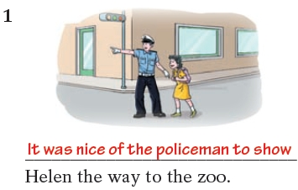
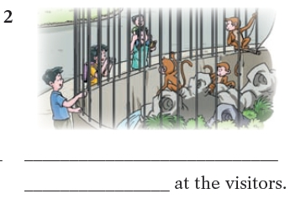
Below are some pictures of Helen's visit to the zoo. Write captions for the pictures.
bad clever careless nice
lose take show wave
It was clever of the monkey to wave

Slide 29
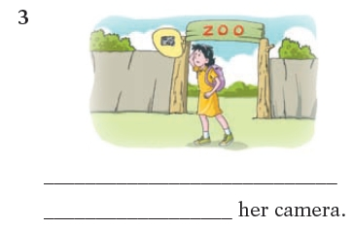
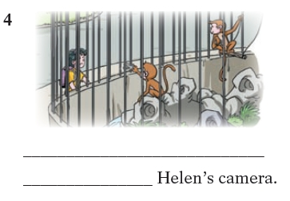
bad clever careless nice
lose take show wave
It was careless of Helen to lose
It was bad of the monkey to take

Slide 30

Let’s learn the useful expressions.

Slide 31
Notes P71-73
1.Someone was throwing rocks at a duck in the park, … (P72-B
有人向公园里的一个鸭子扔石头，……
throw sth at sb 把某物向某人扔去
（挑衅地，恶意地）
throw sth to sb 把某物扔给某人
（不带恶意）
不要朝猴子扔石头。
Don’t throw rocks at the monkeys.
请把球扔给我。
Please throw the ball to me.

Slide 32
2. I feel really sorry about it. (P72-B)
为此我感到很遗憾。
feel sorry about = be sorry about
对……感到遗憾
昨天没参加晚会，我感到很遗憾。
I didn’t come to the party, so I felt very sorry
about it.

Slide 33
3. It flew away from us. (P72-B)
它从我们身边飞走了。
fly away 飞离；离开
飞机从机场飞走了。
The plane flew away from the airport.

Slide 34
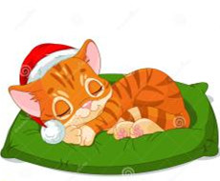
4. fall asleep (P72-B) 睡着
他们所有人一个接一个的睡着了。
One after another, all of them fell asleep.

Slide 35
Part III Post-Learning

Slide 36
Summary
（1）在句型“It is + adj. + for + n. / pron. +
to + v.”中，it 是形式主语，不定式是真正的
主语。
（2）此句型中的形容词表示句中动作的特征，
如可能性、必要性、重要性、紧迫性、频繁
程度以及价值判断等。常用于这一句型的形
容词有：common，easy，right，good，
(un)important， (un)necessary，(im)possible，
(un)usual等。

Slide 37
Summary
（1）在句型
It is + adj. + of + n. / pron. + to+ v.
中，it 是形式主语，不定式是真正的主语。
（2）此句型中的形容词表示句中的人或事物
的特征。常用于此句型的形容词有：
careless， clever， good， kind， nice，
polite，silly等。

Slide 38
It is important for us to learn English well.
“It is + adjective + for + noun/pronoun + to + verb”句型中，形容词通常是描述事物的，修饰的对象是动词不定式。这个句型往往用于表达对某人如果做某件事情的看法，说话时这个动作可能并未完成。
It is very nice of you to lend me an umbrella.
“It is + adjective + of + noun/pronoun + to + verb”句型中，形容词多是描述人物的性格、品质的形容词，修饰的对象是句子的逻辑主语，即of后的名词或代词。而且，在说这句话之前，句中的那个动作通常都已经完成。

Slide 39
Summary
（1）在“adj. + enough + to + v.”结构中enough 为副词，修饰形容词时放在其后，表示主语所指的对象有足够的能力去做某件事，该句型意为“足够……能……”。
（2）此结构的否定形式为
“not + adj. +enough + to + v.”
意为“不够……来……”
可与“too + adj. + to + v.”互换使用。

Slide 40
Part IV Review

Slide 41
一、选择最佳答案填空。
( )1. It is wrong ____ him to laught at the little girl.
A. of B. for C. to D. with
( )2. It is uesful ____ us to learn some computer skills.
A. of B. for C. to D. with
( )3. The child is ____ tall ____ get the apples on the
table.
A. not so, that B. too, to
C. enough, to D. not, enough to
( )4. It’s not good for you ____ so many computer
games. It is a waste of time.
A. to play B. play
C. playing D. to playing
A
B
D
A

Slide 42
二、选用for 或of 填空。
1. It’s very kind ____ you to help me.
2. It’s silly ____ you to say such words.
3. It’s very dangerous ____ children to cross busy
streets.
4. It’s difficult ____ us to finish the work.
5. It is good ____ him to send medicine to the sick
boy.
of
of
for
for
of

Slide 43
Thank you!

