Slide 1

Unit 1 Helping those in need
Speaking

Slide 2
目录
Lead-in
1
Pre-Learning
2
3
While-Learning
Post-Learning
4
5
Review

Slide 3
Part I Lead-in

Slide 4

Talk time
hold a singing competition
hold a food fair
What are you going to do if you want to raise money?
hold an art festival
hold a charity fair
…

Slide 5
Part II Pre-Learning

Slide 6
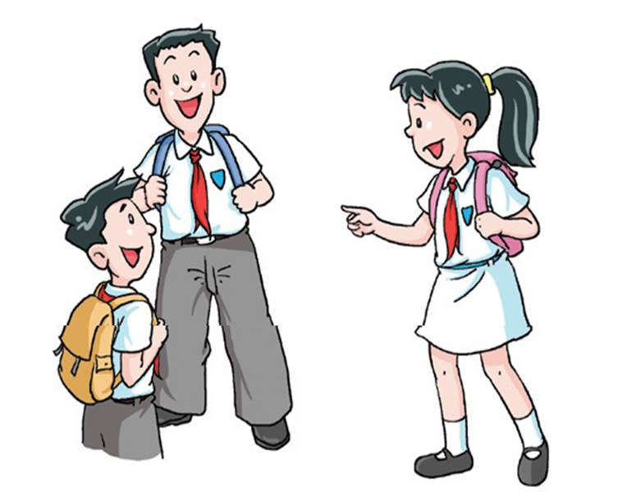
When we are sure about our plan, we use
“be going/planning to do sth”.
I’m going/planning to hold a food fair.
I’m going/planning to hold an art festival.

Slide 7

When we are not sure about our plan, we use
“be thinking about doing sth”.
I’m thinking about holding a singing competition.
I’m thinking about holding a food fair.

Slide 8
Read the following sentences and decide whether each sentence expresses certainty (Sure) or uncertainty (Not sure).
She’s going to buy a new dress.
I’m thinking about going to the cinema.
Mary’s thinking about learning to play the piano.
Cindy’s parents are planning to fly home next week.
We’re thinking about starting a music club.
I’m going to go to bed early tonight.
(Sure)
(Not sure)
(Not sure)
(Sure)
(Not sure)
(Sure)

Slide 9
Part III While-Learning

Slide 10

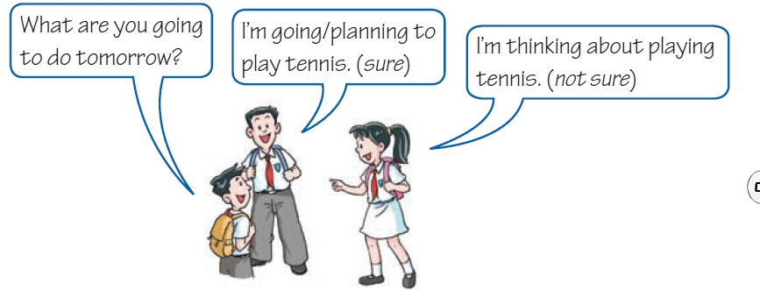
A Talk time
Talking about plans

Slide 11
In pairs, make conversations like the example below.
Change roles and do it again when you have finished.
S1: What are you going to do on Saturday?
S2: (sure) I’m going to do some voluntary work.
(not sure) I’m thinking about doing some voluntary work.
S1: Sunday? S2: (not sure) visit children in hospital
S1: next Saturday? S2: (not sure) visit my grandparents.
S1: this evening? S2: (sure)_____________________

Slide 12
1. S1: What are you going to do on Sunday?
S2: (not sure) I’m thinking about visiting children in
hospital.
2. S1: What are you going to do next Saturday?
S2: (not sure) I’m thinking about visiting my
grandparents.
3. S1: What are you going to do this evening?
S2: (Possible answer) (Sure) I’m going/ planning to
do some shopping with my parents.

Slide 13
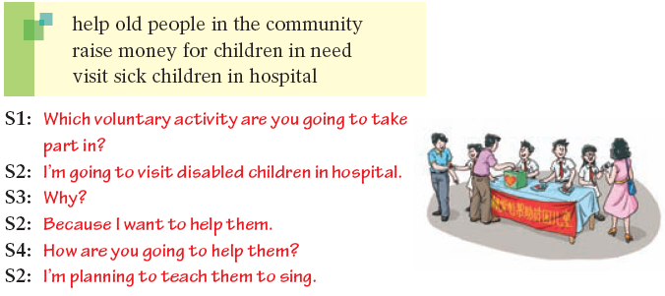
Speak up
Which voluntary activity are you going to take part in? In groups of four, take turns to interview each other. Use the ideas below or your own ideas. Follow the example.

Slide 14
Part IV Post-Learning

Slide 15
Brainstorm more voluntary activities.
What kind of voluntary activity are you going to take part in?

Slide 16

Write a report using information from your interviews.
A report
I interviewed three of my classmates. _______ would like to ___________________________ because he/she thinks that ____________________________________.
_______ chooses to _____________________________ because ______________________________________. _______ wants to ______________________________
___________________________. He/She believes that _____________________________________________.

Slide 17
Part V Review

Slide 18
从方框中选择正确的选项补全对话。
A. Great!
B. Can I join you?
C. Which voluntary work are you planning to do?
D. What are you going to do this Saturday?
E. How are you going to make friends with them?
A: (1)____
B: We are going to the orphanage(孤儿院) to do some voluntary
work.
A: (2)____
B: Play games with them, teach them to tell stories, and help
them express their feelings.
A: (3)____ The work is meaningful, isn’t it?
B: Yes. The children have no parents. They need love.
A: Well. (4)____
B: We are going to play with them and send them presents.
We’ll go to see them at weekends.
A: Very good! (5)____
B: Sure!
D
C
A
E
B

Slide 19
Thank you!

