Slide 1

Unit 1 Helping those in need
Writing

Slide 2
目录
Check-up
1
Pre-Learning
2
3
While-Learning
Post-Learning
4
5
Review

Slide 3
Part I Check-up

Slide 4

Brainstorm more voluntary activities.
What kind of voluntary activity are you going to take part in?

Slide 5

Write a report using information from your interviews.
A report
I interviewed three of my classmates. _______ would like to ___________________________ because he/she thinks that ____________________________________.
_______ chooses to _____________________________ because ______________________________________. _______ wants to ______________________________
___________________________. He/She believes that _____________________________________________.

Slide 6
Part II Pre-Learning

Slide 7
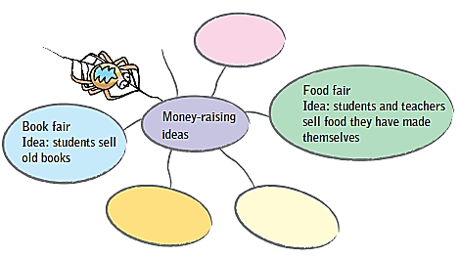
Brain Storming
A In groups, brainstorm some money-raising ideas.
Follow the example.
You and your classmates are planning a money-raising activity to help children in need. You need to write a letter to your head teacher to ask permission.

Slide 8

Discuss
Choose one money-raising activity and discuss how to organize it with other group members. Then answer the questions asked by other groups.
How are you going to raise money?
When and where are you going to have your activity?
What are you going to do during the activity?
Who would you like to ask for help?
How much money do you plan on raising?
…

Slide 9

Let’s learn the new words and expressions.

Slide 10
New words and expressions
P12
in order to 目的在于；为了

Slide 11
Notes P12
1. in order to 目的在于；为了
In order to help the disabled children, we held a
book fair to raise money for them.
为了帮助残疾儿童，我们举办了一个书展来
为他们筹款。

Slide 12
Part III While-Learning

Slide 13
B Discuss how you will write your letter. Write down some notes below.
Why are you writing the letter?
_________________________________________
How are you going to raise money?
_________________________________________
When and where would you like to have the activity?
_________________________________________
What would you like the head teacher to do?
_________________________________________
Because we need to raise money for children in need.
We are going to sell books/sell food/…
We would like to have the activity at … on …
We hope he can help us do some promotion …

Slide 14


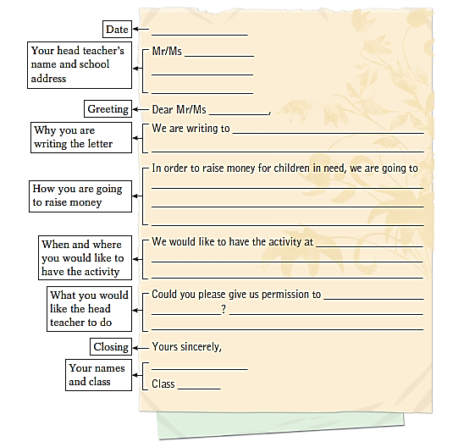
A letter asking for permission from your head teacher
Top tip
Date
Your head teacher’s name
Your school address
Greeting
Do not use “Yours”, “Love,” etc.
Closing
Your name and class

Slide 15
C Write the letter to your head teacher. Use the outline below and your notes in B to help you.
Date
Feburary
Your head teacher’s name and school address
Mr/Ms
No. 399, Tianyuan Road,
Tianhe District, GZ
Greeting
Dear Mr/Ms
We are writing to
ask you for a permission
Why you are writing the letter
In order to raise money for children in need, we are going to
How you are going to raise money
hold a book fair
When and where you would like to have the activity
We would like to have the activity at
our school playground on Friday morning

Slide 16
Could you please give us permission to
What you would like the head teacher to do
hold
the activity
We hope we can borrow the
playground on that days.
?
Closing
Yours sincerely,
Your names and class
Class
13

Slide 17
Part IV Post-Learning

Slide 18

Share your letter with your classmates.

Slide 19
Part V Review

Slide 20
I. 用英语写出下列短语。
have an activity
1. 开展活动 ____________________
2. 筹款 ____________________
3. 为了 ____________________
4. 需要帮助的 ____________________
5. 批准某人 ____________________
raise money
in order to
in need
give sb permission

Slide 21
II. 根据中文意思完成句子。
1. 为了筹到更多的钱，我们校长决定开展一项有意义的活动。
____ ____ ____ ____ more money, our head teacher decided to ____ a meaningful ______.
2. 这么晚了，我爸爸不会允许我出去的。
It ’s so late. My father won ’t ____ ____ _________ to go out.
3. 很高兴我能帮助需要帮助的人。
I’m very pleased that I can help people ____ ____.
In order to raise
have activity
give me permission
in need

Slide 22
Thank you!

