Slide 1

Unit 1 Helping those in need
Grammar

Slide 2
目录
Check-up
1
Pre-Learning
2
3
While-Learning
Post-Learning
4
5
Review

Slide 3
Part I Check-up

Slide 4
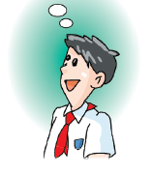
Show time
Share your money-raising plan.
hold a singing competition
hold a food fair
What are you going to do if you want to raise money?
hold an art festival
hold a charity fair
…

Slide 5
Part II Pre-Learning

Slide 6
Make sentences
agree fail learn offer
promise seem want decide hope
manage plan refuse start wish
For example:
I agree to go with them.
We decided to have lunch together.
Jim failed to pass the exam.
I hope to study at Bejing University.
Julia learnt to play the piano when she was 70 years old.
……

Slide 7
Infinitives 动词不定式
Some verbs can have other verbs after them. We usually use to before the second verb. We call these second verbs infinitives.
We can use verbs +to + infinitives in sentences.
Three teenagers offered to do some voluntary work during the school holidays.
Cindy wanted to paint a picture of the park near her home.
Work out the rule
An infinitive is the (base/ -ing/ -ed) form of a verb.

Slide 8
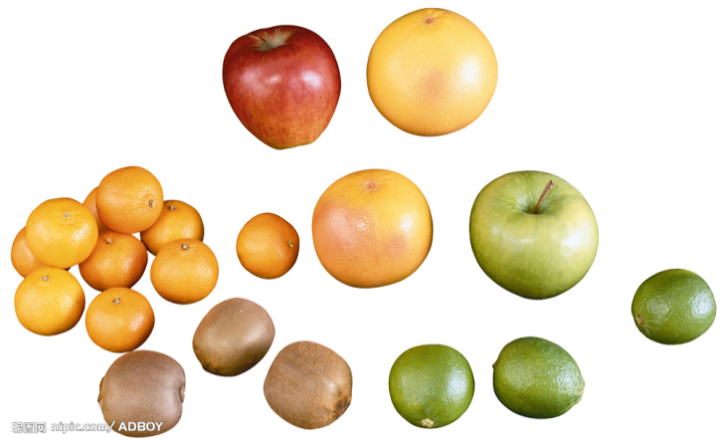
动词不定式的用法
不定式的构成非常简单：
肯定形式：to do sth (do 代表动词原形)
否定形式：not to do sth
一般表示要干还没干的事（干过的事一般用-ing形式）。

Slide 9
Part III While-Learning

Slide 10
verbs + to + infinitives
My mother and I will continue to visit Vivien.
I wanted to help disabled children.
We need to help children like Tim and raise their spirits.
Three teenagers offered to do some voluntary work during the school
holidays.
She wanted to paint a picture of the park near her home.
object
I will continue to do voluntary work in the future.

Slide 11
We often use to + infinitive after these verbs:
choose hope offer want decide learn plan wish
动词不定式的用法1
动词不定式常在以下动词（短语）的后面作宾语：
choose hope offer want decide learn plan wish

Slide 12
Things to remember
We can use question words + to + infinitives after decide, know, learn and remember.
Do you know how to help disabled children?
动词不定式的用法2
“疑问词+动词不定式”也可以作宾语
如：你知道怎么帮助残疾人吗？
Do you know how to help disabled children?

Slide 13
王教授要去一所大学作演讲，去之前他向司机Tim确认一些信息。请选择方框中适当的疑问词完成对话。
how what when where who
Dr Wang: I don’t know where the university is, Tim.
Tim: Don’t worry. I know _____ to get there.
Dr Wang: And I’ve forgotten which room the lecture’s in.
Tim: No problem. I’m sure someone will show us _____ to go.
Dr Wang: I can’t remember what time I’ve got to start my lecture.
Tim: Don’t worry, sir. Look at the schedule. It’ll tell you ____ to
begin.
Dr Wang: I’m so nervous. I’m afraid I might forget my speech!
Tim: Keep calm, sir. I’m sure you’ll remember ____ to say.
Dr Wang: After the lecture. I’ve got to see a person to ask for my
lecture fee. But I don’t know his name.
Tim: It’s all right, sir. I know ____ to speak to.
how
where
when
what
who

Slide 14
A1 Mark and his mother visited Vivien. Mark is telling his friends about the visit. Complete his words with the correct forms of the verbs in brackets.
We (1) ________________(decide/meet) Vivien today. We (2)_____________(want/help) her in some way. When we arrived, Vivien was very happy. She(3)_____________(begin/talk) to me about her school. She said, “I (4)__________(like/go) to school, but I don’t have any friends. I feel lonely.”
Mum gave her some advice. Then Mum asked me to give Vivien her present, but I (5)_____________ (forget/bring) it! Vivien said, “It’s OK. I (6)___________ (hope/see) you again soon.”
decided to meet
wanted to help
began to talk
like to go
forgot to bring
hope to see

Slide 15

We can also use verbs + objects + to + infinitives
in sentences.
Annie taught Tim to sing beautiful songs.
We want them to be happy.
object complement
We taught them to tell stories.
We often use objects + to + infinitives after these verbs:
advise encourage teach warn
allow expect tell
ask order want

Slide 16

Translate the following sentences into English.
杰克想让我给他带些漫画书。
卡西建议他们打车。
爷爷让我把盐递给他。
妈妈提醒我晚饭不要迟到。
Jack wanted me to bring him some comic books.
Things to remember
Cathy advised them to take a taxi.
We can use not + to + infinitives after verbs.
My grandpa asked me to pass him the salt.
My mum reminded me not to be late for dinner.

Slide 17
Things to remember
We use infinitives without to after some verbs, such as let and make.
e.g. This makes them express their feelings.
We can use infinitives either with or without to after the verb help.
e.g. This song helped him (to) relax.

Slide 18
动词不定式的用法3
*动词不定式可以作宾语补足语
如:Annie taught Tim to sing beautiful songs.
We want them to be happy.
*动词不定式常在以下动词（短语）的宾语后面作宾语补足语： advise encourage teach warn allow expect tell ask order want等。
*否定形式为not + to + do
如：The teacher tells us not to be late.

Slide 19
动词不定式的用法3
*动词不定式在let，make，have 等使役动词后作宾语补足语时，要省略to。
如：I will let him go with us.
我会让他跟我们一起去。
I made her cry.
我把她弄哭了。

Slide 20
B Betty is visiting Cindy in the hospital. Complete their conversation with the correct forms of the verbs in brackets.
Betty: Morning, Cindy. We’re organizing a painting competition for the children in hospital. We’ll (1)______ them ___________(ask/paint) pictures. Would you like to take part in the competition?
Cindy: Yes, I’d love to. I want to paint a picture of the park near my home, but the doctor won’t (2)_________ me ___________(let/go) out. He (3)_________ me _________(want/stay) in hospital.
ask
to paint
let
go
wants
to stay

Slide 21
want
to take
Betty: Do you (4)_______ me ___________(want/take) some photos of that park for you?
Cindy: Yes. That would be very kind of you.
Betty: I’ll go there this weekend. Then I’ll bring the photos to you next week and (5)___________ you ___________(teach/paint).
Cindy: Thanks for your help.
teach
to paint

Slide 22
Infinitives of purpose
动词不定式作目的状语
Things to remember
We can also use an infinitive to say why someone needs or uses something.
e.g. Cindy used a brush to paint a picture of a park.
We can use an infinitive to say why someone does something.
e.g. They went to the hospital to help the sick children.
We use Why to ask about the purpose.
adverbial of purpose
e.g. Why did Cindy use a brush?
Why did they go to the hospital?

Slide 23
动词不定式的用法4
动词不定式可以作目的状语 如:
Every Saturday, he went there to look after the
patients.
他每周六都去那照顾病人。
为了使目的意义更加清楚或表示强调意义时，常用短
语in order to 如:
We learn a language in order to communicate.
我们学习语言是为了交流。

Slide 24
C Use the information in the reports on page 3 to answer these questions. Use the correct infinitives in your answers.
Why did the three teenagers offer to do some voluntary work during the school holidays?
  They offered to do some voluntary work _______
  children in need.
2. Why did Betty go to the children’s hospital?
She went to the hospital ___________ a painting
competition for the children there.
3. Why did Betty go to the park near Cindy’s home?
She went there ______________ some photos.
to help
to organize
to take

Slide 25
4. Why did Mark and his mother teach Vivien to tell stories?
They taught Vivien to tell stories __________ her express her feelings.
5. Why did Annie teach disabled children to sing?
She taught them to sing ___________ them joy and peace.
to help
to bring

Slide 26
Part IV Post-Learning

Slide 27
Summary
动词不定式的用法
①构成：to do sth (do 代表动词原形)
否定形式是not to do sth
②动词不定式常在以下动词（短语）的后面作宾语：choose hope offer want decide learn plan wish
③“疑问词+动词不定式”也可以作宾语

Slide 28
Summary
动词不定式的用法
④动词不定式常在以下动词（短语）的宾语后面作宾
语补足语： advise encourage teach warn allow
expect tell ask order want等。否定形式为not to do
动词不定式在let，make，have 等使役动词后作宾
补足语时，要省略to。
⑤动词不定式可以作目的状语。为了使目的意义更加
清楚或表示强调意义时，常用短语in order to

Slide 29
Part V Review

Slide 30
一、同义句转换。
1. They got up early so that they could get there in time.
They got up early ____ ____ ____ ____ there in time.
2. He hopes that he can visit the Canton Tower.
He hopes ____ ____ the Canton Tower.
3. His father went to Beijing on holiday.
His father went to Beijing ____ ____ his holiday.
4. Mary’s brother decided that he would buy the
T-shirt.
Mary’s brother decided ____ ____ the T-shirt.
in order to get
to visit
to spend
to buy

Slide 31
二、选择最佳答案填空。
( )1. Lucy wanted ____ an article on animals.
A. write B. to write C. to writing D. writing
( )2. Let your mother ____ what you have decided.
A. know B. to know C. knowing D. known
( )3. We must work hard ____ a better life.
A. live B. living C. to living D. to live
( )4. Do you know when ____ tomorrow morning?
A. leave B. leaving C. to leave D. will leave
( )5. Our English teacher often asks us ____ English in the morning.
A. read B. reading C. to reading D. to read
B
A
D
C
D

Slide 32
三、根据汉语意思完成英语句子，每空词数不限。
1. 他教他妈妈如何使用电脑。
He taught his mother __________________.
2. 老师让我们打扫我们教室。
Our teacher told us __________________.
3. 他奶奶希望有一天能去北京。
His grandma hopes __________________ one day.
how to use computers
to clean our classroom
to go to Beijing

Slide 33
Thank you!

