Slide 1

Unit 2 Body Language
Vocabulary

Slide 2
目录
Words and expressions
1
2
Notes

Slide 3
Part I
Words and expressions

Slide 4
language n. 语言
communication n.交流；交际
*ballet n. 芭蕾舞
accept v. 接受（建议、邀请等）
*reject v. 拒绝接受；不予考虑
meaning n. 意义；意思
gesture n. 手势
message n.（ 书面或口头的）信息；消息

Slide 5
bored adj.（ 对某人/某物）厌倦的；烦
闷的
part-time adj. 兼职的
well-dressed adj. 衣着入时的；穿着讲究的
lady n. 女士；女子
sigh v. 叹气；叹息
matter n. (询问某人的情况)怎么了
expression n. 表情；神色
appearance n. 外貌；外表
impression n. 印象

Slide 6
towards prep. 向；朝；对着
hold v. (held, held) 使保持（在某位置）
later adv. 以后；后来
remind v. 提醒；使想起
neck n. 颈；脖子
cross v. 使交叉；使交叠
nod v. 点头
shake v. (shook, shaken)（与某人）握手
v. (shook, shaken) 摇头
sure adj. 确信；肯定

Slide 7
body language 身势语；肢体语言
take place 发生
sit up 坐起来；坐直
make a good impression on ...
给······ 留下好印象
remind sb. about sth. 提醒某人某事

Slide 8
Part II Notes

Slide 9
Notes P17-18
1. language n. 语言
foreign language 外语
spoken language 口语
written language 书面语
可数名词，复数形式为languages。
提问某人说什么语言时，常用句型：
What language(s) do/ does sb. speak?表示。如：
Chinese is my first language.
汉语是我的母语。

Slide 10
2. communication n.交流；交际
communicate v.交流，沟通
communicate with sb. 表示“与某人交流/沟通/联络”
communicate to sb. 表示“向某人报告/通知/传达”
如：
Communication skills can be improved through practice.
交流技巧可以通过练习提高。
We communicate with each other by e-mails.
我们用电子邮件彼此交流。
She communicated the news to her mother.
她把这条消息告诉了她妈妈。

Slide 11
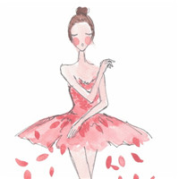
3. *ballet n. 芭蕾舞
如：
I trained as a ballet dancer.
我受过芭蕾舞训练。

Slide 12
4. accept v. 接受（建议、邀请等）
可接名词或代词作宾语。
He accepted a present from his friend.
他接受了朋友的礼物。
区别：accept表示主动而且高兴地接受，receive表示收到，但不一定接受。
She has received his present, but she will not accept it.
她收到了他的礼物，但是她不会接受。

Slide 13

5. *reject v. 拒绝接受；不予考虑
如：
She rejected Mike’s invitation to his birthday party.
她拒绝了迈克参加他的生日聚会的邀请。

Slide 14
6. meaning n. 意义；意思
mean v. 意思是……，意味着
means n. 方法，手段，工具（单复同形）
如：
The meaning of her words was clear. We'd lost our job.
她的话意思很清楚，我们失业了。
What does this sentence mean?
这个句子是什么意思？
Is there any means of contacting him?
有没有什么办法和他取得联系？

Slide 15

7. gesture n. 手势
如：
He made a rude gesture with his fingers.
他用手指做了一个粗鲁的手势。

Slide 16

8. message n.（ 书面或口头的）信息；消息
leave a message 留言
take a message for ... 给……捎个信儿
如：
Will you please give him a message when you
see him?
你见到他时给他带个口信好吗？

Slide 17
9. bored adj.（ 对某人/物）厌倦的；烦闷的
区别bored和boring
bored指人感到无聊、无趣、枯燥，是指使人感到厌烦的，主语是人。如：
The children quickly got bored with staying indoors.
孩子们在屋子里很快就待不住了。
boring指事物让人感到无聊、无趣、枯燥，物本身是无趣的，主语是物，作表语或定语。如：
This is a boring book.
这是一本无聊的书。

Slide 18

10. take place 发生；举行
This film festival took place in October.
这个电影节在十月举行。
take place没有被动语态。

Slide 19
区别：take place与happen
take place | 发生；举行；举办 | 常指某事按规律、预先布置或计划发生或进行，是非“偶然”发生的。
happen | （偶然）发生；碰巧 | 一般用于偶然或突发性事件，没有预见性，主语往往是事故等名词，人作主语时其后常接不定式。
如：
Great changes have taken place in China since 1978.
自从1978年以来，中国发生了巨大的变化。
When did the accident happen?
这起事故发生在什么时候？

Slide 20
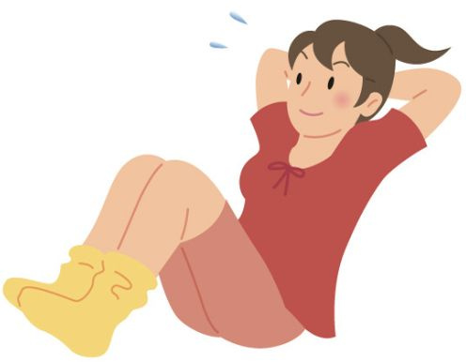
11. sit up 坐起来；坐直
He tried to sit up to look out of the window.
他努力坐起来向窗外看。
sit-ups 仰卧起坐
The girl can only do three sit-ups.
这个女孩只能做三个仰卧起坐。

Slide 21
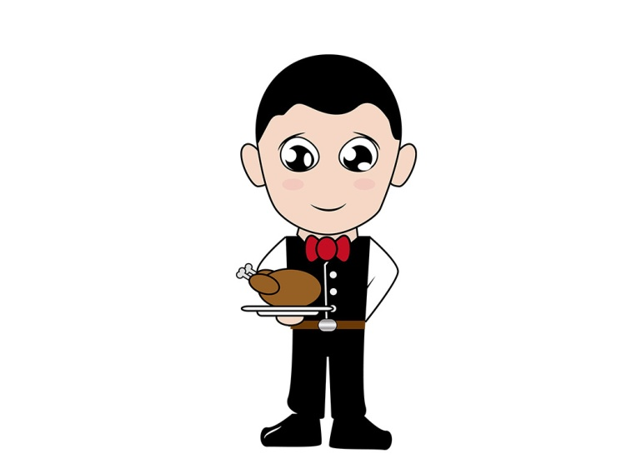
Notes P19
1. part-time adj. 兼职的
In the US, many college students have part-time jobs to earn pocket money.
在美国，许多大学生做兼职工作，以赚取零用钱。

Slide 22
2. well-dressed adj. 衣着入时的；穿着讲究的
The well-dressed young woman is my English teacher.
这个穿着讲究的年轻女子是我的英语老师。
get dressed 穿衣服
dress up 穿上盛装、打扮
He went into his bedroom to get dressed.
他进卧室穿衣服。
Mother loved to dress me up.
妈妈喜欢打扮我。

Slide 23

3. lady n. 女士；女子
Do you know who the lady is?
你知道那位女士是谁吗？

Slide 24
4. She looked at Debbie and Simon, and then walked over to Debbie.
她看看西蒙和戴比，然后朝戴比走去。
walked over to 朝……走去。
其中over是副词，意为“从……的一端到另一端；穿越”。类似的短语有come over to fly over to。
The British students will fly over to our country next week.
这些英国学生下周将飞往我们国家。

Slide 25
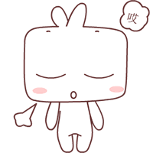
5. sigh v. 叹气；叹息
He sighed deeply at the thought.
想到这里，他深深叹了口气。
6. walk away 走开
Softly, he walked away.
他悄悄地走开了。

Slide 26
7. What’s the matter? 怎么了？
What’s the matter? 是日常用语，用来询问某
人的情况，常翻译为“怎么了？”，如果要
明确询问具体某个人的情况，在matter 后加
上with sb 即可。可与句型What’s wrong (with
sb)? /What’s the trouble (with sb)?互换使用。
What’s the matter with her?
= What’s wrong with her?
= What’s the trouble with her?
她怎么了？

Slide 27
Practice
1. 同义句转换。
You don’t look well. What’s wrong?
You don’t look well. ________ ________ ________?
2.根据中文意思完成句子。
这个小男孩不高兴。他怎么了？
The little boy is unhappy. _____ _____ _____ _____
him?
What’s the matter / trouble
What’s the matter with
或What’s the trouble with
或What is wrong with

Slide 28

8. People always choose Debbie instead of me.
人们总是选择戴比而不是我。
choose…instead of 选……而不选……。
Bobby chose orange juice instead of water.
博比选了橘子汁而不是水。

Slide 29
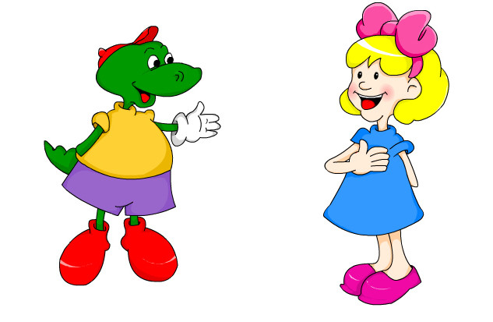
9. It’s the way you communicate.
那是（因为）你的交流方式。
way 方式
you communicate是定语从句。
the way you stand and sit
你站着和坐着的方式

Slide 30
10. get a chance to do sth 得到机会做某事
I don’t get a chance to speak.
我没有说话的机会。
have a chance to do sth 有机会做某事
You have a good chance to learn about travel
there.
你有很好的机会去了解那里的旅行（事宜）。

Slide 31
Practice
1. 选择最佳答案填空。
It is difficult to have a chance ___ a good job nowadays.
A. to get B. get C. to getting D. got
2.根据中文意思完成句子。
去年，我得到机会作为一名交换生去伦敦学习了三
个月。
I _____ _____ _____ _____ _____ in London for
three months as an exchange student last year.
A
got a chance to study

Slide 32
11. Communicating is more than just speaking.
交流不仅仅指说话。
① communicating和speaking是动名词。
②more than （程度上）更强，更多。
Writing is more than making sentences.
写作不仅仅是造句。

Slide 33
12. expression n. 表情；神色
n. 词语，表达方式，表达
There was a worried expression on her face.
她脸上流露出担心的神色。
That expression has gone out. Nobody uses it
now.
那个词已经过时，现在没有人用它了。
Reading can enrich the power of expression.
阅读能够增进表达能力。

Slide 34
13. Your whole appearance communicates things.
你的整个外观都在传递信息。
①whole adj.全部的；整体的。
区别： whole与all
如：a whole day 一整天 two whole weeks 整整两周
all the money 所有的钱
whole | 位于限定词（冠词、形容词性物主代词或所有格）之后 | 用于修饰单数名词；修饰可数名词复数时，一般前面有数量词
all | 位于限定词（冠词、形容词性物主代词或所有格）之前 | 用于修饰复数名词或不可数名词

Slide 35

②appearance n. 外貌；外表
如：
We should not judge a person by his appearance.
我们不应该以貌取人。

Slide 36
14. impression n. 印象
① give sb. a good impression
=make a good impression on sb.
给某人留下一个好印象。
His kindness gave us a deep impression.
= His kindness made a good impression on us.
他的热心给我留下了深刻的印象。
② impress v. 给……留下深刻的印象
impress sth. on sb 使某人意识到某事
impress sb. with ... 给某人留下……印象
He impressed her with his sincerity.
他的真诚打动了她。

Slide 37
15. towards prep. 向；朝；对着
常用来表示“朝，向，对于（某人的态度或某
事的感觉如何）”；在表示时间时，表示
“靠近，将近”。
如：
He walked towards his office.
他朝他的办公室走去。

Slide 38
16. hold v. (held, held) 使保持（在某位置）
v. 拥有，抓住
v. 举行，召集，主持
Hold your arms on.
把手臂伸出来。
She was holding a book in her hand.
她手里拿着一本书。
They were holding a meeting.
他们在开会。

Slide 39
hold up意为“抬起”，它还有“举起”之意。
They held their heads up.
他们昂起了头。
She was holding up an umbrella when I saw her
in the street.
我在街上看到她时，她正撑着一把伞。

Slide 40
Practice
根据中文意思完成句子。
(1) 老师叫他抬起头来。
The teacher asked him to _____ his head _____ .
(2) 他举起地图，以便我们都能看到。
He _____ the map _____ so that we could see it.
hold up
held up

Slide 41
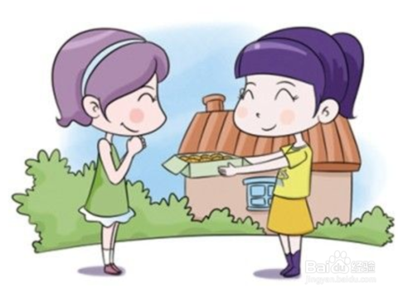
17. look friendly 看起来友好
The manager looks friendly. He offered to show
us around the company.
经理看起来很友好。他主动提出要带我们参观
公司。

Slide 42
18. Her body language is making people feel
welcome, so they go to her for help.”
她的肢体语言让人们感到受欢迎，因此他们向
她寻求帮助。
① make sb. do sth. 使某人做某事
The moving story made us cry.
这个感人的故事使我们哭了。

Slide 43
② go to sb. for help 向某人寻求帮助
If you have any trouble, you can go to the police
for help.
如果有任何麻烦，你可以向警察寻求帮助。

Slide 44

19. He sat up straight and tried smiling at people.
他坐直身体并试着向人微笑。
① sit up straight 坐直

Slide 45
② try doing sth. 试着做某事
区别： try doing sth.与try to do sth.
try doing sth. （用某一办法）试着做某事
Why not try doing it now?
为什么不现在就试着做呢？
try to do sth. 尽力做某事
She tried to pass the exam.
她尽力去通过考试。

Slide 46

③smile at 朝……微笑
I love the way you smile at me.
我喜欢你对着我微笑的方式。

Slide 47
20. later adv. 以后；后来
later不能用于从讲话时刻算起的若干时间之后，
要根据上下文推断何时 起至何时之后。只能
放在段时间名词之后。如：
Half an hour later, she woke up and began to cry.
半个小时后她醒了，接着开始哭起来。
I met her again three years later.
三年后我又遇见她了。

Slide 48
Practice
根据中文意思完成句子。
1. 几天后，他把书还给我了。
He returned the book to me ____ ____ ____ ____.
2. 两个小时后我会完成这项工作。
I will finish the work ____ ____ ____.
a few days later /
after a few days
two hours later

Slide 49
21. with a smile 带着微笑
I'll face it with a smile.
我会以微笑面对。
22. Mr Yang came over at once and said…
杨先生立刻走过来说……
① come over 走过来
② at once 立刻

Slide 50
23. She wanted to remind me that tomorrow is her birthday.
她想提醒我明天是她的生日。
remind意为“提醒；使想起”，常用结构有：
① remind sb + that从句“提醒某人……”，如：
Please remind him that there will be a meeting at
Three o’clock tomorrow afternoon.
请提醒他明天下午三点有个会议。

Slide 51
② remind sb of sth 使某人想起某事 如：
The old woman reminded me of my grandma.
这位老妇人使我想起了我奶奶。
③ remind sb about sth提醒某人（关于）某事
如：
Don’t worry, Mr White. I will remind you about
the meeting.
别担心，怀特先生。我会提醒你开会的事。

Slide 52

④ remind sb to do sth“提醒某人做某事”，如：
Please remind me to post the letter on the way
home.
请提醒我在回家的路上把信寄了。

Slide 53
Practice
根据中文意思完成句子。
(1) 不要忘了提醒她宴会的事。
Don’t forget to _____ _____ _____ the dinner party.
(2) 昨天展出的那幅画使他想起了他在巴黎的家人。
The picture on show yesterday _______ _____ _____
his family in Paris.
remind her about
reminded him of

Slide 54
Practice
(3) 一定要提醒她早点回来。
Be sure to _____ _____ _____ _____ back early.
(4) 请提醒他我们明天早上六点离开。
Please _____ _____ _____ we are leaving at six.
remind her to come
remind him that

Slide 55
24. I’ll think it over. 我会好好考虑。
think over 意为“好好考虑；熟虑”，接名词作
宾语时，名词可以放在短语后面或短语中间；
接代词作宾语时，代词要放在短语中间。如：
Please think the plan over.
= Please think over the plan.
请好好考虑这个计划。
Don’t worry. I will think them over.
别担心，我会好好考虑这些事情的。
用法类似的动词短语还有：turn on, pick up,
look up, turn off等。

Slide 56
Practice
1. 选择最佳答案填空。
( )1. Can you ____?
A. think over it B. think it over
C. think it D. think its over
2. 根据中文意思完成句子。
你应该好好考虑你的将来。
You should ____ ____ ____ ____.
地上有本书，请把它捡起来。
There is a book on the floor. Please ____ ____ ____.
B
think over your future / think your future over
pick it up

Slide 57
Notes P22
1. neck n. 颈；脖子
neck and nceck 齐头并进
She tied a scarf around her neck.
她脖子上围着一条围巾。
They were neck and neck in the 100-metre race.
他们在百米赛跑中齐头并进。

Slide 58
2. Swan Lake is one of the most famous ballets
in the world.
《天鹅湖》是世界上最著名的芭蕾舞之一。
one of +the+形容词最高级+可数名词复数表
示“最……的……之一”。如：
Staying with families and friends is one of the
happiest things in the world.
和家人朋友待在一起是世界上最快乐的事。

Slide 59
3. The dancers move their arms like wings and
move their necks like the long necks of swans.
舞者移动他们像翅膀一样的手臂，转动他们
像天鹅的长脖子一样的脖子。
like 此处为介词，意为“像”。如：
He works like others.
他像其他人一样工作。

Slide 60
Notes P27
1. cross v. 使交叉；使交叠
v. 穿过，越过，渡过
如：
Don't cross your arms.
不要交叉双臂。
They crossed the road.
他们穿过了马路。

Slide 61
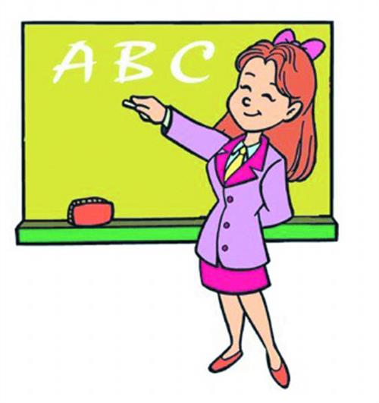
2. nod v. 点头
如：
Simon nodded to agree with our suggestion.
西蒙点头同意我们的建议。

Slide 62
3. shake v. (shook, shaken)（与某人）握手
v. (shook, shaken) 摇头
shake one's hand 摇头
shake hands with sb. 与某人握手
如：
You may shake hands when saying goodbye to
people.
在和别人告别时可以握手。

Slide 63
4. sure adj. 确信；肯定
I think he's coming, but I'm not quite sure.
我想他会来的，但是我不太有把握。
be sure about/ of 确信，对……有把握
后接名词、代词或动词-ing形式，表示对客观
事物有肯定的认识和判断，主语必须是人。
I am really sure about it.
对于这件事我确实有把握。

Slide 64
5. Why don’t you go skating? / Why not go skating? / What about goingskating? / You’d better go skating. 为什么（你）不去溜冰？/去溜冰怎么样？/
你最好去溜冰。
这些都是日常用语，表示建议，回答时常
“That’s a good idea！”或“Good idea！”。
①Why don’t you do ...? / Why not do ...?
意为“ 为什么（你）不做……？”例如：
Why don’t you do some reading at home?
= Why not do some reading at home?
为什么（你）不在家看看书呢？

Slide 65
②What about doing ...? 意为“做……怎么样？”
可与How about doing ...? 互换使用 例如：
What about doing some reading at home?
= How about doing some reading at home?
在家看看书怎么样？
③had better do ... 意为“最好做……”
否定形式为had better not do ...“最好不要做……”
You’d better do some reading at home.
你最好在家看看书。
You’d better not go out at night.
晚上你最好不要出去。

Slide 66
Practice
选择最佳答案填空。
(1) Why not___ shopping with us?
A. to go B. go C. going D. to going
(2) What about ___ a movie tonight?
A. to watch B. watch
C. to watching D. watching
(3) You don’t look well. You’d better ___ to see the doctor.
A. go B. going C. to go D. gone
B
D
A

Slide 67
6. feel like 想要
相当于动词want 或would like，但注意其用法不同。
feel like 后接名词、代词或动名词作宾语；
want后接名词、代词或动词不定式作宾语；
would like后接名词或动词不定式作宾语。例如：
I feel like a cup of coffee.
= I want / would like a cup of coffee.
我想喝杯咖啡。
I don’t feel like eating anything.
= I don’t want / wouldn’t like to eat anything.
我什么都不想吃。

Slide 68
Practice
1. 同义句转换。
He wanted to take a walk after supper.
He ____ ____ ____ a walk after supper.
2. 根据中文意思完成句子。
下星期我们想去长城。
We ____ ____ ____ to the Great Wall next week.
你想要喝水吗？
____ you ____ ____ ________ some water?
felt like taking
feel like going /
want to go
Do feel like drinking
Would like to drink
Do want to drink

Slide 69
Thank you!

