Slide 1
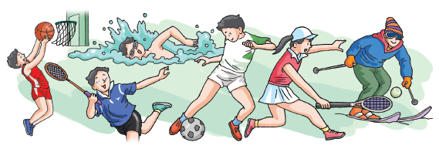
Unit 5 Sport
Writing

Slide 2
目录
Review
1
Pre-Learning
2
While-Learning
3
Post-Learning
4

Slide 3
Part I Review

Slide 4
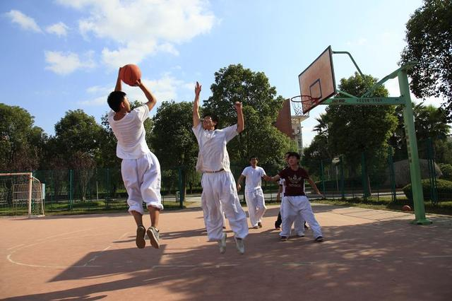
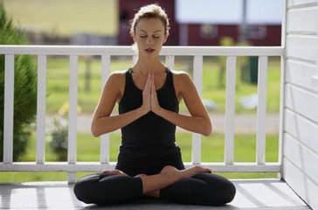
These days, with the development of economy and the improvement of people's living standards, more and more people begin to spend time doing sports.
Different sports for different purpose
Different people need
different sports.

Slide 5
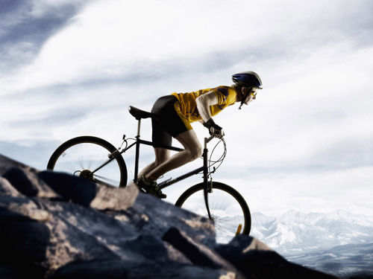
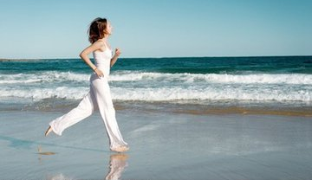
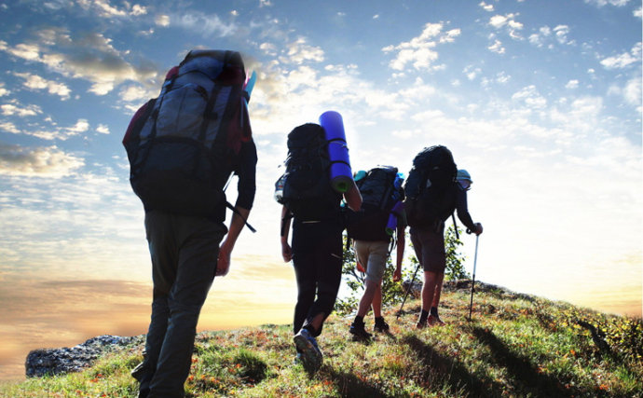
For most people
Keep fit
Lose weight
relax ourselves

Slide 6
Cycling
Swimming
Which one do you like most?
Volleyball
Basketball
Tennis
running
Badminton
Table Tennis

Slide 7
Part II Pre-Learning

Slide 8
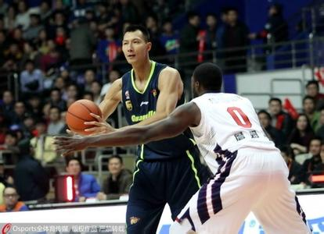
My favourite sport star
There are many sports stars in the world. My favourite star is Yi Jianlian.
Yi Jianlian is a good basketball player. He was born in Heshan, Guangdong. He is 2.12 metres tall and 113 kilos. He is handsome and kind. He works hard in the match and in the training. So his coach and team friends all like him.
Yi Jianlian began his career quite early. When he was fifteen years old, he came into CBA. In 2002, he got the first gold medal --- Asia Youth championship’s champion.

Slide 9
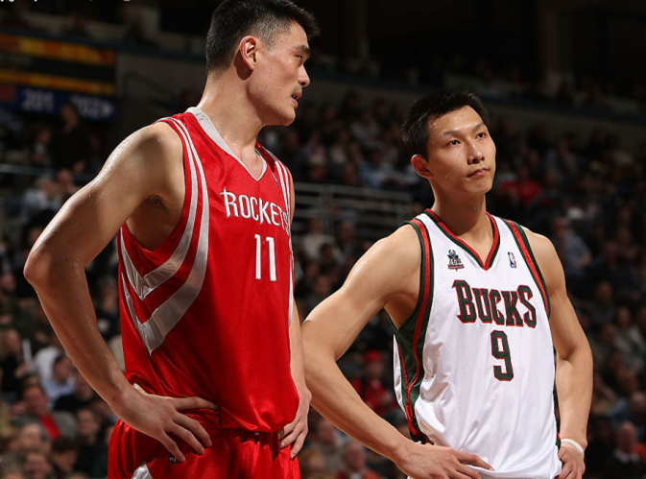
After that, he helped Guangdong team win 3 gold medals from 2003 to 2006 CBA championships. And he won the CBA MVP from 2005 to 2006. In 2006 Asian Games, he got 16.6 points and 10.3 rebounds. He was the greatest basketball player in PRC, in 2006, I think.
On June 28th, 2007, Yi Jianlian came into NBA! All the Chinese people were excited. Because he is the fourth Chinese basketball player who came into NBA.
All the people hope he can become better and better.

Slide 10
Part III While-Learning

Slide 11
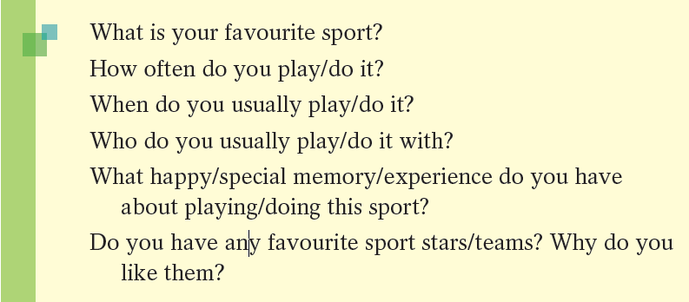
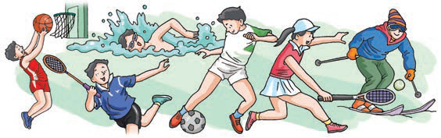
A Think about your favourite sport. Use the following questions to help you.

Slide 12
B Write an article about your favourite sport. Use the questions from A and
the outline below to help you.
Paragraph 1 Begin with a topic sentence.
(My favourite sport is …/… is my
favourite sport.)
Paragraph 2 Give details about your favourite sport.
Paragraph 3 Include your memory or experience of
this sport, or your favourite sport
stars/teams.

Slide 13
My favorite sport
One possible version:
As we know, sport plays an important part in our life.
I am interested in sports and I do sports every day. Of all
the sports, I like swimming most.
It is a healthy and popular sport . swimming in the
water is cool as well as exciting. Besides, swimming
makes me healthy and brings me plenty of enjoyment.

Slide 14
I learned to swim when I was only 5 years old.
Although I was a little nervous in the water at first, with
the help of my parents and coach, I did a good job after
several weeks. Now, I am very good at swimming. I go
swimming once a week.

Slide 15
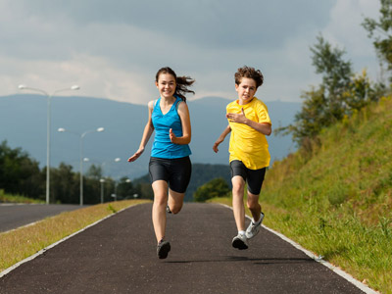
Of course, I like watching this sport. My favorite swimmer is “Michael Phelps” .He always drives me crazy every time he appears on TV.
I believe there will be more and more people love swimming. So everybody can have a good time when going swimming.

Slide 16
some useful expressions
I enjoy sports very much. They help me to keep
healthy and study better.
I find it’s a good way to relax myself.
I have benefited a lot from doing exercise!
Doing sports gives me energy.
Sports can keep me active and strong.
I learn to get on well with others after playing
basketball with my classmates.

Slide 17
描述事物常用句式:
It’s well known to us that …
我们都知道 ……
2. I think it’s + adj. + for sb to do sth
我认为对某人来说做某事是……的。
3. It’s good for your health to …
……有助于你的身体健康。
4. This is a fact that many people are interested in …
很多人对……很感兴趣，这是一个事实。

Slide 18
描写人的常用短语：
be angry with sb
be able to
be born …
make friends with …
be fond of …
be good at …
used to do sth …
at the age of …
生某人的气
能
出生
与某人交朋友
喜欢……
擅长……
过去常常做某事
在……岁时

Slide 19
描写人的常用句型：
He looks like …
他看上去好像……
2. He used to be/ have
他过去常常是（有）…..
3. She is good at …/does well in …
她擅长…..
4. She is the candle lighting my future.
她就像一支蜡烛，照亮我的前程。

Slide 20
Part IV Post-Learning

Slide 21
exercise
假如你在奥运会期间碰到外国朋友，请你介绍中国球员
易建联的情况。
生日: 1987.10.27 出生地:广东 身高:2.12米
经历:2003年他成为大学生college)
2000年1月入选中国国家篮球队
(National Basketball Team)
2007年7月进入美国NBA，继姚明后的第二个
中国球员
爱好: 他喜欢听流行音乐、玩电脑。
其他: 现在还在努力学习英语。

Slide 22
possible version
Born on October 27th.1987, Guangdong, China, Yi Jianlian is a famous basketball player. He is 2.12 meters tall. This handsome boy became a college student in 2003.
With a great gift for basketball, he was chosen to play for the National Basketball Team in January, 2000. Then the young man, as the second Chinese player after Yao Ming, was admitted into NBA.

Slide 23
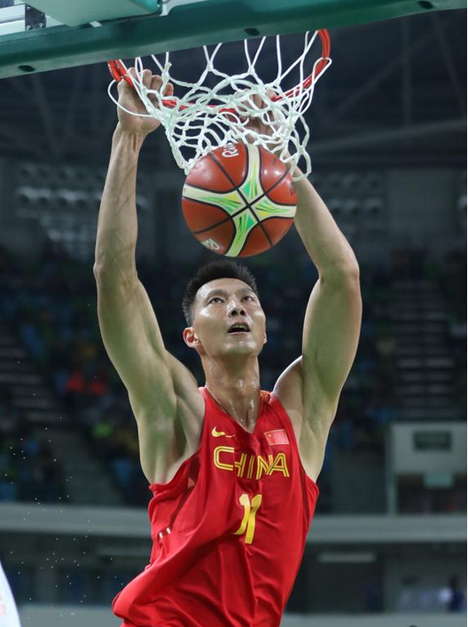
Like most young men, in his spare time, Yi
Jianlian enjoys listening to pop music and playing
computer games. However, he never stops making
progress. Now he is trying his best to learn English
well, so he can communicate with westerners freely.

Slide 24
Thank you!

