Slide 1

Unit 7 Poems
M
P
O
E
Writing

Slide 2
目录
Lead-in
1
Pre-Learning
2
3
While-Learning
Post-Learning
4
5
Review

Slide 3
Part I Lead-in

Slide 4
Saying goodbye to Cambridge again
再别康桥
Let’s enjoy a famous poem

Slide 5
Saying goodbye to Cambridge again
再别康桥
Very quietly I take my leave
As quietly as I came here;
Quietly I wave goodbye
To the rosy clouds in the western sky.
The golden willows (柳树) by the riverside
Are young brides in the setting Sun;
Their reflections (倒影) on the shimmering (闪烁的)
waves
Always linger (徘徊) in the depth of my heart.

Slide 6
The floating heart growing in the sludge (泥泞)
Sways (摇摆) leisurely (悠闲地) under the water;
In the gentle waves of Cambridge
I would be a water plant!
That pool under the shade of elm trees (榆树的阴影)
Holds not water but the rainbow from the sky;
Shattered (碎裂) to pieces among the duckweeds(浮
萍)
Is the sediment (沉淀物) of a rainbow-like dream?

Slide 7
To seek (寻找) a dream? Just to pole a boat upstream
To where the green grass is more verdant ( 翠绿的);
Or to have the boat fully loaded with starligh (星光)
And sing aloud in the splendour (光辉) of starlight.
But I cannot sing aloud
Quietness is my farewell (告别) music;
Even summer insects (昆虫) keep silence (沉默)
for me
Silent is Cambridge tonight!

Slide 8

Very quietly I take my leave
As quietly as I came here;
Gently I flick (抖动) my sleeves
Not even a wisp of ( 一缕) cloud will I bring away.

Slide 9
Part II Pre-Learning

Slide 10
A writing game
Write a verse about your classmates
You are going to write a verse about your class. Follow the following two steps to finish your verse.

Slide 11

Step 1
Rules of the game
use four lines to describe 4 students from the class
the description must be typical about
somebody
call them “A”, “B”, “C” and “D”
make sure the four lines have the same rhyme
check to see if the verse makes sense

Slide 12

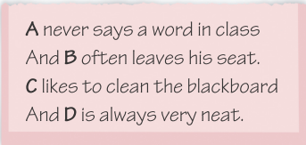
Step 2
Write the verse
Now write your verse about your classmates.
Use the example below to help you.

Slide 13
Part III While-Learning

Slide 14
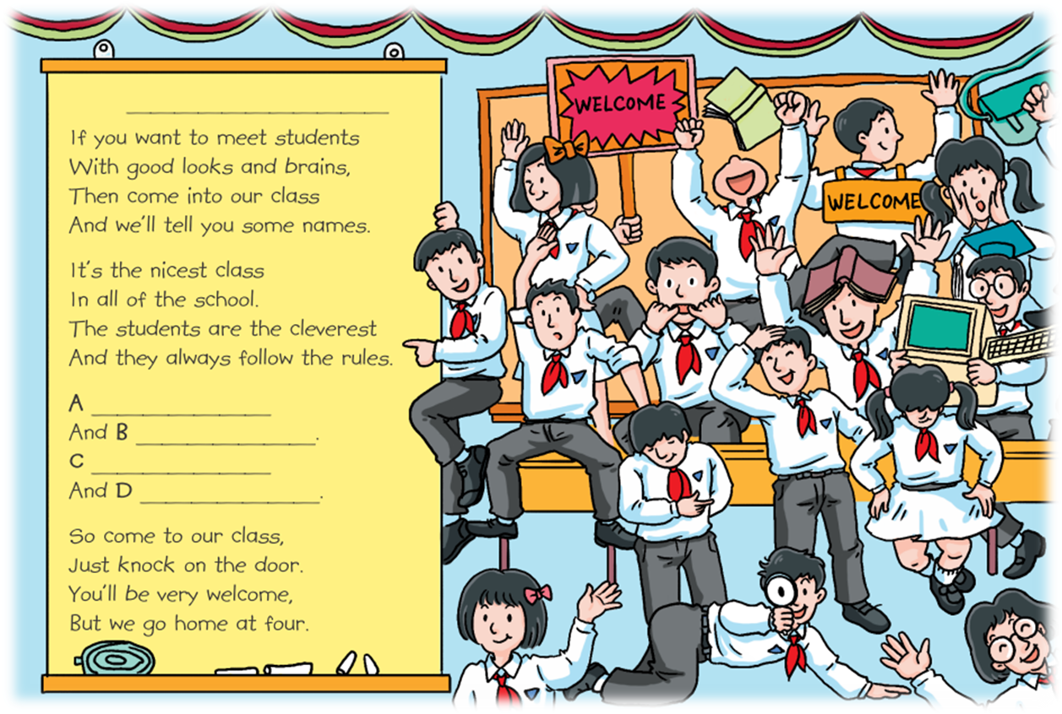
Put your verse into the poem on page 99. Don’t forget to give a title to the poem.

Slide 15
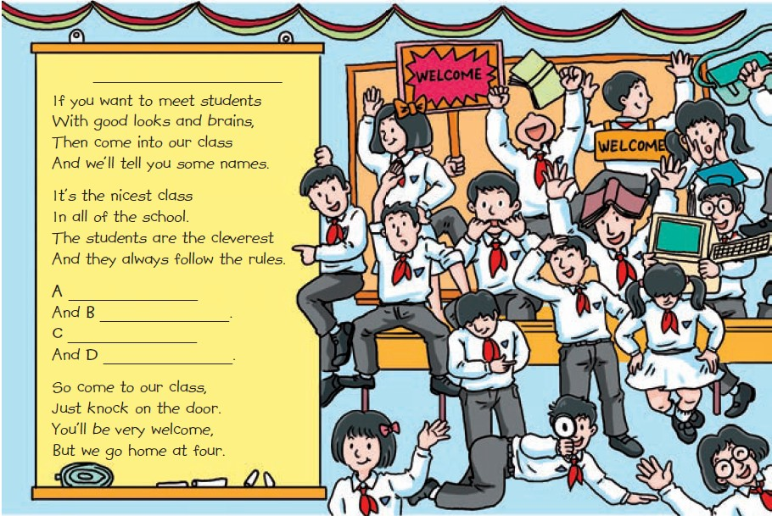
1. What does the student look like?
2. What is the student like?
3. What does the student like to do?
4. What do you think of this student?

Slide 16
If you want to meet students
With good looks and brains,
Then come into our class
And we'll tell you some names.
So come to our class,
Just knock on the door.
You’ll be very welcome,
But we go home at four.
It's the nicest class
In all of the school.
The students are the cleverest
And they always follow the rules.
A __________________________
And B ______________________
C __________________________
And D ______________________

Slide 17
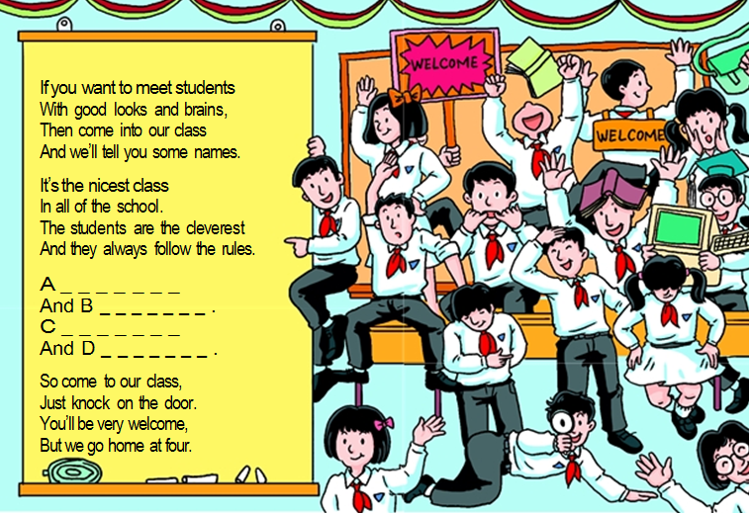

Read and guess

Slide 18

Let’s learn the useful expressions.

Slide 19
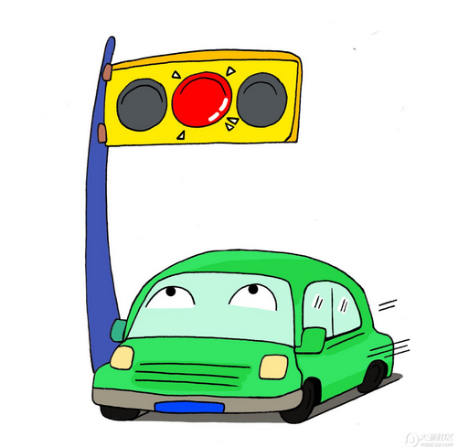
Notes P99
1. And they always follow the rules. （P99-A2）
他们总是遵守纪律。
follow v.遵循
遵守交通规则
Follow the traffic rules.

Slide 20
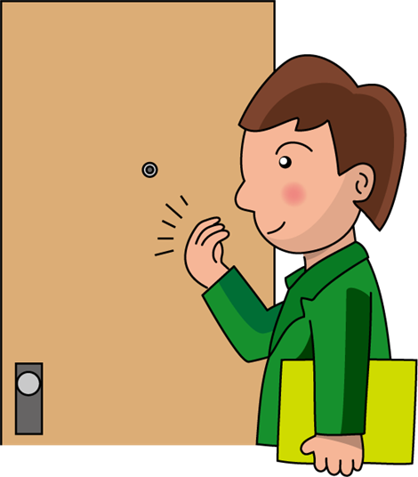
2. Just knock on the door.（P99-A2）
他们总是遵守纪律。
knock on 敲（门、窗等）
是谁在敲打我窗？
Who is knocking on my window？

Slide 21
Part IV Post-Learning

Slide 22

假设你是你们班的班长，你要给同学们讲述你们班的班规。请根据以下表格的内容提示写一则英语口头通知，讲述你们班的班规，并简述你对班规的看法，可适当发挥。词数80 左右，文章开头已给出，不计入总词数。

Slide 23
班规 | 1. 七点半前要到达教室，不要迟到。 2. 在教室里不要吃东西或大声说 话，要保持教室整洁和安静。 3. 课堂上提出问题或回答问题前 要先举手。 4. 下课后不要冲出教室。 5. 教室里没人的时候要关灯、锁门。
对班规的看法 | 遵守班规对我们有好处也很有必要；严格的班规有助于我们把事情做好。

Slide 24
Step 1: 激活词汇
你能想到本单元或以前学过的一些与班规有关的词汇吗？把它们写下来吧！
1. 到达
2. 使……保持清洁
3. 举手
4. 在课堂上
5. 冲出去
6. 关（电灯、机器等）
7. 遵守班规
arrive at / arrive in / get to
keep ... clean
put up one’s hand(s)
in class
rush out
turn / switch off
follow the class rule(s)

Slide 25
Step 2: 精彩结构
运用以下结构，可以让你的文章更出彩哦。
1. 祈使句的肯定式
【例】认真听老师讲课。
Listen to the teacher carefully.
【译】七点半前要到达教室。
Arrive at the classroom before 7:30.

Slide 26
2. 祈使句的否定式
【例】不要开门。
Don’t open the door.
【译】在教室里不要吃东西或大声说话。
Don’t eat anything or talk aloud in the
classroom.

Slide 27
3. It is +形容词+ for sb to do sth
“对某人来说，做某事是……的”
【例】对汤姆来说，学好英语很容易。
It is easy for Tom to learn English well.
【译】对我们来说，遵守班规有好处也很有
必要。
It’s good and necessary for us to follow
the class rules.

Slide 28
Step 3: 谋篇布局
文章内容可分成两段。第一段说明电的______，第二段介绍 _____________。短文应采用 ________时态。
班规
对班规的看法
一般现在

Slide 29
Step 4: 小试身手
Hi, everyone. Now let me tell you something about the class rules. Firstly, don’t be late! Arrive at the classroom before seven thirty. Secondly, don’t eat anything or talk aloud in the classroom. We should keep our classroom
clean and quiet. Thirdly, put up your hands before you ask or answer questions in class. Fourthly, don’t rush out of the classroom after class. Finally, turn off the lights and lock the door when there is no one in the classroom. It’s good and necessary for us to follow the class rules. Strict class rules help us do things well.

Slide 30
Part V Review

Slide 31
翻译下列短语或句子。
1. 举办一场讲座
2. 一位著名的诗人
3. 下周三下午
4. 在五楼
5. 收集诗歌
6. 带上
7. 别迟到。
8. 保持安静
have a talk
a famous poet
next Wednesday afternoon
on the fifth floor
collect poems
take ... with
Don’t be late.
keep / be quiet

Slide 32
Thank you!

