Slide 1

Grammar-
Proper nouns & Conjunctions

Slide 2


Warming-up
Grammar A
What famous places in Paris do you know?
the Eiffel Tower
the Louvre Museum
the Champs-Elysees
The French Alps
…
Proper nouns
专有名词

Slide 3
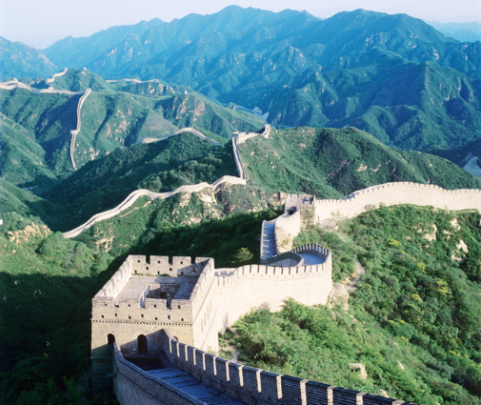
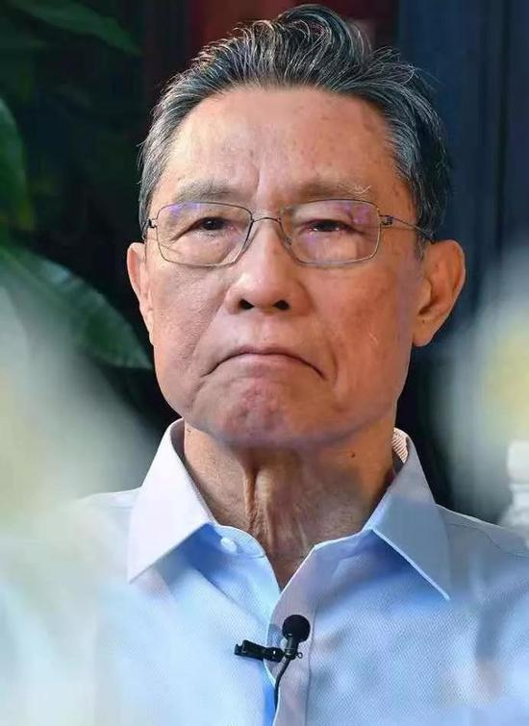

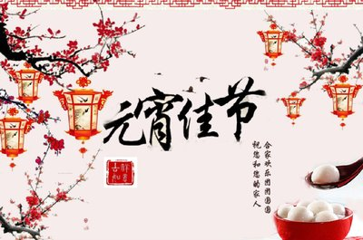
Proper nouns
the Great Wall
Zhong Nanshan
the United Nations
Rule 1: We use a proper noun to refer to the name of a particular _________, ___________ , _________ , _______________.
person
organization
place
time or festival
the Lantern Festival

Slide 4
Have a try
the Tower of Pisa
may
May
tower
the Red Cross
Tuesday
French
red cross
spring
Professor Green
People’s Park
Mary
park
day
Christmas Day
railway station
the UK
Rule 2: A proper noun starts with a a (capital letter / small letter).

Slide 5
Proper nouns
Names of people
Professor Green
Mary
Names of places
the Tower of Pisa
People’s Park
Organizations
the Red Cross
Days of the week
Tuesday
Months
May
Festivals
Christmas Day
Language
French
Abbreviation 缩写
the UK，CID, FBI, ID

Slide 6
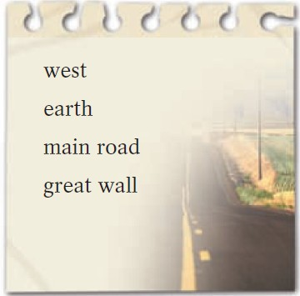
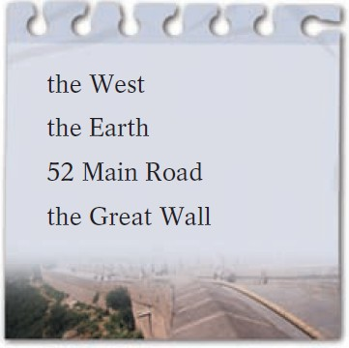
A1 Look at the two lists below. What is the difference between the nouns in List A and List B? Can you think of some more examples?
西；西方
陆地；泥土
（城镇的）主要街道
巨大的墙
西方国家；西欧及北美
地球
（指特定的路名）
中国长城
china
陶瓷
China
中国

Slide 7
A2 Read the passage below. Some of the nouns should begin with a capital letter. Underline these nouns and write the correct nouns above them.
P22
July
Beijing
Uncle Zhang
Last july, I went to beijing to visit uncle zhang. He took me to many interesting places such as the great wall, the summer palace and the palace museum. I learnt a lot about the ming and the qing dynasties. We also visited the main stadium for the 2008 olympics. We went shopping on wangfujing street. I had a wonderful time in beijing and I plan to visit it again during the spring festival next year.
Great Wall
Summer Palace
Palace Museum
Ming
Qing
Dynasties
Olympics
Wangfujing Street
Beijing
Spring Festival

Slide 8
Further-thinking
How to write Chinese names in English?
Li Mei
李梅
王海
张思华
司马建中
长孙无忌
Wang Hai
Zhang Sihua
Sima Jianzhong
Zhangsun Wuji
姓与名分开写（复姓写在一起）
姓与名第一个字母大写

Slide 9
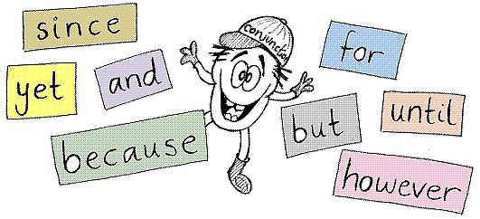
Grammar B
Conjunctions: 连词
We use the conjunctions and, but and so to link two sentences. They show different relationships（关系） between the sentences.

Slide 10


Work out the rules
There are many vineyards in centre of France and farmers grow grapes to make excellent French wine.
而且，和
但是（转折）
A French town by the sea is the perfect place for a summer holiday, but if you prefer to visit France in winter, you can try skiing on the mountains in the French Alps.
所以（因果）
France has something for everyone, so why not visit France this year?
Work out the rule
We use________ to mean ‘also’.
We use________ to show a different idea.
We use________ to show a result.
and
but
so

Slide 11
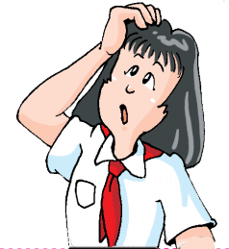
Further-thinking
She came in and took her coat off.
Miss another class and you will fail.
接着，然后
那么（结果）

Slide 12
Have a try
Fill in the blanks
The hotel is very clean, _________the price is not very high.
My grandfather is seventy years old, ________he still enjoys working.
It looks like rain, ________I took an umbrella with me.
and
but
so

Slide 13
Work out the rules
Hurry up, ______ you’ll be late for school.
Work hard, ______ you won’t be successful.
We use ______ to mean “a different result”.
or
or
or
（否则，要不然）
T or F
Because there was something wrong with the clock, so he got up late.
We can’t use _________ and _______ in the same sentence.
F
because
so

Slide 14
Practice
Complete the sentences with and, but, or, so.
I want a pet, _____ my parents won’t allow me to have one.
Don’t watch TV too much, _____ you don’t have enough time to finish homework.
It rained hard this morning, _____ I went to school with an umbrella.
Our dog eats bones, drinks milk ______ sleeps on the sofa.
I went to sleep very late last night, _____ I feel tired today.
I have short, black hair, ______ my sister has long curly hair.
but
or
so
and
so
but

Slide 15
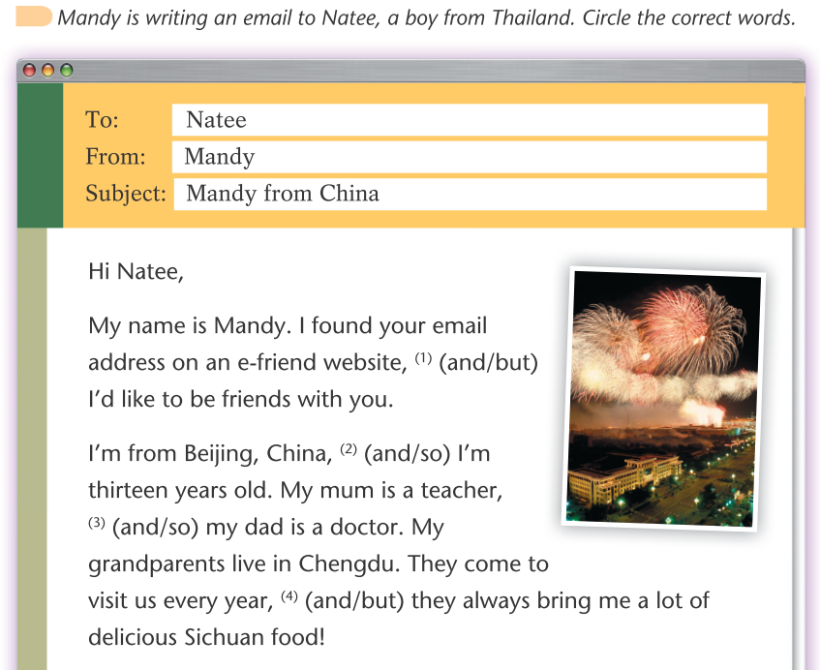
Practice
P23

Slide 16
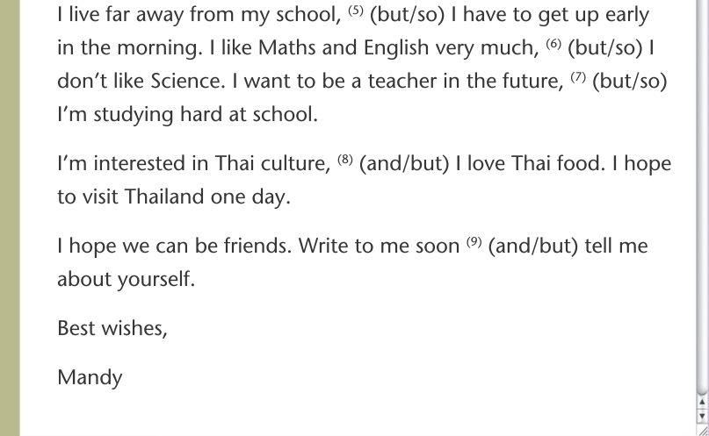

Practice

Slide 17

Summarize
Proper nouns
表示具体的人、事物、团体、地方、专有机构等的名称，其开头的第一个字母要大写。
Conjunctions
and 而且，和，然后，那么
but 然而，但是
so 因此，所以
or 否则，要不然

Slide 18
Practice
下面句子中各有一处错误，请找出并改正。
1. We are going to have a test next monday.
2. One of the students in our class is from canada.
3. I have a penfriend named jessica.
4. Alice wants to buy some special flowers to make her house beautiful during spring festival.
5. Aunt tang is an excellent doctor.
Monday
Canada
Jessica
Spring
Festival
Tang

Slide 19
Practice
Be quick, _________ you will be late for the meeting.
A. but B. or C. so D. and
2. My grandfather is in his 80s, ________ he is still in good health.
A. but B. or C. so D. and
3. Think it over ________ you will find a way.
A. but B. or C. so D. and
4. Don’t frighten the horse, ______ it will kick you.
A. but B. or C. so D. and
5. There is air all around us, ________ we can’t see it.
A. but B. or C. so D. and

Slide 20





“双减”背景下，作业如何减负？
Homework
Notes:
单击“同步练习题”字样，即可打开本课时同步练习题的Word文档。

Slide 21

书面作业（选做）
创新探究性作业（选做）
1. 完成《双语报》N2版Grammar跟踪练习。
2. 完成《双语报》N4版第四课时Grammar练习。
3. 完成阳光学评P27 Grammar部分练习。
4.总结这节语法课仍然存在疑惑的点，整理成错题本。
1. 小组合作，用思维导图梳理and, but, so, or的使用规律；

Slide 22
Thank you!

