Slide 1
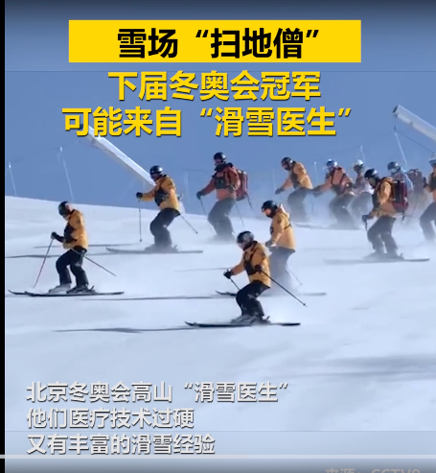

Slide 2
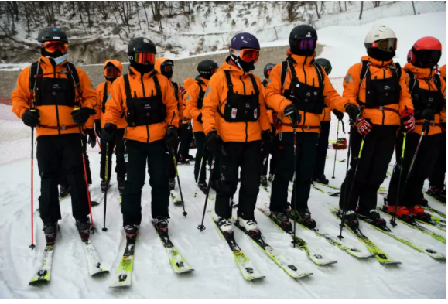
have been trained
A group of doctors _________________(train) specially in skiing skills in China over the last four years ________ preparation for providing medical treatment ________ the Beijing Winter Olympics.
in
during

Slide 3
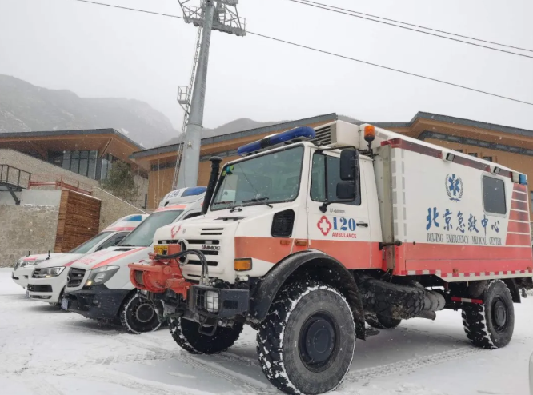
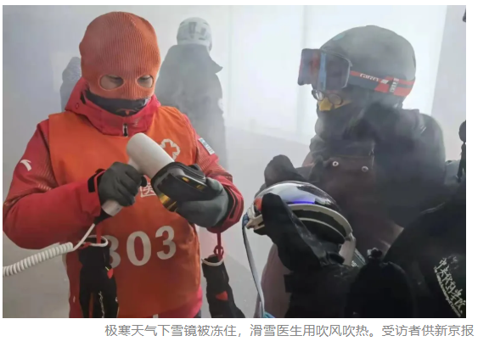
on
In the field, if there's an accident, ski doctors have to be _______ the scene in four minutes with a 10-kilogram medical bag, _______ they have to deal with the injuries and remove the __________(injure) athlete from the track in just 15 minutes.
Training six hours a day, four weeks in a row, Chinese ski doctors have been doing this kind of intense physical and mental training for four winters.
and
injured

Slide 4
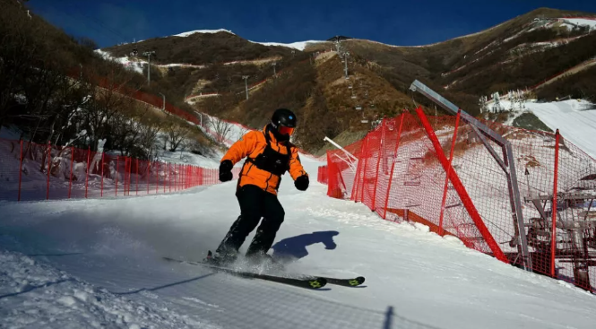
The biggest challenge for alpine skiing doctors is not only skiing proficiently on professional mountain courses with a gradient of around 70 degrees, but also _________(stop) accurately on smooth courses, according to media reports.
stopping

Slide 5
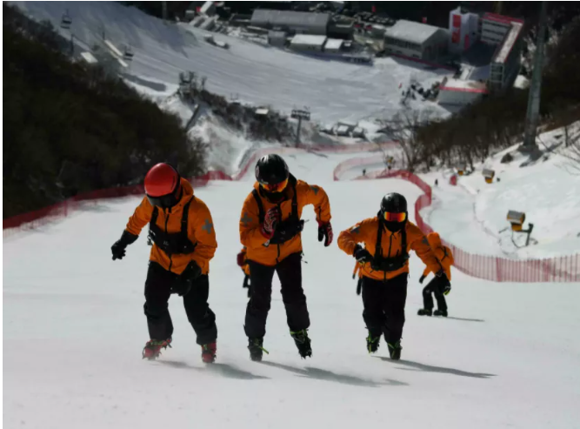
When foreign ski doctors first came to China before the opening ceremony, they may _______________(have) some doubts because there were no professional ski doctors in China before _______ point. __________ communication and working together, they have seen that our professional and skiing skills were actually very strong, Bai said.
have had
that
After

Slide 6


