Slide 1

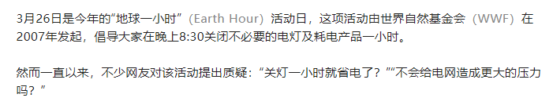


Slide 2
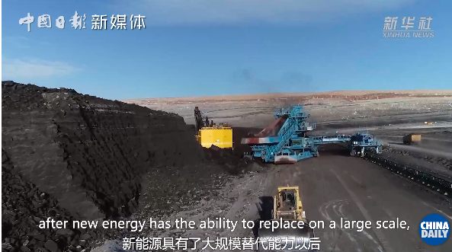
我们觉得像这样的讨论其实也是提升公众和社会环保意识的有益方式方法。（翻译）
We think that discussions like this are actually a beneficial way to raise public and social awareness of environmental protection.

Slide 3
用这样一个简单但是具有标志性的动作, 我们可以唤醒大家对生态环保应对气候变化的意志和决心。
With such a simple but iconic action，we can awaken everyone's will and determination to protect the environment and deal with climate change.

Slide 4
cooperation
The ___________(cooperate) between the government and the people is important to the achievement of the dual carbon goal.
________ also shows the advantages of the Chinese system.
政府与民众的协同配合对双碳目标的实现非常重要，也能彰显中国制度的优势。
It

