Slide 1
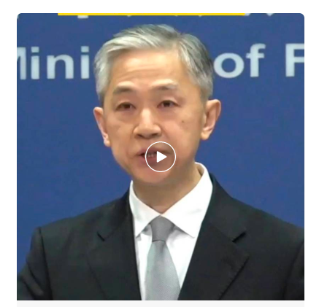

Slide 2
汪文斌回答：台湾当局不放弃任何一个机会蹭热点、博眼球、刷存在。这种伎俩不会得逞。
The Taiwan authorities won't let go of any opportunity to chase the clout and assert themselves in a grandstanding manner. Such attempts are doomed to fail.
词语解释
Chasing clout：通常指在社交媒体上追逐热度、流量和名气。Clout指势力、影响力。追求流量的人则被称为clout chaser。
Assert oneself：迫使人们承认自己的权利；显示自己的权威。类似于网络用语常说的“刷存在感”。
Grandstanding：哗众取宠

Slide 3
真正名誉受损的是那些打着民主、人权旗号肆意干涉别国内政、四处对外发动战争的国家。
The truly discredited countries are those that wantonly interfere in other countries’ internal affairs and wage wars in the name of democracy and human rights.
词语解释
Credit有信用、荣誉、赞许的意思。
Discredit作为动词，指败坏某人的名声；使某人丧失信誉，名声扫地。
Discredited则是动词分词作形容词用，指名誉扫地的。

