Slide 1
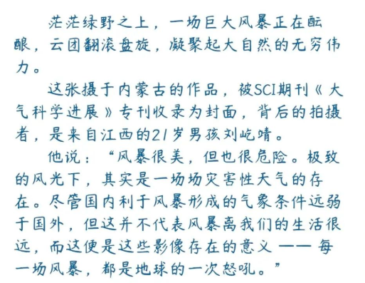
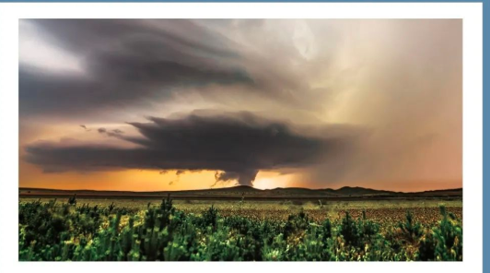

Slide 2
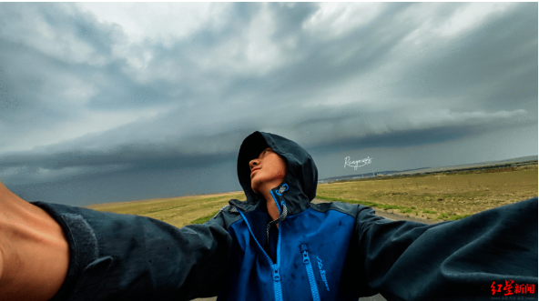
When storm clouds gather, _________ the wind howls in anger, the natural reaction for most people is _________(seek) shelter. ________ some run toward the danger. Photographer Liu Yijing is one of that rare breed, as he captures and frames nature's wrath.
当风暴来袭，大多数人面对黑云压顶、狂风怒号的自然反应是寻找避风港，但有些人却选择奔向险境。风暴摄影师刘屹靖就是这稀有人群中的一员，他用相机捕捉大自然的愤怒。
and
to seek
But

Slide 3
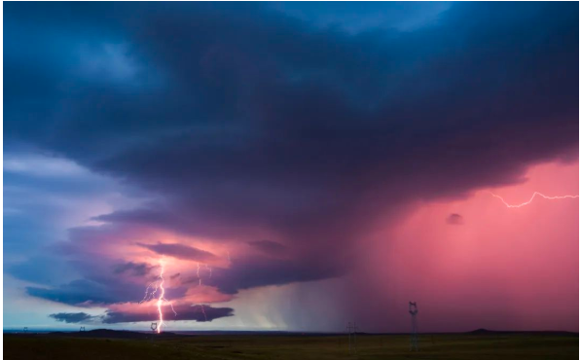
For the past year, Liu, 21, ____________ (travel) about 24,000 kilometers across 11 provincial-level administrative regions in China, chasing and recording thunderstorms. From the first signs---a stronger breeze ______________(develop) into a gale, a turbulent sky, and birds fleeing－he prepares for _______ appears to be a daunting task. In 2021, he took more than 48,000 time-lapse photos, showing Mother Nature at her most violent.
在过去一年里，21岁的刘屹靖途径11个省，跨越2.4万公里，追逐拍摄壮丽的风暴。当风暴开始酝酿，微风渐强、风起云涌、鸟儿四散，刘屹靖已做好准备，迎接这令人心惊胆战的挑战。2021年，他拍摄了超过4.8万条照片和延时影像，展现了自然之母最暴力的一面。
has traveled
developing
what

Slide 4
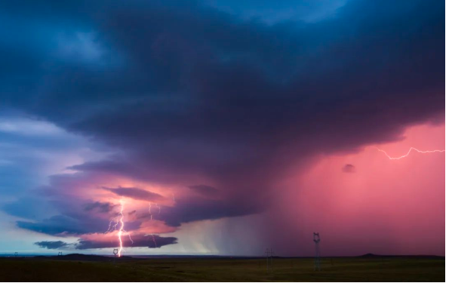
Liu has received a great deal of __________（recognize） for his work. His photos captured a complete supercell structure ______ occurred in the Inner Mongolia autonomous region on Aug 22. This image has been picked ____ the cover photo for the May edition of Advances in Atmospheric Sciences, a key publication in its field.
刘屹靖的作品广受赞誉。他用镜头捕捉到了8月22日发生在内蒙古的一个完整的超级单体雷暴，该作品后被SCI期刊《大气科学进展》五月专刊收录为封面。
recognition
that
as

