Slide 1
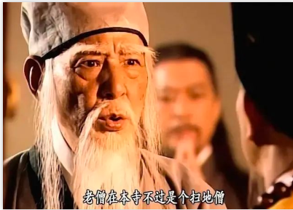
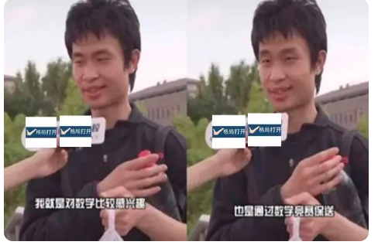

Slide 2
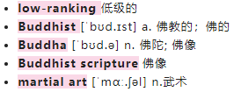
The sweeping monk, a low-ranking figure __________(know) to the world whose daily job is to sweep the floor in a tower ________ Buddhist scriptures are stored in Shaolin Temple, later ________
(turn) out to be a top martial arts master.
扫地僧是一个名不见经传的低级人物，每天的工作是在少林寺的一座藏经阁里扫地，后来人们竟然发现他居然是一位顶级武林高手。
Therefore, Chinese netizens use the term to refer to _______ who appear to be ordinary _______ are in fact the top elites in their industry or field.
因此，中国网民用这个词来指代那些看似普通，但实际上是所在行业或领域的顶级精英的人。
unknown
where
turns
those
but

Slide 3
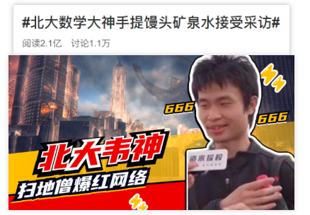
Holding a big bottle of water and a bag of steamed buns, and with ____________(comb) hair and a slightly awkward way of speaking, Wei Dongyi does not seem _______ a typical university teacher.
拿着一大瓶水和一袋包子，头发蓬乱，说话的方式略显尴尬，韦东奕看起来不像是典型的大学老师。
uncombed
like

Slide 4
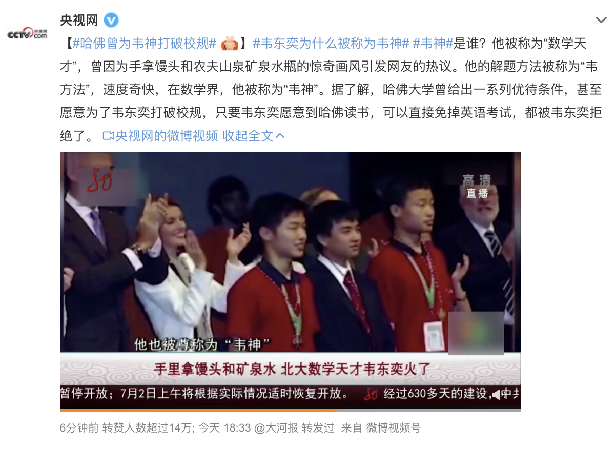

Slide 5
Wei, an assistant professor at Peking University's School of Mathematical Sciences, recently became an online sensation after netizens found the somewhat shy and unsophisticated man has an extraordinary talent for mathematics.
近日，北京大学数学科学学院助理教授韦东奕在网上引起了网友们的热议，网友们发现这个有点害羞、朴实无华的男人有着非凡的数学天赋。
sensation [senˈseɪ.ʃ ə n] n. 引起轰动的人(或事件、情况)
unsophisticated [ˌʌn.səˈfɪs.tɪ.keɪ.tɪd] a. 单纯的；不懂世故的；没经验的

Slide 6
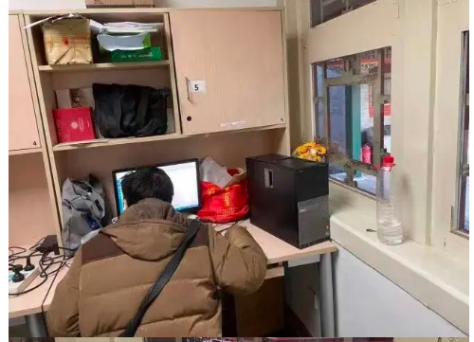
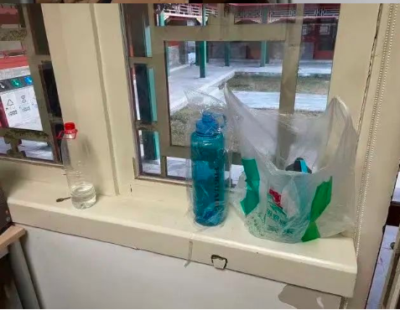

Slide 7
In a viral video, Wei was asked to give encouragement to high school graduates who were taking the national college entrance exam, or gaokao. He simply replied: "Welcome to Peking University. I don't know what else to say.”
Wei said he is a teacher at the university and enrolled there in 2010 __________ taking the gaokao, as he _____________(perform) well in math competitions while in high school.
without
had performed

