Slide 1

Unit 2

Slide 2

UNIT 2
HEALTHY LIFESTYLE

Slide 3

Do a health survey

Slide 4


To do a healthy survey

Slide 5

How well are your classmates looking after their physical and mental health? Work in groups and make a survey. Design a multiple-choice questionnaire to collect information. Use online survey tools if possible to help you make, distribute, and analyse your questionnaires.

Slide 6

PHYSICAL HEALTH
1. Ask questions about what to eat and drink, such as staple foods, snacks, drinks, and other substances, etc.
EXAMPLE
How often do you skip meals?
□ never □ once a day □ several times a week
□ others:_________
2. Ask questions about what to do with one's body, such as sitting, exercise, sleeping, etc.

Slide 7

MENTAL HEALTH
1. Ask questions about what people do in their spare time, such as reading, watching TV, using phone/Internet, playing video games, etc.
2. Ask questions about what people do to feel better when they are stressed, unhappy, or angry.
3. Ask questions about what to do with one's mind, such as learning new things for fun, doing creative activities, etc.

Slide 8


A Health Survey
What kinds of sports do you have regularly?
A. Walking. B. Running.
C. Swimming. D. Other: _____________.
Usually, do you exercise alone or with a friend/family member?
A. Alone. B. With friends.
C. With family members. D. Other: _____________.

Slide 9
How many days do you sleep for 8 hours or more each week?
A. None. B. 1-3 days. C. 4-6 days. D. 7 days.
What do you spend most of your spare time doing?
A. Homework. B. Reading.
C. Surfing the Internet. D. Other: _____________.

Slide 10
What do you do when you feel stressed or depressed?
A. Talk to my family. B. Talk to my friends.
C. Do sports.
D. Listen to music or watch movies.
E. Play games. F. Read a book.
G. Other: ______________________.
If you can choose, whom would you rather spend time with?
A. Myself. B. Friends.
C. Family members. D. Strangers.

Slide 11
Each person in your group should help make the survey. Then ask classmates outside your group to take the survey.

Slide 12
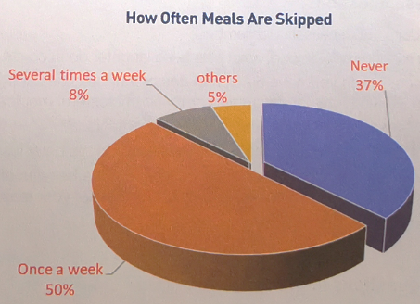

Collect and analyse the survey results by creating pie charts, bar charts, or other ways of summarising data.

Slide 13


Prepare a written or oral report, giving general recommendations for how to solve the most common lifestyle problems that you have found among your classmates.

Slide 14


