Slide 1
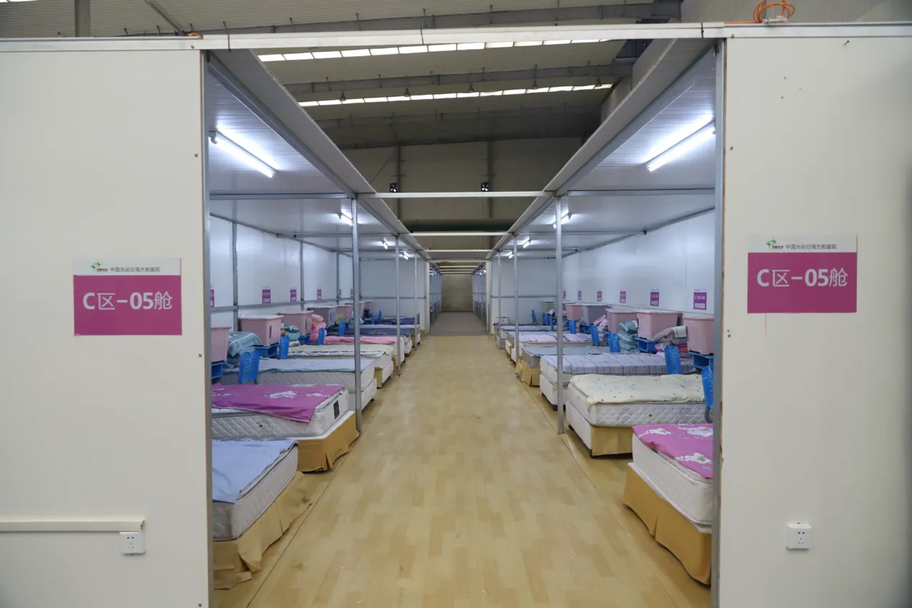
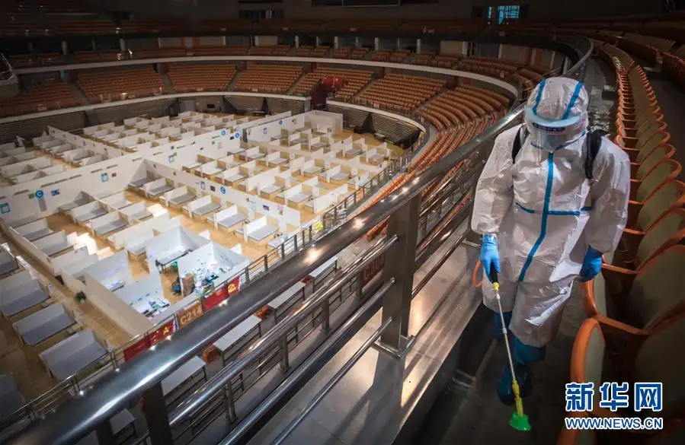
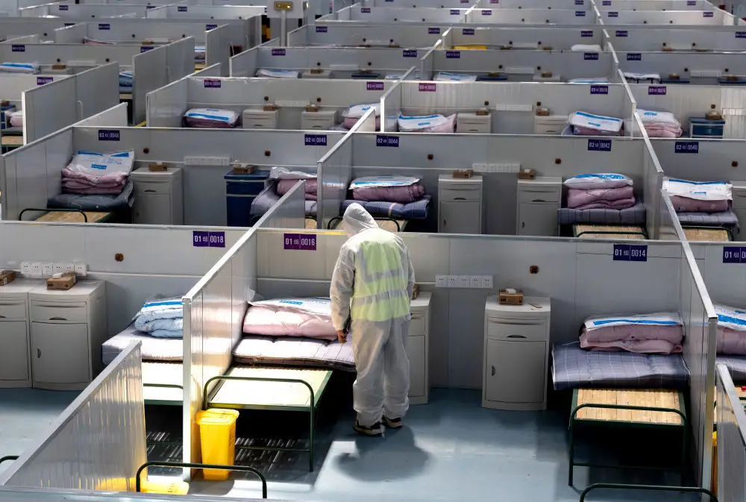
方 舱 医 院

Slide 2
方舱医院的翻译？
mobile hospital
temporary hosptial
cabin hospital
makeshift hospital
fangcang shelter hospital
alternate care site
√
√
√
In order to provide care for more patients and ease the shortage of beds in major hospitals, Wuhan built the makeshift Huoshenshan and Leishenshan hospitals for novel coronavirus patients. With the efforts of thousands of workers, the hospitals were finished in half a month.

Slide 3
When the winter vacation started, none of us expected it to be so different. Over 50 days have passed since the beginning of the novel coronavirus outbreak. It’s also more boring than usual. All I could do was attending online classes and doing my homework.But I became one of the “online supervisors (监督者)” for the construction sites of Huoshenshan Hospital and Leishenshan Hospital.The construction process of the two makeshift hospitals was livestreamed online from the end of January to early February. A great number of Internet users watched it every day . What can you do in 10 days? Read a book or watch a TV series? Here in China, 10 days is enough to build an entire hospital!When the hospitals were finished, the livestreaming website was bombarded (轰炸) with “bullet comments (弹幕评论)” sent by millions of Internet users to congratulate the construction workers and to say how impressed they were by our country. I was so touched, not only by the comments, but also by the fact that so many people were trying their best to overcome the virus and defeat death.
p________
a________
n______
w______
e______
f_______
f____

Slide 4
Springtime in Shanghai is the best! The rest of the time, it’s too hot and rainy to even walk to the supermarket.
Unfortunately, we’re all missing the good weather. Due to the COVID-19, I’ve been under lockdown (封闭管控) since March 24, but some people here have been stuck inside for even longer! Our community workers have also not been home for more than a month.
We were told we could come out on April 1, but the day came and we couldn’t go out. When would we be free? Nobody would say. We tried to order groceries (食品杂货) through Meituan. Everything was closed. We tried restaurants, but it was the same. Our fridge was getting empty. We were low on toilet paper.
After a couple of weeks, my wife’s company sent some food and household supplies. People in our compound (小区) also started arranging (安排) group deliveries (团购) through WeChat. We are in the flour group, the vegetable group and the coffee group. We spend hours each day looking for groceries on WeChat. It’s like having another job. It’s very stressful.
In this tough time, I am grateful (感激的) for my neighbors. Even though we are stuck indoors, we are closer than ever. When we go for our daily tests, we talk and joke around. We share food and supplies (物资). One day, I fiddled (拉小提琴) on the balcony and neighbors listened and cheered. We’ve all decided to make the best of a bad situation.
I just hope it doesn’t get any worse. One thing is for sure: when this is over, even a hurricane (飓风) won’t stop me from walking to the supermarket.

