Slide 1
平安到家！
神十三航天员顺利出舱
大家可以写在P63页空白处

Slide 2
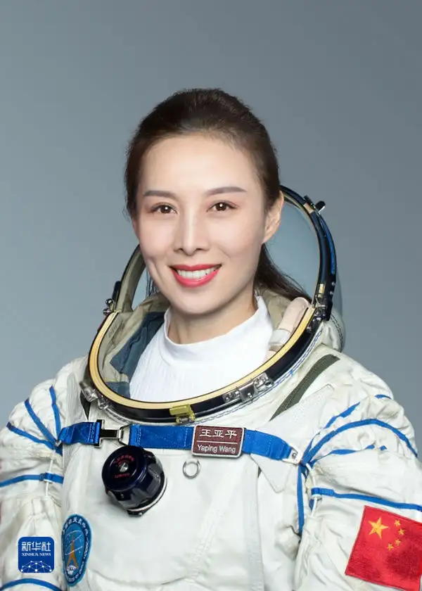
Wang Yaping’s space dream started in 2003, when China sent its first astronaut Yang Liwei into space. She told herself, “China now ______(have) a male astronaut. When will there be a female one? ” At that time, Wang was a pilot in the Chinese army. After having safe flights for 1,600 hours over nine years, Wang was a strong candidate _____ （become）an astronaut in 2010. She pushed herself hard, getting the same training as men, _____ (include) the pull-ups (引体向上) and barbells (杠铃). “The space environment won’t change because you are a woman.” she told Xinhua.
That strong spirit finally ____ (lead) to realizing her dream in 2013. She_____ (join) the team for the Shenzhou X mission.
has
to become
including
led
joined

Slide 3
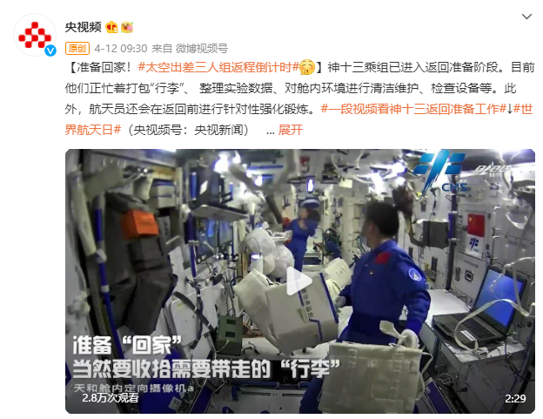

Slide 4
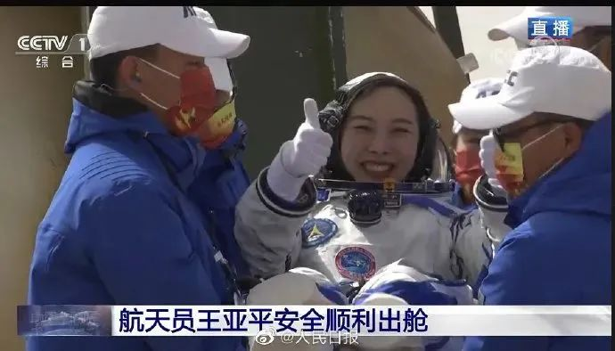
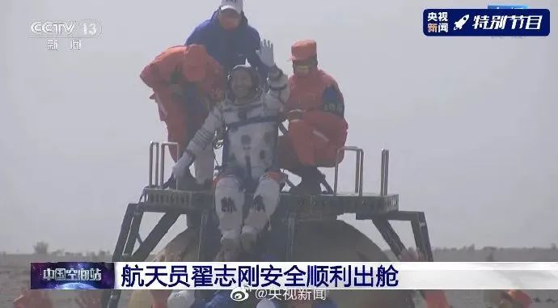
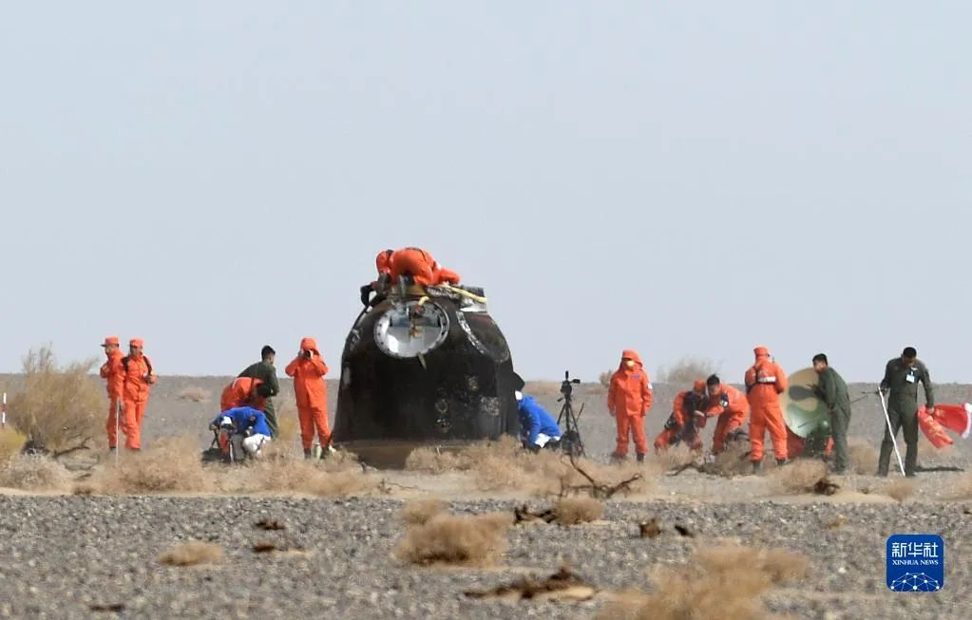
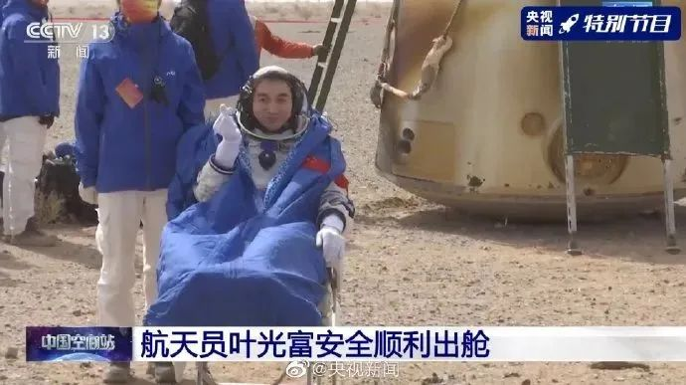
sent
Three Chinese astronauts, the second team ___(send) to orbit for space station construction, have completed their six-month mission and returned to Earth safely on Saturday，April 16th，2022.
The return capsule of the Shenzhou-13 manned spaceship, ___ (carry) astronauts Zhai Zhigang, Wang Yaping and Ye Guangfu, touched down at the Dongfeng landing site in north China's Inner Mongolia Autonomous Region.
Zhai Zhigang, Wang Yaping and Ye Guangfu, astronauts from China‘s Shenzhou-13 manned spaceflight mission, made their first ____ (appear) out of the return capsule after ____ (safe）_____ (land) back on Earth.
carrying
appearance
safely
landing

Slide 5
China's record-setting Shenzhou 13 missionis in the books.
After orbiting Earth for six months, ___1___ three crew members of China's Shenzhou XIII mission have departed ___2___ the Tiangong space station and returned to the mother planet on Saturday morning, finishing the nation's ___3___(long) manned spaceflight.
Shortly after landing, all three astronauts radioed that they were feeling fine after their long space mission, bringing ___4___(applaud) from the China National Space Administration's mission control center in Beijing.
Shenzhou 13 set other national marks as well. For example, the mission's Wang Yaping became the first woman to live aboard Tianhe and the first Chinese woman ever ___5___ (conduct) a spacewalk.
Wang was joined on Shenzhou 13 by Ye Guangfu and Zhai Zhigang, ___6___ commanded the mission. They were very busy during their six months in orbit. The astronauts — or taikonauts, as Chinese spaceflyers are called — performed two spacewalks, conducted more than 20 different scientific experiments and delivered two live ___7___(education) lectures from Tianhe.
The Shenzhou 13 crew also spent some time ___8___(get) Tianhe ready for its next round of visitors, which will arrive ___9___(relative) soon; the Shenzhou 14 mission ___10___(expect) to launch in early June.

Slide 6
China's record-setting Shenzhou 13 missionis in the books.
After orbiting Earth for six months, ___1___ three crew members of China's Shenzhou XIII mission have departed ___2___ the Tiangong space station and returned to the mother planet on Saturday morning, finishing the nation's ___3___(long) manned spaceflight.
Shortly after landing, all three astronauts radioed that they were feeling fine after their long space mission, bringing ___4___(applaud) from the China National Space Administration's mission control center in Beijing.
Shenzhou 13 set other national marks as well. For example, the mission's Wang Yaping became the first woman to live aboard Tianhe and the first Chinese woman ever ___5___ (conduct) a spacewalk.
Wang was joined on Shenzhou 13 by Ye Guangfu and Zhai Zhigang, ___6___ commanded the mission. They were very busy during their six months in orbit. The astronauts — or taikonauts, as Chinese spaceflyers are called — performed two spacewalks, conducted more than 20 different scientific experiments and delivered two live ___7___(education) lectures from Tianhe.
The Shenzhou 13 crew also spent some time ___8___(get) Tianhe ready for its next round of visitors, which will arrive ___9___(relative) soon; the Shenzhou 14 mission ___10___(expect) to launch in early June.
the
from
longest
applause
to conduct
who
educational
getting
relatively
is expected

