Slide 1
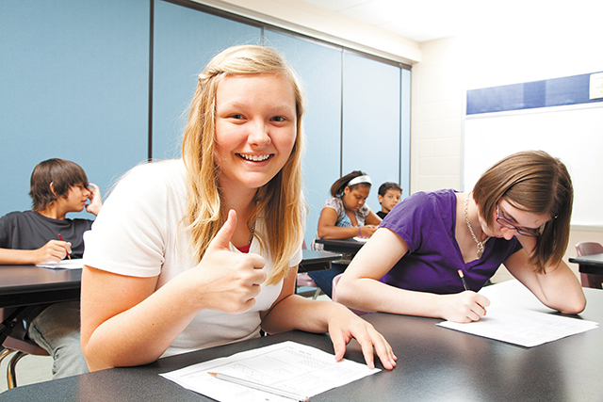
Less stress for tests

Slide 2
To students in England, the General Certificate of Secondary Education (GCSE) examination is like the zhongkao in China. After two years of the COVID-19 pandemic, England’s GCSE exams have been c_______. It affects Year 11 exam takers, like me. Back in February, the GCSE exam boards (考试委员会) said they would reduce the amount of i _______ we need to know for the summer exams. This is due to the many interruptions in our education over the past two years. Not all schools were able to c______ teaching their students during lockdown. Reductions on the syllabus (教学大纲) came mostly as a relief but also c_______ some confusion because what’s been cut out is not always clear.
Most people in my school take at least nine GCSE exams. Five exams (English, math, physics, chemistry and biology) are obligatory (必须的), and another four can be c_______, for example, French, philosophy, history or art. I am taking 12 GCSE exams this year, and the workload (负担) can get a bit too heavy sometimes. So my friends and I are very happy with the reductions!
With the final exams coming up in two weeks, everyone in my year is b_____ studying. Some of my friends, who are super organized, are still taking on extracurricular (课外的) activities! I keep reminding them that they need to give themselves breaks to a_____ overworking their brains; it will do more damage than good! This applies to all students. Whenever you feel overloaded with schoolwork, take a five-minute break to refresh your mind. It will help you be more productive (有效率的)!

Slide 3
To students in England, the General Certificate of Secondary Education (GCSE) examination is like the zhongkao in China. After two years of the COVID-19 pandemic, England’s GCSE exams have been changed. It affects Year 11 exam takers, like me. Back in February, the GCSE exam boards (考试委员会) said they would reduce the amount of information we need to know for the summer exams. This is due to the many interruptions in our education over the past two years. Not all schools were able to continue teaching their students during lockdown. Reductions on the syllabus (教学大纲) came mostly as a relief but also caused some confusion because what’s been cut out is not always clear. This has caused some confusion among students.
Most people in my school take at least nine GCSE exams. Five exams (English, math, physics, chemistry and biology) are obligatory (必须的), and another four can be chosen, for example, French, philosophy, history or art. I am taking 12 GCSE exams this year, and the workload (负担) can get a bit too heavy sometimes. So my friends and I are very happy with the reductions!
With the final exams coming up in two weeks, everyone in my year is busy studying. Some of my friends, who are super organized, are still taking on extracurricular (课外的) activities! I keep reminding them that they need to give themselves breaks to avoid overworking their brains; it will do more damage than good! This applies to all students. Whenever you feel overloaded with schoolwork, take a five-minute break to refresh your mind. It will help you be more productive (有效率的)!

Slide 4
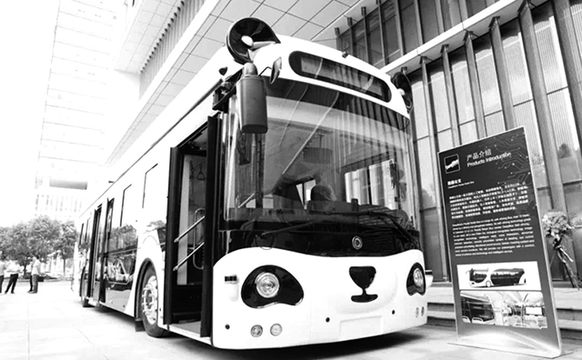
Look! Here comes a cute bus. It looks like a panda with black ears and big eyes. It can c______ 22 people and is about 12 meters long. A Chinese company made it.
The Smart Panda Bus uses AI technology . It can do a lot of things. The bus can drive by itself without a d______. Don’t worry! It’s very safe. When you get on the bus, you can swipe (刷) your hand. The bus will read your handprint and k_____ who you are. There are also robots on the bus. You can talk to them and ask them for help. If there is a thief on the bus, the bus will call the p______. People in some cities, such as Changzhou in Jiangsu, Jinan in Shandong and Deyang in Sichuan, can take the bus. Do you want to ride it?
Did you know?
Inside the bus, there is a vending machine . You can buy breakfast and dinner on the bus. This can s_____ you a lot of time.
carry
driver
know
police
save

Slide 5
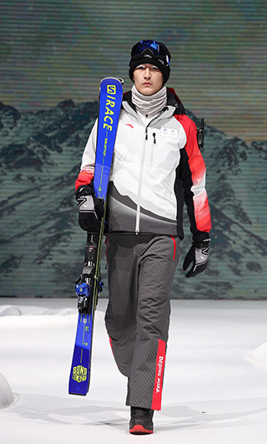
冬奥制服有哪些“黑科技”？
On October 27 , the official uniforms came out. There are three kinds of uniforms for staff , technical officials and volunteers . The uniforms are not just beautiful. They also have some cool technologies .
Shoes:
There is a button on the shoes. Press it and the shoes become tight on your feet.The soles of the shoes have a special design . It helps people stay stable on ice and snow.
Clothes:
They use graphene (石墨烯). It is great to keep people warm. Also the clothes are windproof and waterproof. They are soft enough for people to wear.
Gloves
The inner gloves fit people’s hands well. People can easily touch a screen without taking them off. Do you see the heart shape on the gloves? It is made of silica gel (硅胶). It stops things slipping from your hands.

Slide 6
staff (n. 工作人员)
technical officials (n. 技术官员)
tight (adj. 牢固的，紧的）
The soles (n. 鞋底)
slip （v. 滑，脱落）
Exercies：
The ridges on the soles of my boots stopped me from ______.
I was on friendly terms with most of the hospital _____.
She walked off the place in a miniskirt and _____ top.
My father works in a ______ school.
slipping
staff
tight
technical

Slide 7
听力原文
It is August 2050. Some people are writing about hotels, houses and cars on the Internet. Read their posts.
Life in 2050
The Hotel Whale
The Hotel Whale is built under the water. It is in the shape of a whale. This hotel has 50 bedrooms, a café and a shopping centre.
Mrs Peng: “When we were staying at the hotel recently, my children watched the fish outside their bedroom window. They were never bored!”
Forever Green Houses
These houses are both “green” and “smart”. There is glass outside the houses. Heat is held under the glass and is then used as energy for each house. In the bathroom, your medicine cupboard is connected to your doctor’s computer. In the kitchen, your smart fridge tells the supermarket’s computer when you need more food.
Mr Yu: “When we were living in our old house, we were using more energy. I would certainly recommend Forever Green Houses to my friends. They will satisfy everyone.”
The CJ3
The CJ3 is a new type of hydrogen car. The hydrogen in the car is mixed with oxygen from the air to make electricity for the car. The CJ3 has an electronic map and is driven by a computer. You tell the computer where you want to go. Then you sit back and relax as the car takes you there.
Mr Hu: “While I was driving my old car, I was polluting the city. Now, with the new technology in my CJ3, I’m helping protect the environment.”

Slide 8
七、书面表达: 未来遥不可及，又好像就在眼前。随着科技的不断发展，未来的生活会是什么样的呢？请你根据图表的提示，谈谈对未来生活的畅想。
P118
be designed with artificial intelligence/be greener and more intelligent . They can produce energy on their own.
robots will do all the housework.
Travelling will also be very easy as the houses are able to fly!
not only light but also have some cool technologies
change the temperature by itself according to
keep ---warm in-- and cool in--
much healthier
more kinds than before
provide peopple with more energy
avoid
Cars will be much faster and more convenient. / can be operated automatically
? safer
? They will not only have wings to fly but also change into ships easily to go under the sea.

Slide 9
Task 3 Make a short speech
请参照以下示例，用英语向你的同桌口头介绍未来的餐厅、医院与学校。
Items | Characteristics in the future | Supporting details
Restaurant | * * | * *
no waiters or
waitresses
A computer will read your mind to find out what you want to eat.
healthier
It only serves different kinds of healthy food.

Slide 10
more convenient
As soon as you walk into the hospital, you will receive a report on your health.
Hospital | * * | * *
School | * * | * *
free
All the medicine will be free to everyone.
e-classroom
use tablets instead of paper books and bags
The school computer system, at the end of the term, will evaluate the students’ performance by collecting information on how well they do in each course.
no exams

