Slide 1

Unit 5

Slide 2

Unit 5
Launching your career

Slide 3

Make a speech about your future career

Slide 4
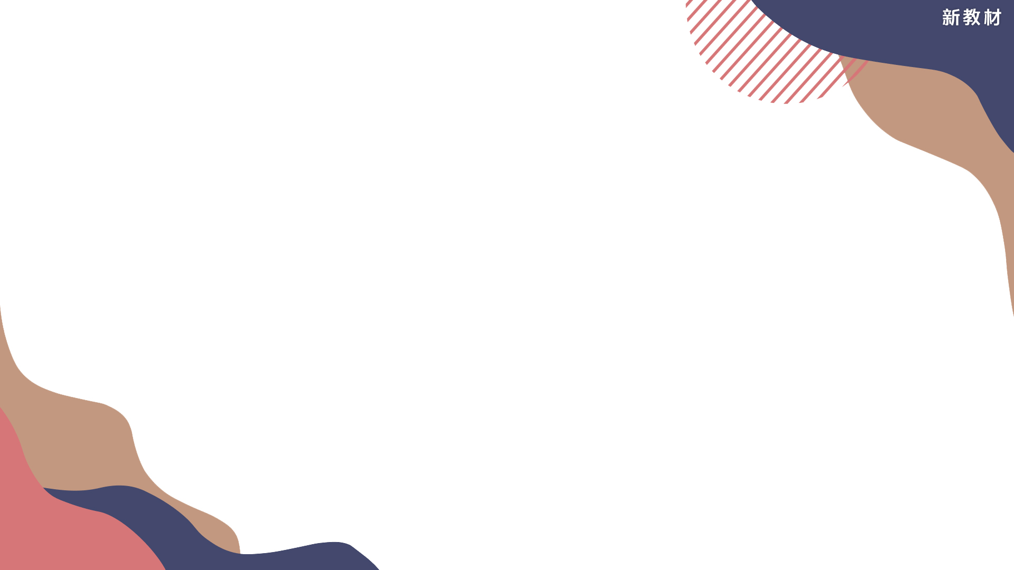

To learn about all kinds of careers.
To be able to make a speech about your future career.

Slide 5
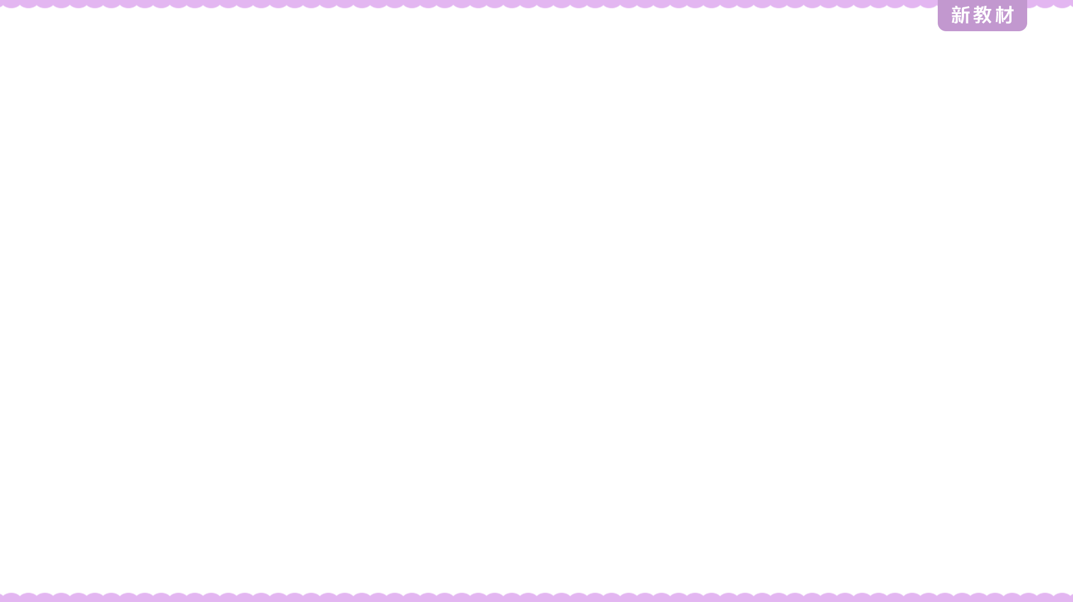

Think about six careers and write them in the order of their importance. Then in groups, report to the others and explain why.
Career |  | Why the career is important
 | 1
 | 2
 | 3
 | 4
 | 5
 | 6

Slide 6

Think about three careers that interest you most. Complete the chart below and then introduce your careers to your group.
The career that interests me |  | Why I would like this career
 | 1
 | 2
 | 3

Slide 7

Choose one career from above and prepare an outline of a speech about how you plan to reach that career goal. Start by completing the mind map below.

Slide 8
Skills
Hobbies
Challenges
Short term
Goals
The career I’d like to have is _____
Education
& Qualifications
Long term

Slide 9

Use your outline to write a speech. Add some pictures to help illustrate your writing. Use the following expressions to help you.
My chosen/ dream career is…
For this career, I need/ must…
Right now, I do not have ... but I plan to...
I may face some challenges, like ...
If I…, then I will…
This career is important to me because…
I am suited to this career because …
My short-term/ long-term goal is…

Slide 10

演讲稿是生活中一种常见的应用文体，是一种用来交流思想、经验，表达主张、见解的文稿，具有宣传、教育和鼓舞等作用。演讲稿以简单句为主要表达形式，语言具有感染力。还要注意适当地使用关联词承前启后。演讲稿的时态以现在时为主。人称以第一、第三人称为主。

Slide 11
正文一般分为下面三部分：
第一部分：引出话题；
第二部分：表达见解；
第三部分：提出建议。
结尾部分：Thank you very much for your attention!
Thank you!...

Slide 12
讲稿常用的表达还有：
★开头
I am very glad / It's a great pleasure to be here to share with you my ideas about ...
Thanks a lot for having been given the chance to ...
The topic of my speech today is ...
I'm grateful that I've been given this opportunity to ...
★结尾
Thank you for your listening / attention!
Thank you very much and have a great day.

Slide 13

Dear friends,
My chosen career is to be a fashion designer. This career is important to me because clothes are my life, and I enjoy making people happy with my clothing. This career began as my hobby. When I was young, my mother bought a sewing machine, and I became interested in seeing her work. Soon, I asked her if she would show me how to sew, and I began making dolls’ clothes, then I made a coat for my dog, and finally I began making clothes for myself.

Slide 14
At first, I was not very good at it, but as you can see, I have gotten much better– I made the clothes I am wearing today！
Of course, there is a lot more to being a fashion designer than just being able to use a sewing machine, so my short- term goal is to go to a school of design in Beijing. There, I can learn about theory, colours, shapes, fabrics, and different styles of design, and I will gain the skills to become successful as a designer. After that, I hope to work for a famous brand so that I can further improve my skills and learn the business side of fashion design.

Slide 15
My long – term goal is to open up my own fashion studio. This will be difficult, and I may face some challenges, as many people who want to become fashion designers fail in their dreams. However, this is my passion and what I want to do more than anything else in the world, so I will work hard to achieve it.
Thank you!

Slide 16


Read your speeches within the group and vote for the best one. Then have the winner make the speech to the class.

Slide 17


Preview the next part Video Time.

Slide 18


