Slide 1

维克多英语
新方略基础课件
Unit 2
性格与行为特征

Slide 2
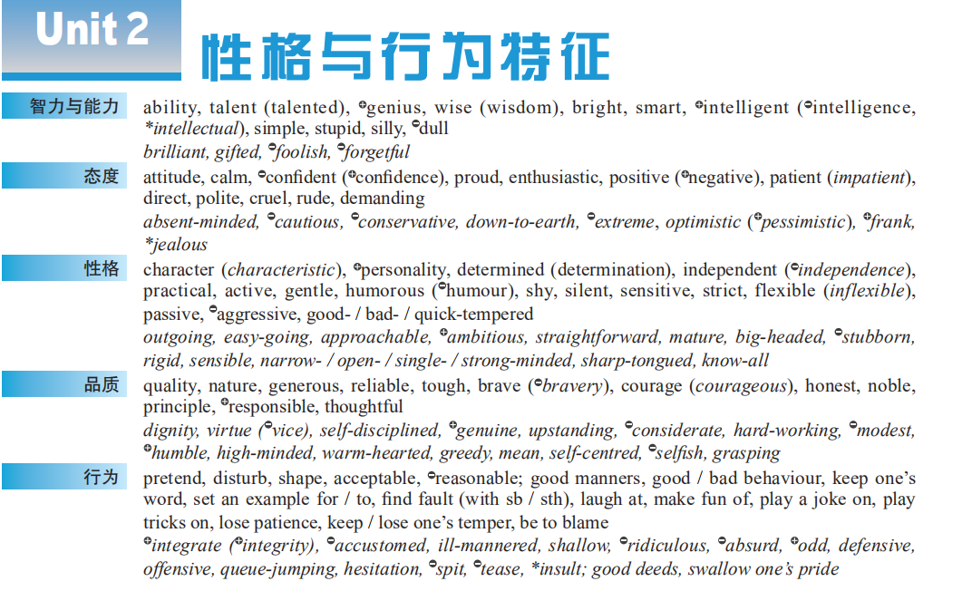

Notes:
2

Slide 3
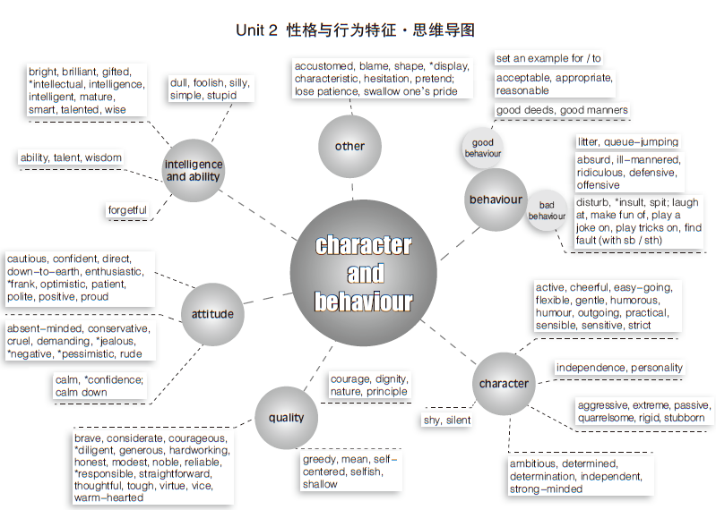

Slide 4
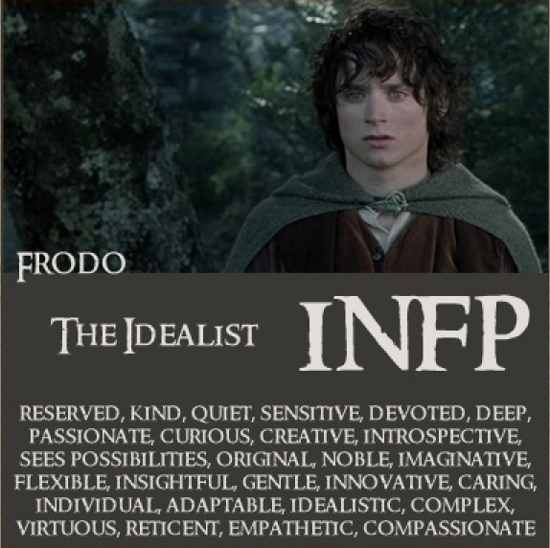
Warm up: Examples in fiction
flexible
People like Frodo are usually __________ (可变通的) and gentle, but when one of their values is violated, they can become __________ (好斗的), fighting passionately for their cause.
They are usually _________ (有天资的) writers. They may be awkward and uncomfortable with expressing themselves verbally, but have a wonderful ______ (能力) to express what they're feeling on paper.
aggressive
talented
ability

Slide 5
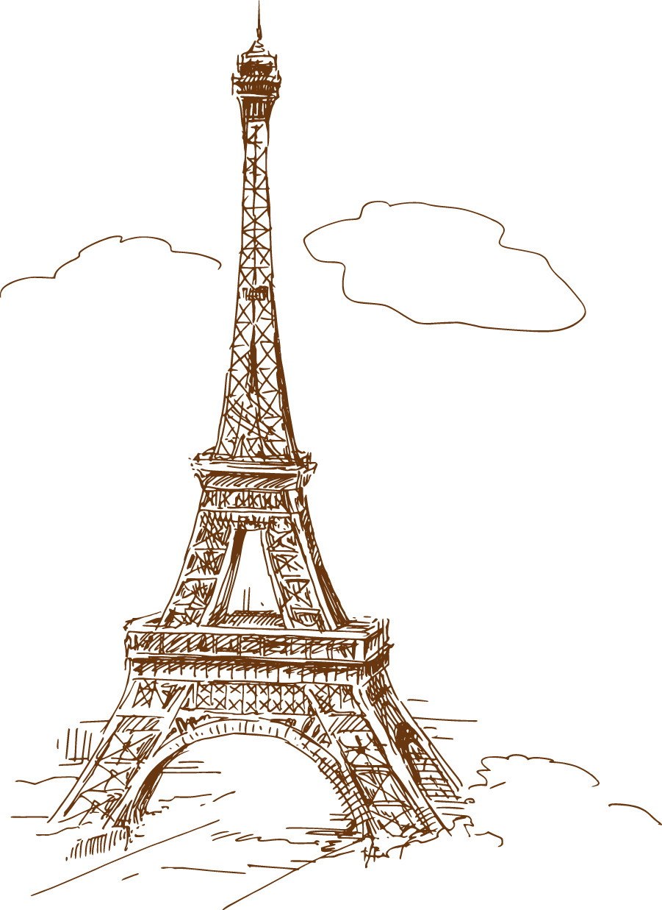
Part I
基础训练

Slide 6
Teaching Guide
教学重难点 | 概念意识
character | 词源义 / 基本义
blame | 输出表达
nature, quality, characteristic, character, personality | 辨析义
shape, practical, demanding, inflexible, know-all, sharp-tongued, swallow one’s pride, shy away from | 熟词生义
be independent of, be enthusiastic about, integrate socially (with), be strict with, be generous in, be responsible for, be sensitive about, be optimistic about, have confidence in, find fault with, keep / lose one’s temper, have a sense of humour, set a good example, lose patience with, make fun of, keep one’s word | 词块
self-centred, strong-minded, easy-going, bad-tempered | 构词法:合成形容词

Slide 7
character

Slide 8
character
人或集体的“性格”
数字的“形状”
性格
事物、事件或地方的与众不同的“性格”
特色；特性
性格
（基本义）
（由人到物）
人的某些优秀“性格”
（好的）品性；道德品质
（语义缩小）
书、电影等中不同“性格”的人物
人物；角色
（由抽象到具象）
区别于其他事物“性格”的记号、标志
符号；文字
（由抽象到具象）

Slide 9
【备考指导】
character
n ❶ [C]［常用单数］性格 ❷ [U] 特色；特性 ❸ [U]（好的）品性；道德品质 ❹ [C] 人物；角色 ❺ [C] 符号；文字
➔ character的释义❶❸❹考频较高；
➔ character在高考听力、阅读和完形中经常出现，为完形词汇。

Slide 10
blame

Slide 11
blame
■ v ______
① blame sb / sth for (doing) sth
While we can’t change the body type we are born with, we can’t
_______________________making us fat .
我们虽然无法改变与生俱来的体型，但不能把肥胖归咎于自
己的基因。 2014 重庆
blame our genes for

Slide 12
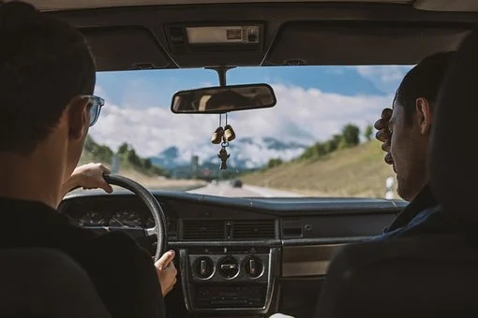
② blame sth on sb / sth
Police are __________________________ dangerous driving.
警方把事故原因归咎于危险驾驶。
blaming the accident on

Slide 13
be to blame (for sth) (对某事) 负有责任
Who ______________ the fire?
谁应对火灾负责？_
lay / put the blame (for sth) on sb
把 (某事的) 责任归在某人身上
_________________________
Others _________________the Americans, complaining that pounds
have piled on thanks to eating too much American style fast food.
其他人则将责任归咎于美国人，他们抱怨说，由于吃了太多的
美式快餐，体重增加了。
is to blame for
lay the blame on

Slide 14
nature, quality, characteristic,
character, personality

Slide 15
辨 nature, quality, characteristic, character, personality
三者都可用作动词，表“适合”之意。
nature意为“天性；本性”；指天生的、无法改变的性格或品质
• It’s just not in Jane’s nature to lie. 简天生不会撒谎。
quality 意为“品质；品德”，尤指好的人品，素质，品德
• He has a lot of good qualities but being organized isn’t one of them.
他有很多优秀的品质，但有条理不是其中之一。
characteristic 意为“特征；特色；特点”，用于人时，指性格中
的具体特征或特点
• Personal characteristics, such as age and sex are taken into account.
个人的特征，如年龄和性别等，都要考虑进去。

Slide 16
三者都可用作动词，表“适合”之意。
character 笼统表示性格全貌
• The book gives a fascinating insight into Mrs Blair’s character.
这部书对布莱尔夫人的性格作了生动的剖析。
personality意为“个性”，侧重指社交方面所反映出的性格特质
• She was very beautiful but seemed to lack personality.
她很漂亮，但似乎缺乏个性。

Slide 17

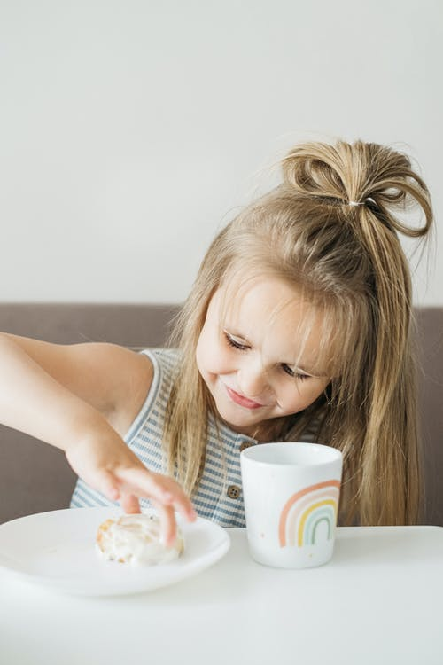
选词填空（nature, quality, characteristic, character, personality）
character
Generosity is part of the American_______.
She is very sensitive by _________.
nature

Slide 18


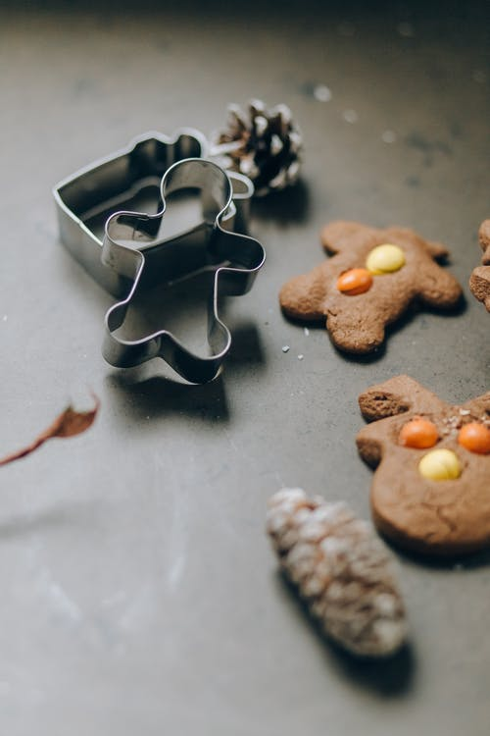
characteristic
Genes determine the ______________ of every living thing.
quality
He shows strong leadership ____________.
personality
He’s honest but he lacks ____________.

Slide 19
【备考指导】
blame
vt 责备；把……归咎于
n [U]（对错误 / 坏事应负的）责任；责备
➔ blame的搭配考频较高；
➔ blame在高考阅读和完形中常出现，为完形词汇。

Slide 20
(熟词生义)
_________ Our characters can shape our social relationships.［名词动化：shape基本义为“形状”，使关系成某形状→？］
 __________ The prime minister has adopted an inflexible attitude to his issue.［in-为否定前缀，词根 flex“弯曲”，词源同 flect, 使弯曲，使变形；-ible为形容词后缀，表性质］
 ____________ Marcy can be sharp-tongued when she gets angry.［合成词：sharp（adj）“尖刻的，严厉的” ，tongue（n）舌头］
影响
强硬的
说话刻薄的

Slide 21
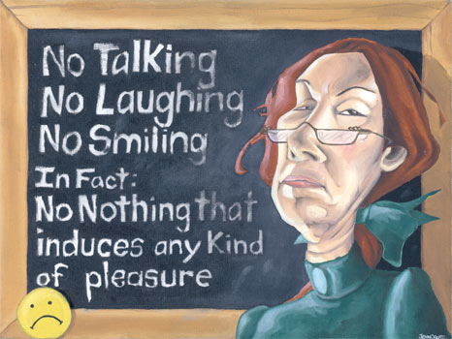
(重点词块)
be independent of
自立的；自食其力的________________________
对······有热情的 / 感兴趣的_________________________
使······融入某群体 _________________________
对······严格____________________
乐于······____________________
be enthusiastic about
integrate ... into / with
be strict with
be generous in

Slide 22
对······有责任 ________________________
对······过分在意 _________________________
对······乐观的 _________________________
对······充满信心 ____________________
找······的茬儿；抱怨；挑剔 ____________________
忍住怒火 / 发脾气 ____________________
be responsible for
be sensitive about
be optimistic about
have confidence in
find fault with
keep / lose temper

Slide 23
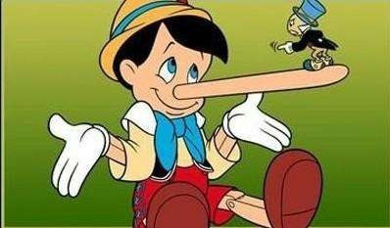
sense of humour
幽默感 ________________________
树立榜样 _________________________
(对······) 失去耐心 ________________________________
取笑；拿······开玩笑____________________
遵守诺言 ____________________
set an example
lose / run out of (one’s) patience (with)
make fun of
keep one’s word

Slide 24
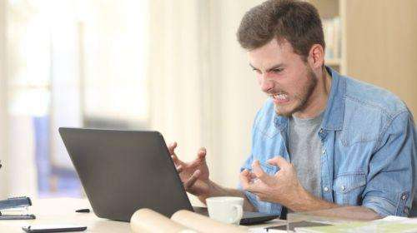
(构词法：合成形容词)
________________________
_________________________
_________________________
____________________
self - centred
以自我为中心的；自私的
strong - minded
有主见的；意志坚强的
随和的；容易相处的
easy - going
bad - tempered
脾气不好的；易怒的

Slide 25
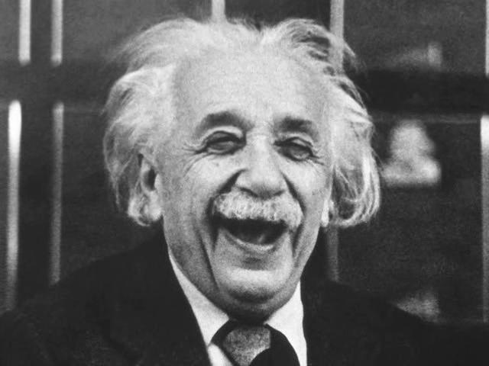
personality, ability, attitude
As an intelligent and famous scientist, Albert Einstein had a pleasant ____________ and was much respected for his friendly manner. He was modest about his _________, and had distinctive __________ and fashions — for example, he minimized his wardrobe so that he would not need to waste time in deciding on what to wear.
personality
abilities
attitudes

Slide 26
personality, ability, attitude
He occasionally had a playful sense of humor, and enjoyed sailing and playing the violin. He was also the stereotypical (典型的) “absent-minded professor”; he was often forgetful of everyday items, such as keys and would focus so attentively on solving physics problems that he would often become unaware of his surroundings.

