Slide 1

维克多英语
新方略基础课件
Unit 25
购物

Slide 2

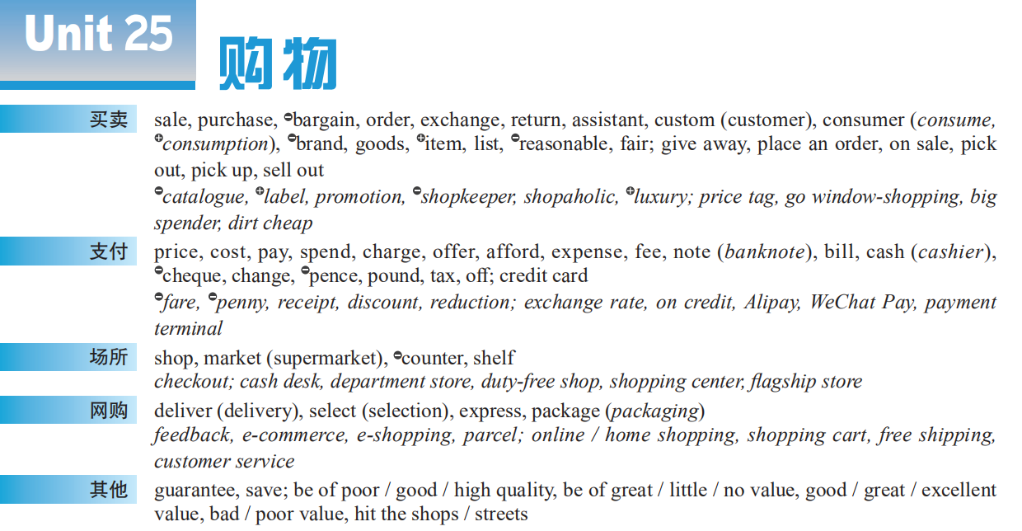
Notes:
2

Slide 3
purchase
online shopping
shopping
shopping places
payment

Slide 4

Warm up: Technology adds luster (光辉)
to 11.11 shopping festival
The day of November 11, nicknamed Singles Day in China has become the country’s biggest annual _______________ (网上购物) spree (狂欢) since it was created on Nov 11, 2009.
online shopping
Besides traditional marketing promotions like coupon (优惠券) distribution and ____________ (特价), this year e-commerce giants (巨头) are adopting cutting-edge technology to create an eye-opening online shopping experience for __________ (消费者).
special sales
consumers

Slide 5

Part I
基础训练

Slide 6
Teaching Guide
教学重难点 | 概念意识
pay | 输出表达；辨析义
guarantee, sell, special offer, pay sb back, express, exchange, hit the shops, make an offer, pick up, afford, reasonable price, rob Peter to pay Paul, cost / pay an arm and a leg, (great / good) value (for money) | 熟词生义
afford, be of + 抽象名词, offer, give away, pick out, offer a discount, on sale, free of charge, at sb’s expense, pay off, in exchange for | 词块
purchase, charge, change, exchange, reasonable, fair | 同义异构

Slide 7
pay

Slide 8

pay
■ v
① pay sb sth:
He still hasn’t _________________________________.
他还没还欠我的钱呢。
② pay for sth:
I have to ________________________________.
我不得不为丢失的书支付赔偿金。
③ pay sb for sth:
He didn’t even offer to ______________________.
他甚至没有提出要给我买票的钱。
paid me the money he owes me
pay for the book lost
pay me for the ticket

Slide 9
_____________________________________.
以其人之道还治其人之身。
I’ll __________________________________ first.
我先还清所有的债务。
Pay somebody back in his own coin
pay off all my debts

Slide 10
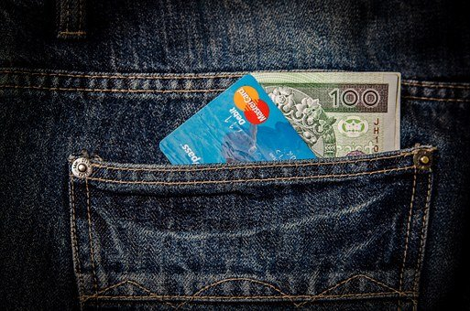
— Are you ________________________________________?
— I’ll pay cash.
—— 你用现金支付还是刷信用卡？
—— 我付现金。
paying in cash or by credit card

Slide 11
辨 cost, pay, spend, take
三者都可用作动词，表“适合”之意。
这四个词都经常译为 “花费”，但用法各不相同。
cost 用于 “事 / 物 + cost + 人 + 钱数” 结构
• The book cost me 8 dollars. 这本书花了我8美元。
spend 用于 “人 + spend + 时间 + (in) doing / on sth” 和 “人+ spend + 钱数 + (on) doing / on sth” 结构
• He spent two years (in) writing the book. 他花了两年时间写成这本书。

Slide 12

三者都可用作动词，表“适合”之意。
pay 用于 “人 + pay + 钱数 + for + 物 ” 结构
• Can you believe I had to pay 30 dollars for a haircut?
你能相信剪了一个头居然花了我30美元吗？
2010 天津
take 用于 “it takes (人) + 时间、金钱或
努力等 + to do sth”结构
• It took us three months to finish the job.
我们花了三个月的时间来完成这项工作。

Slide 13
【备考指导】
pay v ❶ vt & vi 付（钱）；支付 ❷ vt 给予（注意）；进行（访问）
pay back ❶偿还；报答 ❷报复
pay down 先支付（部分货款）作为定金
pay off ❶还清（债务等） ❷取得成功；得到好结果❸付清工资后解雇；遣散
pay up（尤指不情愿或延迟）付清欠款；偿还欠款
n [U] 工资；薪水

Slide 14
【备考指导】
payment n
❶ [U] 付款
❷ [C] (将付或应付的) 款项
➔ pay for及pay off考频较高；
pay在高考各题型中均有出现，为完形词汇，在写作中考频也
很高；
➔ payment主要在高考阅读中出现，在完形中也有考查。

Slide 15
afford

Slide 16
afford
■ v
[常与can, could或be able to连用；常用于否定句] 买得起；承担得起 (时间、后果等)
I _____________________________________for a long journey.
我没时间也没钱去长途旅行。
afford to do sth:
We __________________________________or we’ll miss the plane.
我们不能再等下去了，否则会赶不上飞机。
can’t afford the time and money
can’t afford to wait any longer

Slide 17

❷ [正式用语] 提供；给予
afford sb sth:
The room was cold, but it ________________________________.
这个房间很冷，但是能让我们将城市的美景尽收眼底。
【拓展】affordable adj 支付得起的
afforded us a fine view of the city

Slide 18
【备考指导】
afford vt ❶［常与 can, could 或 be able to 连用；常用于否定句］买得起；承担得起（时间、后果等）
❷［正式用语］提供；给予
➔ afford及其搭配在高考各题型中均有出现，其中afford to do sth考频较高。

Slide 19
be of + 抽象名词

Slide 20


用be of + quality, help, importance结构完成句子
Much of the land was ________________.
大多数的土地都是贫瘠的。
of poor quality
of much help
This book is ______________ to both teachers and students.
这本书对师生都很有帮助。

Slide 21

选词填空（ be of + quality, help, importance）
The meeting to be held next week will _________ great _____________.
下周举行的会议非常重要。
be of
importance

Slide 22
offer

Slide 23

offer ■
❶
① offer sb sth / offer sth to sb:
She offered me a cup of coffee. / She __________________________.
她给我端上了一杯咖啡。
② offer to do sth:
The newspaper __________________________
_________.
这家报纸主动提出为那篇文章道歉。
vt & vi 主动提出；给予
❷ vt 提供 (东西 / 机会)；供应
❸ vt 出 (价)；出售
offered a cup of coffee to me
offered to apologize for the
article

Slide 24
❷
Working in a team _____________________________how to get along with others.
团队工作给我提供了一个学习如何与他人相处的机会。
2008 浙江改
❸
She __________________________________________________.
她出价1000美元购买那幅画。
offers me a chance to learn
offered 1,000 dollars for that painting

Slide 25

offer
■ n
He __________________________ help.
他主动提供帮助。
This camera ______________________.
这款相机特价出售。2010 浙江改
________________________ 接受提议
__________________________________ 拒绝提议
[C] ❶ 提供 (物)；提议 ❷ 开价；报价 ❸ 减价；特价
made an offer of
was / is on special offer
accept / take up an offer
turn down / refuse / decline an offer

Slide 26
【备考指导】
offer
n [C] ❶ 提供 (物)；提议 ❷ 开价；报价 ❸ 减价；特价
vi ❶ vt & vi 主动提出；给予
❷ vt 提供 (东西 / 机会)；供应
❸ vt 出 (价)；出售
offer的动词和名词在高考各题型中均有考查，但动词释义
❶考频较高，为完形词汇，在写作中也有考查。

Slide 27

其他词块
give (...) away
分发 (奖品等) ；输掉；出卖 ___________________
挑出；区别出 ______________________
提供折扣 ___________________________
出售；廉价出售 __________________
免费 _________________
pick out
offer a discount
on sale
free of charge

Slide 28

其他词块
at sb’s expense
由某人付费 / 负担费用 ________________________
交换______________________
还清 (债务等)；取得成功；遣散________________
in exchange for
pay off

