Slide 1

维克多英语
新方略基础课件
Unit 30
天气与自然灾害

Slide 2
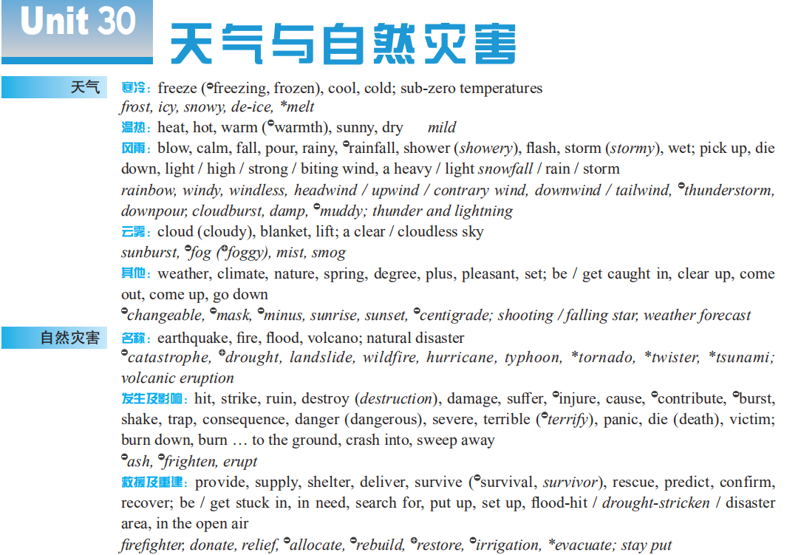
Notes:
2

Slide 3
cold & warm
cloud & fog
wind & rain
weather & natural disasters
rescue & reconstruction
disasters
occurrence & influence

Slide 4
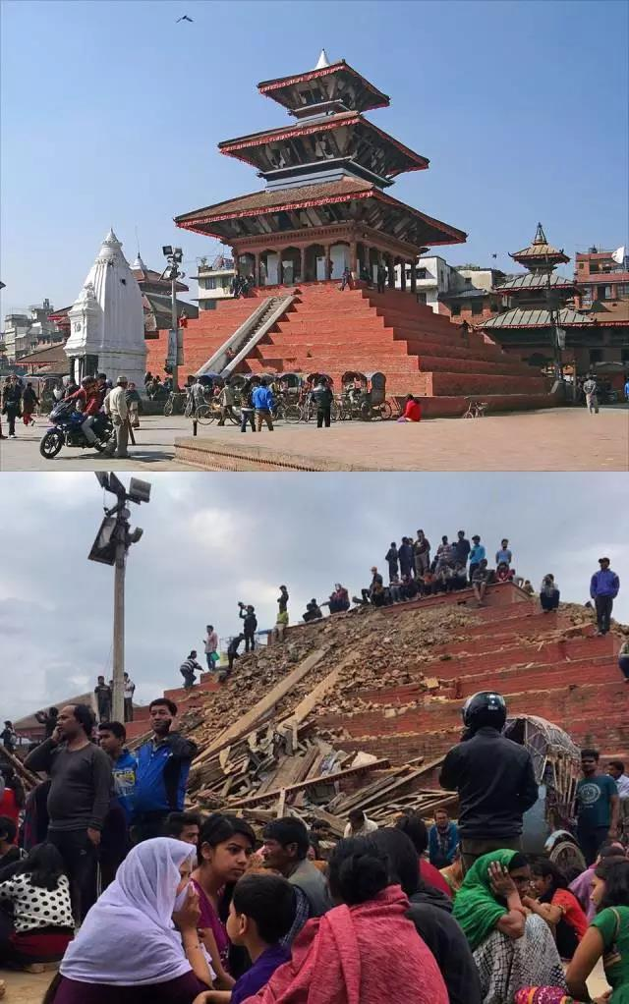

Warm up: Drones can save lives in disasters
On April 24, 2015, a 7.8 ____________ (地震), the most destructive in 80 years, ________ (突然侵袭) Nepal, killing thousands and reducing its capital city to _________ (废墟). Roads were _________ (损坏) or covered by landslides making ________ (营救行动) more difficult.
The Unmanned Aerial Vehicles (UAV’s), or “drones (遥控飞机)” as they are commonly known, has been used in disaster relief work. A drone can be used for _________ (搜索) and _________ (救援).
Before
earthquake
struck
After
ruins
damaged
rescue efforts
search
rescue

Slide 5

Part I
基础训练

Slide 6
Teaching Guide
教学重难点 | 概念意识
cloud, shower | 词源义 / 基本义
ruin, destroy, damage | 辨析义
rain, fog, storm, flood, heat, shelter, blanket, spring | 名词动化
wet, dry, hot, warm, cool, clear | 熟词生义： 形容词动化
pour, climate, lift, relief, supplies, set, strike, spring | 熟词生义：词源义 / 基本义
provide, die down, burn ... to the ground, supply ... with, suffer (...) from, search for, come to sb’s rescue, as a consequence of, pick up, ruin my good mood | 词块

Slide 7
cloud

Slide 8
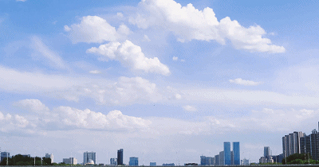
cloud
天空被云“覆盖”
布满云
玻璃、水等被某具体事物“覆盖”
(使)不透明；(使)模糊；(使)浑浊
(用云等)
覆盖(v)
云（n）
基本义
名词
动化
脸上被悲伤、恐惧、愤怒等情绪“覆盖”
显得阴沉(或恐惧、愤怒、忧愁等)
判断力、记忆力等被某抽象事物“覆盖”
使模糊；使难以理解；使记不清楚

Slide 9
【备考指导】
➔ cloud 名词释义考频较高，动词释义考查较为灵活，应重点掌握。

Slide 10
damage, destroy, ruin

Slide 11
辨 damage, destroy, ruin
四者都有“破坏”之意。
三者都可用作动词，表“破坏”之意。
damage 强调“损”，通常指部分性地损坏，往往指价值、用途降低或外表损坏等；或表示可以修复地破坏。
• Smoking will damage your health. 抽烟有害健康。
destroy 强调“毁”，指彻底地毁坏、毁掉或毁灭，往往无法或很难修复。
• That town was destroyed in the earthquake.
那个城镇在地震中毁掉了。

Slide 12

四者都有“破坏”之意。
ruin 强调“破坏”，使美好的事物失去优良的特性或特征，不能恢复。与spoil同义且常可换用，只是语气比 spoil稍强。
• He knocked over a bottle of ink and ruined the table cloth.
他碰翻了一瓶墨水，把那块桌布弄脏了。
• The bad weather ruined / spoilt our trip.
恶劣的天气破坏了我们的旅行。

Slide 13
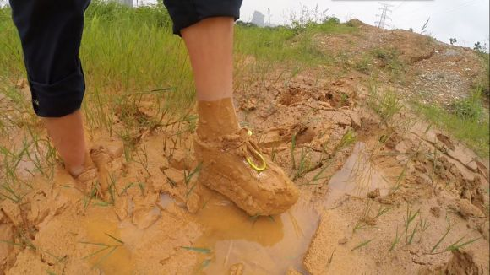
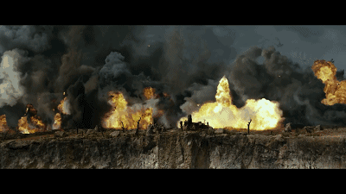
选词填空（damage, destroy, ruin）
ruined
My new shoes got _______ in the mud.
In the bomb attack, two buildings were ___________ and many others were just _________.
destroyed
damaged

Slide 14
rain, fog, storm, flood, heat,
shelter, blanket, spring

Slide 15
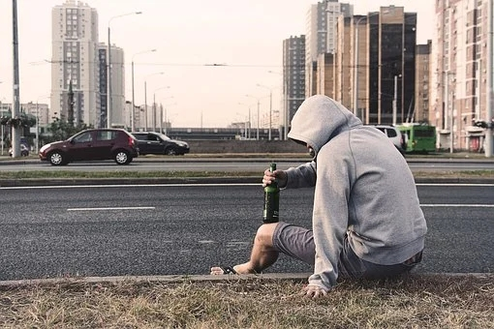

名词动化（rain, fog, storm, flood, heat, shelter, blanket, spring）
fogs
Alcohol ______ the brain.
rained
Bombs _________ down on the city.

Slide 16
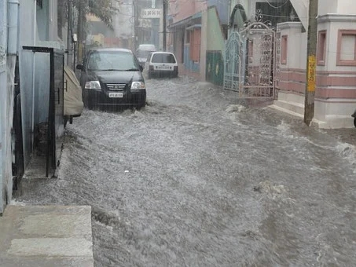

名词动化（rain, fog, storm, flood, heat, shelter, blanket, spring）
flooded
Heavy rainfalls __________ the village.
The reporter believes that good stories _________ from good questions.
spring

Slide 17

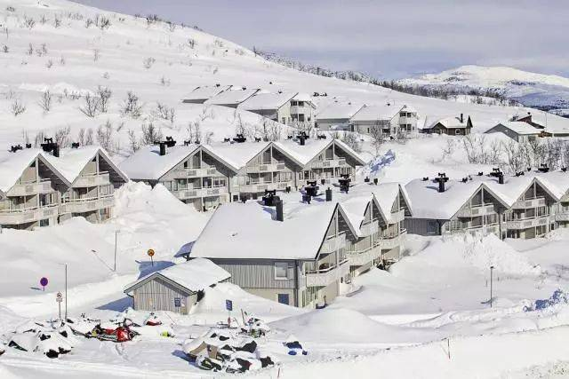
名词动化（rain, fog, storm, flood, heat, shelter, blanket, spring）
stormed
She __________ into my office waving a newspaper.
blanketed
The rooftops were _________ in snow.

Slide 18
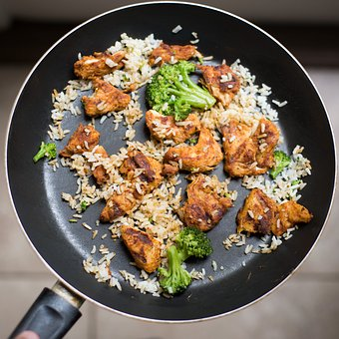
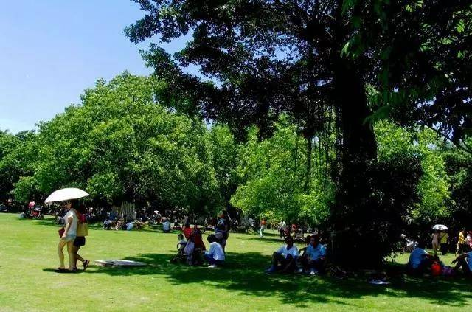
名词动化（rain, fog, storm, flood, heat, shelter, blanket, spring）
heating
You can try ___________ up last night’s leftovers.
We sat in the shade, _________ from the sun.
sheltering

Slide 19
provide

Slide 20

provide
■ v 提供；供应
① provide sth for sb:
Community schools ______________________________________.
社区学校为孩子们提供高质量的教育。 人教⑦ – 4
② provide sb with sth:
My goal is to ____________________________________________.
我的目标是为人类提供高质量的生活。 人教② – 3
provide good-quality education for children
provide humans with a life of high quality

Slide 21
provide for sb [正式用语] 供养；抚养
She needs her new, busy work to ___________________________.
她需要她繁忙的新工作来养家糊口。
provide for her family
provide for sth [正式用语] 为……作准备；防备
Commanders failed to ______________________________.
指挥官们没能防备海上袭击。
provide for an attack by sea
【拓展】
provided (that) conj 只要；假若 (= providing)

Slide 22
【备考指导】
provide
vt 提供；供应
provide及其搭配在高考各题型中均有出现，为完形词汇，且在
写作中考频较高。

Slide 23

其他词块
逐渐变弱；逐渐降低 _______________
(把…) 烧成平地_________________________
给…提供… ___________________________________
患病；受…苦____________________
搜寻____________________
die down
burn (...) to the ground
supply sb with sth / supply sth to sb
suffer from
search for

Slide 24
其他词块
营救某人；给某人救急________________________
因此；因为 (某事)_____________________________
(风)变大；取回；恢复；提高_______________
毁了我的好心情____________________
come to the / sb’s rescue
as a consequence (of sth)
pick up
ruin my good mood

