Slide 1

维克多英语
新方略基础课件
Unit 33
刑事与战争

Slide 2
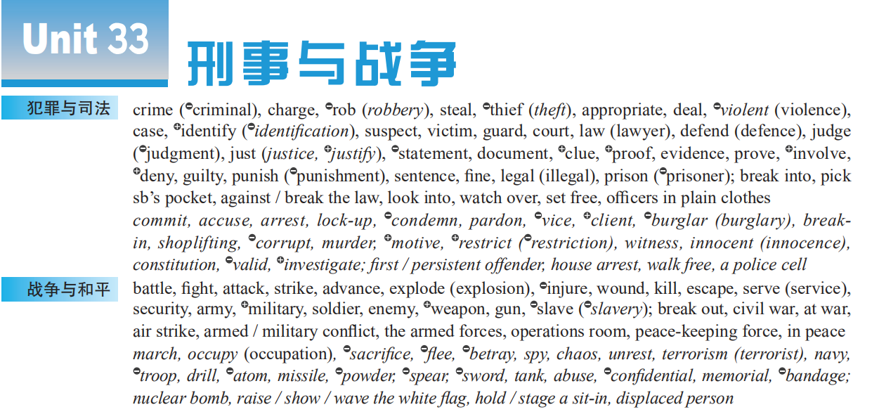
Notes:
2

Slide 3
crimes & laws
crimes & wars
war & peace

Slide 4
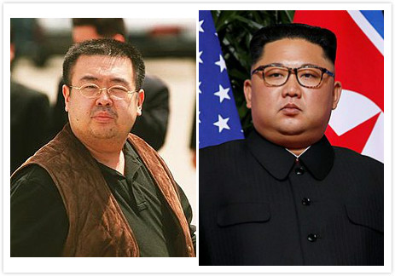
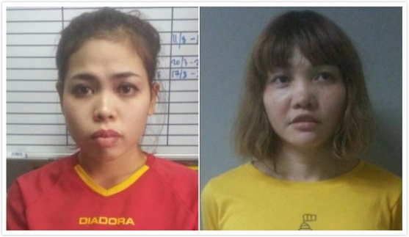
Warm up: Assassination(刺杀) of Kim Jong-nam
Two women accused of killing Kim Jong-nam, half brother of North Korean leader Kim Jong-un, were _______ (指控) with murder. If found guilty, they will face the death penalty. The women have not entered formal pleas (有罪/无罪陈述), which will take place when the _____ (案件) reaches the High Court. But both of them denied the ______ (罪行) when interviewed. In March 2019, Siti was set free after the charge was dropped. In April, the murder charge against Huong was also dropped but she pleaded guilty to a lesser charge and was sentenced to three years and four months in prison.
charged
case
crime

Slide 5
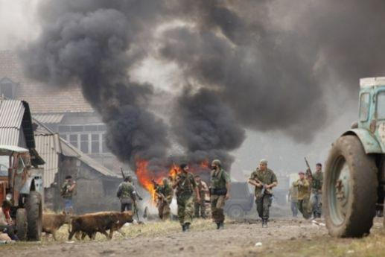
Warm up: famous sayings about wars
1. War is a kind of killing each other between humans, so it must be a
very bloody, very bad thing.
战争是人类之间的一种互相残杀，因此它一定是一件非常血腥、非
常坏的事。
2. War has no winners, only losers.
战争没有胜利者，只有失败者。
3. The war came, and the truth is the first victim.
战争来临时，真理是第一个牺牲品。
4. The real and lasting victories are those of peace, and not of war.
真正而持久的胜利就是和平，而不是战争。

Slide 6

Part I
基础训练

Slide 7
Teaching Guide
教学重难点 | 概念意识
case | 词源义 / 基本义
pardon, attack, just, serve, appropriate, identify | 熟词生义
prove, break out, rob ... of, suspect ... of, defend ... against, sentence ... to, look into, watch over, accuse ... of, be innocent of, be involved in, be found guilty of | 词块

Slide 8
case

Slide 9
case
日常生活中或商业领域的“事例；实例”
例子；案例
事例；实例
（基本义）
医生写的关于病人病情的“事例；实例”
病例
与刑事等相关的警察处理的“事例；实例”
案件
法庭或法院处理的“事例；实例”
诉讼案；官司
出版；刊登；发表

Slide 10

case
■ n
① in any case 在任何情况下；不管怎样
I don’t see why I couldn’t do it. ______________, I’m going to try.
我不明白为什么我不能做这件事。不管怎样，我要试一试。
② in no case 在任何情况下都不；决不
__________________________________________.
在任何情况下你都不应离开岗位。
In any case
In no case should you leave your post

Slide 11
③ in that case 既然如此；那样的话
— He didn’t want to talk to Sally. 他不想和萨利说话。
— ____________________, why did he agree to meet her?
既然那样，为什么他还同意和她见面？
④ in sb’s case 就某人的情况来说
_______________, she failed the exam because she wasn’t well.
就她的情况来看，她是因为生病而考试不及格。
In that case
In her case

Slide 12
⑤ in case of [常用于官方通告] 在…情形时；万一
_______________________, please call the Help Desk at 926-3736.
如遇紧急情况，请拨打救助台的电话926-3736。2008 湖南
⑥ in the case of 就…来说；至于
The amount of fruit in fruit juices must be 6% _________________
oranges.
果汁中的水果含量，如果是橙汁的话，必须占6%。
In case of emergency
in the case of

Slide 13
【备考指导】
case
n ❶事例；实例 ① 例子；案例 ② 病例 ③ 案件④ 诉讼案；官司
❷情况
❸证据；理由
❹箱子；盒子
➔ case的释义❶❷和in case, in case of考频较高；
➔ case主要出现在高考听力、阅读和完形中。

Slide 14
prove

Slide 15
prove ■ v
① prove sth to sb:
Just give me a chance and I’ll ____________________.
给我一个机会，我会向你证明此事的。
② prove sb / sth (to be) + adj / n:
They put me in prison, but, in the end, ______________________.
他们把我关进监狱，但我最终被证明是清白的。 北师大③ – 3
❶ vt 证明；证实
prove it to you
I was proved innocent

Slide 16
③ it is proved that…:
____________________________ in a stressful situation men are more likely to take risks.
经证实，在有压力的情况下，男人更有可能去冒风险。 2012 北京
④ prove oneself (to sb):
When I first started this job, I felt I had to ____________________.
我刚开始干这份工作的时候，觉得必须证明一下自己的实力。
It has been proved that
prove myself

Slide 17
❷ vi [用作系动词] 证明是；被发现是 (反 turn out)
The book has ___________________very successful.
事实证明了这本书非常成功。 人教⑧ – 3
proved (to be)

Slide 18
【备考指导】
prove
v ❶ vt 证明；证实
❷ vi [用作系动词] 证明是；被发现是 (反 turn out)
释义❶的用法prove sth (to sb), prove sb / sth (to be) + adj / n,
prove + that / wh-从句考频较高；
➔ prove在高考各题型中均有出现。

Slide 19

(重点词块)
(火灾、战争等) 突然爆发________________________
抢走某人的某物 _________________________
怀疑某人 (做) 某事_________________________
保护…不受到… ______________________
判决；宣判____________________________
break out
rob sb of sth
suspect sb of (doing) sth
defend sb against / from sth
sentence … to

Slide 20

(重点词块)
调查________________________
保护；监视；照管__________________
无…罪_________________________
参与…；与…有关联_________________
被判…罪____________________________
look into
watch over
be innocent of
(be) involved in
be found guilty of

