Slide 1

维克多英语
新方略基础课件
Unit 39
原因、目的、过程与结果

Slide 2
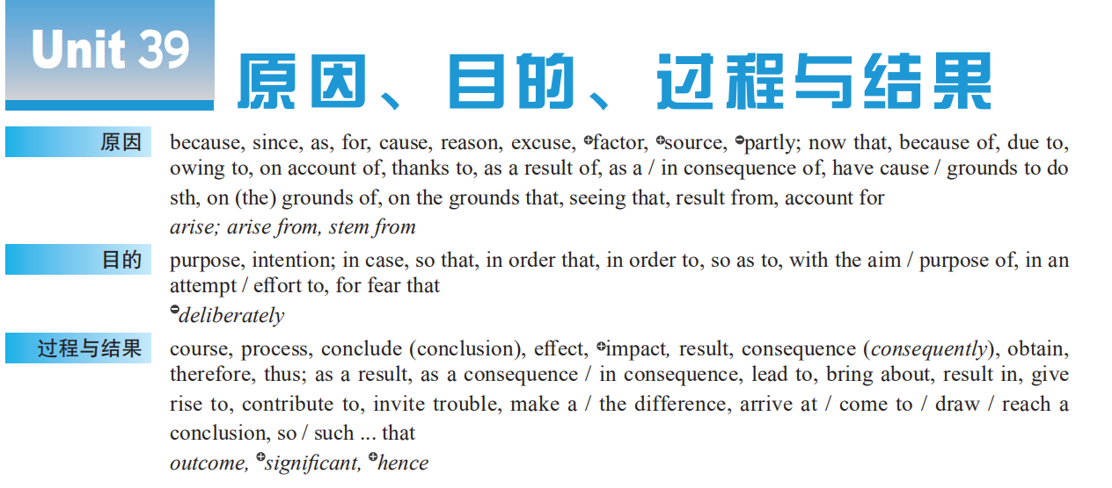
Notes:
2

Slide 3
cause
purpose
event
process
result

Slide 4
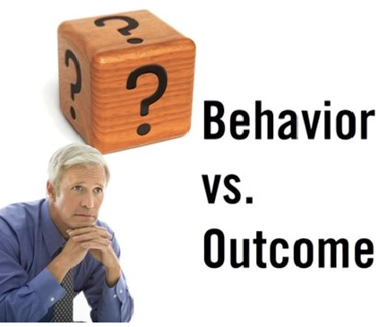
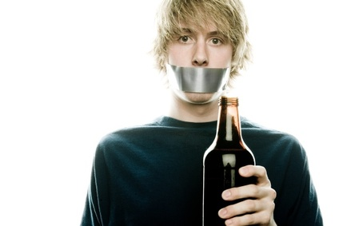
Warm up
Some studies will find that a behavior “____________ (促成)” or is “associated with” an outcome; this does not mean that a certain _____ (过程) must _____ (导致) a certain _____ (结果).
The ___________ (后果) ___________ (由…而造成) alcohol misuse when you are under 18 can be much greater than when you are an adult. Your body and mind are still developing so poisoning them can ___________ (产生严重的影响) your future health.
contributes to
course
lead to
result
consequences
resulting from
have serious
effects on

Slide 5

Part I
基础训练

Slide 6
表达“原因”

Slide 7
❶辨 because, since, as, for
以上各词均含“表明”、“宣称”、“宣布”之义。
because 语气最强,常用于回答why引起的问句，表达说话对方未知的信息。
—Why didn’t you phone me last night?昨晚你为什么不给我打电话?
—Because I didn’t want to disturb you.因为我不想打扰你。
since 表达对方已知的信息，常译为“既然”。
Since everybody is here, let's begin our meeting.
既然人都到齐了，咱们开会吧。

Slide 8
as 表示明显的、已知的理由，常与since互用，可译为“由于”。
As you were out, I left a message.
你不在，所以我留了一张字条儿。
for 为并列连词，连接的不是从句，而是分句。表示对已发生情况的补充说明，不表示直接的原因，语气较弱。
It must have rained last night, for the ground is wet.
昨晚准是下过雨，因为地面是湿的。

Slide 9


选词填空（because, since, as, for）
As / Since
__________ you worked late yesterday, you needn’t have come this morning.
—Would you like to join us in the game?
—I’m afraid not, _______ I have something important to attend to.
for

Slide 10

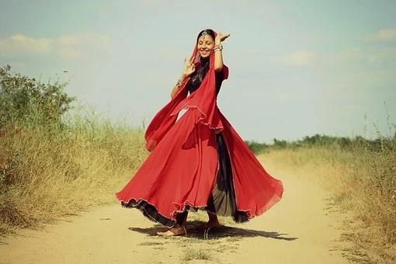
选词填空（because, since, as, for）
Since / As
_________ you know it already, we don’t need to keep it a secret.
I prefer the red dress to the green one _______ it fits me better.
because

Slide 11
❷辨 cause, reason
以上各词均含“表明”、“宣称”、“宣布”之义。
二者都可用作名词，都含“原因”之意。
cause 侧重指导致某事发生的“起因”，常用cause of 结构。
• Breast cancer is the _____________ of death for American women in their forties.
乳腺癌是导致四十几岁的美国女性死亡的主要原因。
reason 多指做某事或解释某事的“理由”“借口”。常用 reason for, reason why结构。
• ________________he didn’t pass the driving test is lacking practice.
他没通过驾驶考试的原因是缺乏训练。
leading cause
The reason why

Slide 12


选词填空（cause, reason）
Money is thought to be the root _______ of all evils.
cause
What are your _______ for saying that?
reasons

Slide 13
❸完成句子
The flood came about _________________________ the heavy rain.
大雨引发了洪水。
_________________we haven’t gone very far, we might just as well turn around to get the map.
既然我们还没走远，不妨返回去取地图。
You ____________________________complaint.
你没有理由抱怨。
Can you ____________________ your movements on that night?
你能解释一下你那天晚上的活动吗？
as a result / consequence of
Since / Now that
have no grounds / cause for
account for / explain

Slide 14


His English improved rapidly _________________________ _________________________ his association with British people.
因为他和英国人有来往，所以他的英语进步迅速。
_______________________, I made great progress in my study.
多亏她帮忙，我在学习上取得了巨大的进步。
because of / due to
/ owing to /on account of
Thanks to her help

Slide 15
表达“目的”

Slide 16
■ 完成句子
This program was set up ___________________________________
providing help for homeless people.
设立这个项目是为了帮助无家可归的人。
Greg has gone on a diet _________________________ lose some weight.
为了减肥格雷格已经开始节食。
Leave your telephone number ________________________________ _________________________.
请留下你的电话号码，以便于我们跟你联系。
with the intention / purpose / aim of
in an effort / attempt to
in order that we might contact you
/ in order to contact you

Slide 17
Pull down your hat ___________ nobody will recognize you.
把帽子拉低，这样就没人能认出你。
Leave your key with a neighbor _____________________________.
把你的钥匙交给邻居一把，以防某一天你把自己锁在门外。
He set off very early ______________________________________.
他早早就出发了，以免面试迟到。
so that
in case you lock yourself out one day
for fear that he might be late for the interview

Slide 18
表达“过程与结果”

Slide 19
■ 完成句子
Good habits always _______________________________________ high efficiency, while bad ones bring the opposite.
好习惯总是会带来高效率，而坏习惯则相反。
We did not provide for ____________________________________ in prices.
我们没有为如此之大的价格涨幅作准备。
lead to / bring about / result in / cause
such a great increase / so great an increase

Slide 20

(重点词块)
make a difference
有作用 / 关系 / 影响________________________
引起；导致；产生 ____________________________
为了_________________________
对…产生…影响____________________
在…的过程中____________________
give rise to / result in / bring about
in order to
have a(n) … effect on
in the course / process of

Slide 21
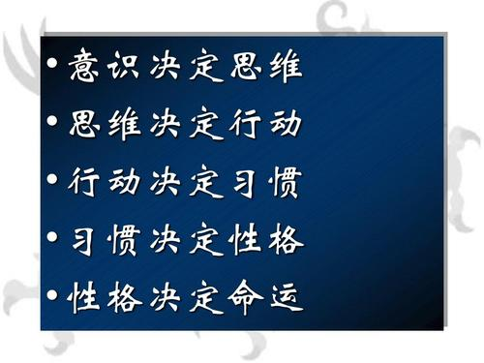
(重点词块)
arise from / out of
因…产生；由…引起____________________
因…发生；随…产生__________________
result from

