Slide 1
Unit 1
Help those in need
Writing

Slide 2
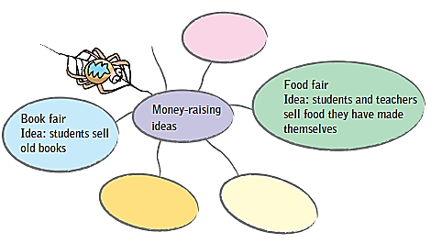
Brain Storming
A Brainstorm some money-raising ideas. And write down your ideas in the spider-gram on P11.

Slide 3

hold a singing competition: competitors pay to
take part in the competition
put on talent shows and ask audience to pay
entry fee（入场费）
hold an art festival
hold an auction
举行拍卖会
hold an book/food fair
persuade rich people(eg. Jack Ma) to donate money

Slide 4
A letter to the head teacher
You and your classmates are planning a money-raising activity to help children in need. You need to write a letter to your head teacher to ask permission.

Slide 5
Discussion
In groups(4-6), choose one money-raising activity and discuss how to organize it.
How are you going to raise money?
When and where are you going to have your activity?
What are you going to do during the activity?
Who would you like to ask for help?
How much money do you plan on raising?
…

Slide 6
B You have discussed about how to plan a money-raising activity. Now please write down some notes below based on your discussion.
Why are you writing the letter?
_________________________________________
How are you going to raise money?
_________________________________________
When and where would you like to have the activity?
_________________________________________
What would you like the head teacher to do?
_________________________________________
Because we need to raise money for children in need.
We are going to sell books/sell food/…
We would like to have the activity at … on …
We hope he can help us do some promotion …

Slide 7



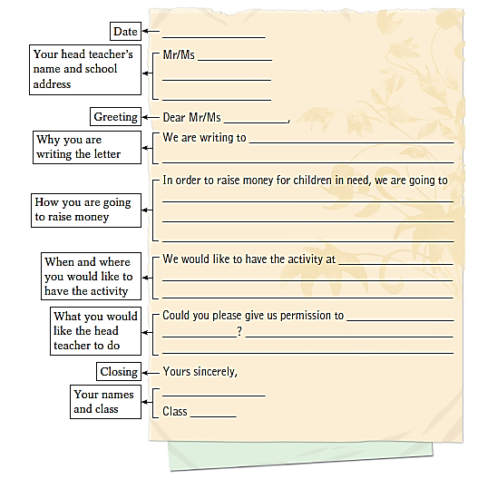
A letter asking for permission from your head teacher
Top tip
Date
Your head teacher’s name
Your school address
Greeting
Do not use “Yours”, “Love,” etc.
Closing
Your name and class

Slide 8
C Write the letter to your head teacher. Use the outline below and your notes in B to help you.
Date
Your head teacher’s name and school address
Mr/Ms
Greeting
Dear Mr/Ms
We are writing to
Why you are writing the letter
In order to raise money for children in need, we are going to
How you are going to raise money
When and where you would like to have the activity
We would like to have the activity at

Slide 9
What you would like the head teacher to do
Could you please give us permission to
?
Closing
Yours sincerely,
Your names and class
Class

Slide 10
the Middle School Attached to Sun Yat-sen University, 135 Xingang West Road, Haizhu District, Guangzhou City, Guangdong Province, China

Slide 11
C Write the letter to your head teacher. Use the outline below and your notes in B to help you.
Date
Feburary
Mr/Ms
Yan
Your head teacher’s name and school address
135 Xingang West Road,
Haizhu District, Guangzhou
Greeting
Dear Mr/Ms
We are writing to
ask you for a permission
Why you are writing the letter
In order to raise money for children in need, we are going to
How you are going to raise money
hold a book fair
When and where you would like to have the activity
We would like to have the activity at
our school playground on Friday morning

Slide 12
Could you please give us permission to
What you would like the head teacher to do
hold
the activity
We hope we can borrow the
playground on that days.
?
Closing
Yours sincerely,
Your names and class
Class
13

Slide 13
Notes P12
in order to do sth. 目的在于；为了
=so as to do sth.
In order to/So as to help the disabled children, we held a book fair to raise money for them.
为了帮助残疾儿童，我们举办了一个书展来
为他们筹款。

Slide 14
I. 用英语写出下列短语。
have an activity
1. 开展活动 ____________________
2. 筹款 ____________________
3. 为了 ____________________
4. 需要帮助的 ____________________
5. 批准某人做某事 ____________________
raise money
in order to
in need
give sb permission to do sth.

Slide 15
II. 根据中文意思完成句子。
1. 为了筹到更多的钱，我们校长决定开展一项有意义的活动。
____ ____ ____ ____ more money, our head teacher decided to ____ a meaningful ______.
2. 这么晚了，我爸爸不会允许我出去的。
It ’s so late. My father won ’t ____ ____ _________ to go out.
3. 很高兴我能帮助需要帮助的人。
I’m very pleased that I can help people ____ ____.
In order to raise
have activity
give me permission
in need

Slide 16
Thank you!

Slide 17
书信格式：
开头和落款都从左边顶格写。
正文:(1)齐头式：每段顶格写，段与段之间空一行。
(2) 缩进式：每段开头缩进4-8个字符。段与段之间不空行。
Date
Feburary
Your head teacher’s name and school address
Mr/Ms
No. 399, Tianyuan Road,
Tianhe District, GZ
Greeting
Dear Mr/Ms
We are writing to
ask you for a permission
Why you are writing the letter
In order to raise money for children in need, we are going to
How you are going to raise money
hold a book fair
When and where you would like to have the activity
We would like to have the activity at
our school playground on Friday morning

Slide 18
Could you please give us permission to
What you would like the head teacher to do
hold
the activity
We hope we can borrow the
playground on that days.
?
Closing
Yours sincerely,
Your names and class
Class
13

