Slide 1
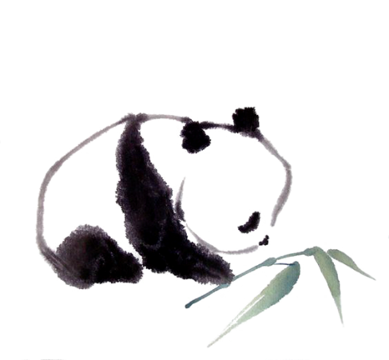

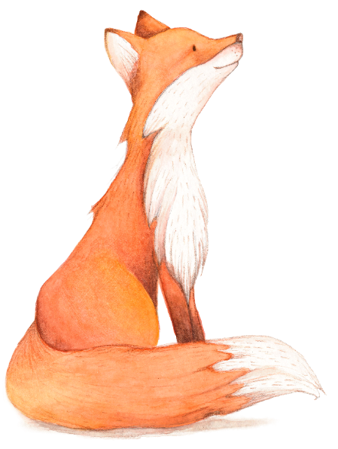
Speaking
Unit 5
Save the
endangered animals

Slide 2

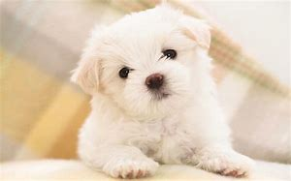
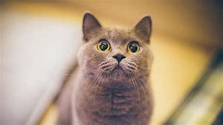
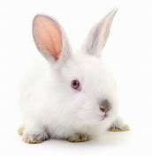
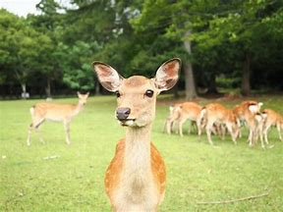
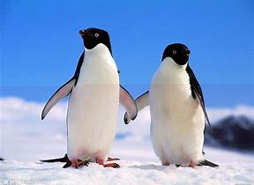
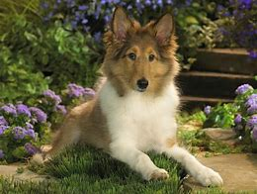
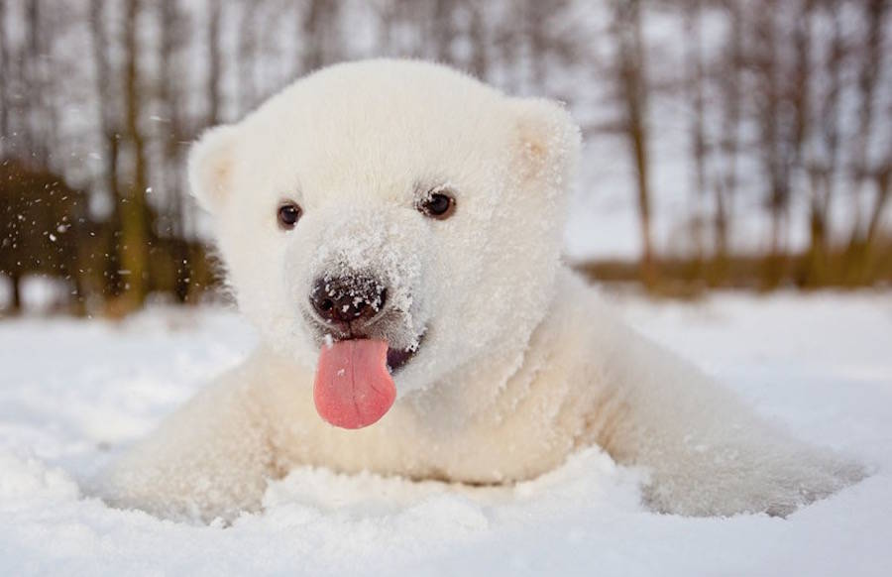
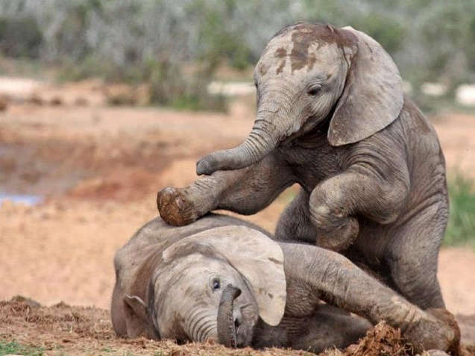
Do you like animals? If yes, what animals do you like best?
penguin ['peŋɡwin]
fox
Polar bear
Work in pairs. Choose one animal, describe its appearance and talk about why you like it.

Slide 3
video
Some animals die out(灭绝) because they are hunted and killed by men.
Watch a video and think about the following questions:
What do you think of the killing and hunting?
It is very cruel for men to kill animals for money.
(2) What do you think we should do?
We should take actions to protect the animals.
It’s our obligation to protect these endangered animals.

Slide 4
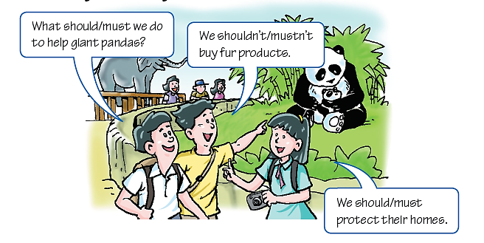

Talk about obligations:
Read the conversation and answer the question.
“ought to”.
What words do the students use when they are talking about obligations?
Modal verbs like “should” and “must”.
Ought to
“shouldn’t” “mustn’t” “ought not to”

Slide 5
Talking about obligations
should/ ought to和must表达义务或责任。
should/ ought to：应该
否定式：should not/ ought not to 不应该
must：必须
否定式：must not：禁止
在表示义务或责任时，should比must略轻一些。

Slide 6
我们应该/必须做什么去保护动物?
What should/must we do to protect animals?
What ought we to do to protect animals?
关于濒危动物，我们应该做什么？
What should/must we do about endangered animals?
What ought we to do about endangered animals?
我们应该/必须保护濒危动物。
We must/should/ought to protect endangered animals.

Slide 7

A1 Read the conversation below and practise it in pairs. Pay attention to the words in blue.
Kevin: What should we do to protect the fish in the river?
Amy: We mustn’t throw rubbish into the river. The fish will die if the river is polluted.
Kevin: What else should we do?
Amy: We should write to factories and ask them to stop polluting the river.
Kevin: Good idea.

Slide 8
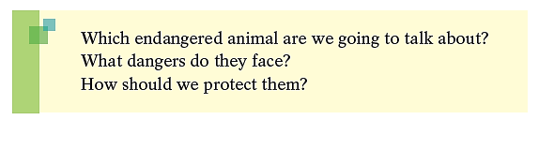
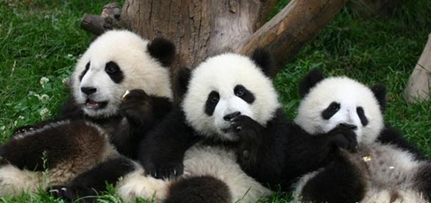
Speak up
How can we help save endangered animals? In groups, choose one endangered animal from A on page 70 to talk about. Use the questions below to help you.

Slide 9
S1: Which endangered animal are we going to talk about?
S2: We are going to talk about …
S1: What dangers do they face?
S2: They are killed every year.
S3: There is not enough food for them.
S4: Their homes are destroyed.
…

Slide 10
Notes P74
1. What should we do to ...?
我们应该做什么来……？
我们应该做什么来让妈妈高兴呢？
What should we do to make our mother happy?

Slide 11
2. product n. 产品
fur products 毛皮制品
尽量以最低的价格买到最好的产品。
Try to get the best product at the lowest price.

Slide 12
3. danger n. 危险；风险
in danger: 处于危险之中
这位老太太生命很危险。
The old lady is in great danger.
dangerous adj. 危险的
在这个湖里游泳很危险。
This lake is dangerous for swimmers.
endanger v. 使遭受危险，危及
endangered adj. 有灭绝危险的

Slide 13
5. face v. 面对
n. 脸，面孔
make faces/ a face 做鬼脸
face to face 面对面
lose/ save face 丢/保全面子
他勇敢地面对困难。
He faced the difficulty with courage.

Slide 14
6. What else should we do?
我们还应该做什么呢？
else意为“别的；另外的；其他的”。
通常用在不定代词(somebody, anybody, something, anything等)
或疑问词(what, who, where)后面。
else 也有所有格形式：else’s。
其他人 somebody else
你还想邀请谁？
Who else would you like to invite?
这件大衣肯定是别人的。
This coat must be someone else’s.

Slide 15
Practice
根据中文意思完成句子。
1. 你还想去哪儿？
_____ _____ do you want to go?
选择最佳答案填空。
( )2. Put it down, Mark. You shouldn’t read _____
letter.
A. anyone’s else’s
B. anyone’s else
C. anyone else’s
D. anyone else
Where else
C

Slide 16
Thank you

